Slide 1

DRAFT- PRE-DECISIONAL / CONFIDENTIAL / NOT FOR DISTRIBUTION
Coronavirus State and Local Fiscal Recovery Fund:
i DRAFT- PRE-DECISIONAL / CONFIDENTIAL / NOT FOR DISTRIBUTION
User Guide: Treasury’s Portal for Recipient Reporting
January 24, 2022
Version: 1.1

Slide 2
Table of Contents
Section I. Section II. Section III. Section IV.
Reporting Basics ................................................................................................. 1
Navigation and Logistics .................................................................................... 3
Reporting Requirements .................................................................................... 8
Project and Expenditure Report....................................................................... 12
Appendix A – Designating SLFRF Points of Contact by SLFRF Account Administrators 42 Appendix B – Bulk File Upload Overview ............................................................................... 49
Appendix C – Expenditure Categories and Template Mapping............................................ 65 Appendix D – SLFRF Expenditure Category Programmatic Data and Other Information . 68 Appendix E – List of Sectors ................................................................................................... 78
Appendix F – Frequently Asked Questions............................................................................ 79
List of Figures
Figure 1 Landing Page.................................................................................................................. 3
Figure 2 Navigation Bar ................................................................................................................ 4
Figure 3 Sample Bulk Upload Icon ............................................................................................... 5
Figure 4 Successful Bulk Upload Example ................................................................................... 5
Figure 5 Bulk Upload Validation Screen ....................................................................................... 6
Figure 6 Manual Validation Text Box ............................................................................................ 6
Figure 7 Sidebar indicating Unsubmit Button................................................................................ 7
Figure 8 Relationship between Expenditure Categories and Multiple Projects .......................... 11 Figure 9 Recipient Information .................................................................................................... 12
Figure 10 Point of Contact List.................................................................................................... 13
Figure 11 Budget Approval and Obligation ................................................................................. 13
Figure 12 SAM.gov question....................................................................................................... 14
Figure 13 Additional SAM.gov questions (1)............................................................................... 14
Figure 14 Additional Sam.gov questions (2) ............................................................................... 14
Figure 15 Record of Highest Paid Officer ................................................................................... 15
Figure 16 No Projects Available Option ...................................................................................... 16
Figure 17 No Projects Available Entry Screen ............................................................................ 16
Figure 18 My Projects Screen Example...................................................................................... 18
Figure 19 Project Expenditure Category Group .......................................................................... 18
Figure 20 Project Expenditure Category ..................................................................................... 19
Figure 21 Bulk Upload for EC 1.1 ............................................................................................... 19
Figure 22 Project Entry Screen ................................................................................................... 20
Figure 23 Manual Entry for EC 1.9 ............................................................................................. 21
Figure 24 Programmatic Data for EC 1.9.................................................................................... 21
Figure 25 Edit and Delete Project Screen................................................................................... 22
Figure 26 Premium Pay Screen and Additional Questions ......................................................... 23
Figure 27 Programmatic Data for Infrastructure Projects ........................................................... 25
Coronavirus State and Local Fiscal Recovery Funds:
Project and Expenditures Report User Guide
1

Slide 3
Figure 28 Davis Bacon Certification............................................................................................ 26
Figure 29 Additional Questions if Response to Davis Bacon Certification is "No" ...................... 26 Figure 30 Certification for Labor Agreements ............................................................................. 27
Figure 31 Additional Questions if response is "No"..................................................................... 27
Figure 32 Revenue Replacement Screen ................................................................................... 29
Figure 33 Subrecipient Bulk Upload Icon.................................................................................... 31
Figure 34 Manually Create a Subrecipient or Beneficiary........................................................... 31
Figure 35 Sam.gov Questions for Subrecipients ........................................................................ 32
Figure 36 Additional SAM.gov questions for Subrecipients ........................................................ 32
Figure 37 Five Highest Paid Officers for Subrecipients or Beneficiaries..................................... 33 Figure 38 Subrecipients Entered ................................................................................................ 33
Figure 39 Subaward Bulk Upload (1) .......................................................................................... 34
Figure 40 Subaward Bulk Upload (2) .......................................................................................... 34
Figure 41 Subaward Reporting ................................................................................................... 35
Figure 42 Subaward Entered ...................................................................................................... 35
Figure 43 Expenditures >$50,000............................................................................................... 37
Figure 44 Aggregated Expenditures <$50,000 ........................................................................... 37
Figure 45 Payments to Individuals .............................................................................................. 38
Figure 46 Tax Offset Provision Screen ....................................................................................... 39
Figure 47 Official Certification ..................................................................................................... 39
Figure 48 Summary of Reported Information.............................................................................. 40
Figure 49 Submission Verification .............................................................................................. 40
Figure 50 Submission Verification with additional language ....................................................... 41
Figure 51 State, Local and Tribal Support Landing Page ........................................................... 42 Figure 52 My Compliance Reports ............................................................................................. 43
Figure 53 Account....................................................................................................................... 43
Figure 54 Account Name ............................................................................................................ 43
Figure 55 Landing Page.............................................................................................................. 44
Figure 56 Certification................................................................................................................. 44
Figure 57 Official Certification of Authorization ........................................................................... 45
Figure 58 Designation Form ....................................................................................................... 45
Figure 59 Designation of Account Administrator, Point of Contact of Reporting and Authorized Representative for Reporting ...................................................................................................... 45
Figure 60 Designation Form ....................................................................................................... 47
Figure 61 Bulk Upload pop up .................................................................................................... 50
Figure 62 File uploaded message............................................................................................... 51
Figure 63 File added to Bulk Upload portal................................................................................. 51
Figure 64 Listing of Bulk Upload Errors ...................................................................................... 51
Figure 65 Bulk Upload Creation .................................................................................................. 52
Coronavirus State and Local Fiscal Recovery Funds:
Project and Expenditures Report User Guide
2

Slide 4
Section I. Reporting Basics
Overview
This document provides information on using Treasury’s Portal to submit the required Coronavirus State and Local Fiscal Recovery Funds (SLFRF) Project and Expenditure (P&E) reports. It is a supplement to the Compliance and Reporting Guidance (Reporting Guidance), which contains relevant information and guidance on the reporting requirements.
Additionally, you should visit Treasury’s SLFRF home page for the latest guidance and updates on programmatic and reporting topics, as well as information on Treasury’s Interim Final Rule (IFR).
Each SLFRF recipient is required to submit periodic reports with current performance and financial information including background information about the SLFRF projects that are the subjects of the reports; and financial information with details about obligations, expenditures, direct payments, and subawards.
What is Covered in this User Guide?
This User Guide contains detailed guidance and instructions for SLFRF recipients in using
Treasury’s Portal for submitting the Project and Expenditure reports. All recipients must submit the required reports via Treasury’s Portal. This guide is not comprehensive and is meant to be used in conjunction with the documents mentioned above.
This User Guide provides detailed instructions to help recipients enter and submit the following:
  Project data
  Subrecipient data
  Subaward data
  Expenditure data
  Project and Expenditure Bulk Upload Templates
Designating Staff for Key Roles in Managing SLFRF Reports User Designations
SLFRF recipients are required to designate staff or officials for the following three roles in managing reports for their SLFRF award. Recipients must make the required designations prior to accessing Treasury’s Portal. The required roles are as follows:
Account Administrator for the SLFRF award has the administrative role of maintaining the names and contact information of the designated individuals for SLFRF reporting. The Account Administrator is also responsible for working within your organization to determine its designees for the roles of Point of Contact for Reporting and Authorized Representative for Reporting and providing their names and contact information via Treasury’s Portal. Finally, the Account Administrator is responsible for making any changes or updates to the user roles as needed over the award period. We recommend that the Account Administrator identify an individual to serve in his/her place in the event of staff changes.
Point of Contact for Reporting is the primary contact for receiving official Treasury notifications about reporting on the SLFRF award, including alerts about upcoming

Slide 5
reporting, requirements, and deadlines. The Point of Contact for Reporting is responsible for completing the SLFRF reports.
Authorized Representative for Reporting or ARR is responsible for certifying and submitting official reports on behalf of the SLFRF recipient. Treasury will accept reports or other official communications only when submitted by the Authorized Representative for Reporting. The Authorized Representative for Reporting is also responsible for communications with Treasury on such matters as extension requests and amendments of previously submitted reports. The official reports may include special reports, quarterly or annual reports, interim reports, and final reports.
Some key items to note:
  Each designated individual must register with ID.me or Login.gov for gaining access to Treasury’s Portal.
  Users who have previously registered through ID.me may continue to access Treasury’s Portal through that method. This link includes further instructions.
  If you have not previously registered with ID.me, you should register through Login.gov following this link. The following links provide additional information:
    https://login.gov/create-an-account/
    https://login.gov/help/get-started/create-your-account/
  An individual may be designated for multiple roles. For example, the individual designated as the Point of Contact for Reporting may also be designated as the Authorized Representative for Reporting.
  The recipient may designate one individual for all three roles.
  Multiple individuals can be designated for each role.
  An organization may make changes and updates to the list of designation individuals whenever needed. These changes must be processed by the Account Administrator.
Refer to Appendix A for guidance on designating individuals for the three roles.
The designated individuals’ names and contact information will be pre-populated in the “Recipient Profile” portion of the recipient’s SLFRF reports, and recipients will be able to update the information, if necessary.
Please contact SLFRP@treasury.gov for additional information on procedures for registering with ID.me or Login.gov.
d) Questions?
If you have any questions about the SLFRF program’s reporting requirements, please contact us by email via SLFRP@treasury.gov.

Slide 6
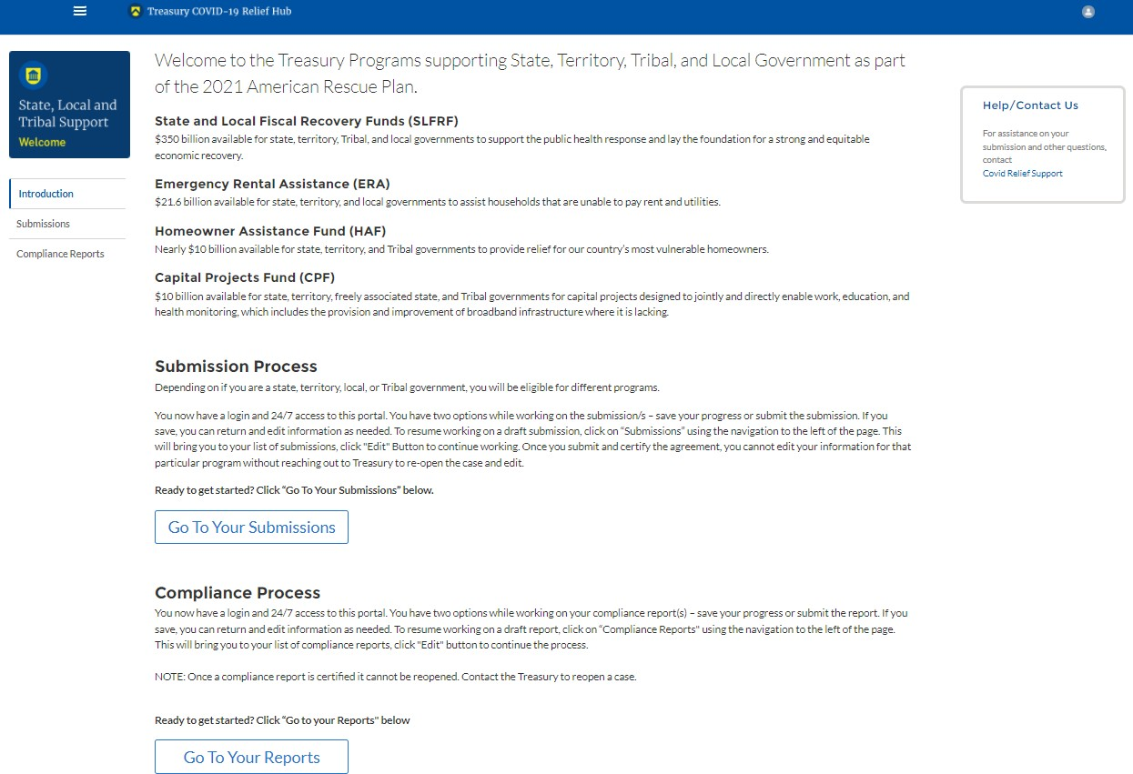
Section II. Navigation and Logistics
a) Login to Landing Page and Portal Navigation
After logging into Treasury’s Portal, the landing page (see Figure 1) will appear listing the Treasury’s Office of Recovery Programs (ORP)-administered program for which your organization may be eligible.
Figure 1 Landing Page
From the landing page, select Go to Your Reports or Compliance Reports on the left side panel to be taken to a list of options for the programs you have access to under the Report Selection section.
At this time, you may select the Project and Expenditures report.
Each listed report constitutes a link to that specific report’s online forms. Selecting a report from the landing page will open the first in a series of screens.
To begin completing a specific report, click on Provide Information for the given report. Refer to the Reporting Guidance for details about each type of required report for submittal.
The Navigation Bar (see Figure 2) on the left of Treasury’s Portal will allow you to freely move between screens.

Slide 7
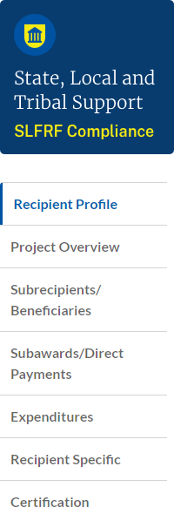
Figure 2 Navigation Bar
Helpful Tips/Shortcuts for Submitting Data to Treasury’s Portal
Treasury’s Portal leads you through a series of online forms that, when completed, will fulfill your reporting obligations. While navigating through Treasury’s Portal and submitting required information, users will have the option of manually entering data directly into Treasury’s Portal or providing information via a bulk upload file that includes all relevant information in a Treasury approved process and format.
Bulk File Upload Files
Recipients can use the bulk upload function for providing required information for the modules listed here:
  Project Overview
  Subrecipients
  Subawards
  Expenditures
When using the bulk upload, recipients must provide the required information in specified formats and use the Treasury approved templates for each respective bulk upload. Recipients must download each of the templates separately from within the relevant Treasury’s Portal module.
Please see Appendix B – Bulk File Upload Overview for complete guidance on using this important function.
Modules accepting bulk upload files are clearly marked in Treasury’s Portal and identified in later sections of this User Guide. The template for each upload file is available in the relevant module for download (see Figure 3).

Slide 8
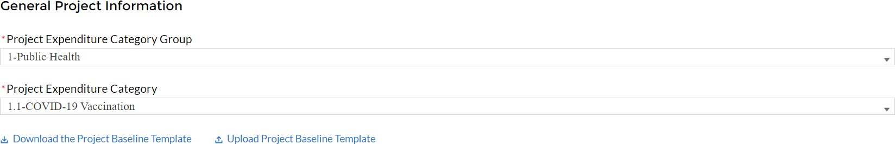
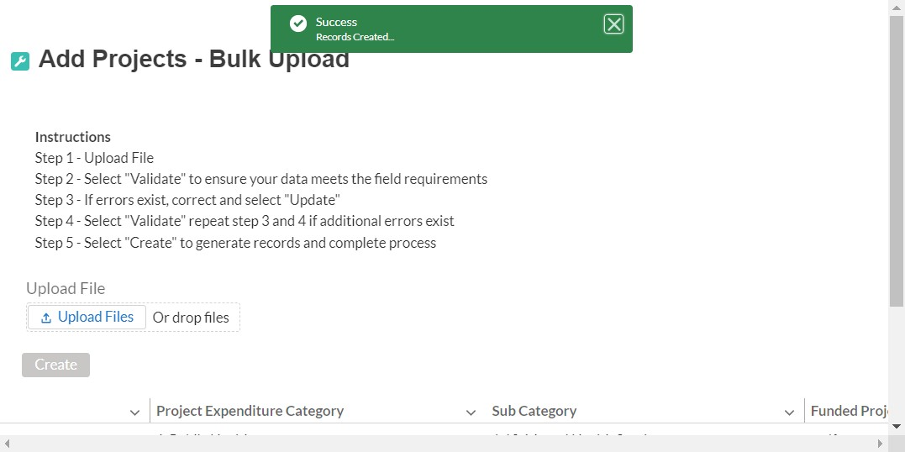
Figure 3 Sample Bulk Upload Icon
All bulk file templates download in the .xls format, but these files must be converted to .csv format to properly upload. When you click the upload button you will be directed to an upload screen. You can either choose to add files or drag and drop files to initiate the bulk upload (see Figure 4). Refer to Appendix B for additional instructions to submit bulk upload file.
Figure 4 Successful Bulk Upload Example
Treasury’s Portal will reject the file if an incorrect template, data format, or file format other than .csv is used for upload (see Figure 5). Treasury’s Portal will display an error message on screen if the bulk data upload file contains errors. If you receive an error message, you will need to correct the errors either in the bulk upload file or on screen and re-submit the corrected version.
There are three common Bulk File Upload errors as described below (see Figure 5):
Blank Data: When a required field is left blank within your bulk upload file, the specific bulk upload file row and cell number will be provided on the screen. In the example below, the user made an error pertaining to the “Completion Status” and the error is located in Column F, Row 9.
Invalid Data: Invalid data includes any type of data (numeric or text) that does not meet the requirements set forth in the Help Text within each bulk upload template. In the example below, the user made an error pertaining to the “Adopted Budget” and the error is located in Column G, Row 9.
Duplicate Data: Duplicate data includes any type of data (numeric or text) that is repeated in the same column when the Help Text within a bulk upload template requires a unique entry. For example, unique numbers should be provided for the

Slide 9
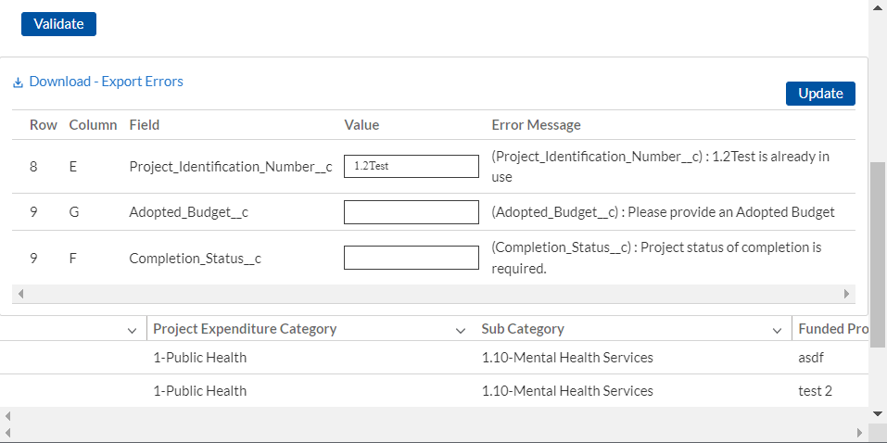
project identification number. In the example below, the user made an error pertaining to the “Project Identification Number” and the error is in Column E, Row 8.
Figure 5 Bulk Upload Validation Screen
Manual Data Entry
Manual data entry requires you to provide inputs as instructed on the screen. Manual inputs are described in detail below for each section of this user guide.
Note: An asterisk ( * ) indicates a required field. Entry into the field is required before you can save or proceed to the next screen.
Your inputs will be subject to validation by Treasury’s Portal to ensure that the data provided is consistent with expected format or description (e.g., entering “one hundred” instead of 100). If a given data entry fails a validation rule, Treasury’s Portal will display an error for you to address.
You will not be able to submit manually entered data that does not satisfy the data validation rules.
Narrative Boxes
When filling out detailed narratives, you are encouraged to type out responses in a word processing application (such as Microsoft Word) to minimize grammatical errors, track word count, and concisely answer all required narrative details. You can then copy and paste the final written narratives directly into the text boxes.
The text boxes (see Figure 6) can be expanded by clicking and dragging the icon in the bottom- right corner.
Figure 6 Manual Validation Text Box

Slide 10
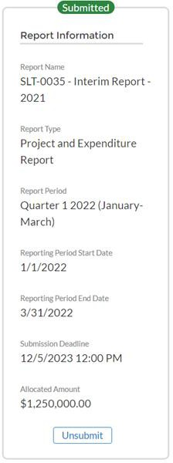
Corrections and Resubmissions
In the event a file is uploaded, or information is entered into Treasury’s Portal, the information will be accepted by Treasury’s Portal as a record.
After a recipient’s submission has been certified and submitted in the system by the ARR, it can be corrected in the Portal by selecting the Unsubmit button. Recipients may unsubmit, then resubmit their Project and expenditure Report any time before the reporting deadline (see Figure 7).
Figure 7 Sidebar indicating Unsubmit Button

Slide 11
Section III. Reporting Requirements
a) Reporting Requirements by Recipient
For the SLFRF program, reporting requirements vary by recipient type, as shown in the table below. Detailed instructions for completion and submission of each report are covered in Part 2 of the Reporting Guidance.
Tier | Recipient | Interim Report | Project and Expenditure Report | Recovery Plan Performance Report
 | States, U.S. territories, | By August 31, | By January 31, | By August 31,
 | metropolitan cities and | 2021 or 60 days | 2022, and then | 2021 or 60 days
 | counties with a population | after receiving | 30 days after the | after receiving
1 | that exceeds 250,000 | funding if | end of each | funding, and
 | residents | funding was | quarter | annually
 |  | received by | thereafter¹ | thereafter by
 |  | October 15, with |  | July 31²
 | Metropolitan cities and | expenditures by |  | Not required
 | counties with a population | category
2 | below 250,000 residents
 | which received more than
 | $10 million in SLFRF
 | funding
 | Tribal Governments which
3 | received more than $30
 | million in SLFRF funding
 | Tribal Governments which |  | By April 30,
4 | received less than $30 |  | 2022, and then
 | million in SLFRF funding |  | annually
 | Metropolitan cities and |  | thereafter³
 | counties with a population
5 | below 250,000 residents
 | which received less than
 | $10 million in SLFRF
 | funding
 | NEUs | Not required
6
b) Project and Expenditure Report Requirements
Quarterly Reporting
The following recipients are required to submit quarterly Project and Expenditure Reports:
States, and U.S. territories
¹ Interim final rule Page 111
² Interim final rule page 112
³ Interim final rule Page 111

Slide 12
Metropolitan cities and counties with population that exceeds 250,000 residents
Metropolitan cities and counties with a population below 250,000 residents which received more than $10 million in SLFRF funding
Tribal Governments that received more than $30 million in SLFRF funding
For these recipients, the initial quarterly Project and Expenditure Report will cover the period from March 3, 2021 to December 31, 2021 and must be submitted to Treasury by January 31, 2022. The subsequent quarterly reports will cover one calendar quarter and must be submitted to Treasury within 30 calendar days after the end of each calendar quarter
States and territories should continue to submit the monthly NEU/Non-UGLG distribution information through the separate module in Treasury’s Portal.
Annual Reporting
The following recipients are required to submit annual Project and Expenditure Reports:
Tribal Governments that received less than $30 million in SLFRF funding
Metropolitan cities and counties with a population below 250,000 residents which received less than $10 million in SLFRF funding
Non-Entitlement Units of Local Government (NEU). To facilitate reporting, each NEU will need a NEU Recipient Number. This is a unique identification code for each NEU assigned by the State or U.S. Territory to the NEU as part of its request for funding.
For these recipients, the initial Project and Expenditure Report will cover from March 3, 2021 to March 31, 2022 and must be submitted to Treasury by April 30, 2022. The subsequent annual reports will cover one calendar year and must be submitted to Treasury by April 30 each year.
Key Concepts for Reporting
The following concept structure applies to all report types:
Expenditure Categories
  Each recipient is required to report the obligations and expenditures by project according to the corresponding Expenditure Category (EC). As noted in the Reporting Guidance, there are a wide range of eligible uses of the SLFRF funds, and Treasury must be able to track how funds are used by recipients for oversight and transparency purposes. In addition, States, U.S. territories and metropolitan cities and counties with a population over 250,000 also need to provide the adopted budget for each project.
    An obligation is an order placed – such as a contract – and similar
transactions that require payment.
    An expenditure is when the service has been rendered or the good has been delivered to the entity, and payment is due.

Slide 13
o The adopted budget is the budget adopted for each project by a recipient associated with SLFRF funds. Recipients will enter the Adopted Budget based on information that exists currently in the recipient’s financial systems and the recipient’s established budget process. Treasury understands that recipients may use different budget processes. For example, a recipient may consider a project budgeted once a legislature has appropriated funds; whereas another recipient may consider a project budgeted at the moment when the funds have been obligated. Note that Treasury is not approving or pre-approving projects or budgets. Treasury will use this information to better understand the intended impact, identify opportunities for technical assistance, and understand the recipient’s progress in program implementation. Treasury is also collecting additional descriptive information about the budget process in order to better understand the context of recipients’ budget processes.
For each project, the recipient will be asked to select the appropriate Expenditure Category based on the scope of the project (as described in Appendix 1 of the Reporting Guidance). Projects should be scoped to align to a single Expenditure Category.
The Expenditure Categories are important not only for tracking projects and expenditures, but also because for certain Expenditure Categories you will need to provide additional programmatic data. You will see them referred to regularly throughout the Reporting Guidance and in this User Guide with “EC” followed by a number.
Appendix C includes the full list of the 66 Expenditure Categories⁴, which refers to the detailed level. For instance, 1.1 is the EC related to Public Health: 1.1 COVID- 19 Vaccination.
While 66 Expenditure Categories are identified, they are a very broad categorization
– each Expenditure Category could include many different programs and activities.
Project
A project is defined as a grouping of closely related activities that together are intended to achieve a specific goal or directed toward a common purpose.
These activities can include new or existing services, funded in whole or in part by the SLFRF award.
Within this broad definition, recipients have flexibility to define their projects in a way that provides the greatest clarity on the work which will be performed.
Each project must align to one Expenditure Category. Projects break down an Expenditure Category into more detail.
You are required to define projects at a sufficient level of granularity to be able to do any programmatic reporting that is required.
⁴ Included in Appendix 1 of the Reporting Guidance

Slide 14
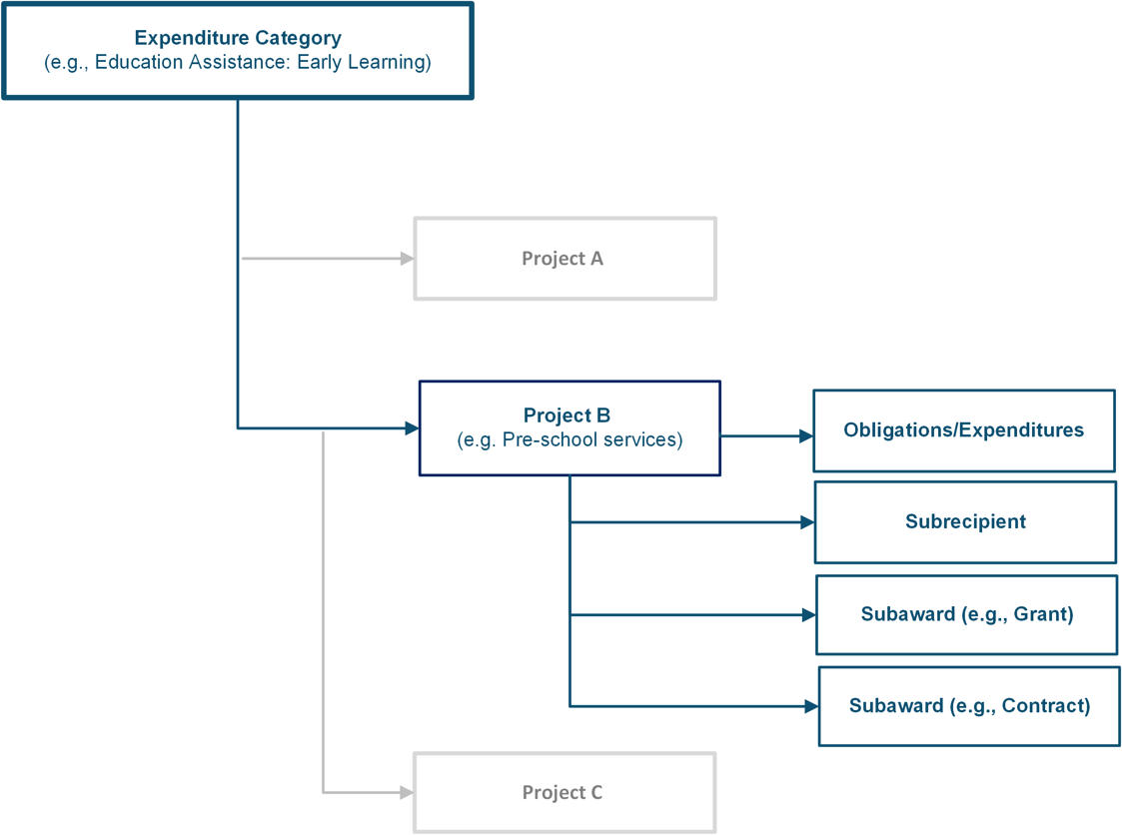
For each Expenditure Category you use funding for, you will have one or more projects.
For each project, you will need to track obligations and expenditures, as well as any subawards made.
Figure 8 depicts the relationship between EC and multiple projects.
Figure 8 Relationship between Expenditure Categories and Multiple Projects

Slide 15
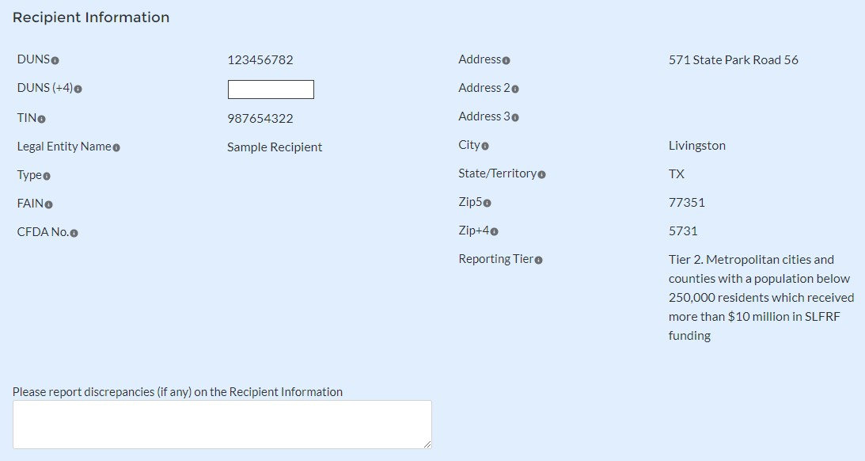
Section IV. Project and Expenditure Report
The Project and Expenditure Report provides information on projects funded, expenditures, and contracts and subawards over $50,000, and other information required from recipients. Multiple modules or “screens” will help navigate recipients through the Project and Expenditure Report in Treasury’s Portal as follows:
Recipient Profile
Project Overview
Subrecipients/Beneficiaries
Subawards/Direct Payments
Expenditures
Recipient Specific
Certification
The following sections describe the reporting steps and information to be collected in each module.
Recipient Profile
Upon login, you will be directed to the recipient information page, which is intended to verify relevant information in Treasury’s Portal. On this screen, you will review and confirm key information on your organization, and input information required for the Project and Expenditure Report. Recipient Profile information will be pre-populated from your SLFRF Application file (see Figure 11). If you have previously entered a DUNS (+4) number, it will appear here.
  Review and confirm your Recipient Profile prepopulated from your SLFRF Application file (see Figure 9).
  If you have a Recipient DUNS (+4) number and the field is not populated, update as necessary.
  Verify the names and contact information for individuals the recipient has designated for
key reporting roles for the SLFRF program displayed on the screen (see Figure 10).
Figure 9 Recipient Information

Slide 16
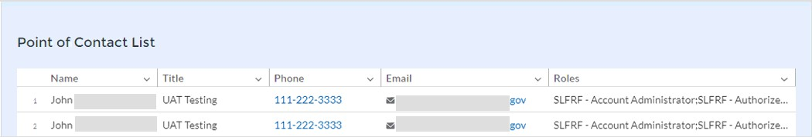
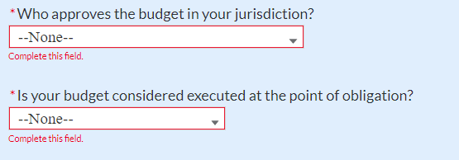
Figure 10 Point of Contact List
If changes are needed to the information displayed on the screen, use the textbox (see Figure 11). Please refer to the instructions in Appendix A if the updates are associated with reporting roles or contact SLFRP@treasury.gov.
For States, U.S. territories, and metropolitan cities and counties with a population over 250,000, provide the answers to the following two questions (see Figure 11):
  Who approves the budget in your jurisdiction? Select from the picklist as follows: Legislature; Executive; Legislature & Executive; Other.
o If Other, specify who approves the budget. Please include information about the role or function, not an individual’s name.
  Is your budget considered executed at the point of obligation? Select “Yes” or “No”. Please note that if you select “Yes” and your budget is considered executed at the point of obligation, then your adopted budget and total dollar value of obligations for each project would be the same.
Figure 11 Budget Approval and Obligation
Treasury is requiring descriptive information about budget processes to support analysis of adopted budget information. Treasury is collecting adopted budget information to better understand the intended impact of recipient projects and help tell the story of how these funds are used, identify opportunities for technical assistance, and understand the recipient’s progress in program implementation. Treasury is requesting this descriptive information to inform these efforts.
Treasury is not approving or pre-approving projects or budgets. Treasury also recognizes that recipients may adjust project budgets over time, and recipients will have the ability to reflect these changes in future reporting.
5. Complete the SAM.gov Registration and Executive Compensation information.

Slide 17
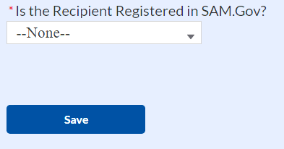
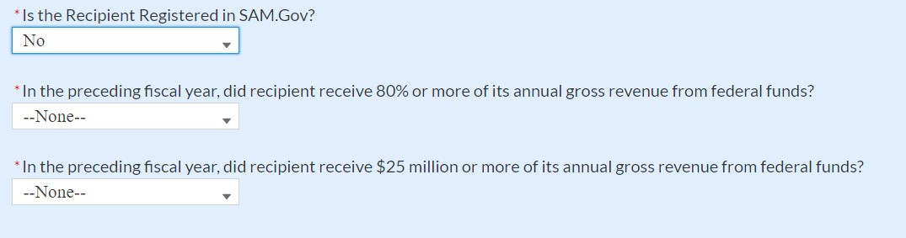
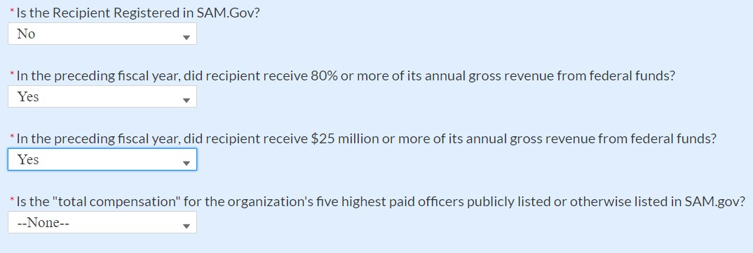
a. Use the dropdown (see Figure 12) to confirm your entity’s SAM.gov status and Executive Compensation reporting eligibility questions.
Figure 12 SAM.gov question
If you are registered in SAM.gov, select “Yes” from the picklist and move on to Step 6 below.
If you are not registered in SAM.gov, select “No” from the picklist. Two additional questions will populate the space below (see Figure 13).
Figure 13 Additional SAM.gov questions (1)
d. If the recipient received 80% or more of its annual gross revenue from federal funds AND the recipient received $25 million or more of its annual gross revenue from federal funds, an additional question will appear (see Figure 14). If the answer is “No” to any of these two questions, move on to step 6 below.
Figure 14 Additional Sam.gov questions (2)

Slide 18
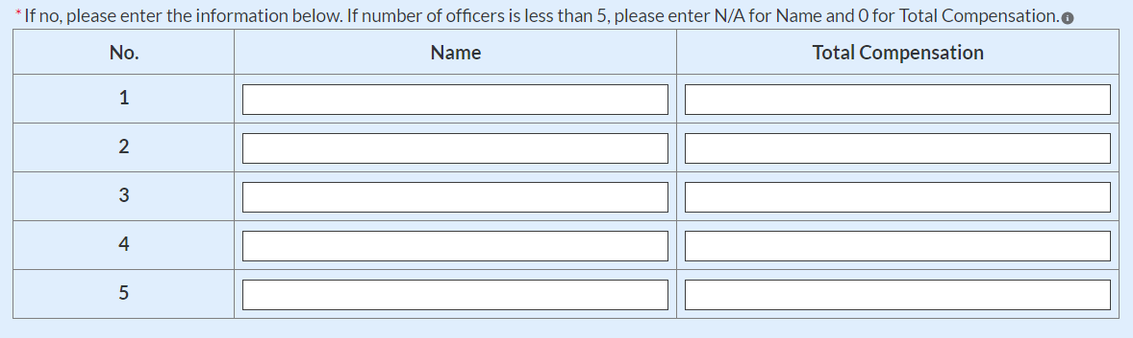
Select “Yes” if the total compensation for the organization’s five highest paid officers is publicly listed or otherwise listed in SAM.gov and move on to Step 6 below.
Select “No” if the total compensation for the organization’s five highest paid officers is not publicly listed or otherwise listed in SAM.gov. Enter the name(s) of the officer(s) in the chart that will appear (see Figure 15) and the total compensation received by each. If fewer than five (5) officers exist, enter “N/A” and $0 in the empty field(s).
Figure 15 Record of Highest Paid Officer
6. Once all fields have been reviewed and verified, click the Save button to save your progress, then click the Next button to proceed to the following screen.
Project Overview
Recipients are required to enter all projects funded through SLFRF funds as part of their Project and Expenditure Report. Once projects are entered, they are viewable on the Project Overview screen and can be updated in future reporting periods.
There are a couple of things to keep in mind when planning and executing your project inventory entry:
  Manual versus Bulk Upload Entry: There are two ways to enter project information – manual data entry and bulk upload. Bulk upload templates are specific to the project’s expenditure category group. Recipients may upload information for multiple projects within the same expenditure category group template simultaneously. Appendix B provides step by step instructions for using the bulk upload option.
Due to the different data collected across expenditure categories, you should not use the same bulk upload template from one expenditure category group to another.
  No Projects Available Option: If your jurisdiction has not yet identified any projects to report, please know that maintaining a project list is a core requirement of the SLFRF program.
For the Project and Expenditure Report due January 31, 2022, in the event recipients have no projects available for entry, an option has been included in Treasury’s Portal to allow recipients to select “No Projects Available” in lieu of adding projects not otherwise

Slide 19
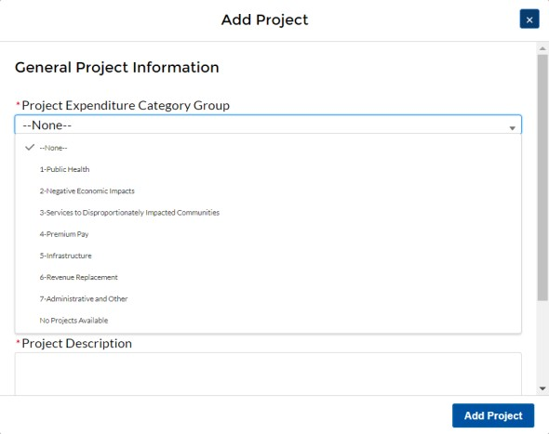
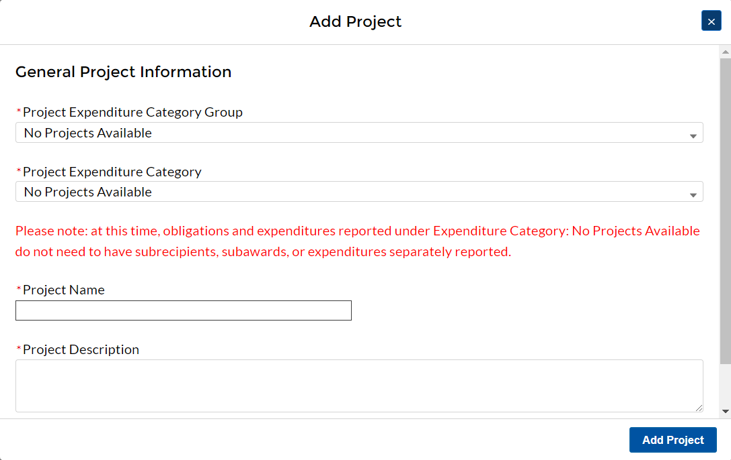
approved. Selecting this option will require providing a written explanation and may result in additional compliance follow-up from Treasury.
To utilize this option, on the Add Project screen
Select “No Projects Available” from the Project Expenditure Category Group (See Figure 16).
Select “No Projects Available” from the Project Expenditure Category (see Figure 17)
Enter in a Project Name of your choosing (See Figure 17).
Enter a description as to the rationale for no projects being available for reporting.
Figure 16 No Projects Available Option
Figure 17 No Projects Available Entry Screen
Non-Infrastructure and Infrastructure Projects Programmatic Data: Treasury requests various programmatic data or impact measures for projects in several non- infrastructure (i.e., projects in EC 1 – 4) and infrastructure projects (i.e., projects in EC
5.1 – 5.17). The programmatic data can be provided via manual project entry or via bulk

Slide 20


upload templates. Appendix B provides step by step instructions for using the bulk upload option for projects with programmatic data. Appendix D provides additional detail on the programmatic data requested by EC. Treasury recognizes that some programmatic data may not be available until a project starts.
Infrastructure Projects with expected total cost over $10M: Information for infrastructure projects with expected total cost over $10 million must be entered manually at this time in Treasury’s Portal. Appendix D provides additional detail on the programmatic data requested by EC.
When creating infrastructure projects via bulk upload, it is important to re-open those project records to manually complete fields related to costs over $10M.
Transfers to NEUs (EC 7.4) (only applicable to States and U.S. territories): States and U.S. territories should report any transfers to NEUs as part of the separate NEU/Non-UGLG module. A project cannot be added under EC 7.4.
Recipients should refer to Appendix C when planning your project inventory entry, as it includes a table identifying which ECs require the programmatic data. The table also maps each EC to its appropriate bulk upload template.
All projects, regardless of Expenditure Category, require a set of “standard” data fields. Some of these fields, such as project name and project ID, are static and do not change across reporting periods. Other fields, such as status of completion and total obligations, will change across reporting periods.
On the Project Overview Screen, recipients can view previously established projects and enter new projects (see Figure 18). The screen displays the total number of projects and total obligations for the recipient. The screen also displays the following for each project entered: project name, project ID, adopted budget (if applicable), total obligations, total expenditures, expenditure category, project status, subaward status, and expenditure status. To go directly to a project to edit or add information, click the colored green or red status button for that project.
For Project Status, the green check icon indicates all required fields have been answered.
For Subaward Status and Expenditure Status, this indicates that at least one subaward or expenditure entry has been made.
For Project Status, the yellow pencil icon indicates that the sum of all obligation or expenditure amounts associated with the project is not equal to that project’s total obligations or expenditures.
For Project Status, the red pencil icon indicates that not all required fields have been answered. For Subaward Status and Expenditure Status, this indicates that no subaward or expenditure entries have been made.
To add a new project from this screen, click the Add New Project button. You may need to refresh your browser screen to see your previous new entries.

Slide 21
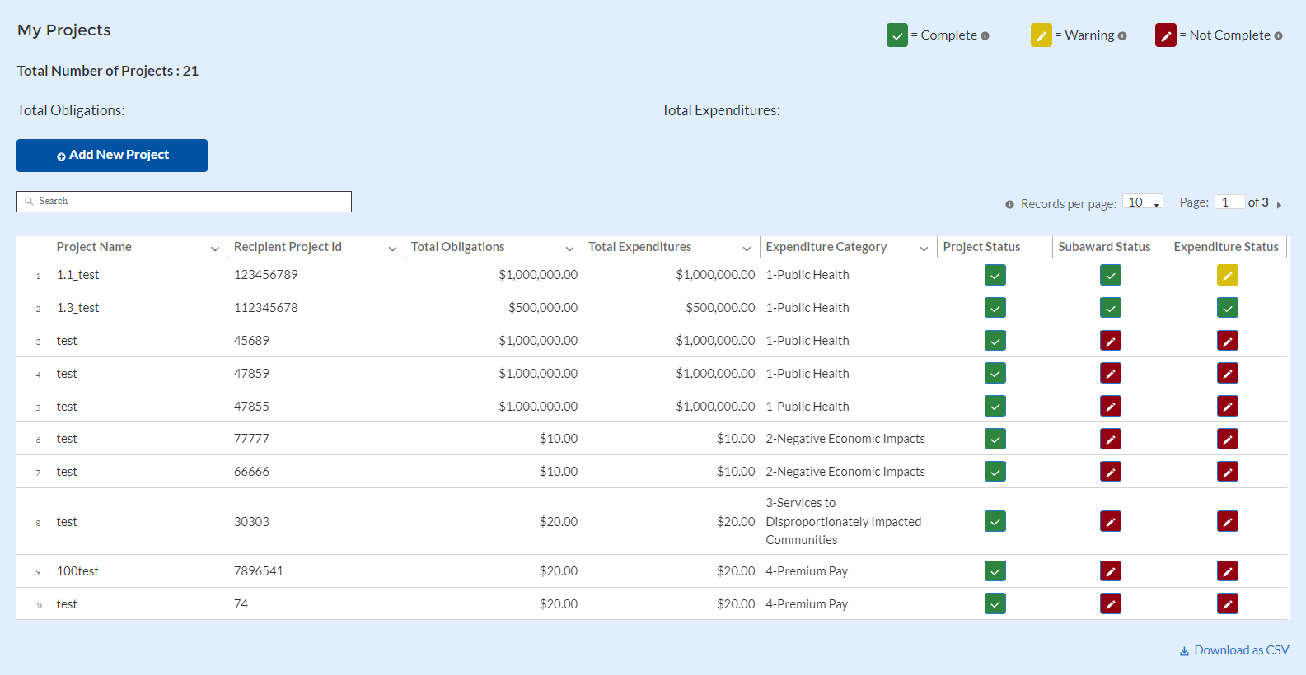
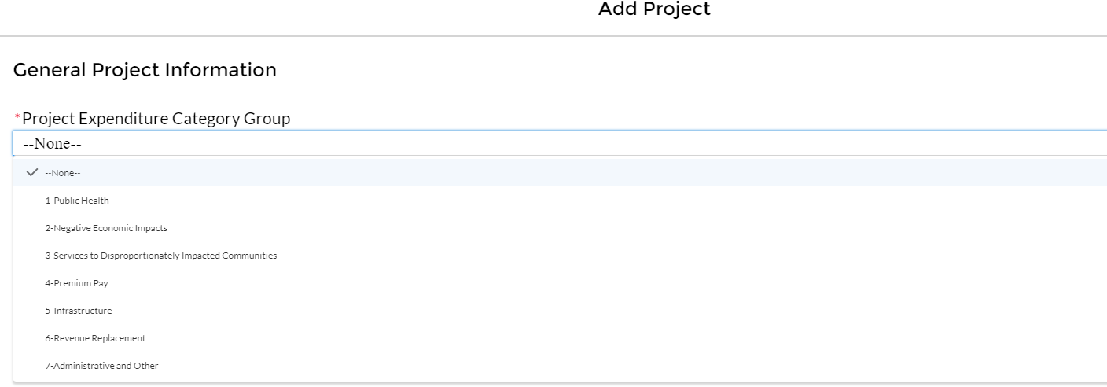
Figure 18 My Projects Screen Example
Add project manually
  Select the Project Expenditure Category Group and Project Expenditure Category from the picklists. Selection of Expenditure Category drives the template by which you will manually enter the project data (see Figures 19 through 22). To view all of the ECs, scrolling may be necessary.
Figure 19 Project Expenditure Category Group

Slide 22
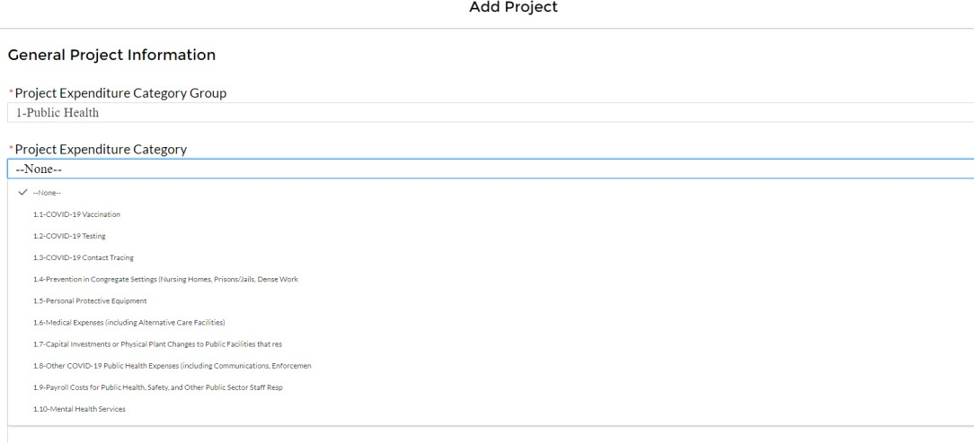
Figure 20 Project Expenditure Category
2. Note that once you select values from the Project Expenditure Category Group and the Project Expenditure Category picklists, the bulk download and upload links will appear (see Figure 21). As you are entering the information manually, go to step 3.
Figure 21 Bulk Upload for EC 1.1
Enter the project name.
Enter the unique project identification number you assigned to the project. Do not use duplicate project numbers for multiple projects.
Select the completion status of the project from the drop-down list. Options are:
  Not started
  Completed less than 50%
  Completed 50% or more
  Completed
For States, U.S territories and metropolitan cities and counties with population over 250,000, enter the adopted budget for the project.
Enter the total dollar value of obligations for this project. If funds have not been obligated, enter "0".
Enter the total dollar value of expenditures for this project. If expenditures have yet to be made, enter "0".
  Note – Recipients should ensure that Total Expenditures are less than or equal to Total Obligations for each project. Treasury’s Portal will otherwise return an error.

Slide 23
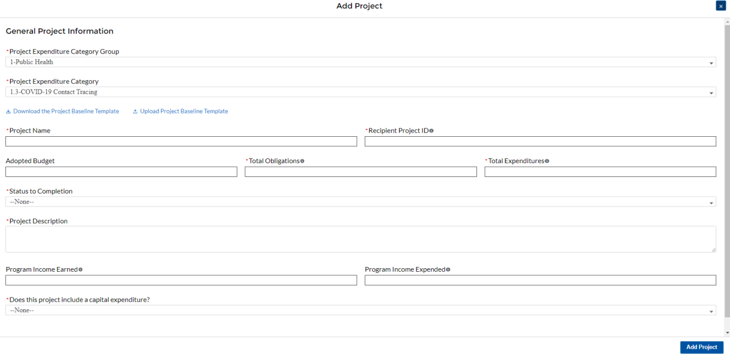
Provide a description for the project between 50 to 250 words. Treasury encourages recipients to include a description of the population they are serving, the desired impact, and how this impact will be measured.
For projects reported under the Project Expenditure Categories EC1: Public Health, EC2: Negative Economic Impact and EC3: Services to Disproportionately Impacted Communities, provide answers to the questions “Does this project include a capital expenditure”? If “Yes”, what is the total expected cost of the capital expenditure, including pre-development costs? If the answer is “No”, include a zero for the expected total cost of the capital expenditure.
If the project earns income or has expended that income, enter the total dollar value of program income earned and Program income expended in the fields of the same name, respectively. This field is optional.
If the project is in an EC which requires additional programmatic data, additional fields will display on the screen. Please see Section IV.d below for more information on providing programmatic data and Appendix D for more information on the programmatic indicators themselves.
Figure 22 Project Entry Screen
Once all of the above information is entered, click the Add Project button, then click the Next button to proceed to the following screen or you can stay on this screen and continue adding projects to your project inventory. Refer to Figure 22.
d) Programmatic Data for Projects
As noted above, projects in several ECs require programmatic data in addition to the standard project information covered above and as described in Part B.3.i and B.3.j of the Reporting Guidance. Appendix D provides additional detail on the measures and information required, by

Slide 24
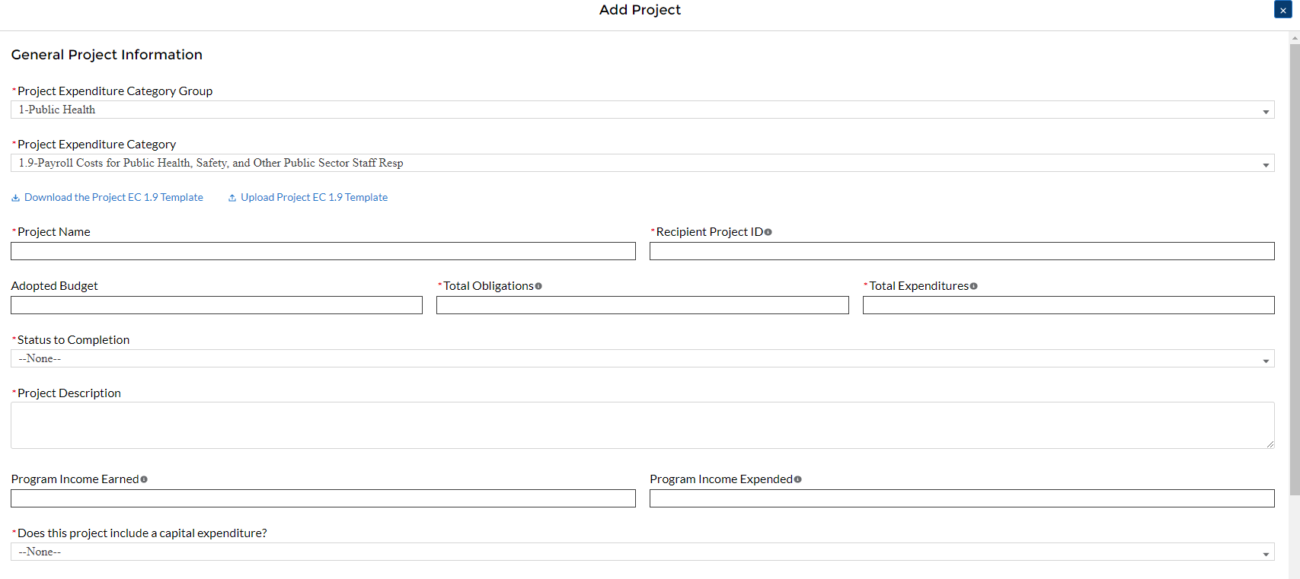
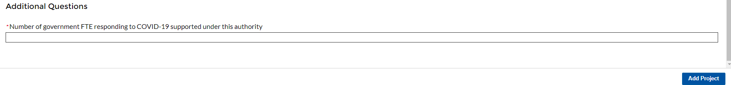
Expenditure Category. This information should be provided at the project-level (e.g., disaggregated by project if the recipient has multiple projects in a single EC).
Programmatic data can be provided via the manual project entry process described above, or in some cases via bulk upload using the Expenditure Category-specific templates, described in Section IV.e and Appendix B.
For example, to manually enter a new project in Expenditure Category 1.9 (see Figure 23) Payroll Cost for Public Health, Safety, and other Public Sector Staff Resp, the recipient should:
Follow steps 1 – 11 in Section IV.c.1 above.
Populate the programmatic data field for “Number of government FTEs responding to COVID-19 supported under this authority” (see Figure 24).
Once all of the above information is entered, click Add Project.
Click the Next button to proceed to the following screen.
Figure 23 Manual Entry for EC 1.9
Figure 24 Programmatic Data for EC 1.9
If entering projects via bulk upload, recipients should populate the programmatic data columns contained in the appropriate EC’s bulk upload template.
Refer to Appendix D for a full listing of project Expenditure Categories with detail on the additional information needed for specific categories. Appendix C provides a helpful table mapping each Expenditure Category to the bulk upload template recipients should use if inputting or updating projects via the bulk upload method.

Slide 25
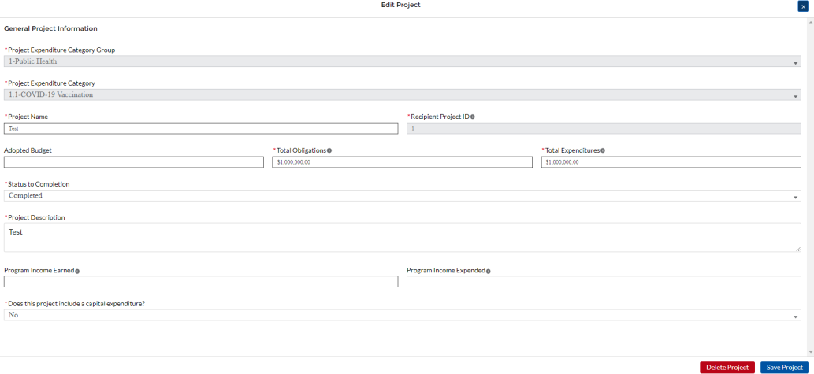
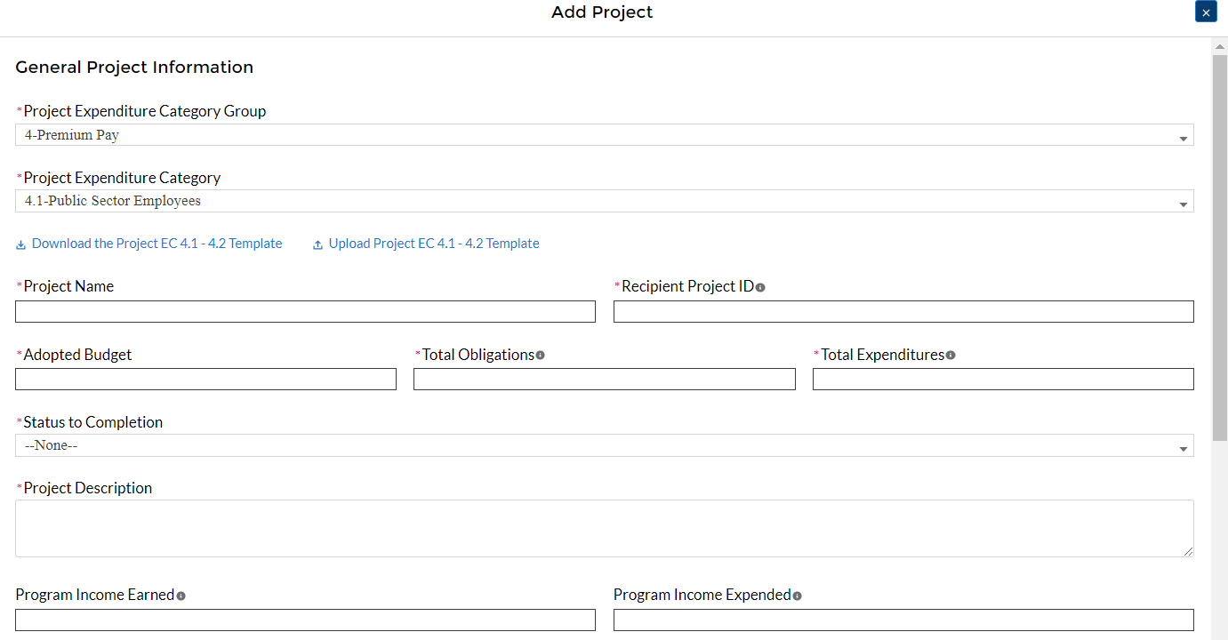
Projects entered into the system can be edited or deleted before final submission. To edit a project, open the project from the My Projects screen. To delete a project, use the Delete Project Button. If a report is already submitted, users will need to un-submit to edit or delete a project record. See Figure 25.
Figure 25 Edit and Delete Project Screen
1. Premium Pay (EC 4.1 and EC 4.2)
If EC 4.1 or 4.2 is selected as the project expenditure category, recipients will need to provide additional data.

Slide 26
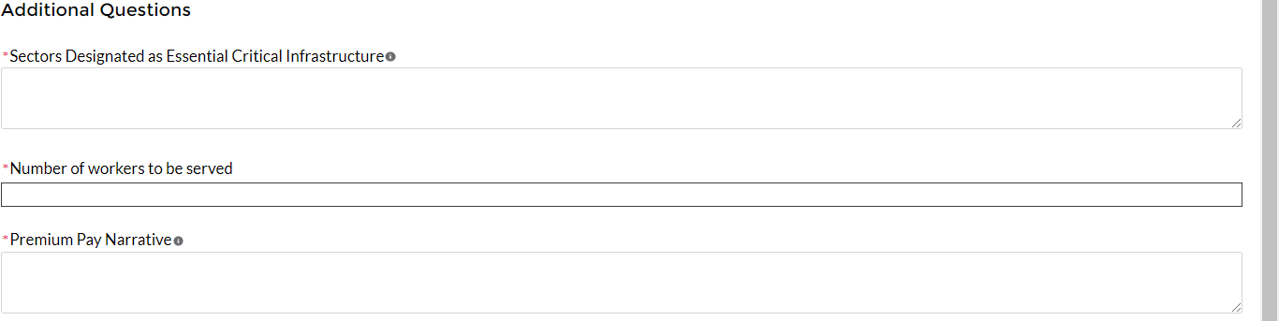
Figure 26 Premium Pay Screen and Additional Questions
In addition, recipients need to provide additional information in regard to Premium Pay, as reflected in Figure 26.
Note - Recipients that are either creating or supporting a Premium Pay program may only provide premium pay to eligible workers, e.g., workers needed to maintain continuity of operations of essential critical infrastructure sectors (see sector list below), for essential work, e.g., work that is not performed while teleworking from a residence; and involves either:
regular, in-person interactions with patients, the public, or coworkers of the individual that is performing the work; or
regular physical handling of items that were handled by, or are to be handled by, patients, the public, or coworkers of the individual that is performing the work.
Sectors designated as essential critical infrastructure sectors: Recipients should refer to the list of sectors below when providing information for this question. Recipients may also refer to this list of sectors on the Subaward screens (see section IV.g) to answer the question: Employer sector for all subawards to third-party employers (i.e., employers other than the State, local, or Tribal government).
Sectors Designated as Essential Critical Infrastructure Sectors
Any work performed by an employee of a State, local, or Tribal government;
Behavioral health work;
Biomedical Research;
Dental care work;
Educational work, school nutrition work, and other work required to operate a school facility;
Election’s work;
Emergency response;
Family or childcare;
Grocery stores, restaurants, food production, and food delivery
Health care;
Home- and community-based health care or assistance with activities of daily living;
Laundry work;
Maintenance work;
Medical testing and diagnostics;
Pharmacy;
Public health work;

Slide 27
Sectors Designated as Essential Critical Infrastructure Sectors
Sanitation, disinfection, and cleaning work;
Social services work;
Solid waste or hazardous materials management, response, and cleanup work;
Transportation and warehousing;
Vital services to Tribes;
Work at hotel and commercial lodging facilities that are used for COVID-19 mitigation and containment;
Work in a mortuary;
Work in critical clinical research, development, and testing necessary for COVID-19 response.
Work requiring physical interaction with patients;
Other
Beyond this list, the chief executive (or equivalent) of a recipient government may designate additional non-public sectors as critical so long as doing so is necessary to protecting the health and wellbeing of the residents of such jurisdictions.
Premium Pay Narrative: Premium pay must be responsive to eligible workers performing essential work during the public health emergency. For groups of workers that do not meet one of the two criteria below, Recipients must submit a written justification to Treasury describing how the premium pay or grant is responsive to workers performing essential work during the public health emergency:
Eligible worker receiving premium pay is earning (with the premium included) below 150 percent of their residing state or county’s average annual wage for all occupations, as defined by the Bureau of Labor Statistics Occupational Employment and Wage Statistics⁵, whichever is higher, on an annual basis; or
Eligible worker receiving premium pay is not exempt from the Fair Labor Standards Act overtime provisions.
2. Infrastructure Projects Programmatic Data (EC 5)
Programmatic data is requested for Infrastructure projects in addition to data uploaded by bulk template. That additional programmatic data can only be entered manually at this time in
Treasury’s Portal.
If adding an infrastructure project via the bulk upload method, recipients will be asked to provide additional data in Treasury’s Portal screens manually (see Figure 27 for example of a project providing water or sewer services). Alternatively, recipients can enter all infrastructure project information manually. Reference Appendix D for detailed information on infrastructure project entry and the Reporting Guidance for more general information on infrastructure project entry.

Slide 28
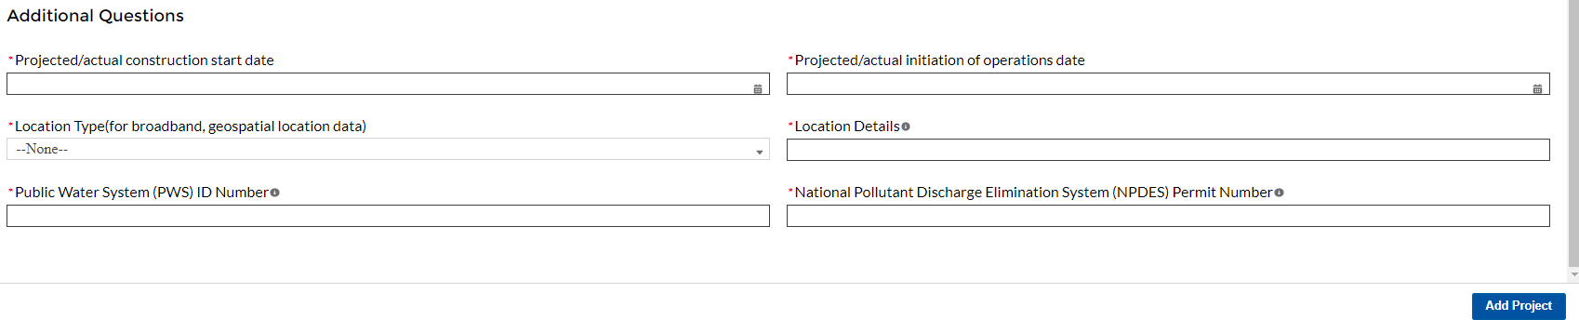
Figure 27 Programmatic Data for Infrastructure Projects
Infrastructure Projects with total expected costs over $10M
Recipients entering infrastructure projects with total expected costs over $10 million are required to respond to two questions manually. If you expect a project to exceed $10 million over its lifetime, it is strongly recommended to complete the certifications in advance to avoid future retroactive reporting burden and project-associated expenses.
Recipients are required to provide the following two certifications, or provide additional information:
  Davis Bacon Act Certification (see Figures 28 and 29):
    Select “Yes” or “No” response to Certification question for compliance with Davis-
Bacon Act: Do you intend to certify that “all laborers and mechanics employed by contractors and subcontractors in the performance of the project are paid wages at rates not less than those prevailing, as determined by the U.S. Secretary of Labor in accordance with subchapter IV of chapter 31 of title 40, United States Code (commonly known as the “Davis-Bacon Act”), for the corresponding classes of laborers and mechanics employed on projects of a character similar to the contract work in the civil subdivision of the State (or the District of Columbia) in which the work is to be performed, or by the appropriate state entity pursuant to a corollary state prevailing-wage-in-construction law (commonly known as
“baby Davis-Bacon Acts”)?
    If response is “No”, enter the following information in the revealed questions:
      The number of employees of contractors and sub-contractors working on the project;
      The number of employees on the project hired directly and hired through
a third party; and
      The wages and benefits of workers on the project by classification; and
      Whether those wages are at rates less than those prevailing⁶.
PLEASE NOTE: Selecting "Yes" to 1(a) means that you intend to certify that all contractors and subcontractors are paying prevailing wages and fringe benefits to all laborers and mechanics on the project.
⁶ As determined by the U.S. Secretary of Labor in accordance with subchapter IV of chapter 31 of title 40, United States Code (commonly known as the “Davis-Bacon Act”), for the corresponding classes of laborers and mechanics employed on projects of a character similar to the contract work in the civil subdivision of the State (or the District of Columbia) in which the work is to be performed.

Slide 29
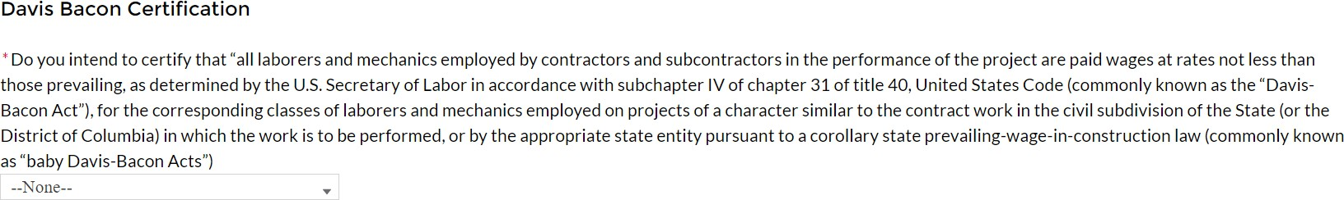
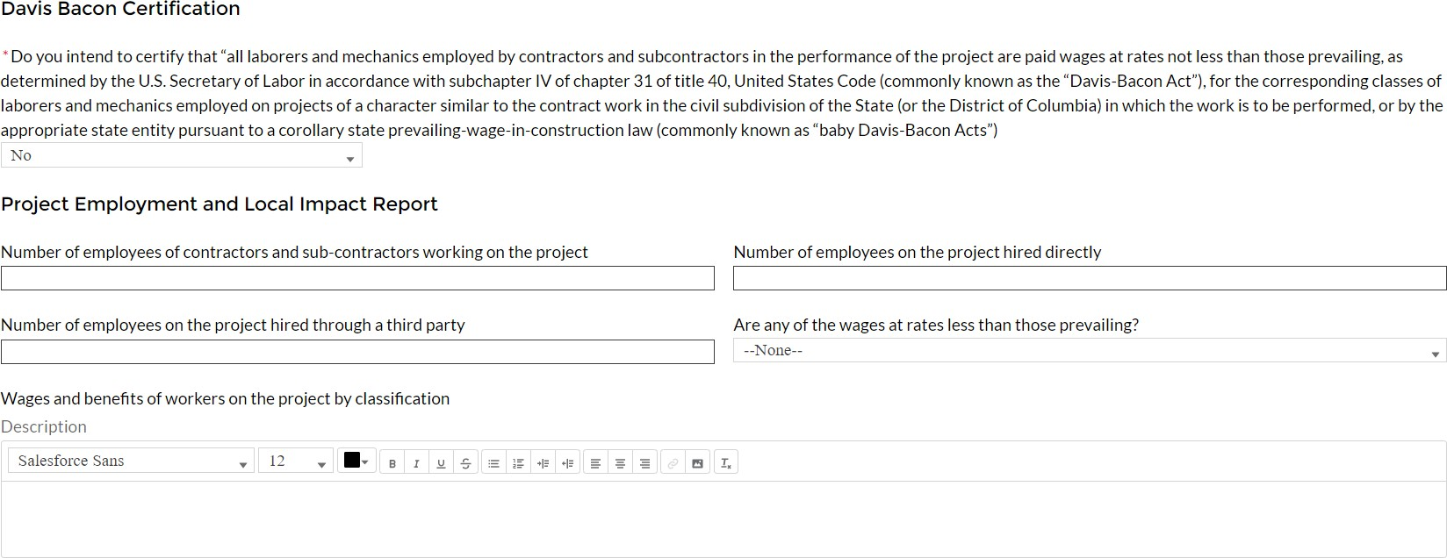
Figure 28 Davis Bacon Certification
Figure 29 Additional Questions if Response to Davis Bacon Certification is "No"
Project Labor Agreement Certification (Figures 30 and 31):
  Select “Yes” or “No” response to Certification question for existence of project labor agreement: Do you intend to certify that “the indicated project includes a project labor agreement, meaning a pre-hire collective bargaining agreement consistent with section 8(f) of the National Labor Relations Act (29 U.S.C. 158(f))?
  If response is “No”, enter the following information about a project continuity plan in the pop-up window:
How the recipient will ensure the project has ready access to a sufficient supply of appropriately skilled and unskilled labor to ensure high-quality construction throughout the life of the project, including a description of any required professional certifications and/or in-house training;
How the recipient will minimize risks of labor disputes and disruptions that would jeopardize timeliness and cost-effectiveness of the project;
How the recipient will provide a safe and healthy workplace that avoids
delays and costs associated with workplace illnesses, injuries, and fatalities, including descriptions of safety training, certification, and/or licensure requirements for all relevant workers (e.g., OSHA 10, OSHA 30);
Whether workers on the project will receive wages and benefits that will secure an appropriately skilled workforce in the context of the local or regional labor market; and
Whether the project has completed a project labor agreement.
iii.

Slide 30
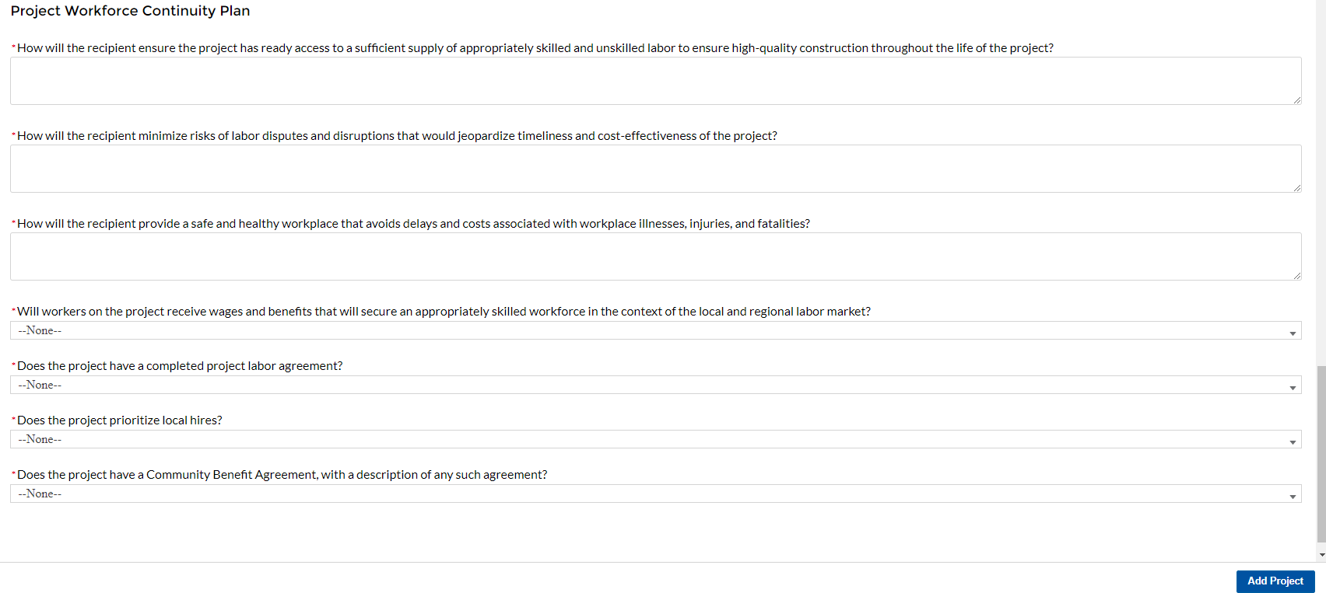
PLEASE NOTE: Selecting "Yes" to 2(a) means that you intend to or are using an 8(f) pre-hire agreement on your project.
Figure 30 Certification for Labor Agreements
Figure 31 Additional Questions if response is "No"
Once all of the above information is entered, click Add Project. Click the Next button to proceed to the following screen.
Water and sewer projects (EC 5.1-5.15)
Recipients will provide information associated with water and sewer projects, under EC 5.1 through 5.15 when the project starts. Recipients are not required to provide the information if the project has not started. When the “Status of Completion” field is marked “Not Started, the additional questions required for water and sewer projects will not populate.
Revenue Replacement
Recipients will have the option to update or provide information associated with revenue replacement not previously provided as part of prior submissions. Information previously provided as part of the Interim Report (if provided) will display in this screen. Depending on your answer to the question, “is your jurisdiction electing to use the standard allowance of up to
$10 million for identifying the revenue loss?” you will be asked conditional questions. Refer to Figure 30.
As outlined in the final rule, Recipients will have the option to make a one-time decision to calculate revenue loss according to the formula outlined in the final rule or elect a “Standard Allowance” of up to $10 million, not to exceed the award allocation, to spend on government services throughout the period of performance.

Slide 31
For recipients calculating revenue loss according to the formula, note that the final rule permits recipients are permitted to choose whether to use calendar or fiscal year calculation dates.
Recipients must use the same calculation time frame (calendar or fiscal year) throughout the award period.
For recipients electing the “Standard Allowance,” Treasury will presume that up to $10 million, not to exceed the award allocation, in revenue has been lost due to the public health emergency and recipients are permitted to use that amount to fund “government services.” Please note that electing the standard allowance does not change a recipient’s total allocation.
Treasury’s Portal will allow all recipients to elect to use this standard allowance instead of calculating lost revenue using the formula. Refer to Figure 32. The following question will display in the screen for all recipients, including those with total allocations of $10 million or less:
Is your jurisdiction electing to use the standard allowance of up to $10 million, not to exceed your total award allocation, for identifying revenue loss? Yes/No (Please note electing the standard allowance does not change your total allocation).
Based on the recipient’s election, certain information will display in Treasury’s Portal which the recipient will need to complete, as noted in the table below:
Data | Standard Allowance – Yes | Standard Allowance- No
Base Year Revenue | N/A | Required
Fiscal Year End Date | N/A | Required
Growth Adjustment Used | N/A | Required
Actual General Revenue as of 12 months ended December 31, 2020 | N/A | Required
Estimated Revenue Loss | N/A | Required
Select whether Fiscal Recovery Funds were used to a make a deposit into a pension fund. Please note that no recipients except for Tribal governments may use Fiscal Recovery Funds to make a deposit to a pension fund | Required | Required
Provide an explanation of how revenue replacement funds were allocated to government services: Please provide an explanation | Required | Required

Slide 32
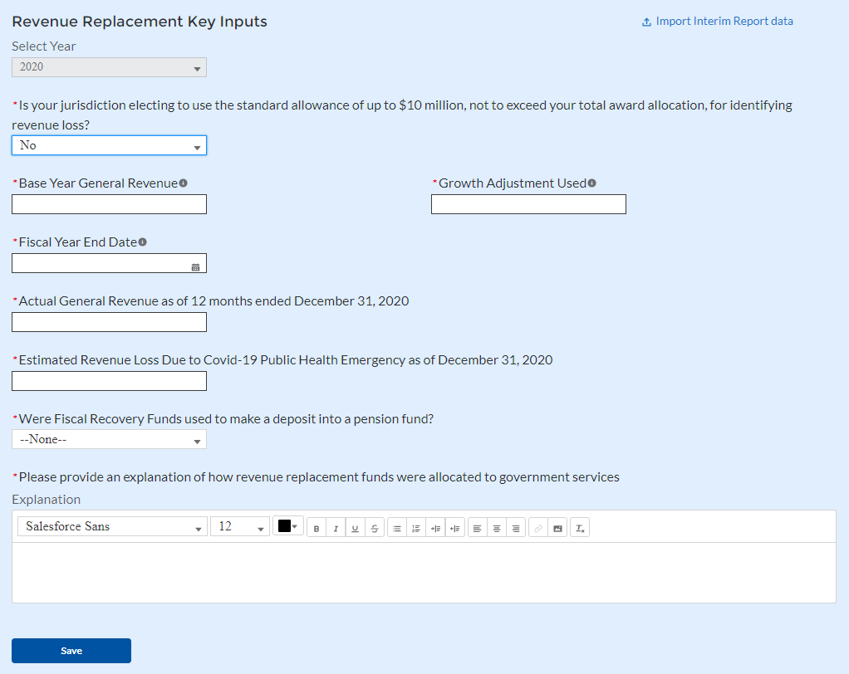
Figure 32 Revenue Replacement Screen
To enter projects using the bulk upload method:
Recipients have the option to provide project information via bulk upload, in lieu of manual entry for some or all of their projects. Please note, bulk upload templates are specific to the EC the project best aligns to. The table in Appendix C provides a mapping of project ECs to their appropriate bulk upload template.
  Fill the downloaded template with information specific to each project’s EC, as follows. Projects within the same EC or set of ECs covered by a given template can be uploaded together. For example, all projects in EC 2.1 to 2.5 (Negative Economic Impacts) can be entered together on the Project Bulk Upload for Project EC 2.1-2.5 Template. Optional
fields are denoted by (*). “Column” below refers to the applicable area in the bulk upload file.
    Column B: Select the Project Expenditure Group
    Column C: Select the Project Expenditure Category
    Column D: Enter the Project Name
    Column E: Enter the unique project identification number assigned by the State or U.S. Territory to the project. Do not use duplicate project numbers for multiple projects
    Column F: Select the completion status of the project
    Column G: Enter the total dollar value of the adopted budget for this project * (only applicable to States, U.S. Territories, and metropolitan cities and counties with population over 250,000)

Slide 33
Column H: Enter the total dollar value of obligations for this project. If no amounts are obligated, enter “0”
Column I: Enter the total dollar value of expenditures for this project. If no expenditures have been incurred, enter “0”
Column J: For projects in EC 1, EC 2, or EC 3, enter a yes or no response to the question, does this project include a capital expenditure?
Column K: If yes, what is the total expected cost of the capital expenditure?
Column L: Enter a description of the project
Column M: Enter the amount of Federal program income earned
Column N: Enter the amount of that was used to cover eligible project costs
Column O: Enter a brief description of the structure and objectives of assistance program(s) (e.g., nutrition assistance for ow income households)
Column P: Enter the number of households served (by program if recipient establishes multiple separate household assistance programs)
Column Q: Enter a brief description of recipient’s approach to ensuring that aid to households responds to a negative economic impact of Covid-19.
Upload the Project Entry and Status template, in this case the template for EC 2.1-2.5, separately as a .csv file by using the respective Upload button on the screen or dropping the files in this view.
Once all of the above information is entered, click Add Project. Click the Next button to proceed to the following screen.
Refer to Appendix B for additional information related to the bulk file upload process
f) Subrecipients or Beneficiaries
The Subrecipients or Beneficiaries Profile documents the information about each subrecipient or beneficiary that has received at least one Subaward or Direct Payment of federal funding greater than $50,000 to execute projects supporting the SLFRF program. Please note that projects entered under EC 6.1 Provision of Government Services are not required to enter Subrecipient, Subaward, or Expenditures (for a subaward) information for the January reporting cycle. The Subrecipients or Beneficiaries module allows users to enter data manually or leverage the bulk file upload capability. For bulk-upload instructions specific to this submodule, see Appendix B. You can download the bulk file template for use in submitting the required data via bulk upload. When ready to submit the data, use the upload button (see Figure 33).

Slide 34
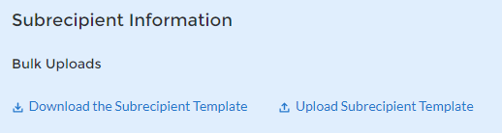
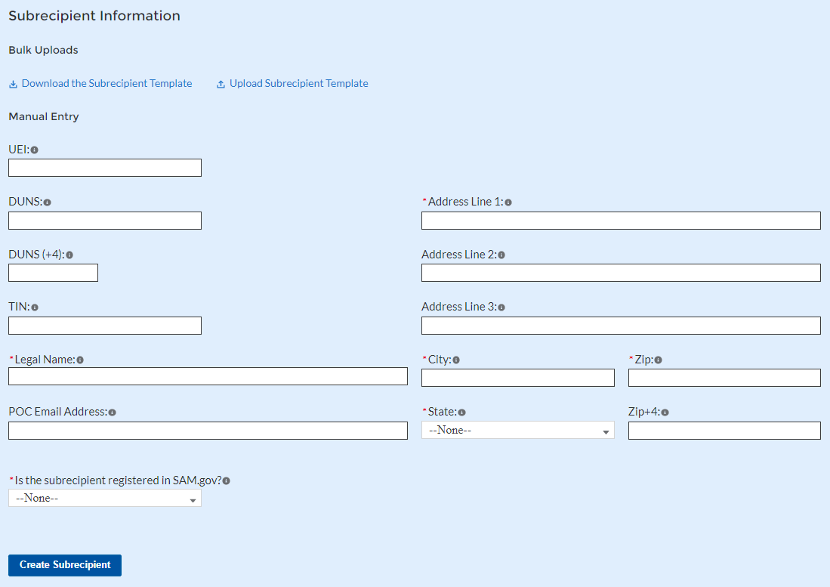
Figure 33 Subrecipient Bulk Upload Icon
Note: When using the bulk file upload capability, the Subrecipient bulk upload must be completed prior to beginning the data entry for the Subawards module.
If you choose to individually enter records, follow the instructions below.
1. Enter the relevant Subrecipient or Beneficiary information in each of the required fields (see Figure 34). Recipients must enter at least one of the following three identifiers for a subrecipient: UEI (Unique Entity Identifier), DUNS, or TIN.
Figure 34 Manually Create a Subrecipient or Beneficiary

Slide 35
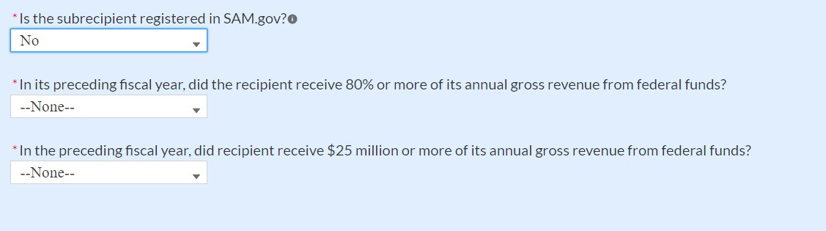
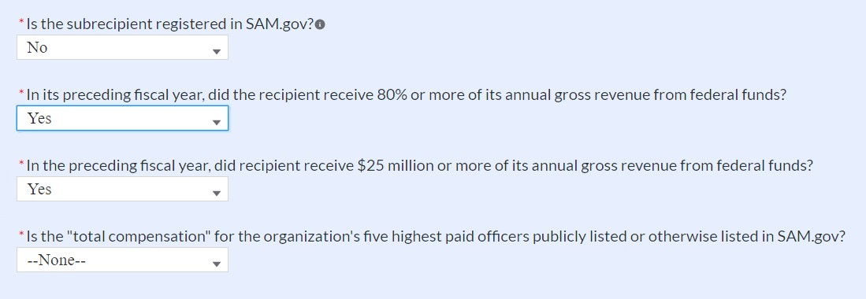
2. If the subrecipient or beneficiary is not registered in SAM.Gov, select “No” from the picklist. Two additional questions will populate the space below (see Figure 35).
Figure 35 Sam.gov Questions for Subrecipients
3. If the recipient received 80% or more of its annual gross revenue from federal funds AND the recipient received $25 million or more of its annual gross revenue from federal funds, an additional question will appear (see Figure 36).
Figure 36 Additional SAM.gov questions for Subrecipients
Select “Yes” if the total compensation for the organization’s five highest paid officers is publicly listed or otherwise listed in SAM.Gov and move on to step 6 below.
Select “No” if the total compensation for the organization’s five highest paid officers is
not publicly listed or otherwise listed in SAM.Gov. Enter the name(s) of the officer(s) in the chart that will appear (see Figure 37) and the total compensation received by each. If fewer than five (5) officers exist, enter “N/A” and $0 in the empty field(s).

Slide 36
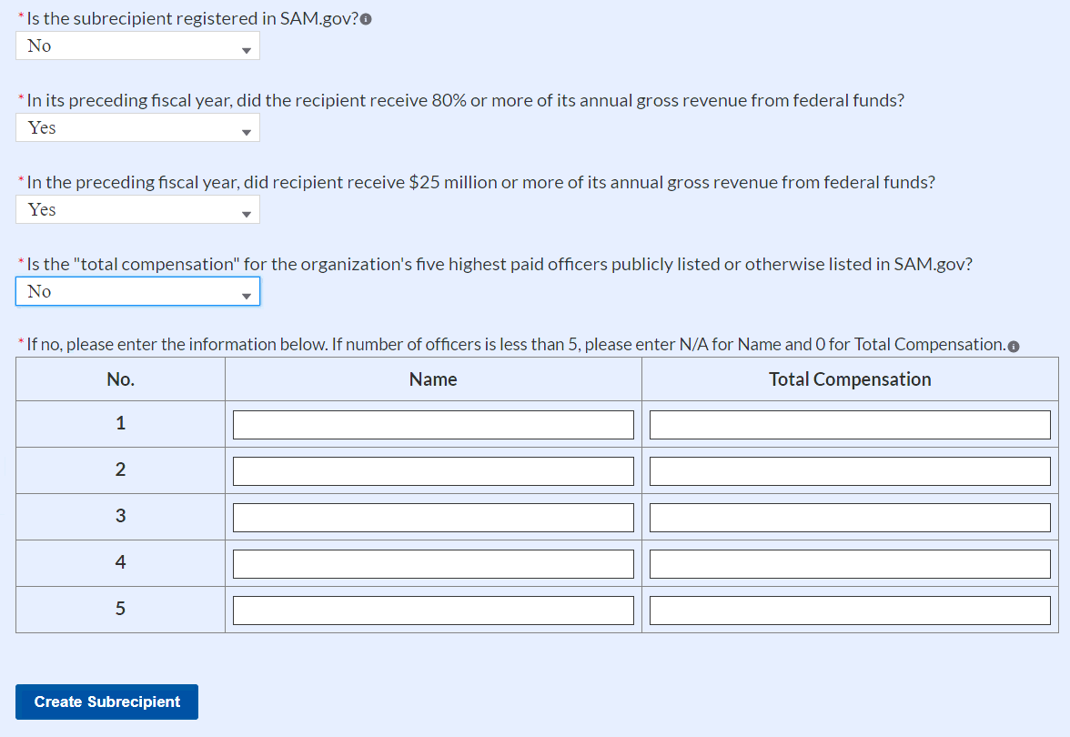
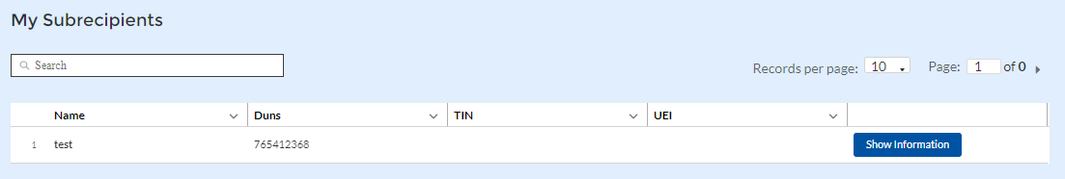
Figure 37 Five Highest Paid Officers for Subrecipients or Beneficiaries
At the bottom of the page, click the Create Subrecipient icon to complete the Subrecipient record and return to Subrecipient screen.
Subrecipient or Beneficiaries entered into the system are shown at the bottom portion of the screen (see Figure 38).
Figure 38 Subrecipients Entered
g) Subawards or Direct Payments
The Subawards or Direct Payments section allows recipients to enter the required information regarding Subawards or Direct Payment of federal funding greater than $50,000 for all direct payments, subawards, and contracts made by your organization under SLFRF. Please note that projects entered under EC 6.1 Provision of Government Services are not required to enter Subrecipient, Subaward, or Expenditures (for a subaward) information for the January reporting cycle.
The Subawards or Direct Payments module allows users to enter data manually or leverage the bulk file upload capability. For bulk-upload instructions specific to this submodule, see Appendix
B. You can download the bulk template using the provided link in Treasury’s Portal before using the upload button (see Figures 39 and 40).

Slide 37
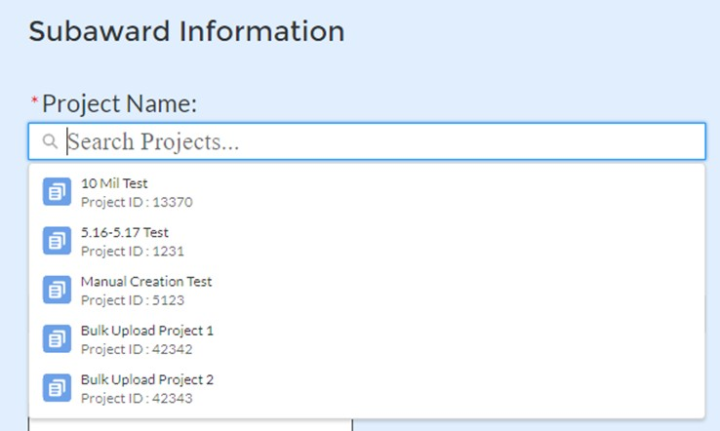
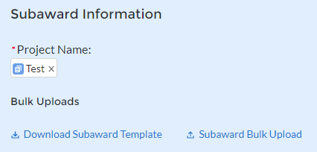
Figure 39 Subaward Bulk Upload (1)
Figure 40 Subaward Bulk Upload (2)
Note: Subaward bulk upload can only be completed after Subrecipient bulk upload is completed.
If you choose to individually enter records, follow the instructions below.
Enter the following fields pertaining to the Subawards or Direct Payments (see Figure 41):
  Subrecipient or Direct Payment Recipient Name from the picklist
  Subaward Number
  Subaward Amount (Obligation)
  Subaward Date
  Period of Performance Start
  Period of Performance End
  Place of Performance Address, City, State, Zip, Zip+4
Select the Subaward Type from the drop-down picklist:
  Contract: Purchase order
  Contract: Delivery order
  Contract: Blanket Purchase Agreement
  Contract: Definitive contract
  Grant: Lump sum Payment(s)
  Grant: Reimbursable

Slide 38
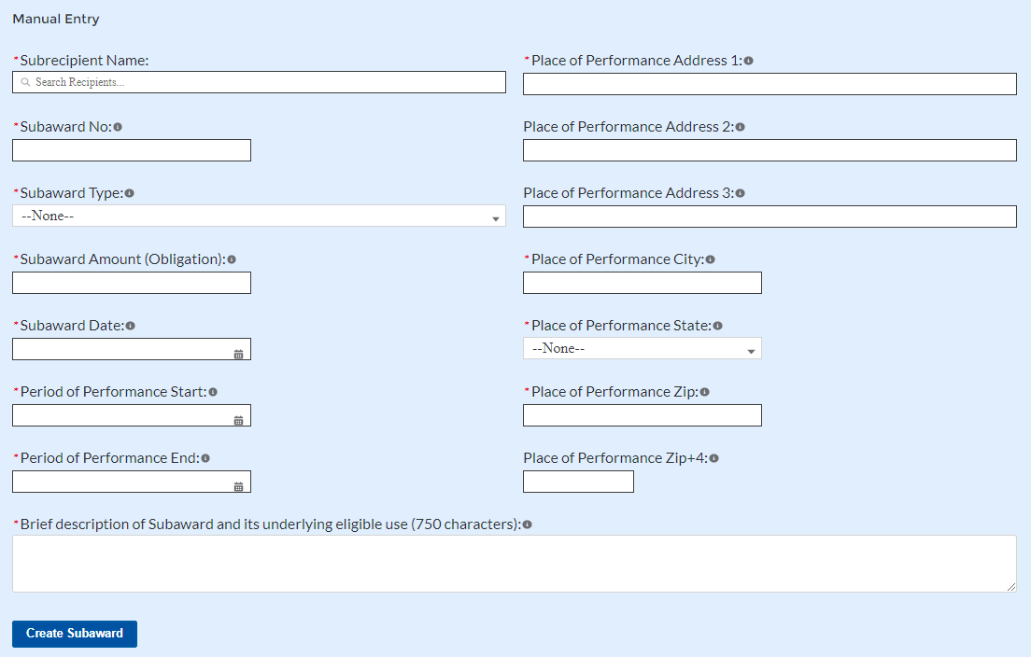
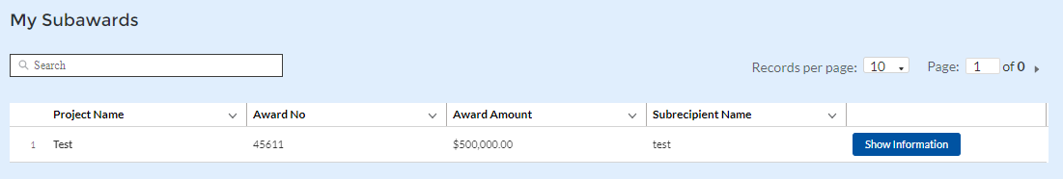
Loan - Maturity prior to 12/31/26 with planned forgiveness (please see note below on use of loans)
Loan - Maturity prior to 12/31/26 without planned forgiveness (please see note below on use of loans)
Loan - Maturity past 12/31/26 with planned forgiveness (please see note below on use of loans)
Loan - Maturity past 12/31/26 without planned forgiveness (please see note below on use of loans)
Direct Payment
Transfer: Lump Sum Payment(s)
Transfer: Reimbursable
Figure 41 Subaward Reporting
Click Create Subaward to establish the Subaward record. Repeat Steps 1 through 3 to create additional Subaward records.
Subawards entered into the system are shown at the bottom portion of the screen (see Figure 42).
Figure 42 Subaward Entered

Slide 39
Expenditures
In the Expenditures tab, recipients will provide information for each contract, grant, loan, transfer, or direct payment greater than $50,000. Additionally, aggregate reporting is required for contracts, grants, transfers made to other government entities, loans, direct payments, and payments to individuals that are less than $50,000. If aggregated expenditures linked to a project equal the total Expenditures reported for that project, the Subaward status box on the My Projects screen is changed to ‘Complete’. Please note that projects entered under EC 6.1 Provision of Government Services are not required to enter Subrecipient, Subaward, or Expenditures (for a subaward) information for the January reporting cycle.
The Expenditures reporting module allows users to enter data manually or leverage the bulk file upload capability. For bulk-upload instructions specific to this submodule, see Appendix B.
If you do not use the bulk upload function, follow the steps listed below.
  To report new expenditures under a specific subaward, enter the subaward number. The Project Name associated with the subaward will auto populate.
  Enter the following:
    Expenditure Start Date
    Expenditure End Date
    Expenditure Amount
  Enter narrative for Administrative Costs, if applicable.
  Click the Create Expenditure button to submit the record. Repeat Steps 1 through 6 to report additional sub-award expenditures. Proceed to the next segment once all sub- award expenditures are reported.
1. Expenditures Greater than $50,000
For expenditures for awards greater than $50,000, fill out the “Expenditures for Awards>
$50,000” box (see Figure 43). Project name and subaward will be selected to link each expenditure to the appropriate entries. Note that the Project name is automatically identified based on the associated Subaward No. entered. Once the information has been entered, click the Create Expenditure button on the bottom left of the box.

Slide 40
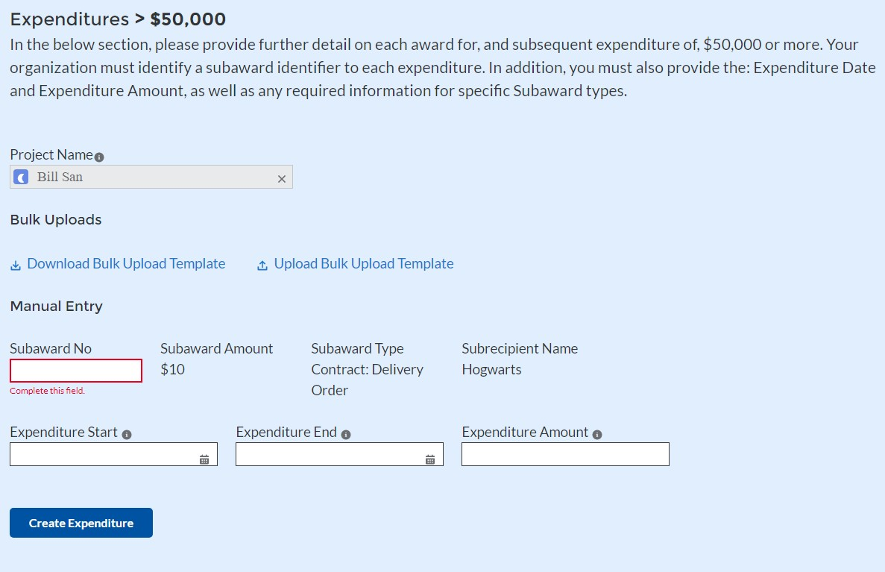
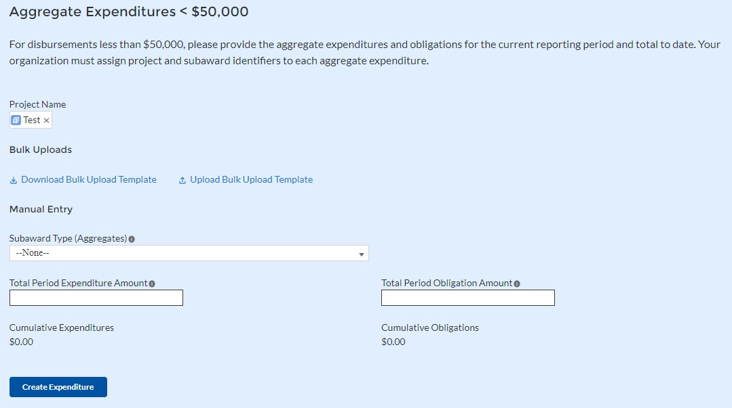
Figure 43 Expenditures >$50,000
Alternatively, the Expenditures for Awards greater than $50,000 bulk upload template (Figure
43) may be used and uploaded with the relevant information.
2. Expenditures Less than $50,000
For expenditures for awards less than $50,000 fill out the “Aggregate Expenditures < $50,000” box (see Figure 44). Once the information has been entered, click the Create Expenditure button on the bottom left of the box. Note the need to manually identify the Project Name as no Subaward is necessary for Aggregate Expenditures less than $50,000.
Figure 44 Aggregated Expenditures <$50,000

Slide 41
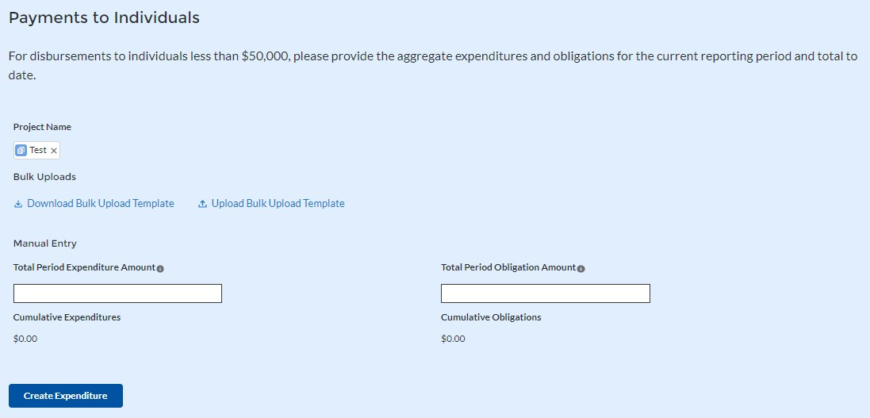
Aggregate subaward types available for selection are as follows.
Aggregate of Contracts Awarded
Aggregate of Grants Awarded
Aggregate of Loans Issued
Aggregate of Transfers
Aggregate of Direct Payments
Alternatively, the Aggregate Expenditures less than $50,000 bulk upload template may be used and uploaded with the relevant information.
3. Payments to Individuals
For disbursements to individuals less than $50,000, recipients should complete the “Payments to Individuals” box (see Figure 45) with expenditure information. Once this information has been entered, click the Create Expenditure button on the bottom left of the box.
Figure 45 Payments to Individuals
Alternatively, the Payments to Individuals bulk upload template (Figure 45) may be used and uploaded with the relevant information. Note the need to manually identify the Project Name as no Subaward is necessary for Payments to Individuals less than $50,000.
Once entries are complete, click the Next button on the bottom right of the page. This will bring recipients to the Report tab.
i) Tax Offset Provision (Only for States and U.S. Territories)
Baseline revenue or revenue-increasing covered charges information are not required at this time. State and U.S territory recipients should provide the amount of revenue-reducing covered changes covering the periods of date of award through July 31, 2021 and separately, August 1, 2021 through December 31, 2021. (See Figure 46).

Slide 42
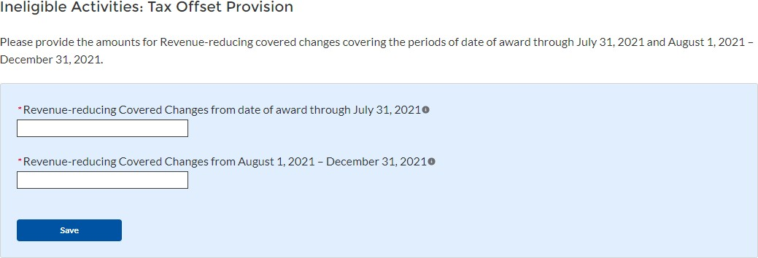
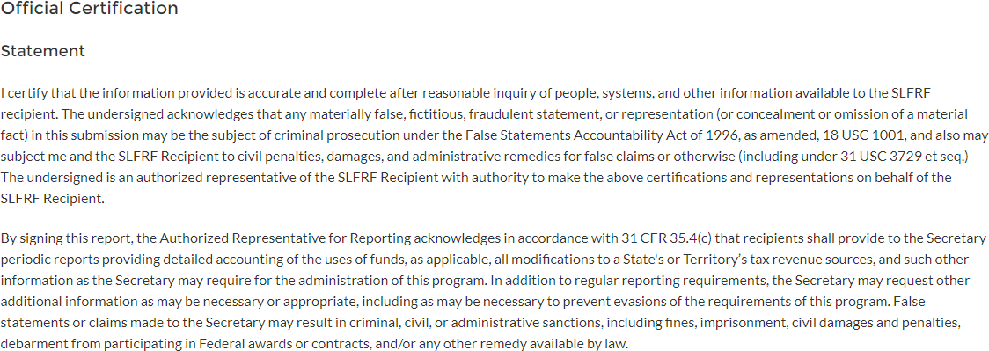
See Section C (11) of the Reporting Guidance for additional information.
Additional guidance will be forthcoming for additional reporting requirements regarding the tax offset provision.
Figure 46 Tax Offset Provision Screen
Official Certification
On this screen, the Authorized Representative for Reporting (ARR) will be asked to certify information pertaining to the Project and Expenditure. By certifying this submission, the ARR is confirming that all reported information is accurate and approved for submission (see Figures 47 and 48).
Users who are not designated as an ARR will not be presented with the screen.
  The ARR’s Name, Title, Telephone Number, and E-Mail Address will be presented on screen for review.
  Allow the Certifying Official to review all prior screens and entries to verify accuracy of the inputted record.
Figure 47 Official Certification

Slide 43
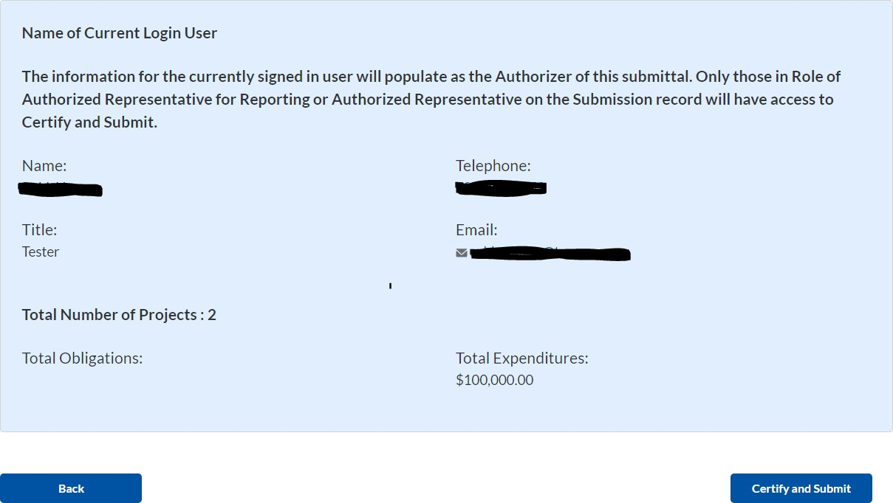
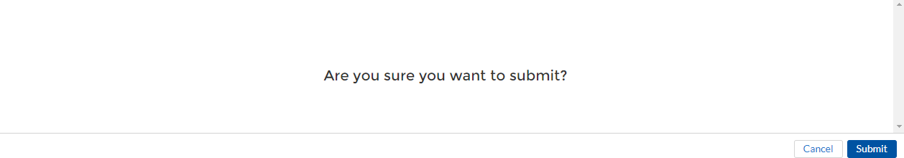
3. Verify information included in Figure 48 and confirm that the values presented are as expected based on the information included or uploaded in previous screens.
Figure 48 Summary of Reported Information
4. When certifying and submitting the report, a confirmation box will appear asking if the recipient is sure it wants to submit (see Figure 49).
Figure 49 Submission Verification

Slide 44
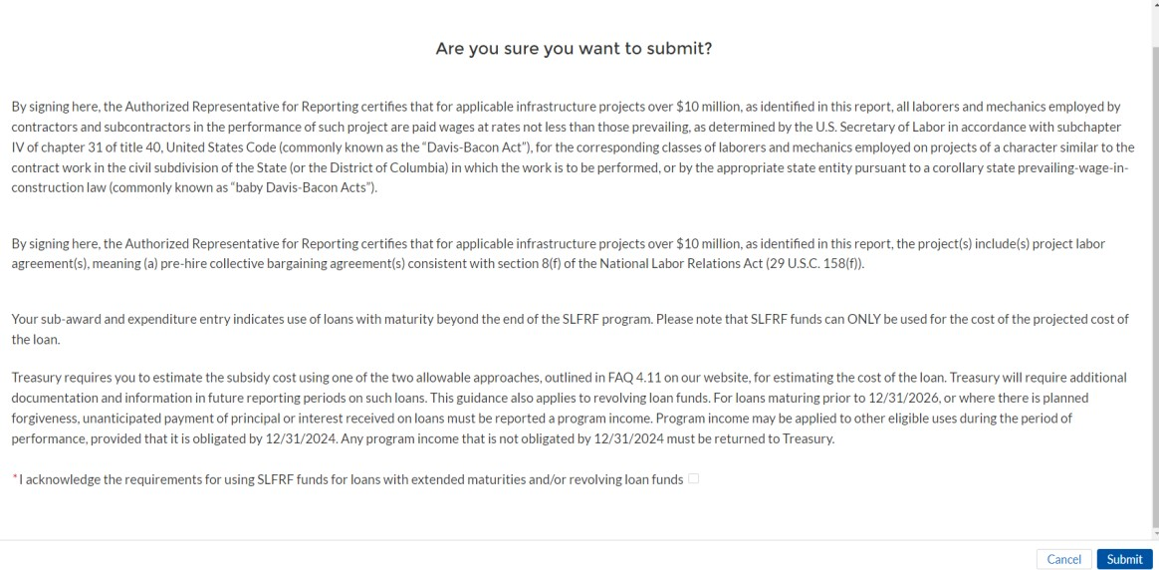
5. A confirmation box may also appear with additional certification language depending on the programmatic data inputs in the user’s report. Figure 50 shows an example of project-dependent certification language.
Figure 50 Submission Verification with additional language
6. Once all of the information is validated, click the Submit button to complete the entry.

Slide 45
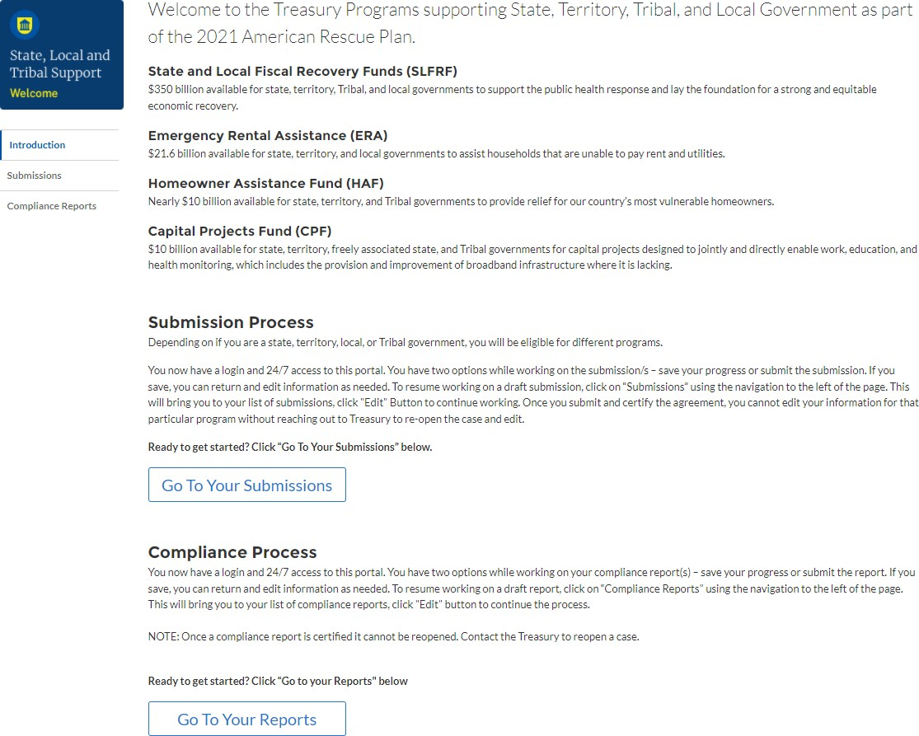
Appendix A – Designating SLFRF Points of Contact by SLFRF Account Administrators
This section provides a brief instruction for SLFRF Account Administrators on accessing
Treasury’s Portal to provide the names and contact information of officials to be designated as
your organization’s points of contact for the SLFRF award(s). The following pages provide step- by-step guidance. See FAQ Section B for commonly asked questions/answers on this topic.
Note- the screens noted below may be subject to change.
Section A: Instructions Step 1
You must be registered in the ID.me or Login.gov system to access Treasury’s Portal. If you have questions about registering in ID.me or Login.gov, please email SLFRP@treasury.gov.
Step 2
Once you are registered in ID.me or Login.gov, click on the link in the email you received
requesting the POC designations. If you do not have the email link, please email us via SLFRP@Treasury.gov and we will provide the link.
Step 3
The link will take you to the Treasury Portal “State, Local, and Tribal Support” landing page as shown below. Once on that page, click on the Go to Your Reports button at the bottom left of the screen, as indicated in by the red box below.
Figure 51 State, Local and Tribal Support Landing Page

Slide 46
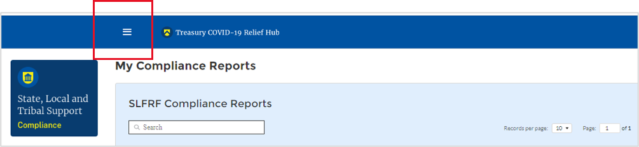


Step 4
The green Go to Your Report button will take you to the Submissions and Compliance page as shown below. Once on that page, click on the three-line navigation icon at the top left of the screen. The red box indicates the icon.
Figure 52 My Compliance Reports
Step 5
After clicking on the three-line navigation icon, a drop-down menu will appear on the top left of
the screen as shown below. Please click on “Account” from the drop-down menu, as shown by the red box below.
Figure 53 Account
Step 6
Next you will see the screen below. Under the “Account Name” heading, click on the name of your organization (as shown by the red box).
Figure 54 Account Name
Step 7
By clicking the name of your organization, Treasury’s portal will open to allow you to provide
names and contact information on your organization’s designees for the SLFRF reports, as shown below. The landing page provides basic information about the designations. Please see section B for more details about the roles and responsibilities for each or the three roles.

Slide 47


Figure 55 Landing Page
Step 8
When you are ready to key in the names of the designated individuals, click on the Certification
button on the left navigation bar, as noted in the red box shown below.
Figure 56 Certification
Step 9
On the “Official Certification of Authorization” screen, you should type in your name to indicate
you are authorized to submit the names of the designated individuals. Once you enter your name, click on the Submit button.

Slide 48



Figure 57 Official Certification of Authorization
Step 10
Next, click on the Designation Form button on the left navigation bar, as noted by the red box shown below.
Figure 58 Designation Form
Step 11
Clicking on the Designation Form button will open the “Designation of Account Administrator, Point of Contact for Reporting, and Authorized Representative for Reporting” screen shown below.
Figure 59 Designation of Account Administrator, Point of Contact of Reporting and Authorized Representative for Reporting

Slide 49
You can use the Designation Form to enter the names and contact information for each of the three designations for each of you SLFRF allocations.
The roles for the SLFRF allocations are displayed as follows:
SLFRF – Account Administrator
SLFRF – Point of Contact for Reporting
SLFRF – Authorized Representative for Reporting
The Designation Form screen shows nine data fields for entering key information about the individual being designated. These include:
Salutation (optional)
First Name
Middle Name (optional)
Last Name
Suffix (optional)
Title
Phone
Email
Name of Entity/Organization (Recipient entity)
Note: The screen will display a list at the bottom of the screen with the names and contact information of individuals (if any) who have previously been designated for any of the three roles. This list will be important in maintaining and updating your organization’s designees in the future.
Designation of the Account Administrator
Remember, we have temporarily authorized you as the SLFRF – Account Administrator. There is no need to re-enter your name and contact information if you plan to continue in that role. If you need to designate someone else as the SLFRF Account Administrator,
  Find your name at the bottom of the screen.
  Hit the blue Edit button located to right of your name.
  Enter the name and contact information of the new SLFRF Account Administrator.
  Hit the blue Complete button.
Designation of Point of Contact for Reporting and Authorized Representative for Reporting
  Enter the next designee’s name and contact information.
  After entering their name and required contact information, select the Program Role(s) for which he/she is being designated.
  Once the role is selected, click on the small arrow to the right of the role, which will move the role to the box on the right.
  Click on the Complete button at the bottom of the screen.
  Follow the same process for each of the remaining designees.
  When you have entered all three designations, please press the Complete button.

Slide 50

As a final step, go to the icon on the upper right of the screen as shown below to exit the system.
Figure 60 Designation Form
Section B: Questions and Answers
Who is authorized to designate the Account Administrator, the Point of Contact for Reporting, and the Authorized Representative for Reporting for my organization’s SLFRF’s award?
Treasury requests that each SLFRF should follow its own decision-making procedures in making the three designations for each award.
What is the deadline for making the designation?
Treasury requests that users of Treasury’s portal make the three designations as soon as possible to enable your organization to submit its Interim Report and Recovery Plan Performance Report (if applicable).
What are the responsibilities for each of the three designated roles?
The required roles are as follows:
Account Administrator for the SLFRF award has the administrative role of maintaining the names and contact information of the designated individuals for SLFRF reporting. The Account Administrator is also responsible for working within your organization to determine its designees for the roles of Point of Contact for Reporting and Authorized Representative for Reporting and providing their names and contact information via
Treasury’s Portal. The Account Administrator can also view and submit reports. Finally, the Account Administrator is responsible for making any changes or updates as needed over the award period. We recommend that the Account Administrator identify an individual to serve in his/her place in the event of staff changes.

Slide 51
Point of Contact for Reporting is the primary contact for receiving official Treasury notifications about reporting on the SLFRF award, including alerts about upcoming reporting, requirements, and deadlines. The Point of Contact for Reporting is responsible for completing the SLFRF reports but cannot certify and submit these reports.
Authorized Representative for Reporting is responsible for certifying and submitting official reports on behalf of the SLFRF award recipient. Treasury will accept reports or other official communications only when submitted by the Authorized Representative for Reporting. The Authorized Representative for Reporting is also responsible for communications with Treasury on such matters as extension requests and amendments of previously submitted reports. The official reports may include special reports, monthly reports, quarterly reports, interim reports, and final reports.
May my organization designate one individual for multiple roles?
Yes, an individual may be designated for multiple roles. For example, the individual designated
as the Account Administrator can also be designated as the Authorized Representative for Reporting or Point of Contact for Reporting. It is also acceptable for an organization to designate one individual for all three roles however it should also adhere to any applicable rules on personnel checks and balances.
May my organization designate more than one individual per role?
Yes, you may designate more than one person per each role but are encouraged to limit the number of users assigned to each role.
May my organization change the designations from time to time?
Yes, an organization may make changes and updates to the list of designation individuals whenever needed.
Must each of the designated individuals register for using Treasury’s Portal?
Yes, everyone designated for any of the roles must register with ID.me or Login.gov before they
will be given access to Treasury’s portal. Please contact us at the email address below for more information and guidance on registering with ID.me or Login.gov. If you are already registered with ID.me, you do not have to register to Login.gov to access your reports.
Additional Questions or Additional Assistance?
If you have additional questions about accessing or using Treasury’s portal to provide the designees’ names and contact information, please send us an email via SLFRP@treasury.gov.

Slide 52
Appendix B – Bulk File Upload Overview
Purpose
This Appendix provides an overview of the SLFRF bulk file upload process. The six (6) bulk file upload templates listed below are presented in the order in which they should be populated and submitted to the SLFRF Treasury Portal. The data requirements for each template can be found in subsequent sections of this Appendix.
  Project Baseline Template (Note: This template will be used for Expenditure Categories 1.1-1.8, 1.10-1.12, 2.6-2.13, 3.6-3.16, 7.1-7.3)
  Subrecipient Template
  Subaward Template
  Expenditures GT $50,000 Template
  Aggregate Expenditures LT $50,000 Template
  Payments to Individuals LT $50,000 Template
Expenditure Category (EC) Templates
Expenditure Categories (EC) which require additional programmatic data and other information are listed below. The reporting requirements for each EC can be found in Appendix D.
Project Baseline Template
Project EC 1.9 Template
Project EC 2.1 - 2.5 Template
Project EC 2.14 Template
Project EC 3.1 - 3.5 Template
Project EC 4.1 - 4.2 Template
Project EC 5 Template
Template Description
c)
Each of the bulk file upload templates contains instructions on how to populate the respective fields within each file. When adding content to each template, please follow the “Help” text, which will provide what is and isn’t permitted for each cell. Each Module in the web application provides a link to download the template. All templates have the same structure as described below:
Row 1: Template Version Row 2: Template Name
Row 3: Instructions: Brief description of the template constraints. Row 4: Field IDs: Column identifiers
Row 5: Required or Optional: This field specifies if the field is optional or required. When the column is required, and a recipient does not provide the required data, the system will not accept any record or allow the file to be uploaded.
Row 6: Field Name: Brief description of each Field or Column

Slide 53

Row 7: Field Help Text: Provides a description of the column. There are 2 types of fields, 1). an open value either text or numbers and 2). A predefined list of pick list values:
Open Value: Any text or number. Text for State name or a Number that represents amounts. Most text types are free formats, the only expectation is for Dates, each column that represents a date describes the accepted
format. For any number field, it is not required to add “,” to represent thousands or it is not required to add “$” to represent currency. Only add decimal “.” when needed.
Pick List: A Predefined list of values that is accepted by the system. When the column is a pick list, row 7 provides the list of options that the system accepts. End users should “copy and paste” the valid value for each record. If the respondent provides a value that is not in the predefined pick list, the
system will not accept the file. Responses should not contain double quotes
Row 8: Data that recipient submits. Row 8 is where recipients insert specific data to submit. The system accepts 1 or many rows.
The following is special guidance for each row or set of rows:
Do not change the content of rows 1 to 7.
Rows 4 to 7 provide metadata of each data element or column of the information that recipients will provide.
Add your data beginning in row 8, column B.
d) Bulk Upload Process
The upload process includes the following steps:
Download the template from the link provided in the web application section of the module.
Open the template in Microsoft Excel.
Add your data starting with row 8, column B of the applicable template. When you finish adding your data for row 8, repeat on additional rows as required.
Save the template as a .CSV file and change the name of the file if needed. Click the Bulk Upload link to open the Bulk Upload box (see Figure 61).
Figure 61 Bulk Upload pop up

Slide 54



Attach your saved .CSV file by clicking on “Upload Files”, alternatively you can drag the file to the designated area.
A message will appear confirming that your file is uploaded (see Figure 62). Click “Done”.
Figure 62 File uploaded message
Your file will be listed at the bottom of the bulk upload window (see Figure 63).
Figure 63 File added to Bulk Upload portal
Click “Validate” to have the system verify that your bulk upload does not have errors.
If the system validation finds errors in your bulk upload, it will return the screen
with the list of the errors (see Figure 64). From here, you can either update on the screen by manually typing in your corrections in the Value column, or you may restart the process with a corrected bulk upload file.
In cases when it may be preferable to work from a master list of errors, click the Download – Export Errors link, highlighted in red box in Figure 62, to download a spreadsheet detailing all errors in the bulk upload file. Once your errors are corrected, click “update”. The system will once again check your upload for errors.
Figure 64 Listing of Bulk Upload Errors

Slide 55

If the system validates that your bulk upload has no errors, it will return the same screen as Figure 63 with instead the option to “Create” (see Figure 65). Click the “Create” button.
Figure 65 Bulk Upload Creation
Once created, your records will show at the bottom of the relevant screen.
e) Bulk Upload Creation Steps
The collective bulk file upload process is contingent upon end-users following the below steps to ensure successful submission.
Note: All data submitted via the bulk upload functionality must be submitted as a .CSV file.
CSV Guidance
Refer to the following link for descriptions of the CSV format.
https://en.wikipedia.org/wiki/Comma-separated_values
Specific CSV characteristics
  The date format is: MM/DD/YYYY. Example: a. 06/22/2021
  All currency values are numeric. It is not required to add “,” for thousand or millions.
  All currency values should not contain a “$” sign. The file will be rejected if a “$” is included in the data entry.
  Once you’ve saved the excel spreadsheet as a .csv file, do not re-open the file. Re- opening the file will cause excel to possible revert to an .xls type file and leading zeros or other issues may occur,
Upload Template Description
Each data element and/or column in the CSV files is described below:
  Index No: Reference number for the data element. For internal use only.
  Defined term: Column Short description.
  Definition: Column long description or definition.

Slide 56
CSV Column Name: The column header name that must be used in the CSV file.
Required: Indicates if the column is required or not required.
List Value: The content of the column is from a list of predefined values. This is valid for some of the columns. The list is provided for all cases. Most of the cases is N/A which means that the type is ether String or Numeric.
Data type: Specify the data type of the column. The options are: Numeric, Text, Date and Pick List.
Max Length: Indicates the maximum length in characters that is allowed for each column.
i) Project Baseline Template
The downloadable templates provide all information required to create the upload files. The following table highlights the data elements required to complete the Project Baseline Template. Expenditure categories not covered by the Project Baseline Template have a devoted template as described in Appendix C.
Defined Term | Definition | Required/ Optional | List Values | Data Type | Max Length
Project Expenditure Category Group | Per guidance, this field represents the predefined project expenditure category | Required | "1-Public Health" "2-Negative Economic Impacts" "3-Services to Disproportionat ely Impacted Communities" "7- Administrative and Other" | Picklist (see permissible values in previous column | n/a
Project Expenditure Category | Per guidance, this field represents and is aligned to the project expenditure category | Required | Refer to “Expenditure Categories covered by the Project Baseline Template” table below | Picklist (see permissible values in previous column | n/a
Project Name | Name of the project. | Required | n/a | String | 150
Project Identification Number (Assigned by recipient) | Identification number assigned to project by recipient. | Required | n/a | Alphanumeric | 20
Status of Completion | Completion status of the project. | Required | "Not started", "Completed less than 50%", "Completed 50% or more", "Completed" | Picklist (see permissible values in previous column | n/a

Slide 57
Defined Term | Definition | Required/ Optional | List Values | Data Type | Max Length
Adopted Budget | Amount of the adopted budget for this project | Required for Tier 1 recipients Optional for other Tier recipients | n/a | Currency | 12,2
Total Obligations | Total dollar value of obligations for this project. | Required | n/a | Currency | 12,2
Total Expenditures | Total dollar value of expenditures for this project. | Required | n/a | Currency | 12,2
Does this project include a capital expenditure? | Does this project include a capital expenditure | Required | Yes No | Picklist (see permissible values in previous column) | n/a
If yes, what is the total expected capital expenditure? | If you answered “yes” to the previous question, enter the total dollar value of the expected capital expenditure | Optional | n/a | Currency | 12,2
Project Description | Brief description of the project. | Required | n/a | String | 1,500
Program Income Earned | The amount of Federal program income earned. | Optional | n/a | Currency | 12,2
Program Income Expended | The amount of program income that was used to cover eligible project costs. | Optional | n/a | Currency | 12,2
Expenditure Categories covered by the Project Baseline Template
1.1 COVID-19 Vaccination
1.2 COVID-19 Testing
1.3 COVID-19 Contact Tracing
1.4 Prevention in Congregate Settings (Nursing Homes, Prisons/Jails, Dense Work Sites, Schools, etc.)
1.5 Personal Protective Equipment
1.6 Medical Expenses (including Alternative Care Facilities)
1.7 Capital Investments or Physical Plant Changes to Public Facilities that respond to the COVID-19 public health emergency
1.8 Other COVID-19 Public Health Expenses (including Communications, Enforcement, Isolation/Quarantine)
1.10 Mental Health Services
1.11 Substance Use Services
1.12 Other Public Health Services

Slide 58
Expenditure Categories covered by the Project Baseline Template
2.6 Unemployment Benefits or Cash Assistance to Unemployed Workers
2.7 Job Training Assistance (e.g., Sectoral job-training, Subsidized Employment, Employment Supports or Incentives)
2.8 Contributions to UI Trust Funds
2.9 Small Business Economic Assistance (General)
2.10 Aid to nonprofit organizations
2.11 Aid to Tourism, Travel, or Hospitality
2.12 Aid to Other Impacted Industries
2.13 Other Economic Support
3.6 Healthy Childhood Environments: Child Care
3.7 Healthy Childhood Environments: Home Visiting
3.8 Healthy Childhood Environments: Services to Foster Youth or Families Involved in Child Welfare System
3.9. Healthy Childhood Environments: Other
3.10 Housing Support: Affordable Housing
3.11 Housing Support: Services for Unhoused persons
3.12 Housing Support: Other Housing Assistance
3.13 Social Determinants of Health: Other
3.14 Social Determinants of Health: Community Health Workers or Benefits Navigators
3.15 Social Determinants of Health: Lead Remediation
3.16 Social Determinants of Health: Community Violence Interventions
7.1 Administrative Expenses
7.2 Evaluation and data analysis
7.3 Transfers to Other Units of Government
j) Subrecipient Template
The downloadable templates provide all information required to create the upload files. The following table highlights the data elements required to complete the Subrecipient Template.
Defined Term | Definition | Required | List Values | Data Type | Max Length
Subrecipient DUNS | The DUNS unique identification number for the Subrecipient Organization. NOTE: Sub-recipients must provide one of the following numbers: -DUNS, or -TIN, or -UEI | Optional | n/a | Numeric | 9
Subrecipient DUNS (+4) | A 4-character suffix that may be assigned by a business concern and appended to its DUNS. | Optional | n/a | String | 4

Slide 59
Defined Term | Definition | Required | List Values | Data Type | Max Length
Subrecipient TIN | The Subrecipient's Internal Revenue Service (IRS) Taxpayer Identification Number NOTE: Sub-recipients must provide one of the following numbers: -DUNS, or -TIN, or -UEI | Optional | n/a | Numeric | 9
Subrecipient UEI | The Sub-recipient's Unique Entity Identifier (UEI) created in SAM.gov. NOTE: Sub-recipients must provide one of the following numbers: -DUNS, or -TIN, or -UEI | Optional | n/a | Numeric | 12
Subrecipient Name | The name of the Subrecipient. | Required | n/a | String | 80
POC Email Address | The email address of the primary point-of-contact for the Subrecipient. | Optional | n/a | String | 40
Address Line 1 | First line of the Subrecipient's address. | Required | n/a | String | 150
Address Line 2 | Second line of the Subrecipient's address. | Optional | n/a | String | 150
Address Line 3 | Third line of the Subrecipient's address. | Optional | n/a | String | 150
City Name | Name of the city in which the Subrecipient is located. | Required | n/a | String | 40
State Code | United States Postal Service (USPS) two-letter abbreviation for the state or territory in which the Subrecipient is located. | Required | (AL, AK, AS, AZ, AR, CA, CO, CT, DE, DC, FM, FL, GA, GU, HI, ID, IL, IN, IA, KS, KY, LA, ME, MH, MD, MA, MI, MN, MS, MO, MT, NE, NV, NH, NJ, NM, NY, NC, ND, MP, OH, OK, OR, PW, PA, PR, RI, SC, SD, TN, | String | 2

Slide 60
Defined Term | Definition | Required | List Values | Data Type | Max Length
 |  |  | TX, UT, VT, VI, VA, WA, WV, WI, WY)
Zip5 | United States ZIP code (five digits) associated with the Subrecipient's address. | Required | n/a | Numeric | 5
Zip4 | Zip Plus4 (four digits) identifying where the predominant performance of the subaward will be accomplished. | Optional | n/a | Numeric | 4
Subrecipient SAM.gov Registration | Confirmation that the Subrecipient is registered in SAM.gov | Required | Yes/No | Picklist (see permissible values in previous column) | n/a
In its preceding fiscal year, did recipient receive 80% or more of its annual gross revenue from federal funds? | Confirmation that the proportion of the Subrecipient's federal funding- to-total annual gross revenue for the preceding fiscal year is at least 80% | Optional | Yes/No | Picklist (see permissible values in previous column) | n/a
In the preceding fiscal year, did recipient receive $25 million or more of its annual gross revenue from federal funds? | Confirmation that the Subrecipient's total annual gross revenue from federal funding across all programs for the preceding fiscal year is greater than $25 million. | Optional | Yes/No | Picklist (see permissible values in previous column) | n/a
Is the "total compensation" for the organization's five highest paid officers publicly listed or otherwise listed in SAM.gov? | Confirmation that qualifying Subrecipient's publicly identify their top five highest compensated executives or have it listed in their SAM.gov profile, if No please provide names and compensation for top 5 executives. | Optional | Yes/No | Picklist (see permissible values in previous column) | n/a
Executive Name (1) | The legal name belonging to one of the five highest paid executives, officers, or employees of the Subrecipient. | Required (If you answered “No” to question in cell Q5) | n/a | String | 100
Total Compensation Executive (1) | The Total Compensation, as defined in 2 CFR part 170.330, earned by the five highest paid executives, officers, or employees of the Subrecipient. | Required (If you answered “No” to question in cell Q5) | n/a | Currency | 12,2
Executive Name (2) | The legal name belonging to one of the five highest paid executives, officers, or employees of the Subrecipient. | Required (If you answered “No” to question in cell Q5) | n/a | String | 100
Total Compensation Executive (2) | The Total Compensation, as defined in 2 CFR part 170.330, earned by the five highest paid executives, officers, or employees of the Subrecipient. | Required (If you answered “No” to question in cell Q5) | n/a | Currency | 12,2

Slide 61
Defined Term | Definition | Required | List Values | Data Type | Max Length
Executive Name (3) | The legal name belonging to one of the five highest paid executives, officers, or employees of the Subrecipient. | Required (If you answered “No” to question in cell Q5) | n/a | String | 100
Total Compensation (3) | The Total Compensation, as defined in 2 CFR part 170.330, earned by the five highest paid executives, officers, or employees of the Subrecipient. | Required (If you answered “No” to question in cell Q5) | n/a | Currency | 12,2
Executive Name (4) | The legal name belonging to one of the five highest paid executives, officers, or employees of the Subrecipient. | Required (If you answered “No” to question in cell Q5) | n/a | String | 100
Total Compensation (4) | The Total Compensation, as defined in 2 CFR part 170.330, earned by the five highest paid executives, officers, or employees of the Subrecipient. | Required (If you answered “No” to question in cell Q5) | n/a | Currency | 12,2
Executive Name (5) | The legal name belonging to one of the five highest paid executives, officers, or employees of the Subrecipient. | Required (If you answered “No” to question in cell Q5) | n/a | String | 100
Total Compensation Executive (5) | The Total Compensation, as defined in 2 CFR part 170.330, earned by the five highest paid executives, officers, or employees of the Subrecipient. | Required (If you answered “No” to question in cell Q5) | n/a | Currency | 12,2
k) Subaward Template
The downloadable templates provide all information required to create the upload files. The following table highlights the data elements required to complete the Subaward Template.
Defined Term | Definition | Required | List Values | Data Type | Max Length
Subrecipient DUNS | The DUNS unique identification number for the Subrecipient Organization. | Optional | n/a | Numeric | 9
Recipient Project Id | Recipient Project ID associated with this Sub Award. This is your unique Project Identification Number. | Required | n/a | Numeric | 20

Slide 62
Defined Term | Definition | Required | List Values | Data Type | Max Length
Subaward No. | Recipient's internal account number for the grant, contract, transfer, or direct payment. This can be the account number, or any other unique identifying number assigned by the Recipient to the award. This number is strictly for the Recipient's recordkeeping. | Required | n/a | String | 20
Subaward Type | The type of Subaward. | Required | "Contract: Purchase Order" "Contract: Delivery Order" "Contract: Blanket Purchase Agreement" "Contract: Definitive Contract" "Grant: Lump Sum Payment(s)" "Grant: Reimbursabl e" "Direct Payment" "Transfer: Lump Sum Payment(s)" "Transfer: Reimbursabl e" "Loan - maturity prior to 12/31/26 with planned forgiveness" "Loan - maturity prior to 12/31/26 without planned forgiveness" "Loan - maturity past 12/31/26 with planned forgiveness" "Loan - maturity past 12/31/26 without planned forgiveness" | Picklist (see permissible values in previous column) | 30
Subaward Amount (Obligation) | Total amount of SLFRF funds obligated by the Recipient to a Subrecipient under a given Subaward. | Required | n/a | Currency | 12,2

Slide 63
Defined Term | Definition | Required | List Values | Data Type | Max Length
Subaward Award Date | The date the Recipient obligated funds to a Subrecipient. | Required | n/a | Date | 8
Primary Sector | Select Primary Sector from picklist. | Required | Refer to Sectors Designated as Essential Critical Infrastructure Sectors table below | Picklist (see permissible values in previous column) | 30
If Other | Explain | Required (If previous question is "Other") | n/a | String | 100
Period of Performance Start | The date on which efforts begin or the Subaward is otherwise effective. | Required | n/a | Date | 8
Period of Performance End | The date on which all effort is completed or the Subaward is otherwise ended. | Required | n/a | Date | 8
Place of Performance Address 1 | First line of the address where the predominant performance of the Subaward will be accomplished. | Required | n/a | String | 120
Place of Performance Address 2 | Second line of the address where the predominant performance of the Subaward will be accomplished. | Optional | n/a | String | 120
Place of Performance Address 3 | Third line of the address where the predominant performance of the Subaward will be accomplished. | Optional | n/a | String | 120
Place of Performance City | The name of the city where the predominant performance of the Subaward will be accomplished. | Required | n/a | String | 40
Place of Performance State Code | United States Postal Service (USPS) two-letter abbreviation for the state or territory indicating where the predominant performance of the Subaward will be accomplished. | Required | (AL, AK, AS, AZ, AR, CA, CO, CT, DE, DC, FM, FL, GA, GU, HI, ID, IL, IN, IA, KS, KY, LA, ME, MH, MD, MA, MI, MN, MS, MO, MT, NE, NV, NH, NJ, NM, NY, NC, ND, MP, OH, OK, OR, PW, PA, PR, RI, SC, SD, TN, TX, UT, | String | 2

Slide 64
Defined Term | Definition | Required | List Values | Data Type | Max Length
 |  |  | VT, VI, VA, WA, WV, WI, WY)
Place of Performance Zip | United States ZIP code (five digits) identifying where the predominant performance of the subaward will be accomplished. | Required | n/a | Numeric | 5
Place of Performance Zip4 | United States ZIP code (four digits) identifying where the predominant performance of the Subaward will be accomplished. | Optional | n/a | Numeric | 4
Purpose of Funds | Recipients must submit a written justification to Treasury describing how the premium pay or grant is responsive to workers performing essential work during the public health emergency unless the worker or groups of workers receiving premium pay meet one of two criteria: (1) the eligible worker(s) receiving premium pay earn (with the premium included) below 150 percent of their residing state or county’s average annual wage for all occupations, as defined by the Bureau of Labor Statistics Occupational Employment and Wage Statistics; or (2) the eligible worker(s) receiving premium pay is not exempt from the Fair Labor Standards Act overtime provisions. | Required | n/a | Sting | 3000
Subaward Description | A description of the overall purpose and expected outputs and outcomes or results of the funded subaward, including significant deliverables and, if appropriate, associated units of measure. The purpose and outcomes or results should be stated in terms that allow an understanding that the subaward constitutes an eligible use of funds. | Required | n/a | String | 750
Sectors Designated as Essential Critical Infrastructure Sectors
Any work performed by an employee of a State, local, or Tribal government;
Behavioral health work;
Biomedical Research;
Dental care work;
Educational work, school nutrition work, and other work required to operate a school facility;
Election’s work;
Emergency response;

Slide 65
Sectors Designated as Essential Critical Infrastructure Sectors
Family or childcare;
Grocery stores, restaurants, food production, and food delivery
Health care;
Home- and community-based health care or assistance with activities of daily living;
Laundry work;
Maintenance work;
Medical testing and diagnostics;
Pharmacy;
Public health work;
Sanitation, disinfection, and cleaning work;
Social services work;
Solid waste or hazardous materials management, response, and cleanup work;
Transportation and warehousing;
Vital services to Tribes;
Work at hotel and commercial lodging facilities that are used for COVID-19 mitigation and containment;
Work in a mortuary;
Work in critical clinical research, development, and testing necessary for COVID-19 response.
Work requiring physical interaction with patients;
Other
l) Expenditures GT $50,000 Template
The downloadable templates provide all information required to create the upload files. The
following table highlights the data elements required to complete the Expenditures GT $50,000 Template.
Defined Term | Definition | Required | List Values | Data Type | Max Length
Subaward Number | Subaward number that allows the Recipient to associate Expenditure records to Subaward records. Enter Subaward Number. Subaward Number is not required if Expenditure Category is "Administrative Cost". | Required | n/a | Numeric | 20
Expenditure Start Date | Start date for the range of time when the expenditure(s) occurred. | Required | n/a | Date | 8
Expenditure End Date | End date for the range of time when the expenditure(s) occurred | Required | n/a | Date | 8

Slide 66
Defined Term | Definition | Required | List Values | Data Type | Max Length
Expenditure Amount | Total amount of SLFRF dollars on the Subaward. | Required | n/a | Currency | 12,2
m) Aggregate Expenditures LT $50,000 Template
The downloadable templates provide all information required to create the upload files. The
following table highlights the data elements required to complete the Aggregate Expenditures LT $50,000 Template.
Defined Term | Definition | Required | List Values | Data Type | Max Length
Recipient Project Id | Recipient Project ID that allows the Recipient to associate Expenditure records to Project records. | Required | n/a | Numeric | 20
Subaward Type Aggregates SLFRF | The Subaward Type that had obligation or expenditure/payment activity during the reporting period. | Required | "Aggregate of Contracts Awarded " "Aggregate of Grants Awarded " "Aggregate of Loans Issued " "Aggregate of Transfers " "Aggregate of Direct Payments " | Picklist (see permissible values in previous column) | 100
Total Period Expenditure Amount (Aggregates) | Sum of Expenditures or Payments during the most recent period for this Sub- Award Type (Aggregates). | Required | n/a | Currency | 12,2
Total Period Obligation Amount (Aggregates) | Sum of sub-award amounts/obligations during the most recent period for this Sub-Award Type (Aggregates). | Required | n/a | Currency | 12,2
n) Payments to Individuals LT $50,000 Template
The downloadable templates provide all information required to create the upload files. The following table highlights the data elements required to complete the Payments to Individuals LT
$50,000 Template.
Defined Term | Definition | Required | List Values | Data Type | Max Length
Recipient Project Id | Recipient Project ID that allows the Recipient to associate Expenditure records to Project records. | Required | n/a | Numeric | 20

Slide 67
Defined Term | Definition | Required | List Values | Data Type | Max Length
Sub Award Type Aggregates SLFRF | The Sub-Award Type that had obligation or expenditure/payment activity during the reporting period. | Required | "Aggregate of Contracts Awarded" "Aggregate of Grants Awarded" "Aggregate of Loans Issued" "Aggregate of Transfers" "Aggregate of Direct Payments" | Picklist | n/a
Total Period Expenditure Amount (Aggregates) | Sum of Expenditures or Payments during the most recent period for this Sub- Award Type (Aggregates). | Required | n/a | Currency | 12,2
Total Period Obligation Amount (Aggregates) | Sum of sub-award amounts/obligations during the most recent period for this Sub-Award Type (Aggregates). | Required | n/a | Currency | 12,2

Slide 68
Appendix C – Expenditure Categories and Template Mapping
The Expenditure Categories (EC) listed below must be used to categorize each project as noted in the Reporting Guidance. The term “Expenditure Category” refers to the detailed level (e.g., 1.1 COVID-10 Vaccination). When referred to at the summary level (e.g., EC 1) it includes all Expenditure Categories within that summary level.
For the table below, the following legend applies.
* Denotes areas where recipients should note if the project includes a capital expenditure
The Programmatic Data column indicates which Expenditure Categories have associated programmatic data, in addition to the project standard information. More information on each EC’s programmatic data is contained in Appendix C and in the Reporting Guidance.
Category |  | Programmatic Data? | Bulk Upload Template
1 Expenditure Category: Public Health
1.1 | COVID-19 Vaccination * | No | Project Baseline Template
1.2 | COVID-19 Testing * | No | Project Baseline Template
1.3 | COVID-19 Contact Tracing* | No | Project Baseline Template
1.4 | Prevention in Congregate Settings (Nursing Homes, Prisons/Jails, Dense Work Sites, Schools, etc.) * | No | Project Baseline Template
1.5 | Personal Protective Equipment* | No | Project Baseline Template
1.6 | Medical Expenses (including Alternative Care Facilities) * | No | Project Baseline Template
1.7 | Capital Investments or Physical Plant Changes to Public Facilities that respond to the COVID-19 public health emergency* | No | Project Baseline Template
1.8 | Other COVID-19 Public Health Expenses (including Communications, Enforcement, Isolation/Quarantine) * | No | Project Baseline Template
1.9 | Payroll Costs for Public Health, Safety, and Other Public Sector Staff Responding to COVID-19* | Yes | Project EC 1.9 Template
1.10 | Mental Health Services* | No | Project Baseline Template
1.11 | Substance Use Services* | No | Project Baseline Template
1.12 | Other Public Health Services* | No | Project Baseline Template
2 Expenditure Category: Negative Economic Impacts
2.1 | Household Assistance: Food Programs * | Yes | Project EC 2.1 – 2.5 Template
2.2 | Household Assistance: Rent, Mortgage, and Utility Aid * | Yes | Project EC 2.1 – 2.5 Template
2.3 | Household Assistance: Cash Transfers * | Yes | Project EC 2.1 – 2.5 Template
2.4 | Household Assistance: Internet Access Programs * | Yes | Project EC 2.1 – 2.5 Template
2.5 | Household Assistance: Eviction Prevention * | Yes | Project EC 2.1 – 2.5 Template

Slide 69
Category |  | Programmatic Data? | Bulk Upload Template
2.6 | Unemployment Benefits or Cash Assistance to Unemployed Workers * | No | Project Baseline Template
2.7 | Job Training Assistance (e.g., Sectoral job-training, Subsidized Employment, Employment Supports or Incentives) * | No | Project Baseline Template
2.8 | Contributions to UI Trust Funds | No | Project Baseline Template
2.9 | Small Business Economic Assistance (General) * | No | Project Baseline Template
2.10 | Aid to nonprofit organizations * | No | Project Baseline Template
2.11 | Aid to Tourism, Travel, or Hospitality* | No | Project Baseline Template
2.12 | Aid to Other Impacted Industries* | No | Project Baseline Template
2.13 | Other Economic Support * | No | Project Baseline Template
2.14 | Rehiring Public Sector Staff* | Yes | Project EC 2.14 Template
3 Expenditure Category: Services to Disproportionately Impacted Communities
3.1 | Education Assistance: Early Learning * | Yes | Project EC 3.1 – 3.5 Template
3.2 | Education Assistance: Aid to High- Poverty Districts * | Yes | Project EC 3.1 – 3.5 Template
3.3 | Education Assistance: Academic Services * | Yes | Project EC 3.1 – 3.5 Template
3.4 | Education Assistance: Social, Emotional, and Mental Health Services * | Yes | Project EC 3.1 – 3.5 Template
3.5 | Education Assistance: Other * | Yes | Project EC 3.1 – 3.5 Template
3.6 | Healthy Childhood Environments: Child Care * | No | Project Baseline Template
3.7 | Healthy Childhood Environments: Home Visiting * | No | Project Baseline Template
3.8 | Healthy Childhood Environments: Services to Foster Youth or Families Involved in Child Welfare System * | No | Project Baseline Template
3.9. | Healthy Childhood Environments: Other * | No | Project Baseline Template
3.10 | Housing Support: Affordable Housing * | No | Project Baseline Template
3.11 | Housing Support: Services for Unhoused persons * | No | Project Baseline Template
3.12 | Housing Support: Other Housing Assistance * | No | Project Baseline Template
3.13 | Social Determinants of Health: Other * | No | Project Baseline Template
3.14 | Social Determinants of Health: Community Health Workers or Benefits Navigators * | No | Project Baseline Template
3.15 | Social Determinants of Health: Lead Remediation * | No | Project Baseline Template
3.16 | Social Determinants of Health: Community Violence Interventions * | No | Project Baseline Template
4 Expenditure Category: Premium Pay
4.1 | Public Sector Employees | Yes | Project EC 4.1 – 4.2 Template
4.2 | Private Sector: Grants to other employers | Yes | Project EC 4.1 – 4.2 Template
5 Expenditure Category: Infrastructure

Slide 70
Category |  | Programmatic Data? | Bulk Upload Template
5.1 | Clean Water: Centralized wastewater treatment | Yes | Project EC 5 Template
5.2 | Clean Water: Centralized wastewater collection and conveyance | Yes | Project EC 5 Template
5.3 | Clean Water: Decentralized wastewater | Yes | Project EC 5 Template
5.4 | Clean Water: Combined sewer overflows | Yes | Project EC 5 Template
5.5 | Clean Water: Other sewer infrastructure | Yes | Project EC 5 Template
5.6 | Clean Water: Stormwater | Yes | Project EC 5 Template
5.7 | Clean Water: Energy conservation | Yes | Project EC 5 Template
5.8 | Clean Water: Water conservation | Yes | Project EC 5 Template
5.9 | Clean Water: Nonpoint source | Yes | Project EC 5 Template
5.10 | Drinking water: Treatment | Yes | Project EC 5 Template
5.11 | Drinking water: Transmission & distribution | Yes | Project EC 5 Template
5.12 | Drinking water: Transmission & distribution: lead remediation | Yes | Project EC 5 Template
5.13 | Drinking water: Source | Yes | Project EC 5 Template
5.14 | Drinking water: Storage | Yes | Project EC 5 Template
5.15 | Drinking water: Other water infrastructure | Yes | Project EC 5 Template
5.16 | Broadband: “Last Mile” projects | Yes | Project EC 5 Template
5.17 | Broadband: Other projects | Yes | Project EC 5 Template
6 Expenditure Category: Revenue Replacement
6.1 | Provision of Government Services | N/A | Revenue Replacement Module
7 Administrative and Other
7.1 | Administrative Expenses | No | Project Baseline Template
7.2 | Evaluation and data analysis | No | Project Baseline Template
7.3 | Transfers to Other Units of Government | No | Project Baseline Template

Slide 71
Appendix D – SLFRF Expenditure Category Programmatic Data and Other Information
The downloadable templates contain information required to create the upload files to include required/optional fields, help text, and permissible data types.
The following table highlights the standard data elements required for the Project Bulk Upload for Baseline Projects.
Project Bulk Upload for Project Baseline Template Table
Defined Term | Definition | Required or Optional | List Values | Data Type | Max Length
Project Expenditure Category Group | Expenditure category | Required | Select from Project EC Group Pick List [1,2,3, and 7] | Pick List | n/a
Project Expenditure Category | Sub-Category | Required | Select from Project EC Pick List [1,2,3, and 7] | Pick List | n/a
Project Name | Official name of the project | Required | n/a | String | 150
Recipient Project ID | Identification number assigned to project by recipient | Required | n/a | Alpha Numeric | 20
Status of Completion | Completion status of the project | Required | "Not started", "Completed less than 50%", "Completed 50% or more", "Completed" | Pick List | n/a
Adopted Budget | Amount of the adopted budget for the project | Required for Tier 1 recipients Optional for other Tier recipients | n/a | Currency | 12,2
Total Obligations | The total dollar value of obligations for this project | Required | n/a | Currency | 12,2
Total Expenditures | The total dollar value of expenditures for this project | Required | n/a | Currency | 12,2
Does this project include a capital expenditure? | Does this project include a capital expenditure | Required | Yes No | Picklist (see permissible values in previous column) | n/a
If yes, what is the total expected capital expenditure? | If you answered “yes” to the previous question, enter the total dollar value of the expected capital expenditure | Optional | n/a | Currency | 12,2
Project Description | Description of Project | Required | n/a | String | 1,500
Program Income Earned | The amount of Federal program income earned. | Optional | n/a | Currency | 12,2

Slide 72
Defined Term | Definition | Required or Optional | List Values | Data Type | Max Length
Program Income Expended | The amount of program income that was used to cover eligible project costs. | Optional | n/a | Currency | 12,2
EC 1.1 – 1.8
There is no additional programmatic data required for the following EC:
EC 1.1 COVID-19 Vaccination
EC 1.2 COVID-19 Testing
EC 1.3 Contact Tracing
EC 1.4 Prevention in Congregate Settings (Nursing Homes, Prisons/Jails, Dense Work Sites, Schools, etc.)
EC 1.5 Personal Protective Equipment
EC 1.6 Medical Expenses (including Alternative Care Facilities)
EC 1.7 Capital Investments of Physical Plant Chances to Public Facilities that respond to the COVID-19 public health emergency
EC 1.8. Other COVID-19 Public Health Expenses (including Communications, Enforcement, Isolation/Quarantine)
EC 1.9 (Payroll Costs for Public Health, Safety, and Other Public Sector Staff Resp)
There are additional programmatic data required for EC 1.9. that can be provided via bulk upload file or manual entry. The Project Template EC 1.9 contains fields required to create the upload files and includes required/optional fields, help text, and permissible data types for EC
1.9 Public Health: Payroll Costs for Public Health, Safety, and Other Public Sector Staff Responding to COVID-19.
In addition to the project base information noted in the Project Bulk Upload for Base Projects table above, additional data to provide is as follows:
Defined Term | Definition | Required or Optional | List Values | Data Type | Max Length
Payroll for Public Health and Safety Employees | Number of government FTE responding to COVID-19 supported under this authority | Required | n/a | Numeric | 6
EC 1.10 – 1.12
There is no additional programmatic data required for the following EC:
EC 1.10 Mental Health Services.
EC 1.11 (Substance Use Services)

Slide 73
EC 1.12 (Other Public Health Services)
EC 2.1–2.5 (Household Assistance)
There are additional programmatic data required for EC 2.1 – 2.5 that can be provided via bulk upload file or manual entry. Project Template EC 2.1 – 2.5 contains fields required to create the upload files and include required/optional fields, help text, and permissible data types for the following categories under EC 2 Negative Economic Impacts:
2.1-Household Assistance: Food Programs
2.2-Household Assistance: Rent, Mortgage, and Utility Aid
2.3-Household Assistance: Cash Transfers
2.4-Household Assistance: Internet Access Programs
2.5-Household Assistance: Eviction Prevention
In addition to the project base information noted in the Project Bulk Upload for Base Projects table above, additional data to provide is as follows:
Defined Term | Definition | Required or Optional | List Values | Data Type | Max Length
Structure and objectives of assistance program(s) | Brief description of structure and objectives of assistance program(s) (e.g., nutrition assistance for low-income households) | Required | n/a | String | 500
Number of households served | Number of households served (by program if recipient establishes multiple separate household assistance programs) | Required | n/a | Numeric | 6
Brief description of recipient’s approach | Brief description of recipient’s approach to ensuring that aid to households responds to a negative economic impact of Covid-19, as described in the final rule. | Required | n/a | String | 500
EC 2.6 – 2.13
There is no additional programmatic data required for the following EC:
EC 2.6 Unemployment Benefits or Cash Assistance to Unemployed Workers.
EC 2.7 Job Training Assistance (e.g., Sectoral job-training, Subsidized Employment, Employment Supports or Incentives).

Slide 74
EC 2.8 Contributions to UI Trust Funds.
EC 2.9 Small Business Economic Assistance (General)
EC 2.10 Aid to nonprofit organizations
EC 2.11 Aid to Tourism, Travel, or Hospitality
EC 2.12 Aid to Other Impacted Industries
EC 2.13 Other Economic Support
EC 2.14 (Rehiring Public Sector Staff)
There is additional programmatic data required for EC 2.14 that can be provided via bulk upload file or manual entry. Project Template EC 2.14 contains fields required to create the upload files and includes required/optional fields, help text, and permissible data types for the Expenditure Category EC 2 Negative Impacts: 2.14 Rehiring Public Sector Staff.
In addition to the project base information noted in the Project Bulk Upload for Base Projects table above, additional data to provide is as follows:
Defined Term | Definition | Required or Optional | List Values | Data Type | Max Length
Number of FTEs rehired by governments under this authority | Number of FTEs rehired by governments under this authority | Required | n/a | Numeric | 6
EC 3.1–3.5 (Services to Disproportionately Impacted Communities)
There is additional programmatic data required for EC 3.1 – 3.5 that can be provided via bulk upload file or manual entry. Project Template EC 3.1 – 3.5 contains fields required to create the upload files and includes required/optional fields, help text, and permissible data types for the following categories under EC 3 Services to Disproportionately Impacted Communities:
3.1-Education Assistance: Early Learning
3.2-Education Assistance: Aid to High-Poverty Districts
3.3-Education Assistance: Academic Services
3.4-Education Assistance: Social, Emotional, and Mental Health Services
3.5-Education Assistance: Other
In addition to the project base information noted in the Project Bulk Upload for Base Projects table above, additional data to provide is as follows:
Defined Term | Definition | Required or Optional | List Values | Data Type | Max Length
NCES School ID or NCES District ID | The National Center for Education Statistics (“NCES”) School ID or NCES District | Required | n/a | Numeric | 750

Slide 75
Defined Term | Definition | Required or Optional | List Values | Data Type | Max Length
 | ID. Separate IDs with commas for multiple entries.
Policy Information
When providing the National Center for Education Statistics (“NCES”) School ID or NCES District ID, please list the School District if all schools within the school district received some funds. If not all schools within the school district received funds, please list the School ID of the schools that received funds. These can allow evaluators to link data from the NCES to look at school-level demographics and, eventually, student performance. For more information on NCES identification numbers see https://nces.ed.gov/ccd/districtsearch/ (districts) and https://nces.ed.gov/ccd/schoolsearch/ (schools).
EC 3.6 – 3.16
There is no additional programmatic data required for the following ECs:
EC 3.6 Healthy Childhood Environments: Child Care.
EC 3.7 Healthy Childhood Environments: Home Visiting
EC 3.8 Healthy Childhood Environments: Services to Foster Youth or Families Involved in Child Welfare System
EC 3.9 Healthy Childhood Environments: Other
programmatic data required for EC 3.10 Housing Support: Affordable Housing
EC 3.11 Housing Support: Services for Unhoused Persons
EC 3.12 Housing Support: Other Housing Assistance
EC 3.13 Social Determinants of Health: Other
EC 3.14 Social Determinants of Health: Community Health Workers or Benefits Navigators
EC 3.15 Social Determinants of Health: Lead Remediation
EC 3.16 Community Violence Interventions.
EC 4.1–4.2 (Premium Pay)
There is additional programmatic data required for EC 4.1 – 4.2 that can be provided via bulk upload file or manual entry. Project Template EC 4.1 – 4.2 contains fields required to create the upload files and includes required/optional fields, help text, and permissible data types for the categories under EC 4 Premium Pay:
EC 4.1 Public Sector Employees
EC 4.2 Private Sector: Grants to other employers
In addition to the project base information noted in the Project Bulk Upload for Base Projects table above, additional data to provide is as follows:

Slide 76
Defined Term | Definition | Required or Optional | List Values | Data Type | Max Length
Sectors designated as essential critical infrastructure sectors | List of sectors designated as essential critical infrastructure sector | Required | Valid entries for Sectors designated as essential critical infrastructure sectors. (See Appendix E) | String | 1500
Number of workers to be served | Number of workers to be served | Required | n/a | Numeric | 7
Premium Pay Narrative | For groups of workers that do not meet one of the two criteria below, submit a written justification to Treasury describing how the premium pay or grant is responsive to workers performing essential work during the public health emergency unless the worker or groups of workers receiving premium pay meet one of two criteria: (1) the eligible worker(s) receiving premium pay earn (with the premium included) below 150 percent of their residing state or county’s average annual wage for all occupations, as defined by the Bureau of Labor Statistics Occupational Employment and Wage Statistics; or (2) the eligible worker(s) receiving premium pay is not exempt from the Fair Labor Standards Act overtime provisions. | Required | n/a | String | 3000

Slide 77
In addition, please see Section IV.d.1 Step 5 and Appendix E for additional information needed on sub-awards supporting projects in these Expenditure Categories.
Note-
Recipients that are either creating or supporting a Premium Pay program may only provide premium pay to eligible workers, e.g., workers needed to maintain continuity of operations of essential critical infrastructure sectors (see sector list for additional details), for essential work, e.g., work that is not performed while teleworking from a residence; and involves either: regular, in-person interactions with patients, the public, or coworkers of the individual that is performing the work; or
regular physical handling of items that were handled by, or are to be handled by, patients, the public, or coworkers of the individual that is performing the work.
EC 5.1–5.17 (Infrastructure)
There is additional programmatic data required for EC 5.1 – 5.17 that can be provided via bulk upload file or manual entry. There is also additional programmatic data required for all projects that can only be entered via manual entry. Project Template EC 5 contains fields required to create the upload files and includes required/optional fields, help text, and permissible data types for all subcategories under Expenditure Category EC 5 Infrastructure:
5.1-Clean Water: Centralized wastewater treatment
5.2-Clean Water: Centralized wastewater collection and conveyance
5.3-Clean Water: Decentralized wastewater
5.4-Clean Water: Combined sewer overflows
5.5-Clean Water: Other sewer infrastructure
5.6-Clean Water: Stormwater
5.7-Clean Water: Energy conservation
5.8-Clean Water: Water conservation
5.9-Clean Water: Nonpoint source
5.10-Drinking water: Treatment
5.11-Drinking water: Transmission & distribution
5.12-Drinking water: Transmission & distribution: lead remediation
5.13-Drinking water: Source
5.14-Drinking water: Storage
5.15-Drinking water: Other water infrastructure
5.16-Broadband: “Last Mile” projects
5.17-Broadband: Other projects
In addition to the project base information noted in the Project Bulk Upload for Base Projects table above, additional data to provide is as follows:

Slide 78
Defined Term | Definition | Required or Optional | List Values | Data Type | Max Length
Projected/actual construction start date | Projected/actual construction start date | Optional REQUIRED if the project has started. NOT REQUIRED if you selected "Not Started" for the "Status to Completion" question. | n/a | Date | 10
Projected/actual initiation of operations date | Projected/actual initiation of operations date | Optional REQUIRED if the project has started. NOT REQUIRED if you selected "Not Started" for the "Status to Completion" question. | n/a | Date | 10
Location Type | Location (for broadband, geospatial location data) | REQUIRED if the project has started. NOT REQUIRED if you selected "Not Started" for the "Status to Completion" question. | - Latitude/longitud e (WGS84 or NAD83 geographic coordinate system) -Address -Address Range -Road Segment | Picklist | n/a
After the bulk upload of EC 5 infrastructure project information, manual entry of additional programmatic data will be required in Treasury’s Portal.
Additional manual entry for all infrastructure projects
  Location
  For projects over $10 million in expected total cost
    Complete Davis-Bacon certification or provide the following:
      Number of employees of contractors and sub-contractors working on the project (number)
      Number of employees on the project hired directly (number)
      Number of employees on the project hired through a third party (number)
      Wages and benefits of workers on the project by classification (rich text field)
      Are any of the wages at rates less than those prevailing? (Y/N)
    Complete certification for labor agreements or provide the following:

Slide 79
How will the recipient ensure the project has ready access to a sufficient supply of appropriately skilled and unskilled labor to ensure high-quality construction throughout the life of the project, including a description of any required professional certifications and/or in-house training? (text box)
How will the recipient minimize risks of labor disputes and disruptions that would jeopardize timeliness and cost- effectiveness of the project? (text box)
How will the recipient provide a safe and healthy workplace that avoids delays and costs associated with workplace illnesses, injuries, and fatalities, including descriptions of safety training, certification, and/or licensure requirements for all relevant workers (e.g., OSHA 10, OSHA 30);”? (text box)
Will workers on the project receive wages and benefits that will secure an appropriately skilled workforce in the context of the local and regional labor market? (Y/N)
Does the project have a completed project labor agreement? (Y/N)
Respond to the question, Does the project prioritize local hires? (Y/N)
Respond to the question, Does the project have a Community Benefit Agreement, with a description of any such agreement? (Y/N)
Additional manual entry for Projects in the Water and Sewer Infrastructure Expenditure Categories (5.1 – 5.15):
National Pollutant Discharge Elimination System (NPDES) Permit Number (if applicable; for projects aligned with the Clean Water State Revolving Fund) Public Water System (PWS) ID number (if applicable; for projects aligned with the Drinking Water State Revolving Fund)
Note- Please provide the NPDES Permit Number or Public Water System (PWS) ID number for projects on systems with such permit/ID numbers. Otherwise, please leave this field blank. Providing this information allows Treasury to connect your reporting data to existing information about the systems.
Additional manual entry for Broadband Projects Expenditure Categories (5.16 – 5.17):
Project is designed to, upon completion, reliably meet or exceed symmetrical 100 Mbps download and upload speeds.
If the project is not designed to reliably meet or exceed symmetrical 100 Mbps download and upload speeds, explain why not,
Confirm that the project is designed to, upon completion, meet or exceed
symmetrical 100 Mbps download speed and between at least 20 Mbps and 100 Mbps upload speed, and be scalable to a minimum of 100 Mbps download speed and 100 Mbps upload speed.
EC 6.1 (Provision of Government Services)

Slide 80
There is no additional programmatic data required for EC 6.1 and there is no bulk upload template option.
In addition, note that obligations and expenditures reported under EC 6.1 Revenue Replacement do not need to have subrecipients, subawards, or expenditures separately reported. If the only project created is for EC 6.1 Revenue Replacement, the following sections will be greyed out: Subrecipient module, Subaward Module, Expenditure Module
EC 7.1 – 7.3
There is no additional programmatic data required for the following ECs:
EC 7.1 Administrative Expenses
EC 7.2 Evaluation and Data Analysis.
EC 7.3 Transfers to Other Units of Government.
EC 7.4 Transfers to Non-entitlement Units (States and Territories only)
Do not enter projects under EC 7.4 (Transfers to Non-entitlement Units (States and Territories only). This information will be collected as part of NEU and Non-UGLG information. Please reference NEU User Guide.

Slide 81
Appendix E – List of Sectors
When entering information for project subawards, selection of a Primary Sector is required for subawards tied to projects in Expenditure Categories:
4.1 Premium Pay: Public Sector Employees; and
4.2 Premium Pay: Private Sector: Grants to other employers.
A primary sector is defined as the sector targeted by the work performed under the sub-award. It is not required for other expenditure categories. The table below lists primary sectors available in the system for selection. If the primary sector is not listed, select “Other” and clarify in the manual entry box.
Sectors Designated as Essential Critical Infrastructure Sectors
Any work performed by an employee of a State, local, or Tribal government;
Behavioral health work;
Biomedical Research;
Dental care work;
Educational work, school nutrition work, and other work required to operate a school facility;
Elections work;
Emergency response;
Family or childcare;
Grocery stores, restaurants, food production, and food delivery
Health care;
Home- and community-based health care or assistance with activities of daily living;
Laundry work;
Maintenance work;
Medical testing and diagnostics;
Pharmacy;
Public health work;
Sanitation, disinfection, and cleaning work;
Social services work;
Solid waste or hazardous materials management, response, and cleanup work;
Transportation and warehousing;
Vital services to Tribes;
Work at hotel and commercial lodging facilities that are used for COVID-19 mitigation and containment;
Work in a mortuary;
Work in critical clinical research, development, and testing necessary for COVID-19 response.
Work requiring physical interaction with patients;
Other

Slide 82
Appendix F – Frequently Asked Questions
These questions are aligned to section 9 of the main FAQs and included in Section IV of the
User Guide: Treasury’s Portal for Recipient Reporting. However, please note that the list of FAQs has been reordered.
  What records must be kept by governments receiving funds?
Financial records and supporting documents related to the award must be retained for a period of five years after all funds have been expended or returned to Treasury, whichever is later. This includes those which demonstrate the award funds were used
for eligible purposes in accordance with the ARPA, Treasury’s regulations implementing those sections, and Treasury’s guidance on eligible uses of funds.
  What reporting will be required, and when will the first report be due?⁷
Recipients will be required to submit an interim report, project and expenditure reports, and annual Recovery Plan Performance Reports as specified below, regarding their utilization of Coronavirus State and Local Fiscal Recovery Funds.
Interim reports: States (defined to include the District of Columbia), territories, metropolitan cities, counties, and Tribal governments will be required to submit one interim report. The interim report will include a recipient’s expenditures by category at
the summary level and for states, information related to distributions to non-entitlement
units of local government must also be included in the interim report. The interim report covered activity from the date of award to July 31, 2021 and were due to Treasury by August 31, 2021 or 60 days after receiving funding if funding was received by October 15, 2021. Non-entitlement units of local government were not required to submit an interim report.
Project and Expenditure reports: State (defined to include the District of Columbia), territorial, metropolitan city, county, and Tribal governments will be required to submit project and expenditure reports. This report will include financial data, information on contracts and subawards over $50,000, types of projects funded, and other information regarding a recipient’s utilization of award funds.
Reports will be required quarterly for the following recipients:
    States and territories
    Metropolitan cities and counties with population over 250,000
    Metropolitan cities and counties with population less than 250,000 that received an award of more than $10 million
    Tribal governments that received an award of more than $30 million.
The initial project and expenditure report for quarterly recipients will be due January 31, 2022 and will cover the period of March 3, 2021 to December 31, 2021. The subsequent quarterly reports will cover one calendar quarter and must be submitted to Treasury within 30 days after the end of each calendar quarter.
Reports will be required annually for the following recipients:
⁷ This question was updated on November 15, 2021

Slide 83
Metropolitan cities and counties with population less than 250,000 that received an award less than $10 million,
Tribal governments that received an award less than $30 million
Non-entitlement units of government
The initial project and expenditure report for annual filers will be due April 30, 2022 and will cover the period of March 3, 2021 to March 31, 2022. The subsequent annual reports must be submitted to Treasury by April 30 each year.
The reports will include the same general data as those submitted by recipients of the Coronavirus Relief Fund, with some modifications to expenditure categories and the addition of data elements related to specific eligible uses.
Recovery Plan Performance Reports: States (defined to include the District of Columbia), territories, metropolitan cities, and counties with a population that exceeds 250,000 residents will also be required to submit an annual Recovery Plan Performance Report to Treasury. This report will include descriptions of the projects funded and information on the performance indicators and objectives of each award, helping local residents understand how their governments are using the substantial resources provided by Coronavirus State and Local Fiscal Recovery Funds program. The initial Recovery Plan Performance Report will cover activity from date of award to July 31, 2021 was due to Treasury by August 31, 2021 or 60 days after receiving funding.
Thereafter, the Recovery Plan Performance Reports will cover a 12-month period and recipients will be required to submit the report to Treasury within 30 days after the end of the 12-month period. The second Recovery Plan Performance Report will cover the period from July 1, 2021 to June 30, 2022 and must be submitted to Treasury by July 31, 2022. Each annual Recovery Plan Performance Report must be posted on the public- facing website of the recipient. Local governments with fewer than 250,000 residents, Tribal governments, and non-entitlement units of local government are not required to develop a Recovery Plan Performance Report.
Please see the Guidance on Recipient Compliance and Reporting Responsibilities for more information.
  What provisions of the Uniform Guidance for grants apply to these funds? Will the Single Audit requirements apply?
Most of the provisions of the Uniform Guidance (2 CFR Part 200) apply to this program, including the Cost Principles and Single Audit Act requirements. Recipients should refer to the Assistance Listing for detail on the specific provisions of the Uniform Guidance that do not apply to this program. The Assistance Listing will be available on beta.SAM.gov.
  Once a recipient has identified a reduction in revenue, how will Treasury track use of funds for the provision of government services?
The ARPA establishes four categories of eligible uses and further restrictions on the use of funds to ensure that Fiscal Recovery Funds are used within the four eligible use categories. The interimfinal rule implements these restrictions, including the scope of the eligible use categories and further restrictions on tax cuts and deposits into pensions.

Slide 84
Consistent with the broad latitude provided to recipients to use funds for government services to the extent of the reduction in revenue, recipients will be required to submit a description of services provided. These services can include a broad range of services but may not be used directly for pension deposits, contributions to reserve funds, or debt service. Recipients may use sources of funding other than Fiscal Recovery Funds to make deposits to pension funds, contribute to reserve funds, and pay debt service, including during the period of performance for the Fiscal Recovery Fund award.
For recipients using Fiscal Recovery Funds to provide government services to the extent of reduction in revenue, the description of government services reported to Treasury may be narrative or in another form, and recipients are encouraged to report based on their existing budget processes and to minimize administrative burden. For example, a recipient with $100 in revenue replacement funds available could indicate that $50 were used for personnel costs and $50 were used for pay-go building of sidewalk infrastructure.
In addition to describing the government services provided to the extent of reduction in revenue, all recipients will also be required to indicate that Fiscal Recovery Funds are not used directly to make a deposit in a pension fund. Further, recipients subject to the tax offset provision will be required to provide information necessary to implement this provision. Treasury does not anticipate requiring other types of reporting or recordkeeping on spending in pensions, debt service, or contributions to reserve funds.
These requirements are further detailed in the guidance on reporting requirements for the Fiscal Recovery Funds available here.
1.5. What is the Assistance Listing and Catalog of Federal Domestic Assistance (CFDA) number for the program?
The Assistance Listing for the Coronavirus State and Local Fiscal Recovery Funds (CSLFRF) was published May 28, 2021 on SAM.gov. This includes the final Assistance Listing number for the program, 21.027.
The assistance listing includes helpful information including program purpose, statutory authority, eligibility requirements, and compliance requirements for recipients. The Assistance Listing number is the unique 5-digit code for each type of federal assistance, and can be used to search for program information, including funding opportunities, spending on usaspending.gov, or audit results through the Federal Audit Clearinghouse.
To expedite payments and meet statutory timelines, Treasury issued initial payments under an existing Assistance Listing number. If you have already received funds or captured the initial Assistance Listing number in your records, please update your systems and reporting to reflect the final Assistance Listing number 21.027. Recipients must use the final Assistance Listing number for all financial accounting, audits, subawards, and associated program reporting requirements.
To ensure public trust, Treasury expects all recipients to serve as strong stewards of these funds. This includes ensuring funds are used for intended purposes and recipients have in place effective financial management, internal controls, and reporting for transparency and accountability.
81

Slide 85
Please see Treasury’s most recent Rule and the Guidance on Recipient Compliance and Reporting Responsibilities for more information.
  If a recipient has received funding as of October 15, 2021 but has not incurred obligations or expenditures as of the end of the reporting period, what are the reporting requirements?
Interim Report: Recipients should submit a report showing no ($0) obligations or expenditures have yet been incurred.
Recovery Plan: Recipients should submit a Recovery Plan, if applicable, describing the planned approach to the use of funds and planned projects.
Project and Expenditure Report: Recipients should submit a report showing no ($0) obligations or expenditures have yet been incurred.
  If a recipient has received funding as of October 15, 2021 but has not established projects as of the end of the reporting period, what are the reporting requirements?
No project level reporting is required in the Interim Report. Recipients should submit a Recovery Plan, if applicable, describing the planned approach to the use of funds and planned projects. Recipients should submit a Project and Expenditure Report describing the adopted budget, where applicable based on reporting tier, for any planned projects.
  If a recipient has not received funding as of October 15, 2021 but received funding before the end of December 31, 2021, what are the reporting requirements?
Treasury recognizes that recipients will need sufficient time to gather the information and determine how to allocate funds in accordance with the interim final rule. As such, recipients that have received funding between October 16, 2021 and December 31, 2021 are not required to submit an Interim Report.
However, recipients in this circumstance and are subject to quarterly reporting (those in Reporting Tiers 1, 2, or 3) will be required to submit a Project and Expenditure Report by January 31, 2022.
Recipients that are not subject to quarterly reporting will be required to submit a Project and Expenditure Report by April 30, 2022.
Recipients must submit a Recovery Plan (if applicable) within 60 days of receiving funding.
  Does the $10 million for metropolitan cities and counties with population less than 250,000 and the $30 million (for tribes) threshold apply to funds received or the total allocation?
The reporting threshold is based on the total allocation expected under the SLFRF program, not the funds received by the recipient as of the time of reporting. Recipient

Slide 86
reporting tiers will be displayed in the reporting portal. If you believe there is an error with the reporting tier or application of the $10 million (for metropolitan cities and counties with a population below 250,00 residents) or $30 million (for tribes) thresholds, please email SLFRP@treasury.gov.
1.10. How should a recipient report funds if funds were received as multiple entity types (e.g., a county and an NEU, or county and a city)?
When receiving funds as multiple entity types, a recipient’s reporting tier is determined by their total allocation across both recipient types and the highest tier for which they qualify. For example, if a recipient receives funding as an NEU and a county with population under $250,000 and their total allocation across both entity types is over
$10M, the recipient should report as a county with population under 250,000 and over
$10M in total SLFRF funding. A recipient’s reporting tier will be available for review in the
Treasury’s Portal. If you believe there is an error in consolidating or not consolidating your governmental entities for the purposes of reporting, please email SLFRP@treasury.gov.
  The guidance covering submission of the Recovery Plan indicates that in addition to submitting a PDF version of the Recovery Plan recipients must also upload a project inventory file and input other programmatic data. Is this no longer required?
Treasury has delayed the collection of this information in Treasury’s Portal in order to streamline reporting and lessen the reporting burden for recipients. Recipients are still required to upload a PDF version of their Recovery Plan by August 31, or 60 days after receiving funding. Recipients are encouraged to use the suggested template posted in the
www.treasury.gov/SLFRPReporting website when preparing the Recovery Plan template. Some data from the Recovery Plan will be phased in to be submitted with the Project and Expenditure report.
  How should recipients report if the population threshold changes during the four- year reporting period?
The population threshold is determined by Treasury at award date and will not change during the four-year reporting period. A recipient’s reporting tier will be available for review in the reporting portal.
  How do Recipients identify what Reporting Tier they are in?
A list of all SLFRF Recipients and their corresponding Reporting Tiers will be published on the Treasury website www.Treasury.gov/SLFRPReporting

Slide 87
In addition, Recipients will be able to find their Reporting Tier after logging into the Treasury Reporting Portal and selecting the Project and Expenditure Report record. The Reporting Tier will be displayed as part of the Recipient Profile.
  Can records be edited or updated after submission? How do I report changes? Interim Report: No changes will be allowed after the initial submission. Any updates will be captured when the first Project and Expenditure Report is submitted.
Project and Expenditure Report: Recipients will have an opportunity to reopen and provide edits to their submitted Project and Expenditure Reports anytime before the reporting deadline. Recipients will then be required to re-certify and submit the report again to properly reflect any edits made.
Recovery Plan: Similarly, Recipients will be allowed to reopen and provide an update of their submitted Recovery Plan report record anytime before the reporting deadline. They should also provide concurrent updates to the publicly posted version.
Recipients will then be required to re-certify and submit the report again to properly reflect any edits made.
  How do recipients correct or edit pre-populated information or project information in Treasury’s Portal?
In the event that information presented in Treasury’s Portal requires correction, recipients should email SLFRP@treasury.gov and provide the necessary edits.
  Is there any possibility of extension for the reporting deadlines for individual recipients?
Generally, No. The data submitted by recipients will be used internally for oversight purposes and to fulfill Treasury’s transparency and legal obligations. Late submissions undermine the efficiency and timeliness of these processes. Recipient submissions after the reporting deadline will be considered as late, and recipients will be asked to provide a date by which the delayed reporting will be submitted so that Treasury can plan for incorporating the data. Treasury’s own reporting will highlight those recipients whose reports were not received by the deadline. If there are any changes to the overall reporting deadlines, they will be communicated to the relevant impacted recipients.
  Is there a penalty for not submitting timely reports?
A record of late reporting could lead to a finding of non-compliance, which could result in development of a corrective action plan, or other consequences.
  What is meant by Date of Award?
The Date of Award is the day the recipient certifies the funding.
  When are recipients subject to the quarterly reporting?

Slide 88
Recipients are required to provide quarterly reporting if they are in Reporting Tiers 1, 2, or 3 (see Section III.b). If applicable, reporting will start in the period funds were received and certified and will be required for all quarters thereafter.
  How should interest or principal received from loans made with SLFRF Funds be treated?
The Project and Expenditure Report will include fields for reporting on program income
at the Project level. Interest received on loans made with SLFRF funds should be tracked as program income (See 2 CFR § 200.1 Program income). Any program income that comes in before 2024 can be recycled by the recipients on eligible projects.
  Will there be a way to capture and tally a total award amount that includes program income for ensuring all funds are spent or that any funds that need to be returned are?
Yes, since Program Income is being collected, Treasury will use the information reported to determine total allowable obligations and expenditures. That information will be made available in the Treasury portal for Recipients as part of future enhancements. Please note, interest earned on advances of federal funds are not considered program income and are not subject to these reporting requirements. (See 2 CFR § 200.1 Program
income
  How should Recipients define expenditure for loans made with SLFRF funds?
For the purposes of reporting through the Treasury portal, expenditures for a loan should be identified as the value of the cash disbursement of the loan at the time of the disbursement. Separately, Recipients will have the opportunity to report, if applicable, on program income. As noted above, interest earned on advances of federal funds are not considered program income.
  Are Recipients required to collect a DUNs number for each of their subrecipients? The Dun & Bradstreet D‑U‑N‑S number remains the official identifier for doing business with the U.S. Government and will be used for confirming SAM.gov registration. For subrecipients that do not yet have DUNs numbers, Recipients should encourage as many of their subrecipients to obtain a DUNs number as possible.
At the same time, Treasury recognizes that the Federal government is also transitioning away from using the DUNs number will only remain as the official identifier until April 4, 2022. In its place, the Federal government will use a Unique Entity Identifier (SAM) created in SAM.gov.
To accommodate Recipients during this shifting period, if there are subrecipients who do not yet have a DUNs number, and/or have challenges in obtaining one, the January 2022 Project and Expenditure Report form will accept for each subrecipient one of the following three identifiers:
    Dun & Bradstreet D‑U‑N‑S number
    Taxpayer Identification Number (TIN)
    Unique Entity Identifier (UEI)
After April 4, 2022 all Subrecipients will be expected to provide a Unique Entity Identifier.

Slide 89
  Who are beneficiaries and are Recipients required to report for them?
A subrecipient is an entity that receives a subaward to carry out a project funded by Fiscal Recovery Funds on behalf of a recipient. Individuals or entities that are direct beneficiaries of a project funded by Fiscal Recovery Funds are not considered subrecipients. Households, communities, small businesses, nonprofits, and impacted industries are all potential beneficiaries of projects carried out with SLFRF funds.
The terms and conditions of Federal awards flow down to subawards to subrecipients, requiring subrecipients to comply with all requirements of recipients such as the treatment of eligible uses of funds, procurement, and reporting requirements.
Beneficiaries are not subject to the requirements placed on subrecipients in the Uniform Guidance, including audit pursuant to the Single Audit Act and 2 CFR Part 200, Subpart F or subrecipient reporting requirements.
The distinction between a subrecipient and a beneficiary, therefore, is contingent upon the rationale for why a recipient is providing funds to the individual or entity. If the recipient is providing funds to the individual or entity for the purpose of carrying out a SLFRF program or project on behalf of the recipient, the individual or entity is acting as a subrecipient. Acting as a subrecipient, the individual or entity is subject to subrecipient monitoring and reporting requirements. Conversely, if the recipient is providing funds to the individual or entity for the purpose of directly benefitting the individual or entity as a result of experiencing a public health impact or negative economic impact, the individual or entity is acting as a beneficiary. Acting as a beneficiary, the individual or entity is not subject to subrecipient monitoring and reporting requirements.
While the definition above is used for Single Audit purposes, Treasury does require that the prime recipient report on both a beneficiary and a subrecipient in the Treasury reporting portal. Similar to reporting under the Coronavirus Relief Fund (CRF), information on both beneficiaries and subrecipients will be collected in a single form in the Project and Expenditure Report.
  Do recipients who have projects under Expenditure Category 6.1 "Provision of Government Services" need to report on Subrecipients, Subawards, and Expenditures?
Recipients who have projects categorized under EC 6.1 "Provision of Government Services" are not required at this time to report on the subrecipients, subawards, and expenditures (for subawards or in aggregate) for those projects for the January reporting cycle.
  How should a Recipient report the Subaward's "Place of Performance" address if the work was performed over a broad area and no specific address is available?
For the Subaward module, if a specific address is not available for a Subaward, you can enter the corresponding Subrecipient's address or the nearest headquarters of your jurisdiction in the required address fields.

Slide 90
  Do jurisdictions need to have committed or dedicated funding received by the August 31, 2021 deadline or 60 days after receiving funding for the initial Recovery Plan?
No. Funding does not need to be committed or dedicated by the time the initial Recovery Plan is submitted. The Recovery Plan should include planned uses of funds and projects to the extent known at the time the Recovery Plan is submitted. Updates can be provided in subsequent Recovery Plans and project and expenditure reports.
  Will the data recipients submit be made publicly available?
Yes, Treasury will make the data submitted by recipients publicly available. The content and timing of release is still under development. Treasury encourages recipients to make their data directly available through their own websites. States and territories are reminded that they need to post the Recovery Plan in their public website by the date the report is transmitted to Treasury.
  What reporting is required if no SLFRF funding was used for the activities covered by the Required Performance Indicators noted in Part 2 C.2. of the Reporting Guidance related to the Recovery Plan?
A recipient only needs to report on mandatory performance indicators if funds were used for that purpose / Expenditure Category.

Slide 91
Revision Log
Version | Date Published | Summary of changes
1.0 | January 7, 2022 | Initial publication
1.1 | January 24, 2022 | Added language around use of “No Projects Available” Updated language around bulk uploads, including edits to Appendix B

Slide 92


Coronavirus State and Local Fiscal Recovery Funds:
Project and Expenditures Report User Guide 89

