Slide 1
Protecting Private Information: Preventing Fraud and Identity Theft

Slide 2
Pete Begin – VP Senior Security Officer
Mascoma Bank

Slide 3
Pete Begin – VP Security Officer
Mascoma Bank
19 years, Mascoma Bank, security and fraud prevention.
24 years, Lebanon NH Police Department
Security and Fraud Prevention Liaison with local, state, and federal agencies throughout New England.

Slide 4
Working and living in a time of fraud and identity theft . . .
Reducing the risk and taking precautionary steps.

Slide 5
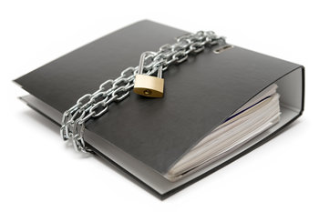
Protecting NPPI
Non-Public Personal Information

Slide 6
Protecting NPPI
Non Public Personal Information
Tax ID Numbers, personal and business

Slide 7
Protecting NPPI
Non Public Personal Information
Tax ID Numbers, personal and business
Date of Birth

Slide 8
Protecting NPPI
Non Public Personal Information
Tax ID Numbers, personal and business
Date of Birth
Bank Account and Credit Card Numbers

Slide 9
How is NPPI accessed by identity thieves?

Slide 10
Line of Sight
Unlocked Computer Screens
Paper forms

Slide 11
Line of Sight
Unlocked computer screens
Paper forms
Phishing
Requests for seemingly harmless information
Telephone
Email

Slide 12
Line of Sight
Unlocked computer screens
Paper forms
Phishing
Requests for seemingly harmless information
Telephone
Email
Network and Computer Use
Unsecure networks, out of date software
Easy to guess passwords
Sending unsecure electronic information
Code and links embedded in email

Slide 13
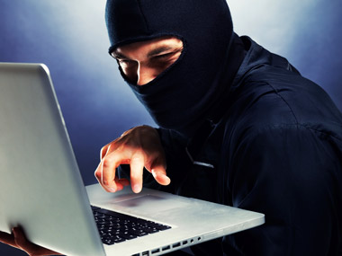
Social Engineering
Definition: Social engineering, in the context of information security, refers to psychological manipulation of people into performing actions or divulging confidential information.

Slide 14
Social Engineering
Definition: Social engineering, in the context of information security, refers to psychological manipulation of people into performing actions or divulging confidential information.
Who might use social engineering to obtain NPPI?

Slide 15
Social Engineering
Definition: Social engineering, in the context of information security, refers to psychological manipulation of people into performing actions or divulging confidential information.
Who might use social engineering to obtain NPPI?
How do they access information?

Slide 16
Information Security
Best Practices -
How to set your sails to navigate around theft and fraud.

Slide 17
Information Security
Protecting Your Clients, Protecting Yourself.
- sometimes shortened to InfoSec, is the practice of preventing
unauthorized access, use, disclosure, disruption, modification,
inspection, recording or destruction of information. It is a
general term that can be used regardless of the form the data
may take (e.g. electronic, physical).

Slide 18
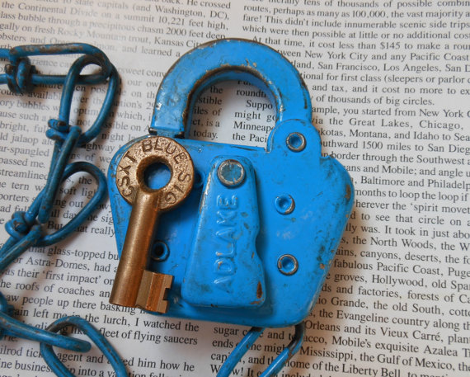
Best Practices
How to set your sails to navigate around theft and fraud.
Make a plan, identify areas in your office that may be at risk.
BEC/Dual control/Follow the rules

Slide 19
Best Practices
How to set your sails to navigate around theft and fraud.
Make a plan, identify areas in your office that may be at risk.
Set expectations and support each other in staying aware,
make taking steps to protect information natural and familiar.

Slide 20
Best Practices
How to set your sails to navigate around theft and fraud.
Make a plan, identify areas in your office that may be at risk.
Set expectations and support each other in staying aware,
make taking steps to protect information natural and familiar.
Keep your radar up, who is around you?

Slide 21
Best Practices
How to set your sails to navigate around theft and fraud.
Make a plan, identify areas in your office that may be at risk.
Set expectations and support each other in staying aware,
make taking steps to protect information natural and familiar.
Keep your radar up, who is around you?
Know your customer and your audience when at work and in the community.

Slide 22
Best Practices
How to set your sails to navigate around theft and fraud.
Physical
Electronic
Phone and email inquiries
Vendors, third parties
Social Media, private and public forums

Slide 23
The many benefits of your commitment…
to protect NPPI

Slide 24
I invite any questions you have currently,
Thank you for your time and consideration.

Slide 25
Protecting Private Information: Preventing Fraud and Identity Theft
Pete Begin
Vice President, Senior Security and Fraud Prevention Officer
Mascoma Bank
Lebanon NH
Peter.begin@mascomabank.com
(603) 443-8664

