Slide 1
GASB UPDATE
New England States Governmental Finance Officers Association
Lisa R. Parker, CPA, CGMA, Senior Project Manager
Ms. Parker.

Slide 2
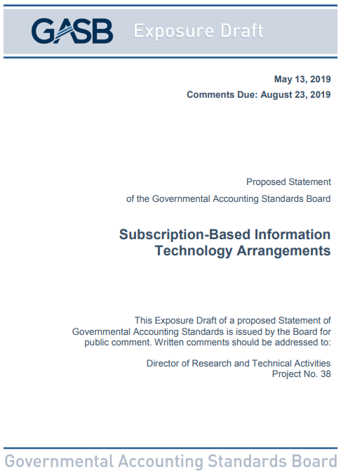
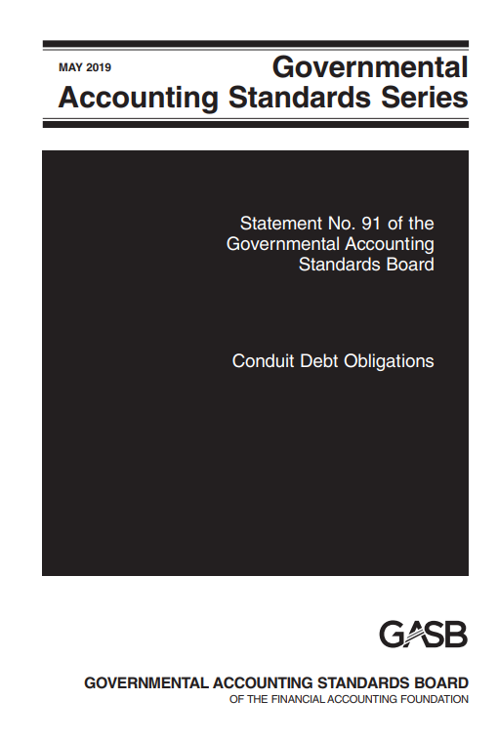


Presentation Overview
Guidance and resources related to coronavirus diseases
Pronouncements being implemented
Projects currently being deliberated by the Board
Pre-agenda research activities
Proposals for public comment
Post-implementation review

Slide 3
GASB Project Manager Position Open
Minimum 10 years of experience, including at least 5 in government finance or auditing, public accounting, finance or accounting academia, or standards setting
Interested?
Go to www.gasb.org
Mouse over “About Us”
Click on “Careers”

Slide 4
Guidance and Resources Related to the Coronavirus Diseases
Postponement of certain effective dates
Guidance on CARES Act
Emergency toolbox

Slide 5
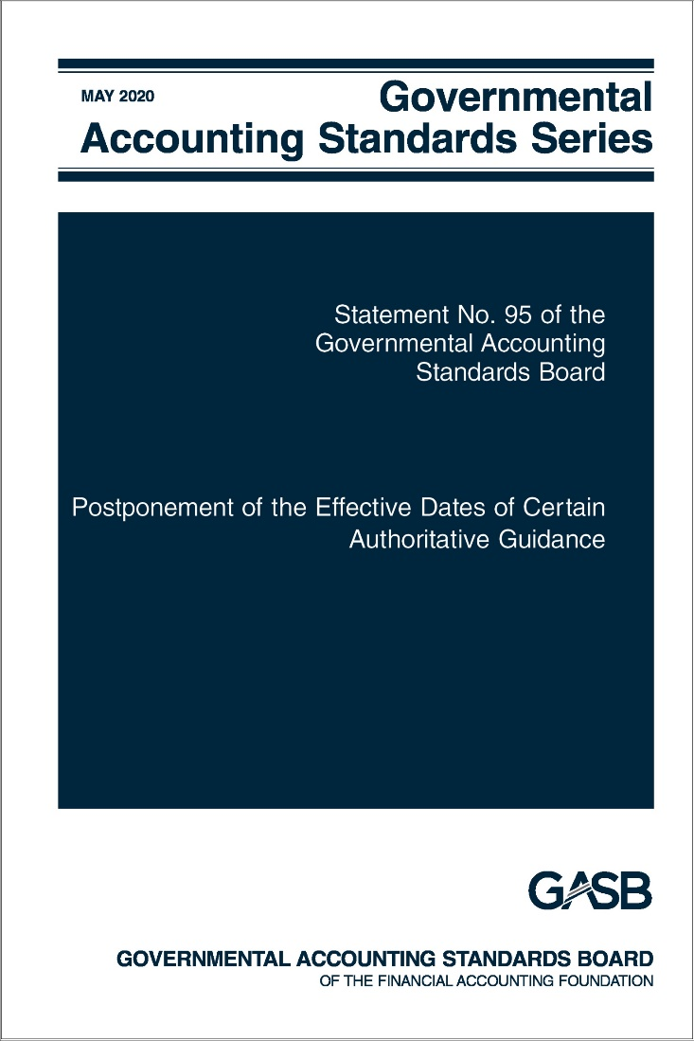
Postponement of the Effective Dates of Certain Authoritative Guidance
Statement No. 95

Slide 6
Effective Date Postponement
What?
Why?
When?
The Board has postponed the effective dates of certain Statement & Implementation Guide provisions
The Board acted in response to numerous stakeholder requests prompted by the COVID-19 pandemic
Effective immediately
Provisions can be implemented early to the extent allowed by each pronouncement

Slide 7
Effective dates are postponed one year for these pronouncements in their entirety
Statement No. 83, Certain Asset Retirement Obligations
Statement No. 84, Fiduciary Activities
Statement No. 88, Certain Disclosures Related to Debt, including Direct Borrowings and Direct Placements
Statement No. 89, Accounting for Interest Cost Incurred before the End of a Construction Period
Statement No. 90, Majority Equity Interests—an amendment of GASB Statements No. 14 and No. 61
Statement No. 91, Conduit Debt Obligations
Implementation Guide No. 2018-1, Implementation Guidance Update—2018
Implementation Guide No. 2019-1, Implementation Guidance Update—2019
Implementation Guide No. 2019-2, Fiduciary Activities

Slide 8
Effective dates are postponed one year for certain provisions of these pronouncements
Statement No. 92, Omnibus 2020, paragraphs 6–10 and 12
Statement No. 93, Replacement of Interbank Offered Rates, pars. 13 and 14
Implementation Guide No. 2017-3, Accounting and Financial Reporting for Postemployment Benefits Other Than Pensions (and Certain Issues Related to OPEB Plan Reporting), Questions 4.85, 4.103, 4.108, 4.109, 4.225, 4.239, 4.244, 4.245, 4.484, 4.491 and 5.1–5.4
Effective dates are postponed 18 months for these pronouncements
Statement No. 87, Leases
Implementation Guide No. 2019-3, Leases

Slide 9
Effective Dates after Statement 95
December 31: Fiscal Year 2021
Statement 89 – construction-period interest
Statement 93 – interbank offered rates (except LIBOR removal and lease modifications)
IG 2019-1 – update
Statement 87 – leases
December 31: Fiscal Year 2022
Statement 92 – omnibus 2020 (multiple effective dates)
December 31: Fiscal Year 2023
Statement 94 – public-private partnerships
Statement 93 – LIBOR removal and lease modifications
Statement 91 – conduit debt
Statement 97 – certain component unit criteria and Section 457 plans
IG 2020-1 – update
Statement 96 – SBITAs
IG 2021-1 – update (4.1–4.21, 4.23, 5.2, and 5.4)
IG 2021-1 – update (4.22)
December 31: Fiscal Year 2024
IG 2021-1 – update (5.1)
IG 2019-3 – leases
Statement 98 – the annual comprehensive financial report
Statement 100 – accounting changes and error corrections
Statement 101 – compensated absences
Statement 99 – omnibus 2022 (extension of LIBOR, SNAP distributions, nonmonetary transaction disclosures, pledges of future revenues, clarification of provisions in Statement 34, and terminology updates)
Statement 99 – omnibus 2022 (leases, PPPs, and SBITAs)
Statement 99 – omnibus 2022 (financial guarantees and classification of derivatives)

Slide 10
Effective Dates after Statement 95
Statement 87 – leases
June 30: Fiscal Year 2022
Statement 92 – omnibus 2020 (multiple effective dates)
IG 2019-3 – leases
Statement 91 – conduit debt
Statement 93 – LIBOR removal and lease modifications
Statement 89 – construction-period interest
June 30: Fiscal Year 2023
Statement 94 – public-private partnerships
IG 2020-1 – update (except 4.6–4.17 and 4.19–4.21)
Statement 96 – SBITAs
IG 2020-1 – update (4.6–4.17 and 4.19–4.21)
Statement 97 – certain component unit criteria and Section 457 plans
Statement 98 – the annual comprehensive financial report
IG 2021-1 – update (4.1–4.21, 4.23, 5.2, and 5.4)
IG 2021-1 – update (4.22)
June 30: Fiscal Year 2024
IG 2021-1 – update (5.1)
Statement 99 – omnibus 2022 (extension of LIBOR, SNAP distributions, nonmonetary transaction disclosures, pledges of future revenues, clarification of provisions in Statement 34, and terminology updates)
Statement 99 – omnibus 2022 (leases, PPPs, and SBITAs)
Statement 99 – omnibus 2022 (financial guarantees and classification of derivatives)
Statement 100 – accounting changes and error corrections
June 30: Fiscal Year 2025
  Statement 101 – compensated absences

Slide 11
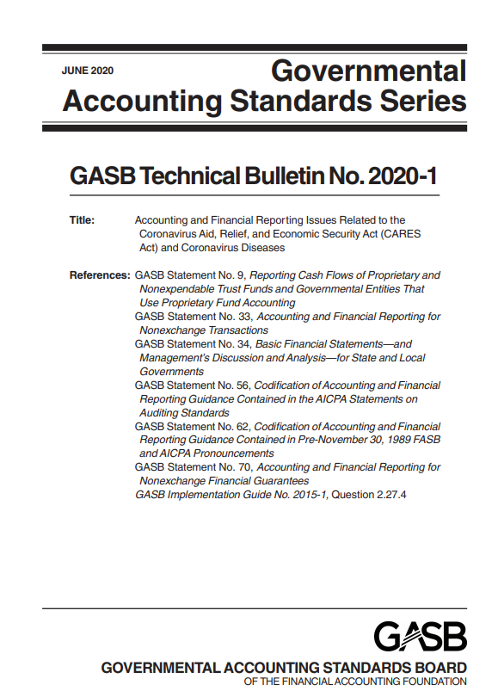
Accounting and Financial Reporting Issues Related to the Coronavirus Aid, Relief, and Economic Security Act (CARES Act) and Coronavirus Diseases
Technical Bulletin 2020-1

Slide 12
Technical Bulletin 2020-1
What?
Why?
When?
The Board has cleared guidance that addresses issues arising from the CARES Act and coronavirus diseases
The Board acted in response to numerous stakeholder requests for guidance
Effective immediately

Slide 13
Relevance of the Technical Bulletin 2020-1
Statement No. 76, The Hierarchy of Generally Accepted Accounting Principles for State and Local Governments.
Category A Guidance
GASB Statements
Category B Guidance
Technical bulletins, Implementation guides, and AICPA literature cleared
Analogy
Similar guidance (¶6)

Slide 14
Topics Addressed
Whether resources received from the Coronavirus Relief Fund (CRF) are subject to eligibility requirements or to purpose restrictions and how they should be accounted for
  CRF funds are voluntary nonexchange transactions subject to eligibility requirement rather than purpose restrictions
  Recipient government should recognize resources received from the CRF as liabilities until the applicable eligibility requirements are met, including the incurrence of eligible expenditures
  Recipient government should recognize revenue for the CRF resources received when the eligibility requirements are met

Slide 15
Topics Addressed
Whether CARES Act provisions that address a government’s loss of revenue should be considered an eligibility requirement, for purposes of revenue recognition
  Yes, resources provided to address a governments loss of revenue are contingent upon an eligibility requirement
  Resources received from CARES Act programs that specifically include an eligibility requirement for loss of revenue should be recognized as revenue when the government meets the action-based eligibility requirement

Slide 16
Topics Addressed
Whether amendments to the CARES Act after the statement of net position date but prior to the issuance of financial statements are the basis for recognition in financial statements for the period reported
  No, any amendment to the CARES Act after the statement of net position date should be considered a nonrecognized subsequent event (Statement 56)
  Those amendments do not represent conditions that existed as of the period end being reported

Slide 17
Topics Addressed (continued)
How to account for forgivable loans under the Paycheck Protection Program (PPP)
  Loans provided through the PPP have been guaranteed through a nonexchange financial guarantee provided by the US Small Business Administration
  Statement 70 requires that a government continue to report the loan as a liability until the government is legally released from the debt
  The government should report an inflow of resources in the reporting period to the extent that they are legally released from the debt

Slide 18
Topics Addressed (continued)
Whether resources provided through certain programs to a business-type activity or enterprise fund are nonoperating revenues
  Higher education emergency fund, CARES Act airport grants, formula grants for rural areas, and urbanized area formula grants
    Resources provided are subsidies and should be reported as nonoperating revenues
  Provider relief fund
    Resources provided constitute payment for care or treatment of uninsured individuals and testing of COVID-19 – should be reported as operating revenues

Slide 19
Topics Addressed (continued)
Whether outflows incurred in response to the coronavirus are extraordinary items or special items for financial reporting purposes
  Extraordinary items – BOTH unusual in nature and infrequent in occurrence
    Reasonable to expect that coronavirus disease will recur in the foreseeable future
  Special items – within the control of management and EITHER unusual in nature or infrequent in occurrence
    Appearance of coronavirus disease is not within the control of management

Slide 20
COVID-19 Page & Emergency Toolbox
Guidance and resources available at https://gasb.org/emergency-toolbox.html
Emergency toolbox
  Intended to help stakeholders quickly identify the GASB’s authoritative guidance that could be relevant to the current circumstances, including topics such as contingencies, going concern, prior-period adjustments, revenue and receivable recognition, and subsequent events
  Provides links to COVID-19 resources and nonauthoritative guidance of professional organizations

Slide 21
Proposals for Public Comment

Slide 22
Risks and Uncertainties Disclosures

Slide 23
Risks and Uncertainties Disclosures
What?
Why?
When?
The Board has proposed standards to identify and disclose risks faced by governments
Stakeholders asked the GASB to address this issue
Comment deadline is September 30, 2022

Slide 24
Exposure Draft: Scope and Purpose
Current vulnerabilities due to certain concentrations
For example, (1) principal employers, (2) principal industries, (3) principal resource providers, (4) composition of principal inflows of resources, (5) workforce covered by collective bargaining agreements, and (6) suppliers of material, labor, or services
Current vulnerabilities due to certain constraints common in the government environment
For example, (1) limitations on raising revenue, (2) limitations on spending, (3) limitations on the incurrence of debt, and (4) mandated spending
Objective: To provide users essential information about risks faced by governments that may impact their ability to continue to provide services and meet their obligations as they come due

Slide 25
Exposure Draft: Disclosure Criteria
Disclosures should be required when the government determines that:
An event associated with a concentration or constraint either has occurred or is more likely than not to begin to occur within 12 months of the financial statement date or shortly thereafter (3 months)
It is at least reasonably possible that the event will cause there to be a substantial effect within 3 years of the date of the financial statement
Substantial effect is one that affects the government’s ability (1) to continue to provide services at the level provided in the current reporting period or (2) to meet its obligations as they come due

Slide 26
Exposure Draft: Disclosure Requirements
Disclose sufficient detail to enable users to understand the general nature of the risks and their potential effect on the government’s ability to provide services or meet its obligation.
Description of concentration or constraint
Disclosure not required if mitigating actions cause any of the disclosure criteria to no longer be met.
Disclosures should be made at the primary government level unless a risk is specific to a reporting unit relative to other reporting units and has a substantial effect on that reporting unit but not on the primary government. In that case the disclosure should be made for the reporting unit.
Description of each event associated with the concentration or constraint, including the criteria that were met
Description of actions taken to mitigation the substantial effect.

Slide 27
Project Timeline
Added to Current Technical Agenda | July 2020
Deliberations Began | September 2020
Additional Outreach Conducted | February–April 2021
Exposure Draft Issued | June 2022
Comment Deadline | September 30, 2022

Slide 28
Pronouncements Being Implemented

Slide 29

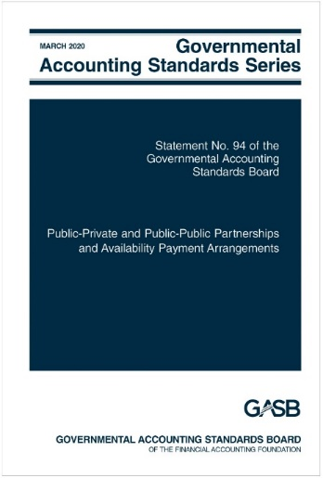
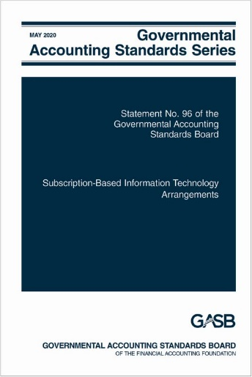
Leases
Statement 87
Public-Private and Public-Public Partnerships and Availability Payment Arrangements
Statement 94
Subscription-Based Information Technology Arrangements
Statement 96

Slide 30
Definitions
Lease - a contract that conveys control of the right to use another entity’s nonfinancial asset (the underlying asset) as specified in the contract for a period of time in an exchange or exchange-like transaction.
P3 - arrangement in which a government (the transferor) contracts with an operator [governmental or nongovernmental] to provide public services by conveying control of the right to operate a nonfinancial asset, such as infrastructure or other capital asset (the underlying PPP asset), for a period of time in an exchange or exchange-like transaction.
SBITA - a contract that conveys control of the right to use another party’s (a SBITA vendor’s) IT software, alone or in combination with tangible capital assets (the underlying IT assets) as specified in the contract for a period of time in an exchange or exchange-like transaction.

Slide 31
Recognition and Measurement Guidance
Meets both lease and P3 definitions
Underlying PPP assets existing assets of transferor
Improvements required to be made by operator
Underlying PPP assets not existing assets of transferor
Meets SCA definition
Does not meet SCA definition
Statement 94 para. 15 and 38
Statement 94 para. 16 and 39
Improvements not required to be made by operator
Statement 94, para. 14 and 37
Meets SCA definition
Does not meet SCA definition
Statement 94 para. 15 and 38
Statement 87

Slide 32
Relationship between Leases and SBITAs
All SBITAs meet definition of lease
Depends on what the underlying asset is:
  Tangible capital assets alone – Statement 87
  IT software alone – Statement 96
  IT software in combination with tangible capital assets:
    Software component is insignificant compared to cost of underlying tangible capital asset – Statement 87
    Otherwise – Statement 96
Also excluded from Statement 96:
  Governments acting as SBITA vendors
  Contracts that meet the definition of a P3 in Statement 94
  Perpetual software licenses

Slide 33
Topics That Are The Same
Lease/PPP/Subscription Term
Short-Term Lease/SBITA
General recognition and measurement

Slide 34
Lease/PPP/Subscription Term
For financial reporting purposes, when does the lease/PPP/subscription term start and end?
  Start with the noncancelable period
2021…………………………………………………..2027
………………………………….2031
  Plus periods covered by options to:
    Extend, if reasonably certain of being exercised
    Terminate, if reasonably certain of not being exercised
  Excludes cancelable periods
    Periods for which lessee/transferor and lessor/operator both have option to extend or terminate (such as rolling month-to-month leases/PPPs/subscriptions)
  Fiscal funding and cancellation clauses are ignored unless reasonably certain of being exercised

Slide 35
Short-Term Leases/SBITAs
Definition | At beginning of lease/SBITA, maximum possible term under the contract is 12 months or less Includes all one-party options to extend Excludes cancellable periods
Lessee accounting | Recognize expenses/expenditures based on the terms of the contract Do not recognize assets or liabilities associated with the right to use the underlying asset
Lessor accounting | Recognize lease payments as revenue based on the payment provisions of the contract Do not recognize receivables or deferred inflows
Notes:
The GASB chose maximum possible term rather than lease term because GASB was concerned about potential misapplication of lease term guidance to manufacture short-term leases, thus avoiding recording liabilities.

Slide 36
Initial Reporting
 | Assets | Liability | Deferred Inflow
Lessee/ Operator/ SBITA | Intangible lease asset (right to use underlying asset)—value of lease liability plus prepayments and initial direct costs that are ancillary to place asset in use | Present value of future lease payments (incl. fixed payments, variable payments based on index or rate, reasonably certain residual guarantees, etc.) | NA
Lessor/ Transferor | Lease receivable (generally includes same items as lessee’s liability) Continue to report the underlying asset | NA | Equal to lease receivable plus any payments received up front that relates to a future period
Notes:
FASB requires that lessors derecognize leased asset. GASB decided to not derecognize due to cost/benefit.
Lease incentives also affect measurement of the lessee’s lease asset and liability, and the lessor’s receivable.

Slide 37
Subsequent Reporting
 | Assets | Liability | Deferred Inflow
Lessee/ Operator/ SBITA | Amortize the intangible lease asset over shorter of useful life or lease term | Reduce by lease payments (less amount for interest expense) | NA
Lessor/ Transferor | Depreciate leased asset (unless indefinite life or required to be returned in its original or enhanced condition) Reduce receivable by lease payments (less amount needed to cover accrued interest) | NA | Recognize revenue over the lease term in a systematic and rational manner
Notes:
Amortization of discount reported as interest revenue

Slide 38
Other Topics That Are The Same
Contracts with multiple components
  Generally, account for lease (etc) and non-lease (etc) components as separate contracts and multiple underlying assets as separate lease (etc) components
  Allocate contract price to different components
Modifications and terminations

Slide 39
Modifications
Both parties – account for an amendment resulting in a modification to the contract as a separate contract (separate from the most recent contract before the modification) if the following conditions are met:
  The modification adds one or more underlying assets that were not included in the original contract
  The increase in payments for the additional asset does not appear to be unreasonable based on (1) the terms of the amended contract and (2) professional judgment

Slide 40
Terminations
When the lessee’s/operator’s/SBITA’s right to use the underlying asset decreases – partial or full termination
  Lessee/Operator/SBITA-
    Reduces the carrying values of the asset and liability
    Recognizes a gain or loss for the difference
  Lessor-
    Reduces the carrying value of the receivable and related deferred inflow of resources
    Recognizes a gain or loss for the difference

Slide 41
Key Implementation Issues – GASB 87
Much of GASB 87 is driven by the legal form of the contract
If contract gives either party the option to cancel, even if it is highly unlikely that they wont, it is a cancellable period (Q4.15 in IG 2019-3)
If renewal is an option within the contract versus there being a new contract:
Need to exercise professional judgment
Is it an exchange or an exchange-like transaction—definition of a lease
Whether payments are fixed in substance
It determines whether renewal history matters—it matters if there is a renewal option and it does not matter if it is a new contract (Q4.11 in IG 2020-1)
Could change the short-term lease evaluation (Q4.10 in IG 2020-1)
Estimating the incremental borrowing rate (discount rate) if no similar debt has been issued

Slide 42
Key Implementation Issues – GASB 87
Transition provisions
Statement 87 requires that leases be recognized and measured using the facts and circumstances as of the beginning of the period of implementation
For example:
As of January 1, 2022 for FYE December 31, 2022
As of July 1, 2021 for FYE June 30, 2022
Not allowed to go back to the actual beginning of the lease
Materiality
Materiality is always a consideration

Slide 43
Topics Unique to Statement 94
Service Concession Arrangements
  Retained definition from Statement 60
    Except for public services do not have to relate to primary function of underlying asset
  Retained general approach from Statement 60

Slide 44
Topics Unique to Statement 94
New or Improved Underlying PPP Assets
  Transferor:
    SCA – recognize at acquisition value when placed in service
    Not SCA – recognize receivable at operator’s estimated carrying value at date of future transfer and additional deferred inflow
  Operator:
    SCA – recognize intangible right-to-use asset
    Not SCA – recognize deferred outflow and liability for future transfer

Slide 45
Topics Unique to Statement 94
Availability Payment Arrangements
  Government contracts with another entity to operate or maintain the government’s nonfinancial asset
  Entity receives payments from the government based on the asset’s availability for use
  Asset’s availability may be based on the physical condition of the asset or the achievement of certain performance measures
  May include design, finance, construction, or service components
    Design, construction, financing components and ownership transfers – financed purchase
    Service components – outflows of the period

Slide 46
Topics Unique to Statement 96
Implementation Costs
  Preliminary project stage
    Expense
  Initial implementation stage
    Generally capitalize
    Expense if short-term SBITA
  Operation and additional implementation stage
    Generally expense
    Capitalize if specific criteria met
  Training costs always expensed

Slide 47
Topics Unique to Statement 96
Subscription Term
  Commences when initial implementation stage is completed
  No subscription liability or subscription asset until then
  Payments made before are prepayment until commencement
Multiple Modules
  Subscription term begins when first module (or set of interdependent modules) is implemented

Slide 48
Effective Dates
Pronouncement | Beginning After
Statement 87 | June 15, 2021*
Statement 94 | June 15, 2022**
Statement 96 | June 15, 2022*
Implementation Guide 2019-3 | June 15, 2021*
Implementation Guide 2020-1 (Statement 87 questions) | December 15, 2021*
* Fiscal years beginning after this date, and all reporting periods thereafter
** Reporting periods beginning after this date

Slide 49

Accounting for Interest Cost Incurred before the End of a Construction Period
Statement No. 89

Slide 50
Interest Cost
What?
Why?
When?
The Board issued Statement 89 to enhance the relevance of capital asset information and simplify financial reporting
Accounting guidance was based on FASB Statements 34 and 62, which were incorporated into the GASB literature by GASB Statement 62 but were not reconsidered in light of GASB’s Concepts Statements
Effective for periods beginning after December 15, 2020
Earlier application is encouraged

Slide 51
Recognizing Interest Cost
Financial statements prepared using the economic resources measurement focus:
Interest cost incurred before the end of a construction period should be recognized as an expense in the period incurred.
Financial statements prepared using the current financial resources measurement focus:
Interest cost incurred before the end of a construction period should be recognized as an expenditure consistent with governmental fund accounting principles.
Prospective application at transition
Notes:
Would retain existing accounting requirements under modified accrual in the governmental funds.

Slide 52

Conduit Debt Obligations
Statement No. 91

Slide 53
Conduit Debt
What?
Why?
When?
The Board improved the standards related to conduit debt obligations by providing a single reporting method for government issuers
Interpretation 2 had been in effect for 20 years before its effectiveness was evaluated; based on GASB research, improvements were needed to eliminate diversity in practice
Effective for periods beginning after December 15, 2021
Earlier application is encouraged

Slide 54
Definition of Conduit Debt
There are at least three parties involved: the government-issuer, the third-party obligor (borrower), and the debt holder or trustee.
The issuer and the third-party obligor are not within the same financial reporting entity.
The debt obligation is not a parity bond of the issuer, nor is it cross-collateralized with other debt of the issuer.
The third-party obligor or its agent, not the issuer, ultimately receives the proceeds from the debt issuance.
The third-party obligor, not the issuer, is primarily obligated for the payment of all amounts associated with the debt obligation.

Slide 55
Limited, Additional & Voluntary Commitments Extended by Issuers
Generally, issuers’ commitments are limited to the resources provided by the third-party obligor.
Occasionally, an issuer may extend an
additional commitment
to support debt service in the event of the third-party obligor’s default.
For example:
Extending an appropriation pledge
Extending a financial guarantee
Pledging its own property, revenue, or other assets as security
Extending a moral obligation pledge
Under a voluntary commitment, issuer voluntarily decides to make a debt service payment or request an appropriation for a payment in the event that the third-party is, or will be, unable to pay.

Slide 56
Recognition by the Issuer
Do not recognize a conduit debt obligation as a liability
May have a related liability arising out of an additional or voluntary commitment
Additional commitment: report a liability when qualitative factors indicate it is more likely than not that the issuer will support debt service payments for a conduit debt obligation
Voluntary commitment: if a certain event or circumstance has occurred, evaluate likelihood, then report a liability if it is more likely than not that the issuer will support debt service payments
Voluntary commitments for which a liability is recognized and all additional commitments: At least annually reevaluate whether recognition criteria are met while conduit debt is outstanding
Notes:
Box 3: The list of qualitative factors in paragraph 13 should be used to assess whether it is more likely than not an issuer will support debt service payments.

Slide 57
Arrangements and Capital Assets
Some conduit debt obligations include
arrangements* that involve capital assets to be used by the third-party obligor but owned by the issuer.
Payment schedule of the arrangement coincides with the debt service repayment schedule.
Capital asset is built or acquired with proceeds of the conduit debt obligation.
Payments from the third-party obligor are to cover debt service payments.
Issuer retains title to the capital asset from the beginning of the arrangement.
*Often characterized as “leases”

Slide 58
Arrangements and Capital Assets (continued)
Accounting by the issuer:
Do not report those arrangements as leases
Do not recognize a liability for the related conduit debt obligations
Do not recognize a receivable for the payments related to those arrangements
If the arrangement meets the definition of a service concession arrangement, follow Statement 60

Slide 59
Arrangements and Capital Assets (continued)
Does title pass to third-party obligor at end of arrangement? | Does the issuer recognize a capital asset? | Does the issuer recognize a deferred inflow of resources?
Yes | No | No
No, and third party has exclusive use of entire capital asset | Yes, when the arrangement ends | No
No, and third party has exclusive use of only portions of the capital asset | Yes, at the inception of the arrangement | Yes, at the inception of the arrangement; deferred inflow recognized as revenue over the term of the arrangement

Slide 60
Disclosures by Type of Commitment
A general description of the issuer’s conduit debt obligations
Description of limited commitments
If the issuer recognizes a related liability
Description of timing of recognition and measurement of the liability
Cumulative payments that have been made
Amounts expected to be recovered, if any, for those payments
Description of additional commitments (legal authority and limits; length; arrangements for recovering payments from third-party obligors, if any)
Aggregate outstanding principal amount
Beginning balances, increases, decreases, ending balances

Slide 61
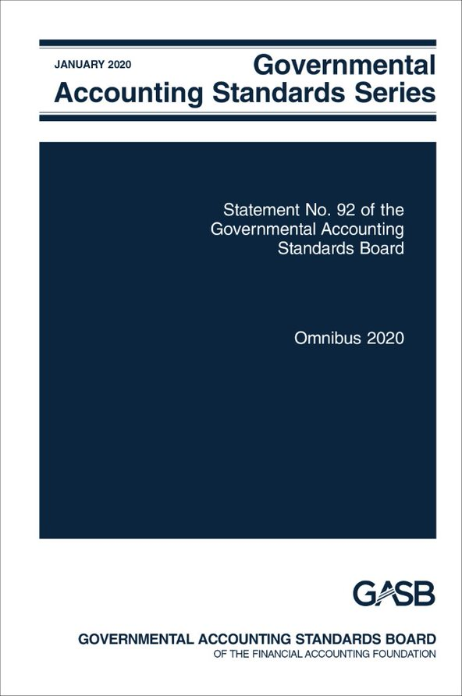
Omnibus 2020
Statement No. 92

Slide 62
Omnibus 2020
What?
Why?
When?
The Board has amended existing standards covering multiple topics
Omnibus projects are used to address issues in multiple pronouncements that, individually, would not justify a separate project
Effective dates vary by topic
Earlier application is encouraged and permitted by topic

Slide 63
Provisions of Statement 92
Leases
Government combinations and disposals of operations
Derivative instruments
Effective date of Statement 87 and Implementation Guide 2019-3 is changed from “reporting periods” to “fiscal years…and all reporting periods thereafter”
Provides an exception to the use of acquisition value in the measurement of an acquired asset retirement obligation
Amends NCGA and GASB pronouncements to standardize the terminology used to refer to derivative instruments (from derivatives to derivative instruments)
Acquiring government should measure the assets and liabilities related to an acquired entities ARO in accordance with Statement 83

Slide 64
Provisions of Statement 92 (continued)
Application of Statement 84 to Postemployment Benefit Arrangements
Limit the requirements of paragraphs 22 and 25 to defined benefit pension and OPEB plans – plans not administered through a trust that meets specified criteria should apply Statement 84 with regard to the liability to the beneficiary (employee)
Applicability of Statements 73 and 74
Fair value measurements
Amends paragraph 81 of Statement 72 to adjust the example of nonrecurring fair value measurements of assets and liabilities
Supersedes guidance in Statements 73 and 74 regarding recognition of a liability to employers and NECEs for the excess of assets over liabilities for benefits payments and administrative expenses in custodial funds in circumstances in which assets are accumulated for the pensions and OPEB of other employers and NECEs
Amend Statements 73 and 74 to replace references to control of assets in those same circumstances, to avoid limiting the application of the associated requirements of those Statements
Same example as presented in paragraph 455 of Statement 62

Slide 65
Provisions of Statement 92 (continued)
Intra-entity transfers of assets
Amends paragraph 15 of Statement 48 to clarify that amounts associated with the transfer of capital or financial assets from an employer or NECE to a defined benefit pension or OPEB plan within the same financial reporting entity should be reported as contributions to the plan, in accordance with Statements 68 and 75
Clarifies that the provisions of paragraph 15 apply to all transfers of assets within a financial reporting entity
Amends paragraph 37 of Statement 10 to clarify that amounts that are recoverable from reinsurers or excess insurers and that relate to paid claims and claim adjustment expenses may be reported as reductions of expenses but are not required to be.
Reinsurance recoveries

Slide 66
Effective Dates for Statement 92
Requirements related to: | Effective Date
Leases Reinsurance recoveries Derivative instruments | Upon issuance
Intra-entity transfers of assets Applicability of Statements 73 and 74 | Fiscal years beginning after June 15, 2021
Application of Statement 84 to postemployment benefit arrangements Fair value measurements | Reporting periods beginning after June 15, 2021
Government combinations and disposals of operations | For government acquisitions occurring in reporting periods beginning after June 15, 2021

Slide 67
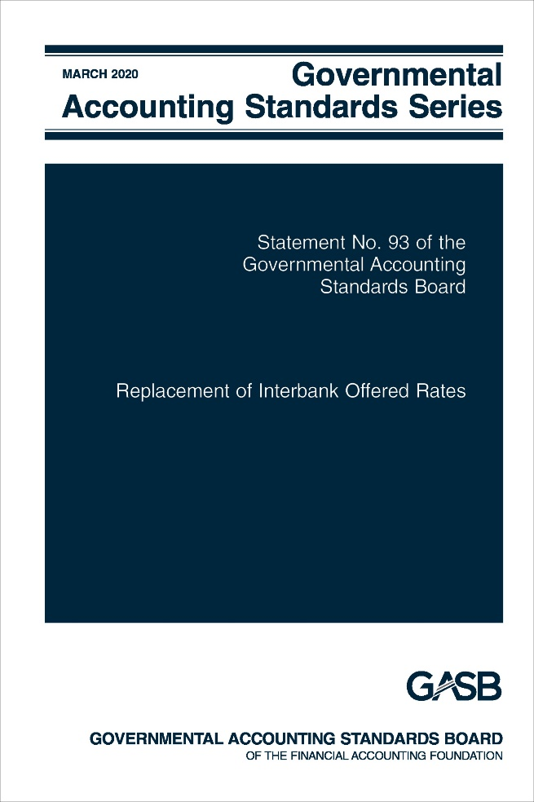
Replacement of Interbank Offered Rates
Statement No. 93

Slide 68
Replacement of Interbank Offered Rates
What?
Why?
When?
The Board has issued guidance to facilitate the transition from using IBORs in hedging derivative instruments and leases
LIBOR in its current form is expected to effectively sunset
LIBOR: periods ending after December 31, 2021
All other: periods beginning after June 15, 2020
Leases: periods beginning after June 15, 2021

Slide 69
Replacement of Interbank Offered Rates
Some governments have entered into agreements in which variable payments made or received depend on an Interbank Offered Rate (IBOR), most notably is the London Interbank Offered Rate (LIBOR)
LIBOR is sunsetting
Therefore, governments are amending or replacing financial instruments for the purpose of replacing LIBOR with other reference rates
Notes:
Statement 87 does not include nonexchange transactions, such as $1/year leases, because the Statement 87 reporting model based on leases being financing transactions does not work well for nonexchange transactions. (Report a $1 lease liability and asset?)
The right-to-use asset is that “specified in the contract”
Control is manifested by (1) the right to obtain present service capacity from use of the underlying asset and (2) the right to determine the nature and manner of use of the underlying asset
In final deliberations, the Board decided to specifically note that the right to use a nonfinancial asset refers to the right to use another entity’s underlying asset. The Board also decided that the right-to-use asset should be what is “specified in the contract,” which would include the right to use the underlying asset for portions of time during a lease term, such as leases for certain days each week or for certain hours each day.
The Board also agreed to add guidance for determining when a lease contract conveys control of the right to use the underlying asset. The guidance is similar to the FASB guidance but is based on the notions of control found in Concepts Statement No. 4, Elements of Financial Statements, including (1) the right to obtain the present service capacity from use of the underlying asset and (2) the right to determine the nature and manner of use of the underlying asset. The control criteria would be applied to the right-to-use asset as specified in the contract. The Board agreed that, unlike FASB, the criteria would not limit a lease to contracts that convey “substantially all” of the present service capacity from use of the underlying asset.

Slide 70
Statement 53, as amended
Requires a government to terminate hedge accounting when it renegotiates or amends a critical term of a hedging derivative instrument, such as the reference rate of a hedging derivative instrument

Slide 71
Exception to Termination of Hedge Accounting
Continue to apply hedge accounting to an effective hedging derivative instrument with a variable payment based on an IBOR, if all criteria are met:
The new reference rate essentially equates the old rate by :
The original hedging derivative instrument is ended and the replacement hedging derivative instrument is entered into on the same date
Critical terms are identical, except for term changes that are necessary for reference rate replacement (see next slide)
Hedging derivative instrument is amended or replaced to change the reference rate of its variable payment or add/change reference rate-related fallback provisions
Adjusting the new rate by a coefficient or constant, limited to what is necessary to essentially equate the rates, and/or
An up-front payment, limited to what is necessary to essentially equate the rates

Slide 72
Two-Step Transition to a SOFR
A hedging derivative instrument may be amended or replaced in two steps: a transition from an IBOR to another rate (such as the effective federal funds rate) prior to transitioning to a secured overnight financing rate (SOFR)
Hedge accounting continues when all of the following criteria are met:
The first step replaces an IBOR with another rate
That interim rate is replaced by a SOFR in the second step
All four of the criteria for a one-step transition are met

Slide 73
Other Provisions
Effective Federal Funds Rate and SOFR are appropriate benchmark interest rates for taxable debt when applying the consistent critical terms method
LIBOR is no longer an appropriate benchmark interest rate for taxable debt when applying the consistent critical terms method
Replacing an IBOR as the reference rate of a hedged item does not terminate hedge accounting
Uncertainty related to the continued availability of IBORs does not, by itself, affect the assessment of whether the occurrence of a hedged expected transaction is probable
The lease modifications guidance in Statement 87 should not be applied to when a lease contract is amended solely to replace an IBOR

Slide 74
Effective Dates and Transition
The provision removing LIBOR as an appropriate benchmark rate is effective for reporting periods ending after December 31, 2021
All other provisions are effective for reporting periods beginning after June 15, 2020
Earlier application is encouraged
Should be applied retroactively, if practicable (hedge accounting should be reestablished for terminations prior to the effective date of this Statement)

Slide 75
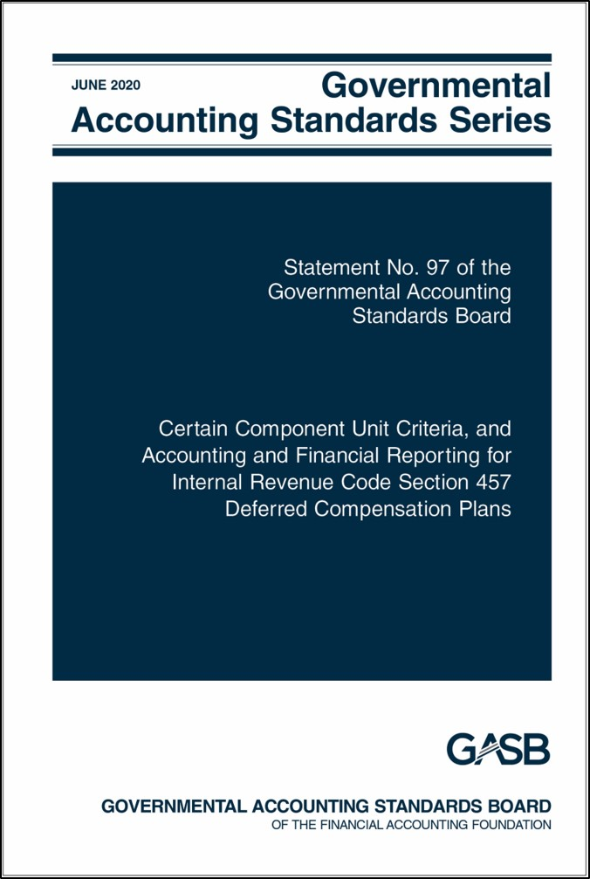
Certain Component Unit Criteria, and Accounting and Financial Reporting for Internal Revenue Code Section 457 Deferred Compensation Plans
Statement No. 97

Slide 76
Fiduciary Component Units and Deferred Compensation Plans
What?
Why?
When?
The GASB has changed the criteria for including certain employee benefit plans as component units and improvements to Statement 32 on IRC Section 457 plans
Some 457 plan characteristics have changed due, in part, to changes in the IRC; questions have been raised about whether certain employee benefit plans should be included as component units
Effective dates vary by topic
Earlier application is encouraged and permitted for certain topics

Slide 77
Relevant Guidance on Fiduciary Component Units
Paragraph 7 of Statement 84 amended Statement 14 to indicate that a primary government is considered to have a financial burden if it is legally obligated or has otherwise assumed the obligation to make contributions to a pension plan or OPEB plan
Implementation Guide 2019-2 provided guidance that in the absence of a governing board, a government performing the duties of a governing board for a defined contribution (DC) plan that is administered through a trust that meets the criteria in Statement 67 is effectively the same as appointment of a voting majority

Slide 78
Relevant Guidance on Fiduciary Component Units (continued)
The implication of that existing and considered guidance is that many governments would be required to report DC plans and other employee benefit plans as component units in their fiduciary fund financial statements
The Board directed the staff to conduct additional outreach on the structure of those types of arrangements and user needs for information about them
Based on the outreach, the Board decided to expand the project and issue guidance on component units

Slide 79
Component Unit Criteria
For purposes of determining whether a primary government is financially accountable, the absence of a governing board (when the government is perform the duties a governing board normally would perform) should be treated the same as the appointment of a voting majority of a governing board, except for DC pension plans, DC OPEB plans, or other employee benefit plans
The criterion that a legal obligation to contribute (or otherwise assuming the obligation) is considered to be a financial burden applies only to defined benefit plans

Slide 80
457 Plans
All requirements relevant to pension plan reporting should be applied to Section 457 plans that meet the definition of a pension plan
All requirements relevant to pensions should be applied by employers to benefits provided through Section 457 plans that meet the definition of a pension plan
Investments should be valued as of the end of the reporting period (allowance to use the most recent report of the plan administrator is eliminated)

Slide 81

The Annual Comprehensive Financial Report
Statement No. 98

Slide 82
Renaming the Financial Report
What?
Why?
When?
The Board has renamed the financial report in response to stakeholders who pointed out that its acronym, as it commonly was pronounced, sounded like a highly offensive racial slur
The GASB’s commitment to diversity and inclusion dictate that its standards should be free of potentially offensive terminology
Effective for fiscal years ending after December 15, 2021.
Earlier application is encouraged.

Slide 83
The Annual Comprehensive Financial Report
The new name of the broader report is annual comprehensive financial report (ACFR)

Slide 84
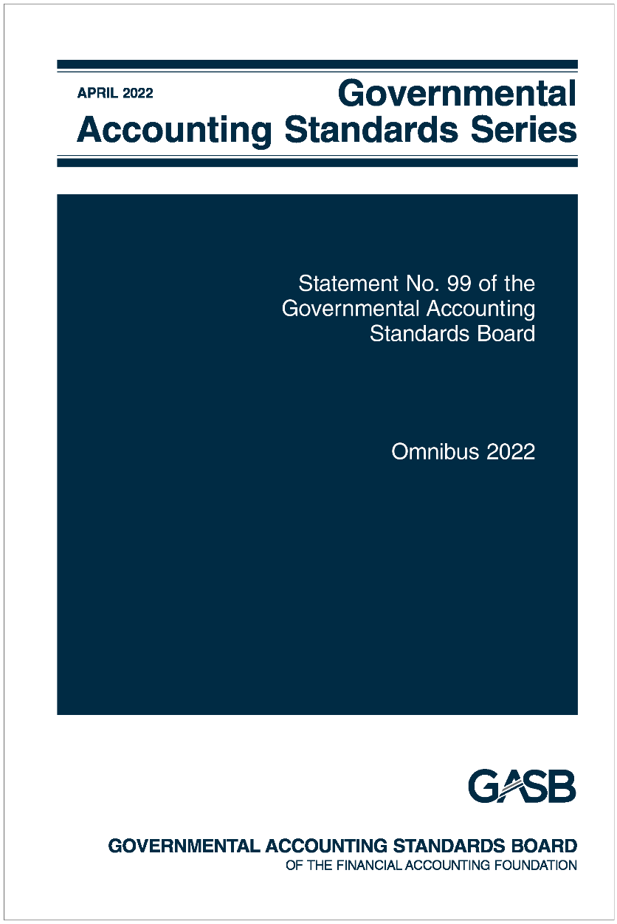
Omnibus 2022
Statement No. 99

Slide 85
Omnibus 2022
What?
Why?
When?
Practice issues identified during implementation and application of certain GASB Statements and accounting and financial reporting for financial guarantees
Omnibus Statements are issued to address issues in multiple pronouncements that, individually, would not justify a separate pronouncement
Various effective dates:
1) Upon issuance
2) Fiscal years beginning after June 15, 2022
3) Fiscal years beginning after June 15, 2023

Slide 86
General Omnibus Topics
Financial Guarantees
Extended Use of LIBOR
Technical Updates/Corrections
Leases, PPPs, and SBITAs
Other Derivative Instruments

Slide 87
Financial Guarantees
Statement 99 DOES
Apply the liability recognition, liability measurement, and disclosure requirements in Statement 70 to governments that extend exchange or exchange-like financial guarantees.
Statement 99 DOES NOT
Prescribe expense classification.
Prescribe recognition guidance for the consideration received in an exchange or exchange-like financial guarantee transaction.

Slide 88
Other Derivative Instruments
Other Derivative Instruments
Change in fair value would be reported on flow statement separately from investment revenues
Termination of hedge accounting
If hedging derivative instruments cease to be effective, the balance of the deferrals would be reported on the flows statement separately from investment revenues.
Disclosures would be distinguished from hedging derivative instruments and investment derivative instruments
Disclose fair value of derivative instruments that were reclassified from hedging derivative instruments

Slide 89
Leases, PPPs, and SBITAs
Remeasurement of certain assets and liabilities
Would not be remeasured solely for a change in an index or rate used to determine variable payments
Option to Terminate
Unconditional right that exists within the contract - the right to terminate due to the action or inaction of the other party is not an option to terminate
Short-term Leases and SBITAs
Modified short-term leases or SBITAs would be remeasured from the inception of the lease or SBITA
For leases only - the option to purchase the underlying asset would be considered an option to terminate for purposes of measuring the lease term

Slide 90
Leases, PPPs, and SBITAs (cont.)
Variable Lease Payments
Variable lease payments, other than those that depend on an index or rate or those that are fixed in substance, would not be included in the measurement of the lease liability.
Lease Incentives
Includes the assumption of or an agreement to pay a lessee’s preexisting lease obligation to a third party
The receivable for the underlying PPP asset would be remeasured if there is a change in the PPP term
PPP Remeasurement
Deferred outflow of resources would be adjusted by the same amount as any remeasurement change to the liability for the underlying PPP asset

Slide 91
Replacement of Interbank Offered Rates
London Interbank Offered Rate (LIBOR)
Date at which it is not an appropriate benchmark interest rate would change to when it is no longer determined by the ICE Benchmark Administration using the methodology in place as of December 31, 2021.

Slide 92
Technical Updates/Corrections
SNAP/ Food Stamps
States no longer use paper food stamp coupons. Specialized guidance in Statement 24 is no longer relevant. Should apply Statement 33 instead.
Nonmonetary Transactions
Should disclose measurement attribute(s), rather than basis of accounting for assets transferred.
Pledges of Future Revenue
Blending guidance provided

Slide 93
Technical Updates/Corrections (cont.)
Government-Wide Statements
Clarifies that no total column is required for the financial reporting entity as a whole.
Terminology Updates
Balance sheet – Statement of net position
Balance sheet date – Date of financial statements or Statement of net position date
Equity Funds – Other assets used
Fund Equity – Equity interest
Flow of resources statement – Resource flows statement

Slide 94
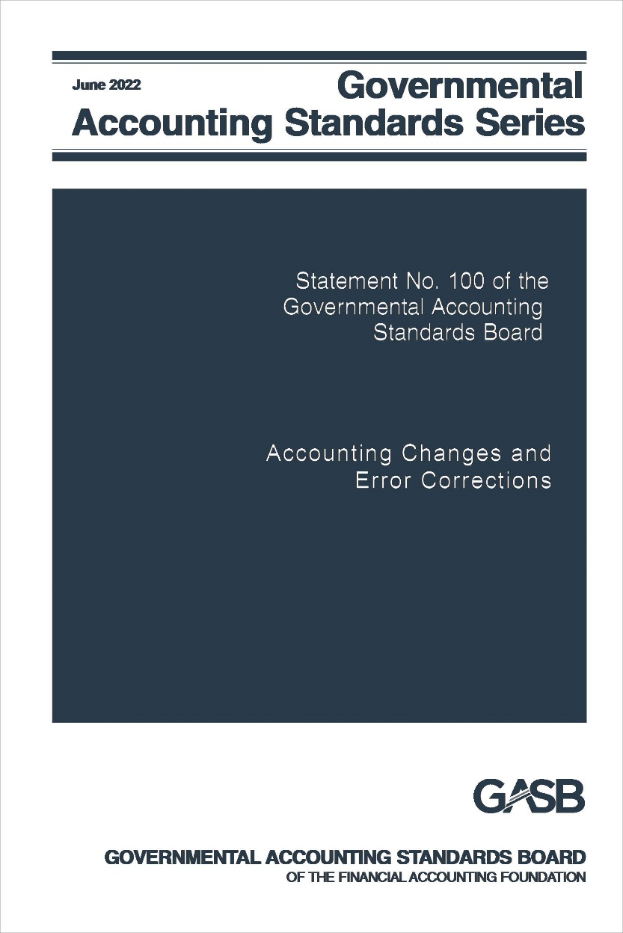
Accounting Changes and Error Corrections
Statement No. 100

Slide 95
Accounting Changes and Error Corrections
What?
Why?
When?
The Board has amended existing standards for accounting changes and error corrections
The relevant guidance is based on several sources of accounting standards, some of which have been superseded, and much of which has been in effect without review by the GASB for decades
Effective for fiscal years beginning after June 15, 2023.
Earlier application is encouraged.

Slide 96
Classification
Accounting changes
Change in accounting principle
Change in accounting estimate
Change to or within the financial reporting entity
Correction of an error in previously issued financial statements

Slide 97
Change in Accounting Principle
A change in accounting principle results from either:
A change from one generally accepted accounting principle to another that is justified on the basis that the newly adopted accounting principle is preferable, based on the qualitative characteristics of financial reporting
Implementation of new pronouncements

Slide 98
Accounting Estimates
Accounting estimates are:
Outputs determined based on inputs such as data, assumptions, and measurement methodologies
Amounts subject to measurement uncertainty that are recognized or disclosed in basic financial statements

Slide 99
Change in Accounting Estimate
A change in accounting estimate occurs when inputs change
A change in measurement methodology should be justified on the basis that the new methodology is preferable, based on the qualitative characteristics of financial reporting.
Changes to inputs result from a change in circumstance, new information, or more experience

Slide 100
Change to or within the Financial Reporting Entity
A change to or within the financial reporting entity results from:
Addition/removal of a fund that results from movement of continuing operations within the primary government, including its blended component units
A change in the fund presentation as major or nonmajor
Addition/removal of a component unit (except for acquisitions, mergers, and transfers of operations, and Statement 90 component units)
Change in presentation (blended or discrete) of a component unit
Notes:
NOTE: Transactions or other events that could be classified as either a change in accounting principle in accordance with paragraph 5a or a change to or within the financial reporting entity should be considered a change to or within the financial reporting entity.

Slide 101
Correction of an Error
An error results from mathematical mistakes, mistakes in the application of accounting principles, or oversight or misuse of facts that existed at the time the financial statements were issued about conditions that existed as of the financial statement date
Facts that existed at the time the financial statements were issued are those that could reasonably be expected to have been obtained and taken into account at that time about conditions that existed as of the financial statement date
A change from (a) applying an accounting principle that is not generally accepted to transactions or other events to (b) applying a generally accepted accounting principle is an error correction
Notes:
NOTE: Transactions or other events that could be classified as either a change in accounting principle in accordance with paragraph 5a or a change to or within the financial reporting entity should be considered a change to or within the financial reporting entity.

Slide 102
Accounting for Accounting Changes and Error Corrections
Change in accounting principle
Reported retroactively by restating prior periods presented, if practicable
Change in accounting estimate
Reported prospectively
Recognized in current-period flows
Change to/within the reporting entity
Reported by adjusting current period beginning balances
Error correction
Reported retroactively by restating prior periods presented
If not practicable, restate beginning balances of current period

Slide 103
Display
Shown separately
Aggregate amount of adjustments to and restatements of beginning balances should be displayed for each reporting unit

Slide 104
Note Disclosures
Disclosures vary depending on the type of item, but common disclosures include:
The nature of the change or error and its correction
Reason for the change
The effects on beginning net position, fund balance, or fund net position, as applicable, presented in a tabular format

Slide 105
RSI and SI
The Statement addresses how to present in RSI and SI information that is affected by an accounting change or error correction
Periods earlier than those presented in basic financial statements should not be restated for changes in accounting principles
Periods earlier than those presented in basic financial statements should be restated for error corrections, if practicable

Slide 106

Compensated Absences
Statement No. 101

Slide 107
Compensated Absences
What?
Why?
When?
The Board has amended existing guidance for compensated absences
A review of Statement 16 indicated opportunities for improvement and additional guidance for certain types of leave
Effective for fiscal years beginning after December 15, 2023.
Earlier application is encouraged

Slide 108
Scope and Applicability
A compensated absence is
Leave for which employees may receive one or more:
Other cash payments, such as payment for unused leave upon termination of employment
Noncash settlement, such as conversion to postemployment benefits
Examples:
Vacation and sick leave
Paid time off (PTO)
Holidays
Certain types of sabbatical leave
Cash payments when the leave is used for time off
Parental leave

Slide 109
Recognition Criteria – Leave that has not been used
Leave is attributable to services already rendered
Employee has performed the services required to earn the leave
Leave is more likely than not to be used for time off or otherwise paid or settled
Likelihood of more than 50 percent
Leave accumulates
Can be carried forward from reporting period when earned to a future reporting period when it will be used or otherwise paid or settled

Slide 110
Exceptions to the General Recognition Approach
Leave that is dependent upon the occurrence of a sporadic event that affects a relatively small proportion of employees in any particular reporting period
Unlimited leave and holiday leave taken on specific date
Recognize liability when leave commences
Recognize liability when used
Parental leave, military leave, jury duty recognized when commences
Not sick leave or sabbatical leave
Leave more likely than not to be settled through conversion to defined benefit postemployment benefits
Excluded from liability

Slide 111
Measurement
Pay rate
Salary-related payments
Generally the employee’s pay rate at financial reporting date
Directly and incrementally related
DC pension or OPEB recognized as related leave is earned – not pension or OPEB liability
Exception: more likely than not to be paid at a different rate
DB pension or OPEB excluded

Slide 112
Leave Used But Not Paid
Liability for amount of cash payment or noncash settlement
Include applicable salary-related payments

Slide 113
Note Disclosures and Effective Date
Note disclosures
  No new note disclosures
  Exceptions to existing long-term liability disclosures for compensated absences:
    Option to present net increase or decrease with indication that it is a net amount
    Not required to disclose governmental fund used to liquidate
Effective date
  Fiscal years beginning after December 15, 2023

Slide 114
Implementation Guidance Updates
2019-1, 2020-1, and 2021-1

Slide 115
Implementation Guidance Updates
What?
Why?
When?
The GASB annually updates its Q&A implementation guidance
New guidance is added as new pronouncements are issued and new issues arise
Effective dates vary by Q&A from periods beginning after June 15, 2020 through periods beginning after June 15, 2023

Slide 116
Implementation Guide 2019-1
Adds new questions on standards regarding
Cash flows reporting
Derivative instruments
Updates existing Q&A guidance related to
Derivative instruments
Pension and OPEB plan reporting
Tax abatement disclosures
Fund balance
Pensions and OPEB
Nonexchange transactions
Insurance recoveries
Intra-entity transfers of assets
Financial reporting entity
Irrevocable split-interest agreements

Slide 117
Implementation Guide 2020-1
Adds new questions on standards regarding
Certain asset retirement obligations
Updates existing Q&A guidance related to
External investment pools
Fiduciary activities
Financial reporting entity
OPEB
Pensions
Deferral of certain Implementation Guide questions and answers
Leases
Conduit debt obligations
External investment pools

Slide 118
Implementation Guide 2021-1
Adds new questions on standards regarding
Derivative instruments
Fiduciary activities
Updates existing Q&A guidance related to
Leases, including
Definition of a lease
Lease term: options to extend or terminate; reassessment
Short-term leases
Lessee recognition and measurement
Lessor recognition and measurement
Lease incentives
Modifications and terminations
Nonexchange transactions
Financial reporting model
Sales and pledges and intra-entity transfers (Statement 48)

Slide 119
Current Technical Agenda Projects

Slide 120
Classification of Nonfinancial Assets

Slide 121
Classification of Nonfinancial Assets
What?
Why?
When?
The Board will review the existing classification of nonfinancial assets and other related sub-classifications (for example, capital assets or intangible assets)
A review of existing standards found that they generally were effective, but that there were aspects that could be significantly improved
Deliberations scheduled to begin July 2022

Slide 122
Topics to Be Considered
How should the existing definitions of nonfinancial assets and capital assets be modified, if at all? Should new classifications be added?
Should right-to-use intangible assets resulting from Statements 87, 94, and 96, continue to be classified as capital assets?
Should other types of assets, such as capital assets held for resale, continue to be classified as capital assets?
If classifications are added, how should those classifications be defined?
Should other intangible assets addressed in Statement 51 continue to be classified as capital assets?
If classifications are added and defined or existing definitions or classifications are modified, what should be the effect, if any, on presentation within the statement of net position or disclosure in notes to financial statements?

Slide 123
Project Timeline
Pre-Agenda Research Started | August 2020
Added to Current Technical Agenda | December 2021
Deliberations Begin | July 2022
Exposure Draft Scheduled to Be Considered for Issuance | May 2023

Slide 124
Conceptual Framework: Recognition

Slide 125
Exposure Draft: Recognition of Elements of Financial Statements
What?
Why?
When?
The Board issued an Exposure Draft of a Concepts Statement on recognition of financial statement elements
Recognition concepts are one of the components needed to complete the conceptual framework
A final Concepts Statement is scheduled to be considered for issuance in Q4 2023

Slide 126
Recognition Concepts
The measurement focus of a specific financial statement determines what items should be reported as elements of that financial statement.
The related basis of accounting determines when those items should be reported.

Slide 127
Tentative Decisions: Recognition Hierarchy
Follow a specific order when evaluating an item for recognition:
Does it meet the definition of an asset or liability?
Yes: Recognize asset or liability
No: go to next step
Does it meet the definition of a deferred outflow of resources or a deferred inflow of resources?
Yes: Recognize deferral
No: go to next step
Does it meet the definition of an outflow of resources or an inflow of resources?
Yes: Recognize inflow/outflow
No: Do not recognize the item

Slide 128
Tentative Decision: Recognition Framework
Two Measurement Focuses
Economic Resources
(applied in government-wide, proprietary fund, and fiduciary fund financial statements)
Short-Term Financial Resources
(would replace current financial resources in the governmental funds)
Notes:
Subject to the limitations of financial reporting described in Concepts Statement 1.

Slide 129
Tentative Decisions: Recognition Framework (continued)
Item meets definition of an element under the measurement focus
Measurement of item sufficiently reflects qualitative characteristics
Recognize the item in financial statement
Notes:
Qualitative characteristics of information in financial reports per Concepts Statement 1.
Financial statements presented applying the short-term financial resources measurement focus would reflect the amount of fund balance at period-end that is available for spending in the next period, which may or may not be restricted for specific purposes, as well as fund balance that is legally or contractually required to be maintained intact.
This is subject to the limitations of financial reporting described in Concepts Statement 1.

Slide 130
Project Timeline
Preliminary Views Issued | September 2018
Redeliberations Began | June 2019
Exposure Draft Approved | June 2020
Redeliberations Began | May 2021
Final Concepts Statement Scheduled to Be Considered for Issuance | December 2023

Slide 131
Financial Reporting Model Reexamination

Slide 132
Financial Reporting Model Improvements
What?
Why?
When?
The Board proposed improvements to the financial reporting model― Statements 34, 35, 37, 41, and 46, and Interpretation 6
A review of those standards found that they generally were effective, but that there were aspects that could be significantly improved
A final Statement is scheduled to be considered for issuance in Q4 2023

Slide 133
Overview of the Proposals
Measurement focus and basis of accounting for the governmental funds
Format of governmental funds financial statements
Clarification of operating and nonoperating in proprietary funds
Presentation of proprietary funds statement of revenues, expenses, and changes in net position
Management’s discussion and analysis
Budgetary comparisons
Major component unit presentations
Unusual or infrequent items

Slide 134
Tentative Decisions: Recognition in Governmental Funds
Short-term financial resources measurement focus and modified accrual basis of accounting
Elements from short-term transactions or other events recognized as the underlying transaction or other event occurs
Elements from long-term transactions and other events recognized when payments are due
Financial assets: cash, assets that are available to be converted to cash, and assets that are consumable in lieu of cash

Slide 135
Recognition in Governmental Funds (cont.)
Short-Term Transactions
Period from inception to conclusion is one year or less
Long-Term Transactions
Period from inception to conclusion is more than one year
Inception
generally is when a party to the transaction takes an action that results in the initial recognition of an asset or liability
Conclusion
generally is when the final payment of cash or other financial assets is due according to the terms of the binding arrangement (or estimated payments)

Slide 136
Tentative Decisions: Presentation of Governmental Funds
Financial statements presented in
current and noncurrent activity
format
Current activity—
all other
Noncurrent activity—related to purchase and disposition of capital
assets and issuance and repayment of long-term debt

Slide 137
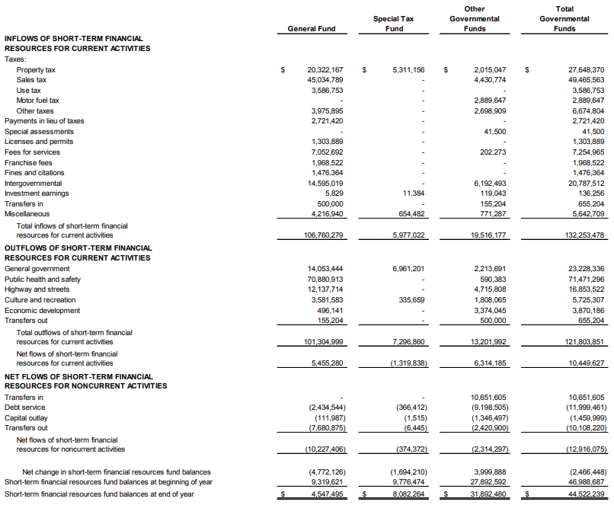
Proposed Statement of Short-Term Financial Resource Flows
Current and Noncurrent Activity Format
Notes:
This is the lower half

Slide 138
Proposals: Proprietary Funds
Separate presentation of operating and nonoperating revenues and expenses
Operating
Activities other than nonoperating activities
Nonoperating
Subsidies received and provided
Revenues and expenses of financing
Resources from the disposal of capital assets and inventory
Investment income and expenses

Slide 139
Proposals: Proprietary Funds (cont.)
Subsidies
Resources received from another party or fund to keep rates lower than otherwise would be necessary to support the level of goods and services to be provided
Resources provided to another party or fund that results in higher rates than otherwise would be established for the level of goods and services to be provided
Add a new subtotal for operating income (loss) and noncapital subsidies

Slide 140
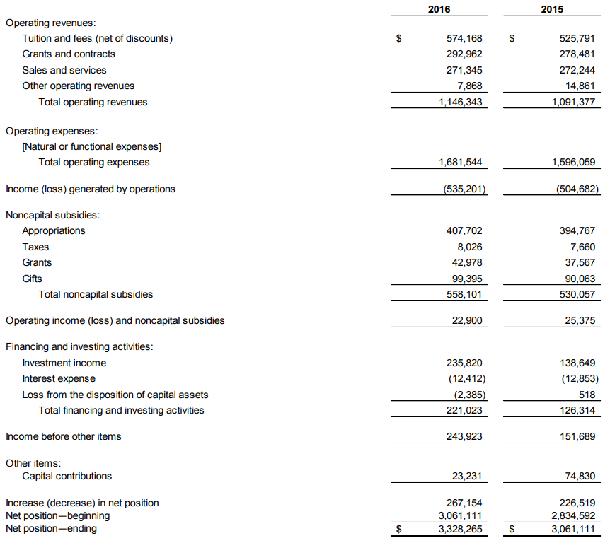

Slide 141
Proposals: Management’s discussion and analysis
Users of MD&A “have different levels of knowledge and sophistication about governmental accounting and finance,” “may not have a detailed knowledge of accounting principles” (as in Concepts Statement 1, paragraph 63)
Add clarification and structure to the requirement for brief discussion of the basic financial statements, including their relationships and significant differences
Emphasize the level of thoroughness required for the analysis of year-to-year changes and the need to avoid unnecessary duplication
Amend the requirements for currently known facts, decisions, or conditions with examples, such as economic trends; subsequent year’s budget; actions government has taken on postemployment benefits, capital improvement plans, and long-term debt; actions other parties have taken that affect the government
Move budgetary analysis and discussion of infrastructure assets (if applicable) to the relevant parts of RSI

Slide 142
Other Proposals
Budgetary comparisons
If it is not feasible to present major component unit financial statements in separate columns in the reporting entity’s financial statements, the financial statements of the major component units would be presented in the reporting entity’s basic financial statements as combining financial statements
Major component unit presentations
Would be presented as required supplementary information (no option for basic statements)
Required variances would be final-budget-to-actual and original-budget-to-final-budget
Notes:
The Board has tentatively decided to carry forward the major component unit proposals to the ED.

Slide 143
Other Proposals (continued)
Unusual or Infrequent Items
Disclose additional information about those inflows and outflows, including the programs, functions, or identifiable activities to which they are related and whether they are within the control of management
Separately present inflows and outflows of resources that are unusual in nature and/or infrequent in occurrence (replacing extraordinary and special items)

Slide 144
Proposed Effective Dates
Based on total annual revenues in fiscal year beginning after June 15, 2022
$75 million or more
Apply in fiscal years beginning after June 15, 2024
Less than $75 million
Apply in fiscal years beginning after June 15, 2025

Slide 145
Project Timeline
Pre-Agenda Research Started | April 2013
Added to Current Technical Agenda | September 2015
Invitation to Comment Issued | December 2016
Preliminary Views Issued | September 2018
Exposure Draft Approved | June 2020
Redeliberations Began | May 2021
Final Statement Scheduled to Be Considered for Issuance | December 2023

Slide 146
Going Concern and Severe Financial Stress: Reexamination of Statement 56

Slide 147
Going Concern and Severe Financial Stress
What?
Why?
When?
The Board will review existing standards related to going concern and address issues related to disclosures regarding going concern uncertainties and severe financial stress
As it is currently defined, going concern may not be meaningful for governments, which hardly ever go out of business; users need information about governments’ severe financial stress, but that information is not readily available
The Board added the project to its current technical agenda in December 2021

Slide 148
Topics to Be Considered
How should the existing guidance on going concern uncertainties (including the definition of a going concern) be clarified or improved to reduce diversity in practice in applying the guidance?
How should severe financial stress be defined? How should that definition differ from going concern uncertainties?
If a government is determined to be exposed to severe financial stress, what relevant information should a government disclose in notes to financial statements?

Slide 149
Revenue and Expense Recognition

Slide 150
Revenue and Expense Recognition
What?
Why?
When?
The Board proposed a comprehensive model for recognition of revenues and expenses
Guidance for exchange transactions is limited; guidance for nonexchange transactions could be improved and clarified
The Board is scheduled to consider the issuance of an Exposure Draft in Q1 2025

Slide 151
Broad Project Objective
Develop a comprehensive, principles-based model that establishes guidance applicable to a wide range of revenue and expense transactions to:
Expand on areas where there is no guidance—expenses
Expand on areas where there is limited guidance—certain revenues
Consider practice issues and challenges identified in current guidance—Statement 33
Consider the conceptual framework—issued after Statement 33
Consider performance obligation recognition
Notes:
Scope excludes financial instruments such as investments, derivative instruments, and long-term debt; capital assets and inventory; and postemployment benefits, including compensated absences.

Slide 152
Scope of the Project
The scope is defined broadly to include revenues and expenses except for those explicitly excluded:
Financial instruments
Investments
Derivative instruments
Capital assets and inventory
Purchase, sale, or impairment
Capitalization and depreciation
Long-term debt
Inventory valuation
Post-employment
Pensions
OPEB
Other: compensated absences

Slide 153
Proposed Recognition Model Components
Categorization
Identify the type of transaction
Recognition
Determine what element should be reported and when
Measurement
Determine the amount to report

Slide 154
Proposed Categorization Methodology
Notes:
Categorization does NOT describe GEOGRAPHY: no relationship to operating / nonoperating.
Illegal or unenforceable transactions have no binding arrangement and are outside the scope. Examples of transactions that fail each step and therefore are Category B: sales and income taxes don’t have mutual assent; donations don’t have identifiable rights and obligations, purpose-restricted grants do not have interdependent rights and obligations; Category A would include eligibility grants and contracts for services.

Slide 155
Outcomes of the Proposed Model *
Category A | Category B
Fees for service (water, electric, garbage) | Taxes (property tax, income tax, sales tax)
Eligibility-based grants | Punitive fees
Research grants and revolving loans | Special assessments
Medicaid fees for services | Donations
Tuition fees | Regulatory fees (drivers licenses, building permits, marriage licenses, professional licenses)
Most expenses | Purpose-restricted grants
 | Capital fees (developer fees, PFCs)
 | Medicaid supplementary payments
* Transactions highlighted in blue would have different outcomes than under current literature

Slide 156
Proposed Revenue Recognition Principles
CATEGORY A
CATEGORY B
Legally Enforceable Claim
Step 1: Is there an increase in net assets?
Fiscal Period
Timeline
Asset Dr
Liability Cr
Asset Dr
Deferred Inflow Cr
Asset Dr
Revenue Cr
Step 2: Does the increase in net assets result in a related liability?
Step 3: Does the increase in NA result in inflow applicable to a future period?
Step 4: Recognize revenue

Slide 157
Category A Revenue Recognition Example
College Tuition
Category A
Legally Enforceable Claim
Government provides resources (education)
Timeline
Asset Dr
Liability Cr
Asset Dr
Revenue Cr
Prepayment of tuition
Inflow of resources as the College performs its obligation

Slide 158
Category B Revenue Recognition Example
Property Taxes
Category B
Legally Enforceable Claim
Government imposes property tax
Fiscal Period
Timeline
Asset Dr
Liability Cr
Asset Dr
Deferred Inflow Cr
Asset Dr
Revenue Cr
Prepayment of property tax
Imposition before fiscal period
Inflow of resources is applicable

Slide 159
Proposed Expense Recognition Principles
CATEGORY A
CATEGORY B
Legally Enforceable Claim
Step 1: Is there a decrease in net assets?
Fiscal Period
Timeline
Asset Dr
Liability Cr
Deferred Outflow Dr
Liability Cr
Expense Dr
Liability Cr
Step 2: Does the decrease in net assets result in a related asset?
Step 3: Does the decrease in NA result in outflow applicable to a future period?
Step 4: Recognize expense

Slide 160
Category A Expense Recognition Examples
A performance obligation is satisfied when there is a transfer of control of resources
City orders supplies
Expense is recognized as the city receives the supplies
School district hires CPA
Public utility employees
Expense is recognized as the CPA firm carries out the expected work, such as an audit
Expenses for wages are recognized as the employees perform services over time

Slide 161
Category B Expense Recognition Examples
Expense is recognized at the same time as the payable, unless there are time requirements
Contractual arrangements
Shared revenue (outflows)
General aid (outflows)

Slide 162
Proposed Measurement Principles
Transaction Amount
Allocated Amount for Category A Transactions
Direct measurement of the most liquid item
Notes:
For Category A transactions, the transaction amount would be allocated to the performance obligations in the binding arrangement
Most liquid item for revenue transactions would be the asset; for expense transactions, it would be the liability.
Collectibility – an allowance for uncollectible amounts reduces receivables; revenue should be recognized NET of uncollectible amounts.

Slide 163
Project Timeline
Pre-Agenda Research Started | September 2015
Added to Current Technical Agenda | April 2016
Invitation to Comment Cleared | January 23, 2018
Preliminary Views Approved | June 2020
Redeliberations Began | May 2021
Exposure Draft Scheduled to Be Considered for Issuance | March 2025

Slide 164
Pre-Agenda Research Activities

Slide 165
Capital Assets

Slide 166
Capital Assets
What?
Why?
When?
The GASB is evaluating existing guidance related to capital assets and the usefulness of information reported by governments
Stakeholders have asked the GASB to review various aspects of capital asset reporting; the most relevant standards have been in effect 15-20 years
The Board added the pre-agenda research in August 2019

Slide 167
Topics to Be Considered
What choices do governments make with respect to their capital asset-related accounting policies? Why do they select those policies?
How do governments determine when outflows enhance the service capacity or extend the useful life of an asset?
How do governments report exchanges of capital assets?
How do depreciation and estimated useful lives compare with the actual diminution of service capacity?
What has been the experience with the modified approach to reporting infrastructure? How has it affected comparability of statement information?
Should changes in the condition of capital assets be reflected as flows of resources in the financial statements? How would it be measured?
What information do governments collect and report about deferred maintenance? How is it estimated?

Slide 168
Subsequent Events

Slide 169
Topics to Be Considered
How prevalent are recognized and unrecognized subsequent events?
How prevalent are subsequent event disclosures?
What types of subsequent events are disclosed in practice?
What difficulties do governments have, if any, distinguishing between subsequent events that require adjustments to the financial statements and those that are limited to disclosure?
What difficulties do governments have, if any, determining whether information that became available prior to the issuance of the financial statements reflects conditions that existed as of the date of the financial statements?

Slide 170
Topics to Be Considered (continued)
How are the standards applied to events occurring after the issuance of the financial statement when a government reissues the financial statements?
What impact might the proposed changes to MD&A in the Financial Reporting Model project have on subsequent events reporting?
What information are governments disclosing about subsequent events? Is that information essential to users for making decisions and assessing government accountability?
What disclosures do users need, if any, about subsequent events that they are not currently receiving? How would they use that information?
What essential information, if any, do users need regarding recognized subsequent events?

Slide 171
Post-Implementation Review (PIR)

Slide 172
What is PIR?
The GASB monitors and supports implementation of all of its pronouncements
For Statements resulting from comprehensive projects and major projects that address a fundamental aspect of the standards, the GASB also:
Examines a random some of financial reports for the year prior to, year of, and year after implementation
Collects information from their preparers regarding staff hours and nonstaff costs for those three years
Examine financial reports for the same random sample in the fifth year of implementation
Conduct stakeholder roundtables and surveys regarding their experience with the standards
Reports the findings publicly

Slide 173
Why does the GASB conduct PIRs?
To provide general support to stakeholders when implementing significant new pronouncements
To identify and address practice issues that arise
To collect timely information that the Board can use to evaluate cost-benefit considerations as it develops other pronouncements and when it reexamines the standards in the future
To answer technical inquiries from stakeholders and develop and publish Q&A implementation guidance

Slide 174
How does the GASB involve stakeholders in PIR?
Stakeholders bring potential implementation issues to the GASB’s attention
Governments are recruited to keep track of their staff hours and nonstaff costs related to the pronouncement and provide that information for the year prior to implementation and the first and second years of implementation
Stakeholders of all types are invited to participate in roundtable discussions and to respond to surveys regarding their experience with the standards in practice

Slide 175
Which Statements are under review?
Statement 67—Pension plan reporting
Statement 68—Employer reporting for pensions
Statement 72—Fair Value measurement & reporting
Statement 75—Employer reporting for other postemployment benefits (OPEB)
Statement 84—Fiduciary activities
Statement 87—Leases

Slide 176
What is the status of the PIRs?
Pensions | Comparison of the data between the 1st and 4th year implementation continues; completed 11 planned stakeholder roundtables
Fair value | Beginning collection and analysis of fifth-year reports
OPEB | Analysis of prior year and implementation year reports completed, second year analysis nearly completed; collection of implementation effort and cost information completed and being analyzed
Fiduciary activities | Recruitment of governments completed; collection of implementation effort and cost information has begun
Leases | Recruitment of governments continues; collection of implementation effort and cost information has begun

Slide 177
Questions?
Visit www.gasb.org

Slide 178
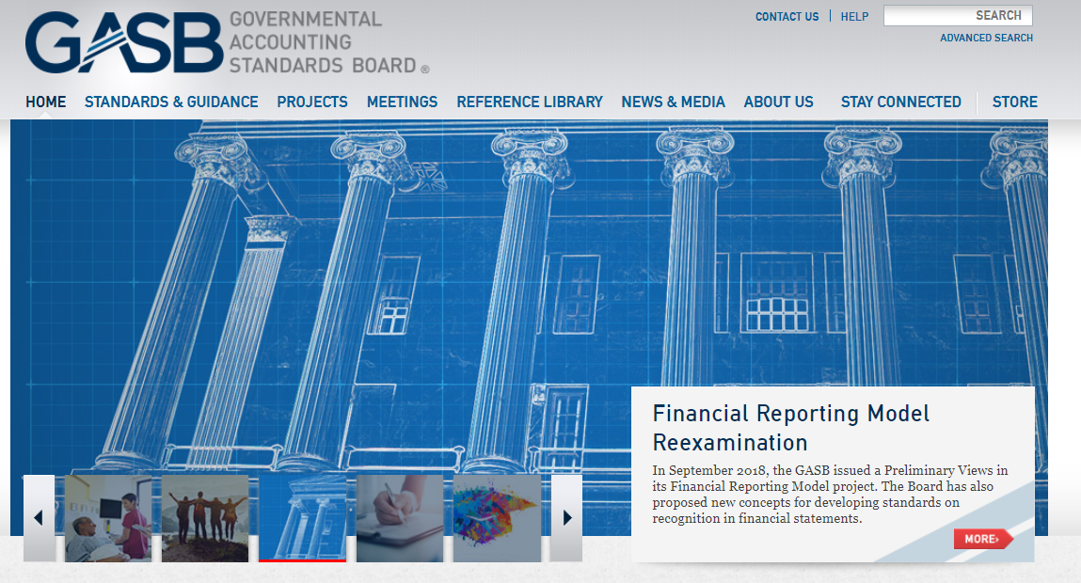
www.gasb.org

Slide 179
Website Resources
Free download of Statements, Implementation Guides, Concepts Statements and other pronouncements
Free access to the basic view of Governmental Accounting Research System (GARS)
Free copies of proposals
Up-to-date information on current projects
Form for submitting technical questions
Educational materials, including podcasts

Slide 180
Thank You

