Slide 1
Internal Controls and Segregation of Duties
Presented By: Katherine Heck, NHMA Sponsored by: Melanson CPA’s
Notes:
Local governments are required to establish and maintain adequate internal controls for purposes of financial reporting, managing operations, and legal compliance. Effective internal control is an integral part of a municipality’s governance system and ability to manage risk. One of the primary goals of internal controls is to create a separation of accountability and duties among municipal officials or employees. Join Katherine Heck, from the New Hampshire Municipal Association to discuss internal control standards and how to establish and maintain internal control and the segregation of duties within your organization.
Resources: https://www.comptroller.tn.gov/content/dam/cot/la/documents/manuals/2015_ICCManual_Complete_redesign-Final.pdf

Slide 2
AGENDA
What is the Purpose Internal Controls?
What does it mean to “segregate duties”?
Learn why….
This is a process: a means to an end, not the end itself.
Accomplished by people, not merely policy, procedures and forms.
Reasonable, but not absolute, assurance that assets and resources are safeguarded.
How are Internal Controls Developed?
Notes:
Process --- it’s going to change, not stagnant
Just as people are the core of your operations, people are the foundation of your IC system
Reasonable, not absolute -- there are limitations to any IC system
Want REASONABLE assurance there are safeguards in place

Slide 3
Internal Control Defined:
The Committee of Sponsoring Organizations of the Treadway Commission (COSO) is a joint initiative of the five private sector organizations listed on the left and is dedicated to providing thought leadership through the development of frameworks and guidance on enterprise risk management, internal control and fraud deterrence.
Internal control, as defined by COSO in its Internal Control—Integrated Framework is “a process, effected by an entity’s board of directors, management, and other personnel, designed to provide reasonable assurance regarding the achievement of objectives relating to operations, reporting, and compliance.”
Effective internal control is an integral part of an organization’s governance system and ability to manage risk.
Source: http://www.coso.org/

Slide 4
What are Internal Controls?
Anything that helps safeguard assets.
Anything that helps make more effective and efficient use of those assets.
Notes:
Money --- equipment---buildings----systems like the payroll system or assessing system, or TC billing systems

Slide 5
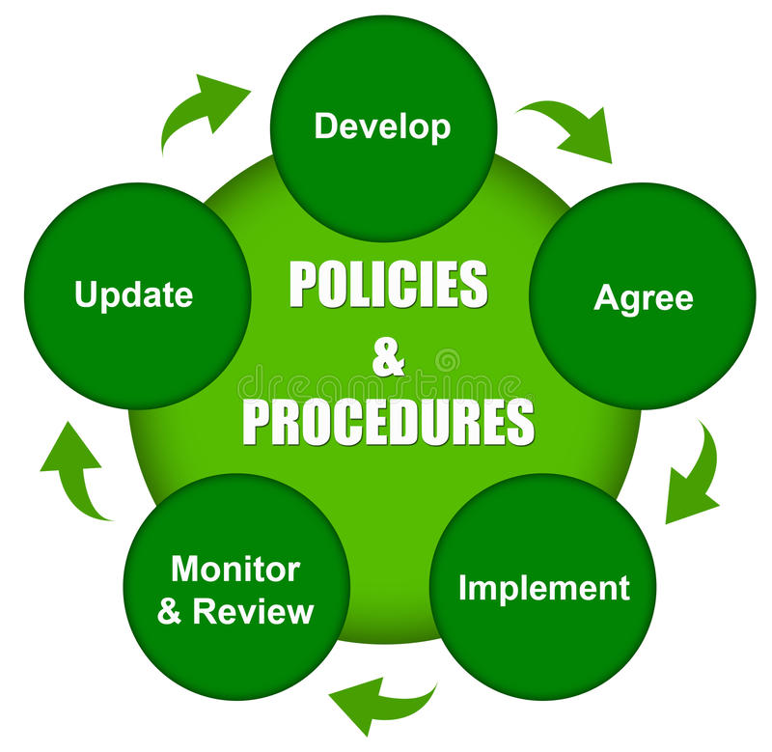
What are Internal Controls?
Internal control is a process.
Dynamic – ongoing and active
Iterative
Each process is defined and implemented by a set of policies and procedures‐ a series of ongoing actions and activities that occur throughout the organization.

Slide 6
Internal Controls Are Meant To:
1. Protect assets from waste and abuse.
2. Promote operational effectiveness and efficiency.
3. Ensure accurate, reliable records.
4. Encourage adherence to policies, rules, regulations and laws.
Notes:
Protect assets from loss or misuse
Duplicate purchases when equipment is idle elsewhere
Idle cash ---Not investing - Messages to Treasurers
Accountability - Steward of public resources - accounting system that provide accurate data --- so that appropriate decisions can be made by those people that must rely on the information
Compliance --- grant provisions, other spending requirements
THESE ARE THE 4 OBJECTIVES OF YOUR IC PROCESS
A process that is created which attempts to prevent or minimize the possibility of accounting errors, irregularities, and illegal acts. In effect….To minimize Waste, Abuse and Fraud.
Minimize Waste:
Significant loss or misuse of resources that results from deficient or negligent practices, controls, or decisions.
Waste involves behavior that is deficient or improper when compared with behavior that a prudent person would consider reasonable and necessary given the facts and circumstances. Waste does not necessarily involve fraud or other violations of law.
Minimize Abuse:
Grossly intentional, wrongful, or improper use of resources or misuse of rank, position, or authority.
Abuse involves behavior that is deficient or improper when compared with behavior that a prudent person would consider reasonable and necessary given the facts and circumstances. Abuse does not necessarily involve fraud or other violations of law.

Slide 7
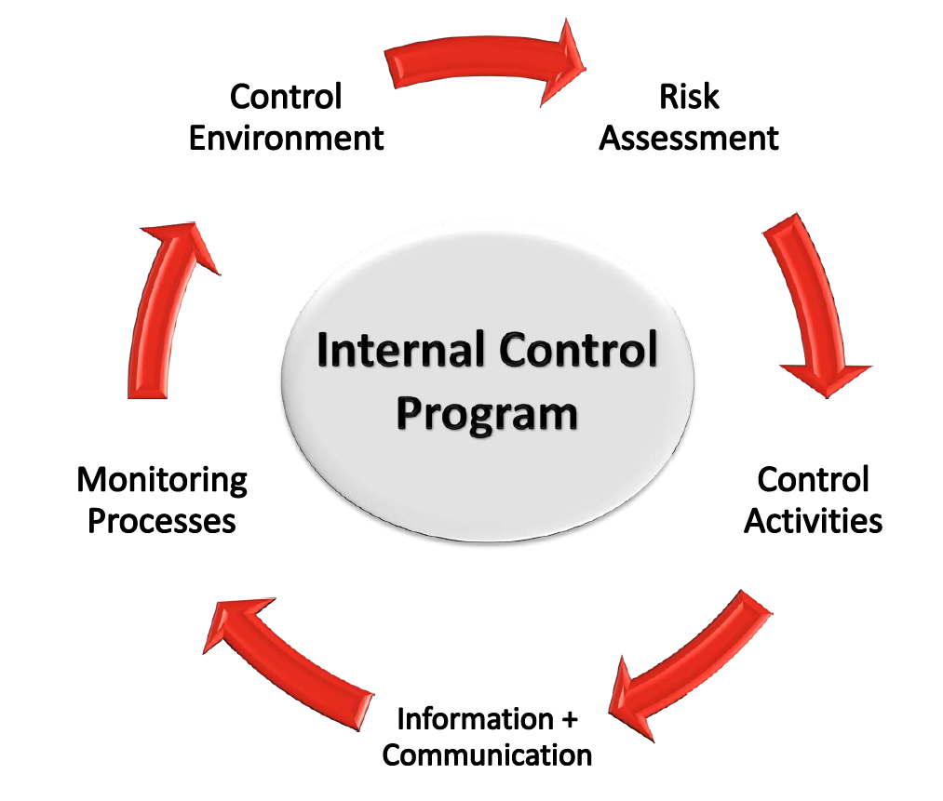
What Are Internal Controls?
A process: a means to an end, not the end itself.
Accomplished by people, not merely policy, procedures and forms.
Reasonable, but not absolute, assurance that assets and resources are safeguarded.
Notes:
Process --- it’s going to change, not stagnant
Just as people are the core of your operations, people are the foundation of your IC system
Reasonable, not absolute -- there are limitations to any IC system
Want REASONABLE assurance there are safeguards in place
Internal Controls provide a several benefits
Provides management and elected officials with confidence to achieve objectives
Provides feedback on functions ‐ performance measurement, annual reviews
Ability to meet requirements that create the opportunity for access to capital markets
Reliable reporting supports management and board decisions for resource deployment
Increased ability and confidence to communicate performance
Consistent mechanism for processing transactions
Higher efficiency and accuracy
Enhanced efficiency results in a better design and enhanced implementation in conducting a system of internal controls
Primarily by understanding the importance of specifying suitable objectives and the risks and controls that are most important to achieving these objectives
Coordinating efforts for identifying and assessing risks across multiple objectives may reduce the number of controls that may be redundant, or in some cases unnecessary

Slide 8
Importance of Internal Controls
Ensure
Ensure objectives are accomplished.
Reduce
Reduce fraud opportunities.
Prevent
Prevent loss of funds or other resources.
Establish
Establish standards of performance.
Assure
Assure compliance with laws, regulations, policies and procedures.
Preserve
Preserve integrity.
Eliminate
Eliminate adverse publicity.
Assure
Assure public confidence.
Notes:
Fraud - unfortunate fraud situation in NH --- I’ll talk about fraud risk
IC are the first line of defense in preventing and detecting fraud!
IC Also there to help protect employees

Slide 9
Types of Internal Controls:
Preventive – Designed to stop an unwanted outcome before it happens.
Reading/understanding policies
Review/approve purchase orders
Passwords to stop unauthorized access
Detective – Designed to find and correct errors that have already occurred.
Cash counts/reconciliation
Expenditures vs. budget
Reviewing payroll reports
Notes:
Preventive - understand policies -- want employees to know what to do and the right way to do it
Approvals = Preventive control
Anything done to compare expectations to r
Internal controls have direct and indirect costs
Trade off of recruiting and retaining more experienced and/or those with higher competency and the related higher compensation costs.
Costs associated with assessing the efforts to select develop and perform control activities
Efforts that add to the overall process
Efforts to maintain and update the control process
Costs of added technology – not just the technology itself
Cost of additional information requirements and the collection, storage and access
eality is a detective control!

Slide 10
Basic Objectives of Internal Control
Reporting Objectives
Reporting objectives pertain to the preparation of reports for use by organizations and stakeholders and may relate to financial or non‐financial reporting and to internal or external reporting.
Internal reporting objectives are driven by internal requirements in response to a variety of potential needs such as the entity’s strategic directions, operating plans, and performance metrics at various levels.
External reporting objectives are driven primarily by regulations and/or standards established by regulators and standard‐setting bodies.
External Financial Reporting Objectives
accessing capital markets and may be critical to being awarded contracts or in dealing with suppliers and vendors
External Non‐Financial Reporting Objectives
reporting requirements as set forth by regulations and standards for management reporting on the effectiveness of internal control over financial reporting are part of external non‐financial reporting objectives
Internal Financial and Non‐Financial Reporting Objectives
information deemed necessary to manage the organization
Source: http://www.coso.org/

Slide 11
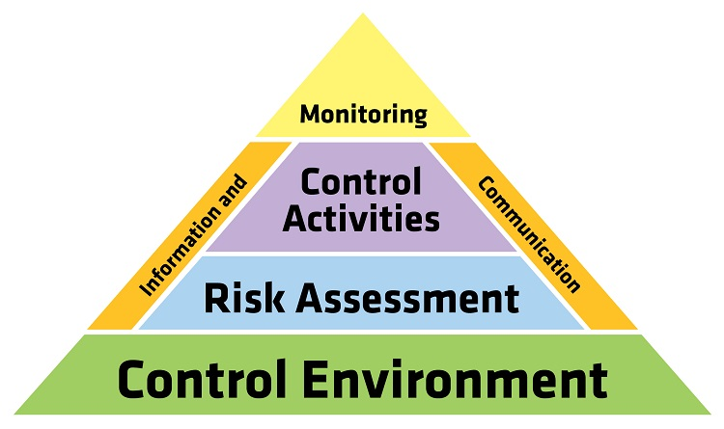
The Framework of Internal Controls
The Control Environment.
Risk Assessment.
Implementing Control Activities.
Information and Communication.
Monitoring.
Notes:
5 elements --- focus primarily on the first 3
Preventive Controls – Preventive controls are designed to keep errors or irregularities from occurring. Many of these controls are based on the concept of segregation of duties. No employee should be in a position to both perpetrate and conceal errors or fraud in the normal course of their duties. An employee who is responsible for approving transactions should not be the one who also records the transaction or maintains the custody of the asset.
Detective Controls – Detective controls are designed to identify errors or irregularities that already exist. They are implemented to ensure that the preventive controls are working effectively. Examples include monthly reconciliations of bank accounts, conducting physical inventory counts and internal or external audits.
Monitoring Controls – Monitoring controls ensure that internal controls continue to operate effectively over time. When implemented, a company will be able to identify and correct problems on a timely basis, and produce more accurate financial information and timely financial statements. Examples of monitoring procedures include periodic evaluation of internal controls, follow‐up on anomalies identified in operating reports or metrics and supervisory reviews of reconciliations.

Slide 12
The Control Environment
Set the tone at the top – internal controls are important!
Integrity and ethical values - must be clearly communicated in writing and by example.
Commitment to competence –sound personnel policies including job descriptions, hiring policies, background checks, job qualifications, performance evaluations.
Authority and responsibility – clear lines of authority. If everyone if responsible, then no one is responsible. Provide all of the authority necessary and only the authority necessary.
Notes:
Control Environment
Set of standards, processes and structure that create the basis for carrying out internal control across the organization
Management reinforces expectations at various levels of the organization
Comprises the Integrity and Ethics of the organization
Sets organizational structure for responsibilities and authority
Oversight, implementation
Attracting, retaining and training competent employees
The control environment sets the stage for the overall system of internal controlsManagement is aware of the importance of IC and communicates – if management attaches importance to IC, so will employees
Management == BOS, SB, Managers Super, FD
Employees need to know that their superiors care about IC
Performance Evaluations ---constructive ---to benefit the employee, the supervisor and the operation that they work for. Future goals
Management must exhibit in writing and in action integrity and ethical behavior. Employees are the foundations of your IC system --- di as I say, don’t do as I do isn’t going to fly.
Committed to competence:
Sound personnel policies – Employees are qualified, trained, retrained so skills are up to date, clear understanding of their responsibilities
Job descriptions stating responsibilities and qualifications ---samples at LGC
Hiring policies --background checks, reference checks, financial positions --criminal check, credit check, MV, positions bondable
GET SIGNED RELEASE FORM
Dishonest or unqualified employees can’t be expected to perform control procedures effectively
Elected positions --- encourage them to take advantage of training opportunities that are offered through their associations, LGC
Performance Evaluation – corrective action
Authority and Responsibility
- need to be able to pinpoint responsibility
– provide resources necessary to do their jobs

Slide 13
Control Activities
Directive Controls provide guidance to employees to help achieve the desired objectives in the department
Preventive Controls are designed to deter the occurrence of an undesirable event. The development of these controls involves predicting potential problems before they occur and implementing procedures to avoid them.
Detective Controls are designed to identify undesirable events that do occur and alert management about what has happened. This enables management to take corrective action promptly.
Corrective controls identify flaws in the process and determine actions to be taken (employee training)
Notes:
There are different control activities
Directive Controls provide guidance to employees to help achieve the desired objectives in the department
Preventive Controls are designed to deter the occurrence of an undesirable event. The development of these controls involves predicting potential problems before they occur and implementing procedures to avoid them.
Detective Controls are designed to identify undesirable events that do occur and alert management about what has happened. This enables management to take corrective action promptly.
Corrective controls identify flaws in the process and determine actions to be taken (employee training)
Control Activities
Control activities help ensure risk responses are effectively carried out and include policies and procedures, manual and automated tools, approvals, authorizations, verifications, reconciliations, security over assets, and segregation of duties. These activities occur across an agency, at all levels and in all functions, and are designed to help prevent or reduce the risk that agency objectives will not be achieved.
Managers set up control activities to provide reasonable assurance that the agency and business unit objectives are met. An example of a control activity is something as simple as listing tasks assigned to staff members and then periodically checking the list to verify that assignments are completed on time.
– Control levels are performed at all levels of the entity and at various stages within the business process

Slide 14
What is Risk?
When working toward its objectives, every organization faces a wide range of uncertain internal and external factors = Risks.
The effect of this uncertainty on the organization’s objectives is called risk, which can be either positive, representing opportunity, or negative, representing a threat.
Risk should always be assessed in light of setting and achieving your organization’s objectives. If there are no objectives, there is no risk.
This risk assessment process is both active and frequent.
Notes:
Proper risk management
helps you make informed decisions about the level of risk you want to retain and implementation of the necessary controls.
helps organizations understand the risks they are exposed to, put controls in place to counter threats, and effectively pursue their objectives.
Organization identifies objectives with sufficient clarity to enable identification and assessment of risks relating to objectives
Operations objectives
Management choices
Risk tolerance
Operations and Financial performance goals
Basis for committing resources
External financial and Non‐financial reporting objectives
Complies with applicable accounting standards
Reliable, timeliness and transparency
Internal reporting objectives
Designed to provide management the information needed to manage the organization
Unique to each organization
Compliance Objectives
Laws and regulations establish minimum standards of conduct

Slide 15
What is the Objective Risk Management?
Reliable Financial Reporting
Timeframes should be set for each report (daily/monthly/annually)
Procedures established to ensure accuracy
Efficient Operations
Eliminate redundant operations
Utilize technology when available to reduce time (cost)
Legal Compliance
Identify applicable laws and confirm compliance

Slide 16
Identify and Analyze Risks
Identify risks at all levels of the entity
Ongoing and iterative process conducted to enhance ability to achieve objectives
What is the severity and likelihood of loss?
Analyze internal and external factors
What is the frequency of risk assessment?
Takes into account operational priorities and cost
Involve appropriate levels of Management
Responsibility and accountability for risk identification and analysis is the responsibility of management.
Estimate the significance of each risk
What is the likelihood (probability)
Frequency
Duration of impact after the occurrence
Determine how to respond to the risk
Once potential significant risks is assessed, management determines how to manage the risk

Slide 17
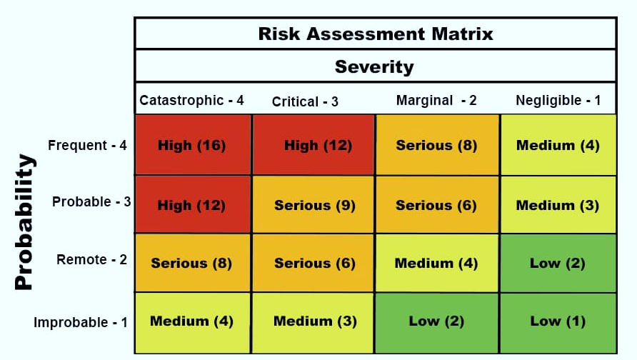
Risk Assessment
Changes effecting risk
Inherent Risk
Fraud Risk
Unfamiliarity
Opportunity
Complexity
Notes:
Second element of the COSO framework is risk assessment
Changes that increase risk
Things by their nature are risky
Fraud risk
Risk Assessment
Every entity faces a variety of internal and external risks
Risk is the possibility that an event will occur that adversely affect the achievement of objectives
Risk assessment is a dynamic and iterative process for assessing risks to the objectives.
A pre‐condition of risk assessment is the establishment of objectives
An risk assessment forms the basis for determining how risks are managed
What is the entity’s risk tolerance –
the acceptable level of variation in performance relative to the achievement
Reason we’re discussing risk is to help identify where your priorities may need to be ---what areas in your operations may need some attention in terms of improving internal controls
Understanding the different types of risks that are out there will help you set priorities.
Where are the biggest risk areas in your town or school district? Those should be your focus.
In the beginning, I said IC are a Process--- on-going process because these risk areas change all the time
Inherent Risk
The nature and characteristics of certain activities and assets puts them at greater risk for fraud or material error. This condition is referred to as inherent risk. Some characteristics that generally increase inherent risk are:
Opportunity ‐ The more liquid or mobile an asset is, or the more decentralized an operation is, the greater the potential for fraudulent activity. For example, inherently risky assets include laptop computers and other portable electronic equipment, cash (especially undeposited cash) and gasoline. Inherently risky operations include the collection of cash in almost any venue, loaning and storage of electronic equipment, and credit card and cell phone usage.
Unfamiliarity ‐ The newer the activity or program, the greater the possibility that its operation and risks may not be well understood and its objectives and goals may not be realized. New services may require unique internal control policies and procedures, or may require modification of existing internal controls. For example, when a new recreational facility is opened, procedures for the collection and deposit of fees may not be in place or be well understood by employees. On the operational side, liability insurance may not be adequate to indemnify the organization against claims that may occur because of citizen or spectator injuries.
Complexity ‐ The more complex an activity is, the greater the possibility of errors occurring. For example, legal and grant requirements governing aid programs may increase the likelihood that significant noncompliance and eligibility concerns may occur. When planning a large capital project, management may not be sufficiently familiar with the oversight, financial, legal and insurance requirements of construction projects, leading to unexpected costs and delays in completing the project.

Slide 18
Risk Assessment – Consider Changes Effecting Risk:
Changes in operations - economic, political.
Changes in personnel.
Changes in IT systems.
Rapid growth.
Change in structure, staff reductions.
Change in programs, activities, services or vendors.
Notes:
No Child Let Behind, Berlin mills ---positive or negative --I-93 widening ---natural disasters
Always a certain element of risk regardless of how qualified a person may be ---learning curve ---in key positions --New Employees, period of vacancy when functions performed on a temporary basis
IT changes ---manual to automated, learning curve, we’ve all been thru it
Rapid growth -- Increased demand for services. Attempts to cut corners, let some controls slide to get things done
Change in structure - normal system of check and balances may be altered
Change in programs -- always seems to get the medias attention --Concord’s curbside recycling
Building projects
You can see why a risk assessment is an on-going process because these types of changes occur all the time ---need to be aware that these changes may require modification of changes to the controls in place.

Slide 19
Risk Assessment – Consider Inherent Risk
Cash – the more easily an asset can be converted to personal use, the more likely it is to be stolen.
Complexity – the more that can go wrong, the more that is likely to go wrong.
Decentralization.
Unfamiliarity-An unresponsiveness to previously identified internal control weaknesses sends a negative message about management’s attitude!
Notes:
Inherent by their nature
Handling Cash is always risky
Example ---2 piles of $10000 - one id all checks, the other is all $10’s and $20,
Medicaid to schools program --very complex
School districts reimbursed for certain sped services for certain students ---teachers, aides, support staff, transportation personnel, nurse - complex billing, coding, reporting – risk == under billing or over billing
Example --unlocked car in front of house, other end of town , a few towns over, here.
Generally people feel it’s riskier to leave your car unlocked the further you are from home.
Same true for town/school --- the further the operation from the town hall or central office, the more risk
$500 in the town hall, or $500 at the town dump -- inherently, which has more risk associated with it?
See that in an example
If your auditor identified an IC problem and it’s been ignored, that itself creates an inherent risk
“As we noted last year…” never good

Slide 20
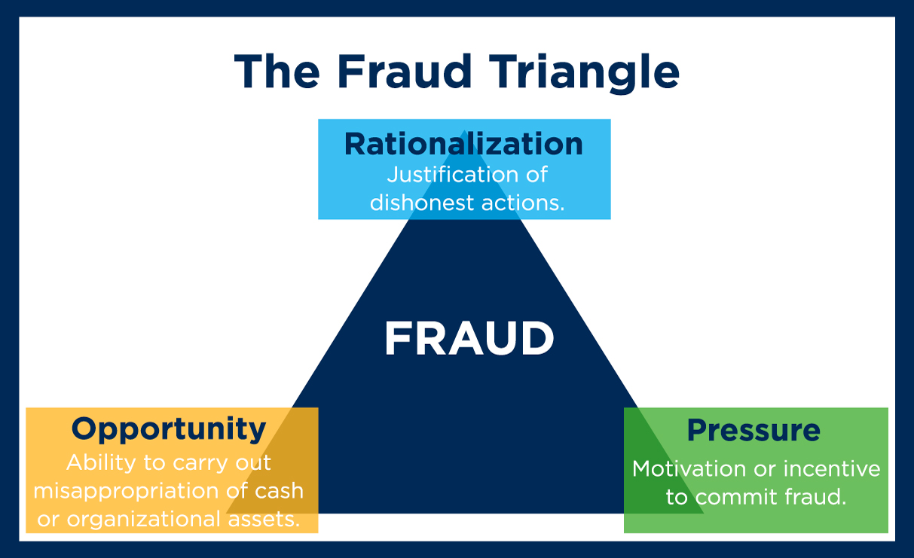
Risk Assessment – Consider Fraud Risks
Embezzlement/Conversion
Cash, securities, broker/dealers, investment managers
Mechanical errors
Incorrect amounts
Improper amortization of premiums and discounts Incorrect payees
Wire transfer failures
Judgement Errors
Inappropriate securities selection Poor market timing (?)
Selection of an insolvent dealer or depository
Cover Up
Fraud
Delaying or avoiding recognition of losses
Financial Stress – personal, business, illness.
Addictions – gambling, drugs, alcohol.
Disaffection - an employee believes they are being, or have been, mistreated.
Past Problems.
Notes:
Embezzlement/Conversion
Cash, securities, broker/dealers, investment managers
Mechanical errors
Incorrect amounts
Improper amortization of premiums and discounts Incorrect payees
Wire transfer failures
Judgement Errors
Inappropriate securities selection Poor market timing (?)
Selection of an insolvent dealer or depository
Cover Up
Fraud
Delaying or avoiding recognition of losses

Slide 21
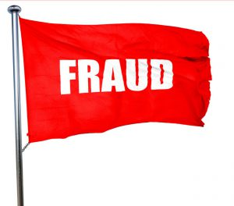
Red Flags
Employee Red Flags
Employee lifestyle or behavioral change Significant personal debt and credit problems Refusal to take vacation or sick leave
Lack of segregation of duties in vulnerable areas.
Management Red Flags
Reluctance to provide information to auditors
Management decisions are dominated by an individual or small group Weak internal control environment
Excessive number of checking accounts or frequent changes in banking accounts Excessive number of year‐end transactions
High employee turnover rate
Service contracts result in no products
Cash Receipts and Disbursements
Records and Reports
Purchasing
Fixed Assets
Notes:
Cash Receipts and Disbursements Flags Lack of segregation of key duties Deposits not made intact
Cash receipts issued out of sequence No cash receipt log kept
Lack of control over CFO’s signature Uncontrolled access to blank checks.
Records and Reports Flags
Large number of write‐offs of accounts Discrepancies between bank deposits and postings
Excessive or unjustified cash entries and/or adjustments No supporting documentation for adjusting entries Incomplete or untimely bank reconciliations
Purchasing Flags
Lack of segregation of key duties Purchases that bypass normal procedures Changes made to vendor files
Vendor addresses match employee addresses
Fixed Asset Flags
Lack of segregation of key duties
Lack of asset tags and periodic physical inventories Lack of physical security over assets.

Slide 22
Sample Risk Assessment
Change Risk | Inherent Risk | Fraud Risk
Notes:
3 Kinds of risk ---Assess in order to identify where you need to pay attention
Can not anticipate every potential risk, but can anticipate some. Involve manager and supervisors at all levels
Organization identifies objectives with sufficient clarity to enable identification and assessment of risks relating to objectives
Operations objectives
Management choices
Risk tolerance
Operations and Financial performance goals
Basis for committing resources
External financial and Non‐financial reporting objectives
Complies with applicable accounting standards
Reliable, timeliness and transparency
Internal reporting objectives
Designed to provide management the information needed to manage the organization
Unique to each organization
Compliance Objectives
Laws and regulations establish minimum standards of conduct

Slide 23
Sample Risk Assessment: EXAMPLE Transfer Station Operation
Change Risk ⇓ | Inherent Risk ⇓ | Fraud Risk ⇓
Rapid Growth | Cash | Financial Stress
Staff Turnover | Decentralized | Past Personnel Issues
Notes:
High Risk or Low Risk?
Even without the fraud piece, there’d still be risk

Slide 24
Sample Risk Assessment EXAMPLE: Fuel Charges
Change Risk | Inherent Risk | Fraud Risk
New Vendor | Decentralized | Price of Fuel
Notes:
Fraud: Perceived pressure, opportunity, rationalization

Slide 25
Questions To Ask Regarding Risk Assessment
Where is the potential risk?
What is the likelihood of an unwanted occurrence and what would be the impact?
What compensating controls can be implemented?
Does the cost of the controls exceed their benefit?
Notes:
Trying to identify potential risk
Don’t expect you to do the tic tac toe grid with every type of transactions, but be aware of the risks, and ask these questions
After assessing relevant risks, and depending on the organization’s risk appetite or limits for taking risks, management can determine how best to manage these risks.
In some cases, the risk response may be acceptance—that is, taking no action apart from monitoring the changes in risk.
avoidance—not participating in or exiting the activities giving rise to a given risk;
reduction— removing the source, changing the likelihood, or changing the nature, magnitude, or duration of the consequences of a given risk;
sharing—transferring a portion of the risk via insurance, hedging, a joint venture, or other technique.

Slide 26
Information and Communication
To be useful, information must be:
Appropriate
Accurate
Timely
Current
Accessible
Notes:
4th element
Accounting/reporting system as a whole ---useful, understandable and get to the right people
Contrary to popular belief, IC are not implemented just to make the auditors happy!
Identify, capture, and exchange information in a form and timeframe that enables people to carry out their responsibilities and to maintain accountability
Information and Communication
The control structure must provide for the identification, capture and exchange of information both within the agency and with external parties.
Information communicated should be timely and accurate.
Internal communication throughout the organization – directives and responsibilities
Conveys the code of ethics, internal control philosophy
Approach and delegation of Authority
External communication includes inbound information from the outside party and provides the external parties with requirements and expectations
Allows stakeholders (citizens) and suppliers to understand the services standards and provide valuable input on performance and service quality and effectiveness.
Effective management should appropriately convert such input into continuous improvements in operations, reporting, and compliance.
Organization communicates deficiencies in a timely manner to those responsible for taking corrective action
Assesses the results of ongoing and separate evaluations
Not only to identify short comings in internal control that can adversely affect the entire organization, but also identify areas to improve efficiency of internal control
Communicates deficiencies
Communicating to the responsible party to take action is critical
Method established by laws, rules, and internal policy
Monitors Corrective actions
Management is responsible for tracking the remediation efforts and making sucorrective action is completed on a timely basis

Slide 27
Information and Communication
Up, down, lateral and around.
Accounting policies and procedures manual:
Clearly outlines specific authority and responsibility
Serves as a reference tool
Lessens the threat to continuity due to employee turnover
Notes:
Which employee, which function, which manner
Guidance on less frequently encountered transactions and situations
Employees free to report when policies and procedures are not being followed, or not working as intended ---because this is an on-going process
Organization obtains or generates and uses relevant, quality information
Identifies information requirements
Info is necessary to carry out internal control responsibilities
Gathered by BOD and senior management and summarized
Controls themselves establish information requirements
Captures internal and external sources of data
Internal Sources of Data– Email, minutes from meetings, personnel reports, response to surveys, whistleblower hotline
External Sources of Data – service providers, industry research, regulatory bodies, social media, whistleblower hotline
Processes relevant data into information
Source, capture and process large volumes of data in meaningful actionable information
Manual and automated
Maintains quality throughout processing
Must be accessible, correct, current, protected, retained, sufficient, timely, valid and verifiable
Considers costs and benefits

Slide 28
Monitoring
Periodic
Ongoing
Separate evaluation of internal controls:
Independent Auditor – material weakness, reportable condition, non-compliance, significant deficiency
Insurance Carrier (Property/Liability) - internal control assessment
Management and Leadership analysis.
Notes:
External auditors are not responsible for an entity’s internal controls. External auditors evaluate internal controls as part of their audit planning process, but they are not responsible for the design and effectiveness of your controls.
Management provides the leadership needed to establish and guide an integrated internal control framework. Effectively establishing a positive “tone at the top” by conducting an organization’s affairs in an honest and ethical manner and establishing accountability at all levels of the organization. If management does not demonstrate strong support for internal controls, the organization as a whole will be unlikely to practice good internal controls.
Things change ‐ by monitoring the risks and the effectiveness of control measures on a regular basis, an agency can react dynamically to changing conditions.
Monitoring evaluates the effectiveness internal controls and is designed to ensure that internal controls continue to operate effectively. Monitoring is effective when it leads to the identification and correction of control weaknesses before they materially affect the achievement of the agency’s objectives.
Proper monitoring is most effective when results are prioritized and communicated, and weaknesses are corrected and followed up on as necessary.
There are two types of monitoring: ongoing and periodic. Ongoing monitoring occurs in the course of operations. It includes tasks such as supervisory reviews of reconciliations, reports, and processes. Periodic monitoring includes tasks such as periodic internal audit sampling and annual reviews of high‐risk business processes. Internal control deficiencies uncovered by monitoring should be reported to higher levels of management.

Slide 29
Monitoring
Investigate and resolve discrepancies.
Maintain professional skepticism – explanations should be supported by some type of evidence.
Promptly follow-up on all indications of potential errors and irregularities.
Notes:
IC can not eliminate all errors and irregularities, but alert management to their presence for timely and effective corrective action.
Professional skepticism does not mean distrusting employees -- it means that management will insist, simply as a matter of good business practice, that all explanations of discrepancies be supported by evidence.
Unusual transactions: expectation vs reality
Vendor checks cashed rather than deposited
Invoices for items not typical from that vendor
Physical condition of the documentation itself
In those areas where you’ve identified high risk in your town review reports, reconciliations, trends, comparisons, prior year, other towns
Tips and complaints --follow through, especially if in an area that already been identified as high risk
Just as a smoke alarm does not put out a fire, the same is true of internal controls – both are designed to provide an “alert”.
Internal controls are a tool to detect and prevent errors and irregularities (intentional misstatement of the financial statements or a theft of assets).
Be alert to “red flags” such as unusual or unexplained discrepancies.
Monitoring doesn’t just help detect problems, it helps prevent them.

Slide 30
Accountability
Organization holds individuals accountable for their internal control responsibilities
Enforces Accountability through structures, authorities and responsibilities
Establishes Performance Measures, Incentives and Rewards
Evaluates Performance Measures, Incentives and Rewards
Align incentives and rewards with fulfillment of internal control responsibilities
Clear objectives, defined implications, meaningful metrics
Consider Excessive Pressures – evaluate the pressures associated with achieving objectives
Do not set unrealistic performance targets
Evaluate performance of internal control responsibilities
Adherence to standards of conduct
Expected levels of competence
Accountability is interconnected with leadership and is the result of the tone established by the governing body and senior management.
Notes:
Organization holds individuals accountable for their internal control responsibilities
Enforces Accountability through structures, authorities and responsibilities
Establishes Performance Measures, Incentives and Rewards
Evaluates Performance Measures, Incentives and Rewards
Align incentives and rewards with fulfillment of internal control responsibilities
Clear objectives, defined implications, meaningful metrics
Consider Excessive Pressures – evaluate the pressures associated with achieving objectives
Do not set unrealistic performance targets
Evaluate performance of internal control responsibilities
Adherence to standards of conduct
Expected levels of competence
Accountability is interconnected with leadership and is the result of the tone established by the governing and senior management.

Slide 31
Who Is Responsible?
EVERYONE plays some role in effecting internal controls.
All personnel should be responsible to communicate:
Problems in operations
Deviations from established standards or expectations
Violations of policy, law or regulations
Governing Body – BOS, Council, School Board, Commissioners, Aldermen
Manager, Superintendent
Department Heads, Principals
Supervisory Personnel
Each Individual Employee
Budget Committee
Notes:
they are performing as intended.
The governing board’s responsibilities for internal controls primarily involve oversight, authorization and ethical leadership.
The governing board relies upon management, to create the policies needed to ensure that services are provided effectively and assets safeguarded.
Senior Management relies upon managers and department heads to recommend and implement procedures that lower identified risks.

Slide 32
Where to Start: Internal Control Self-Assessment
A basic checklist from the checklist published by the Vermont State Auditors Office:
2022 VT checklist: https://diovermont.org/wp-content/uploads/2022/02/Internal-Control-Checklist-Fillable-.pdf
Answers on the right indicate a potential internal control weakness that may need attention.

Slide 33
Where to Start: Where Are the Risks?
Cash, decentralization, no segregation of duties, change, potential for fraud.
Where does the money come from, where does it go?
Notes:
Where is the risk exposure in your town , in your school district?

Slide 34
Where to Start: Address the Identified Weakness
Authorization controls
Record controls
Security controls
Segregate duties
Personnel policies
Reconciliation
Verification
Analytic review

Slide 35
Government Finance Officers Association Statement on Fraud Prevention
Fear of detection and punishment is a product of effective internal controls. Weak internal controls both permit and invite irregularities by reducing or removing that fear.
The single most important step that can be taken to prevent fraud is for management to establish and maintain an effective internal control structure!

Slide 36
Implementing Control Activities
Authorizations – in writing, in advance, by specific individual(s), documentation (audit trail).
Properly designed records – sequential numbering, automatic duplicates, info for multiple purposes, avoid unnecessary info.
Security of assets and records – controlled access, physical security, keep confidential records separate from non-confidential records, computer backup, disaster recovery.
Notes:
Pinpoint responsibility
Documentation valid ---pay from an invoice, not a statement.
Receipts ---Retain your receipt for future reference
PO approved, receiving slip, invoice, approval
Treasurers -- correct bodies authorize disbursements -- majority, not an individual
Controlled access ---payroll records, deductions, assessment records, billing records
TC abatements/ Assessor in writing checks and balances
Limit access to individuals specific needs.

Slide 37
Implementing Control Activities
Periodic reconciliations – i.e. bank reconciliations, accounting record reconciliations (i.e.tax collector to treasurer), reasonableness review.
Periodic verification – i.e. physical inventory, payroll payout.
Analytical review – what’s expected vs. what’s reported, data entry controls, edit checks, exception reporting, financial vs. non-financial data.
Notes:
BOS - Do you know when the TCTC don’t balance with the treasurer?
Payroll -- fictitious employees ---decentralized, pay for time not worked, pay for unauthorized overtime, termination pay
Person distributing checks different than person preparing checks
Analytic review -- #participants vs fees
Cost for food service consistent with # students?
Reasonableness check ---Ashland fund balance, but no money

Slide 38
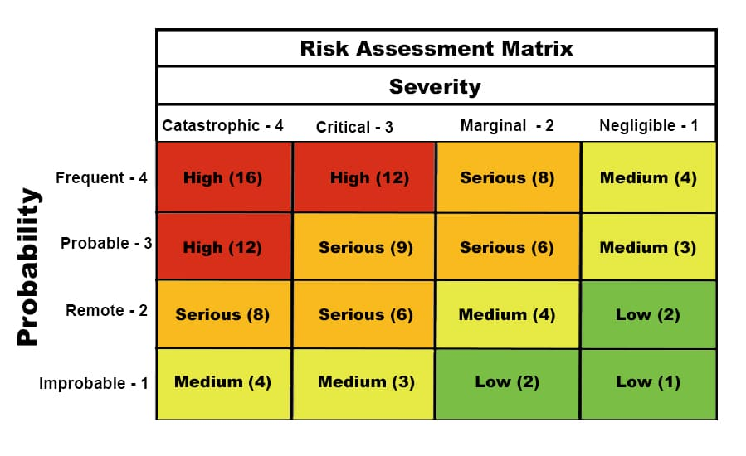
Sample Control Activities: Transfer Station Operation
Change Risk ⇓ 4 | Inherent Risk ⇓ 6 | Fraud Risk ⇓ 6
Rapid Growth *Reports | Cash *Remit Daily *Receipts | Financial Stress *HR Resources
Staff Turnover *Supervision *Segregation | Decentralized *Reports | Past Personnel Issues *Clear Expect. *Evaluation

Slide 39
SAMPLE Control Activities: Fuel Charges
Change Risk | Inherent Risk | Fraud Risk
New Vendor *Reference Check | Decentralized *Monitor Delivery | Price of Fuel *Monitor Delivery
Notes:
Fraud: Perceived pressure, opportunity, rationalization
Big bucks on fuel –more this year!
Someone from the custodial dept will meet you

Slide 40
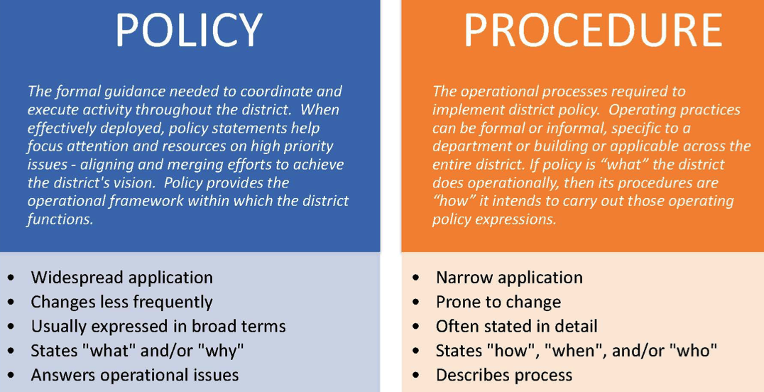
Implementing Control Activities
Policies (what should be done) and procedures (how it should be done) designed to ensure that the objectives (protect assets, effectiveness/efficiency, accurate records, and compliance) are achieved.
Notes:
3rd element
When a weakness has been identified, there may already be a compensating control in place

Slide 41
Policies reflect management or board statements of what should be done to effect internal control.
Such statements should be in writing
Explicitly stated in management communications
Implied through management actions and decisions.
Procedures consist of actions that implement a policy – actions should be described in writing, and this written documentation typically results in the formation of a policy.
These are actions that permeate an entity’s activities and that are inherent in the way management operates the entity.

Slide 42
Control Activities through Policies and Procedures Organization deploys control activities that establishes the procedures
Procedures to support the deployment of Management Directives
Responsibility and Accountability for Executing policies and procedures
Performs controls activities in a timely manner
Takes corrective action
Performs using Competent personnel
Reassesses Policies and Procedures

Slide 43
Most Common Internal Control Deficiencies
Lack of written financial policies and procedures.
Inadequate cash and receipts procedures.
Inadequate reconciliations.
Lack of personnel policies.
Lack of personnel evaluations.

Slide 44
Limitations of Internal Controls
Judgement – decisions made by people under pressure and time constraints, based upon information on hand.
Breakdowns – lack of understanding, simply making mistakes.
Management Override – high level management override prescribed policies and procedures.
Collusion – 2 or more individuals circumventing controls.
Cost vs. Benefit – risk and effect must be weighed against the cost of establishing controls.
Notes:
Collusion - Fear of detection and punishment very effective.
Segregation of duties very effective --significant hurdle to those who might otherwise be tempted to commit irregularity
Cost v benefit --supervisor BOS countersign a voided receipt so cashier isn’t accused of taking money because receipts don’t tie out
How much risk willing to take.

Slide 45
Balancing Risks and Controls
Excessive Risks – loss of assets, loss of funding, poor decisions, non-compliance, increased regulation, public scandal.
Excessive Controls – increased bureaucracy, complexity, time, non-value-added activities, reduced productivity
Reasonable Assurances:
Cost-Benefit
Notes:
If not addressing high risk areas, potential for ….
However, more is not always better……
REASONABLE…..
An effective system of internal control provides management and the board of directors with reasonable assurance regarding achievement of an entity’s objectives.
That stated….No matter how well designed and operated, internal control can provide only reasonable (not absolute) assurance that all agency objectives will be met
– WHAT IS REASONABLE????
The term “reasonable assurance” rather than “absolute assurance” acknowledges that limitations exist in all systems of internal control, and that uncertainties and risks may exist, which no one can confidently predict with precision. Absolute assurance is not possible.
Reasonable assurance does not imply that an entity will always achieve its objective

Slide 46
Common Methods of Control Activities
Authorization –designed to provide reasonable assurance that all transactions are within the limits set by policy or that exceptions to policy have been granted by the appropriate officials.
Review and approval – designed to provide reasonable assurance that transactions have been reviewed for accuracy and completeness by appropriate personnel.
Verification – Control activities in this category include a variety of computer and manual controls designed to provide reasonable assurance that all accounting information has been correctly captured.
Reconciliation –Provide reasonable assurance of the accuracy of financial records through the periodic comparison of source documents to data recorded in accounting information systems.
Physical security over assets – Designed to provide reasonable assurance that assets are safeguarded and protected from loss or damage due to accident, natural disaster, negligence or intentional acts of fraud, theft or abuse.

Slide 47
Source: GFOA
Internal Control and Financial Reporting
Institutionalize good financial management practices.
Formal policies usually outlive their creators, and, thus, promote stability and continuity. They also prevent the need to re‐invent responses to recurring issues.
Clarify and crystallize strategic intent for financial management.
Financial policies define a shared understanding of how the organization will develop its financial practices and manage its resources to provide the best value to the community.
Define boundaries. Financial policies define limits on the actions staff may take.
The policy framework provides the boundaries within which staff can innovate in order to realize the organization's strategic intent.
Support good bond ratings and thereby reduce the cost of borrowing.
Promote long‐term and strategic thinking.
The strategic intent articulated by many financial policies necessarily demands a long‐term perspective from the organization.
Manage risks to financial condition.
A key component of governance accountability is not to incur excessive risk in the pursuit of public goals.
Financial policies identify important risks to financial condition.
Comply with established public management best practices.
Notes:
Financial policies are central to a strategic, long‐term approach to financial management. Some of the most powerful arguments in favor of adopting formal, written financial policies include their ability to help governments:
Internal Controls Financial Reporting
Do the financial statements fairly reflect all transactions?
Are all transactions are recorded in accordance with applicable policies and rules?
Are the Assurance that transactions are carried out in accordance with the appropriate authorized individuals within the entity?
Is there a reasonable assurance that financial resources are safeguarded against theft and loss due to waste, abuse, mismanagement, errors, fraud, and omissions?

Slide 48
Establish formal written procedures
Identifying risks
Creating a separation of duties
Safeguard physical and financial assets
Efficiency of operations
Reliability of financial reporting
Compliance with legal requirements
Minimize opportunities for fraud, employee error
Internal Control In the Treasury Function
Internal controls constitute specific policies and procedures (the controls) designed to achieve the objectives of:

Slide 49
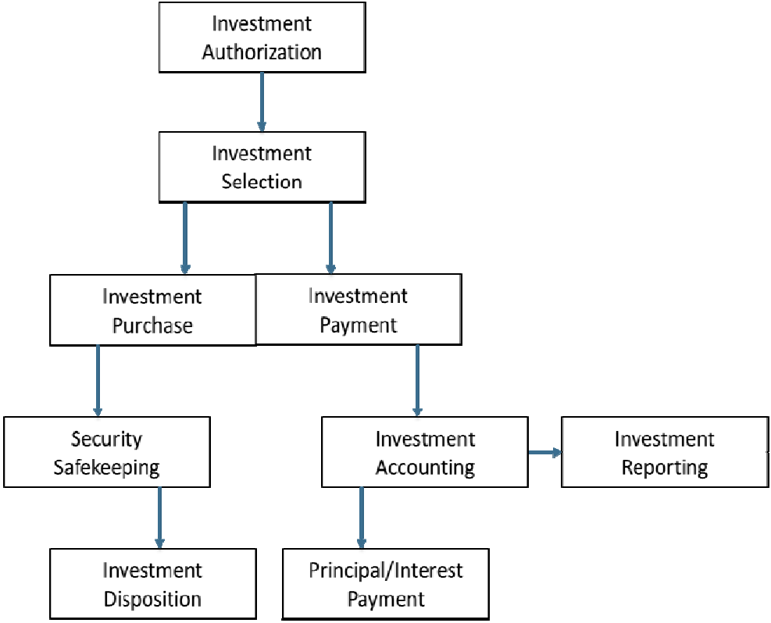
Internal Controls for Investment Activity
Investment Authorization
Authorized decision makers
Guidelines on permitted investments (investment policy) Flexible to respond to changes in the markets
Restrictive to minimize the risk of fraud or loss
Investment Selection
Only permitted investments
Risk reward and market conditions
Factors to consider: Yield, Maturity, Credit worthiness Permitted does not equal appropriate
Investment Purchase and Payment
Clearly, well documented transactions
Trade ticket, custody statement, investment report
Establishing and maintaining ownership
Reconcile custody statements and other internal/external reports
Security Safekeeping
Source: Investing Public Funds second edition

Slide 50
Internal Controls as They Relate To Cash Management
Internal controls specifically ensure:
The safety of all funds
The timeliness of recording the receipt of all funds
That assignment of duties complies with separation of duties guidelines
That reconciliations are completed and reviewed on a monthly schedule
A sound audit trail and adequate documentation are created

Slide 51
Common Methods of Control Activities
Segregation of duties – Reduce the risk of error and fraud by requiring that more than one person is involved in completing a particular fiscal process.
Education, training and coaching – Reduce the risk of error and inefficiency in operations by ensuring that personnel have the proper education and training to perform their duties effectively. Education and training programs should be periodically reviewed and updated to conform to any changes in the agency environment or fiscal processing procedures.
Performance planning and evaluation –Establish key performance indicators for the agency that may be used to identify unexpected results or unusual trends in data which could indicate situations that require further investigation and/or corrective actions. Evaluations may be done at multiple levels within the agency, as appropriate: the agency as a whole; major initiatives; specific functions; or specific activities.
Performance reviews may focus on compliance, financial or operational issues. For example, financial reviews should be made of actual performance versus budgets, forecasts and performance in prior periods.
Source: http://www.coso.org/

Slide 52
Segregation of Duties
Although control activity procedures are not intended to increase staffing levels, acceptable procedures are to be established and followed which may require changes in existing workloads and/or additional staff position(s).
A periodic thorough internal review of control activities may identify policies and procedures that are no longer required.
Small to medium size operations may not be able to institute internal control procedures on the same level as larger, more complex agencies.
In cases where staffing limitations may prohibit or restrict the appropriate segregation of duties, management must either have more active oversight of operations or utilize personnel from other units to the extent possible as compensating controls.

Slide 53
Segregation of Duties
Separation of duties protects the organization and the individual by ensuring that no one person has the ability to control all of the steps involved in handling and accounting for money received by the local government.
Custody
Record Keeping
The ideal is that any one person performs no more than 2 functions; three people are needed for the four functions.
Authorization
Reconciliation

Slide 54
Implementing Control Activities
Segregate
Segregate incompatible duties – duties where someone is able to both commit an irregularity and then conceal it:
Authorize a transaction
Record the transaction
Maintain custody of the asset resulting from the transaction
Provide
Provide compensating controls when segregation not possible – vacation, periodic rotation of duties, have someone else do the job and see if there is any noticeable change.
Appoint
Appoint a Deputy
Cross train an alternate
Notes:
Insure one person does not have responsibility for the entire process.
Payroll example, treasurer from VD, person collecting responsible for deciding to uncollectible
Small operation, can not always have separate person ==Compensating controls
Collusion - circumvents segregation of duties, multiple dishonest people, significant hurdle
Noticeable change may be indicative of irregularity
Town Clerks/Treasurers/ Tax Collectors ---Have deputy!

Slide 55
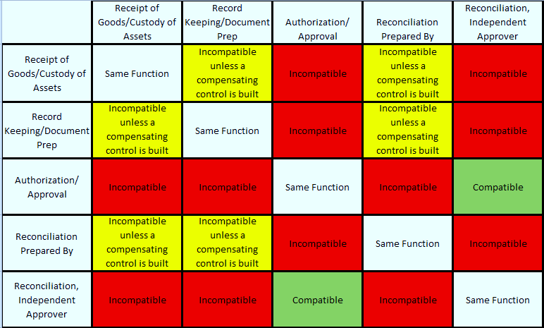
Segregation of Duties
Notes:
Segregation of duties
Custody vs. Accounting
The custody of assets should be separate from the accounting for those assets (physical and financial)
Executing vs. Recording
Recording transactions should be done by someone other than the person executing the transaction
Certain transactions may require dual signatures (purchases or transfers over a certain threshold)
Rotation of duties
A periodic rotation of duties (particularly if unannounced) may reduce likelihood of fraud
This is also a method for cross training in the event of staff turnover, reduction in staff or for temporary coverage (vacations)

Slide 56
When Segregation Is Not Possible
If one person performs two or more of the functions:
Risk exists that presents the opportunity for something to go wrong
A compensating control is needed to reduce the risk
The compensating control might be an extra layer of review

Slide 57
Examples of compensating controls may include:
A manager/dept head may perform a high level of review of detailed transaction reports
A manager may periodically sample transactions and request supporting documentation to ensure the transactions are complete, appropriate, and accurate.
Someone from an another area may perform an external review of a reconciliation.
For instance, two departments within a municipality may share responsibility to review each others reconciliations.
Some local governments have a centralized collections and/or financial services department

Slide 58
Reconciliation & Balancing
What should you reconcile ?
Who should reconcile?
All accounts and transactions-credit card transactions, accounts payable, accounts receivable, payroll, fixed assets, Due to/Due From accounts, special revenue, and other areas against the general ledger, or balance sheet
Reconciliation should be performed by a person with no cash handling responsibilities
The reconciliation must be dated and signed or initialed
The reconciliation should be reviewed by an independent party

Slide 59
Commitment to Competence
Commitment to attract, develop and retain competent individuals aligned to the objectives
Establish Policies and Practices
Reflect expectations of competence to support objectives
Define accountability and performance
Evaluates Competence and Addresses Shortcomings
Governing Body and Management evaluate competence internally and externally
Requires relevant skills and expertise
Attract, Develop and Retain Individuals
Training, mentoring, evaluate, retain
Plans and Prepares for succession
Contingency plans for responsibilities for internal controls
Governing Body is responsible, management identifies and assesses

Slide 60
THANK YOU! ? Questions
Katherine Heck
Government Finance Advisor
New Hampshire Municipal Association
603.224.7447
kheck@nhmunicipal.org

Slide 61
Sources and References
Essentials of Treasury Management, Association of Financial Professionals, First Edition, D.J. Masson, Ph.D., CTP, CertICM, Peggy Weber, Ph.D.., CTP, CPA, David A. Wikoff, Ph.D., CTP, CertICM
GFOA best practice, Creating an Investment Policy, (2010) (New)
Investing Public Funds, Second Edition, Girard Miller, M. Corrine Larson, and W. Paul Zorn, GFOA
Committee of Sponsoring Organizations of the Treadway Commission, Internal Control – Integrated Framework (COSO Report)
Adopting Financial Policies, Best Practices, GFOA, September 2015
COSO Integrated Framework Internal Controls
American Institute of Certified Public Accountants (AICPA)
State of Vermont, Department of Finance and Management
Management’s Responsibility for Internal Controls, Thomas P. DiNapoli, State Comptroller, Office of the State Comptroller, Division of Local Government and School Accountability
Center for Audit Quality, www.TheCAQ.org
www.coso.org
www.gfoa.org
www.fgfoa.org
www.afponline.org
www.AICPA.org

Slide 62
PRACTICE POINTER: Custody
Having access to or control over any physical asset
Custodians:
Collect and handle payments
Prepare deposits
Have access to safes, lock boxes, & file cabinets where funds are kept

Slide 63
PRACTICE POINTER: Record Keeping
Record keeping is the process of creating and maintaining official records
Record keeping may occur manually or through an automated data system
Record Keeping Examples:
Customer receipts
Deposit slips
Credit card receipts
Cash register reports
EFT (electronic funds) payment documents
Balancing and reconciliation reports
Record Retention

Slide 64
PRACTICE POINTER: Paper/Electronic Documentation
Documentation is essential for an effective internal controls program in the investment function
Every transaction should be documented with a confirmation from the broker, the custodian and should include specific detail including
Date of transaction
Buy/Sell
Broker/Dealer
Competitive Bid quotes when appropriate
Account number name
Wire transfer instructions (limited internal control)
Security Description
Investment yield, price
Dollar amount
Maturity of investment
Delivery instructions
Source: Investing Public Funds second edition

Slide 65
Wire Transfer Agreements
PRACTICE POINTER
Wire transfers typically involve large sums of money
Policies should be in place to minimize risk of loss
Listing of accounts
Custody functions
Authorized personnel and dollar limits
Allowable types of communications (email, verbal, fax)
Requirement that the instructions are on letterhead
Confirmation and notification procedures
Bank liability
Source: Investing Public Funds second edition

Slide 66
PRACTICE POINTER: Authorization
Authorization is the process of granting formal approval to perform a specific function
For example, someone must be authorized in order to perform one of the following functions:
Verify cash collections
Review daily balancing reports
Approve discounts, voids, or refunds

Slide 67
PRACTICE POINTER: Authorization
The person who originally created a transaction should not be:
The one who makes a correction
The one who creates a void
The one who creates/approves a refund
The best practice is to have a supervisor/department head/manager, etc., take these actions

Slide 68
PRACTICE POINTER: Custody – System Passwords
Every person must have their own password
Passwords must never be shared
Don’t write your passwords down
If you need to leave the work area, sign off your password; log back on when you return
Passwords should be changed periodically
Passwords should be inactivated whenever a custodian vacates the position

Slide 69
PRACTICE POINTER-Develop General Controls over Technology
Organization selects and develops control activities over technology that supports the achievement of objectives
Determines dependency on Technology in processes
How much of the process is automated
Deployed to ensure automation works properly
Establishes relevant technology infrastructure
Designed to help ensure completeness, accuracy and availability of the process
Networking, computing resources
Can be internal or external
Establishes relevant security management
Restrict to authorized users
Which users can execute transactions
Establishes relevant technology development and maintenance of process controls
Provides a structure for system design
Documentation, approvals, checkpoints

