Slide 1
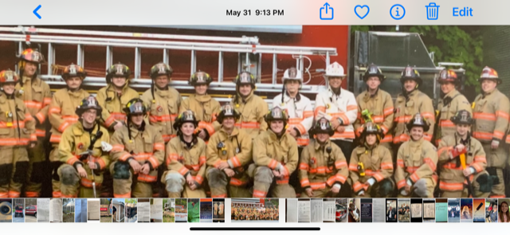

Slide 3
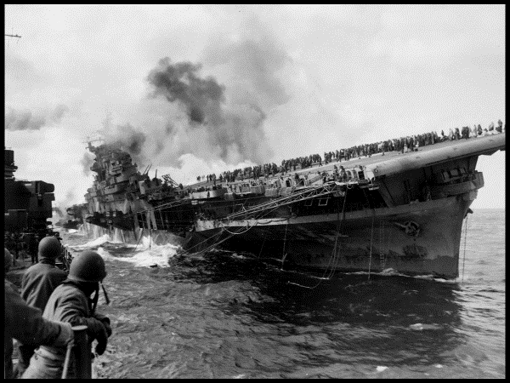

Slide 4
1900-1922
The GI Generation
Notes:
Audie Murphy

Slide 5
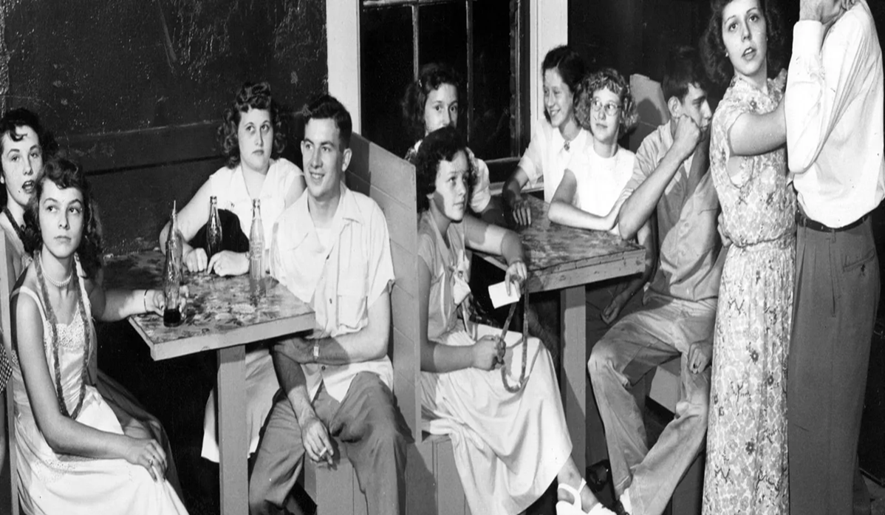
1922-1945 Silent Generation
Notes:
Forbes, The class of 49 taking no chances.

Slide 6
1945-1960 Baby Boomers

Slide 7
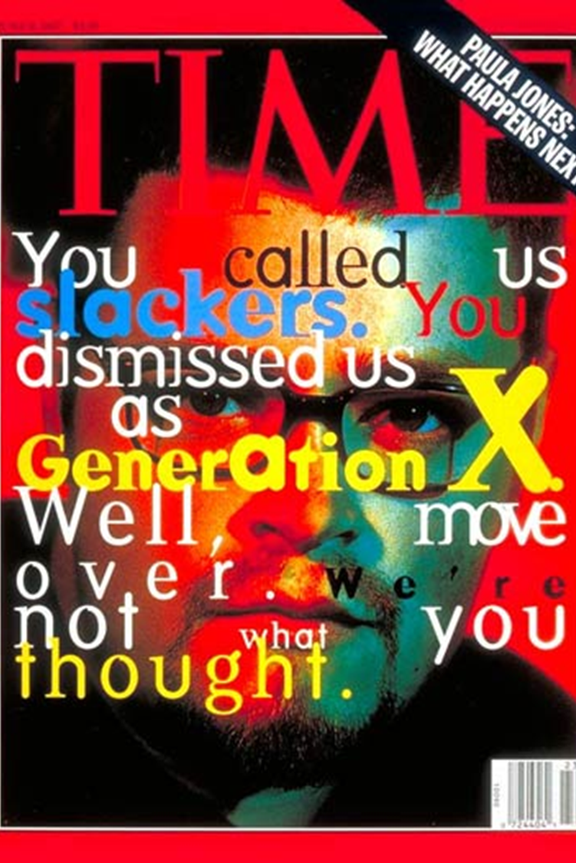
1960-1980
Gen X

Slide 8
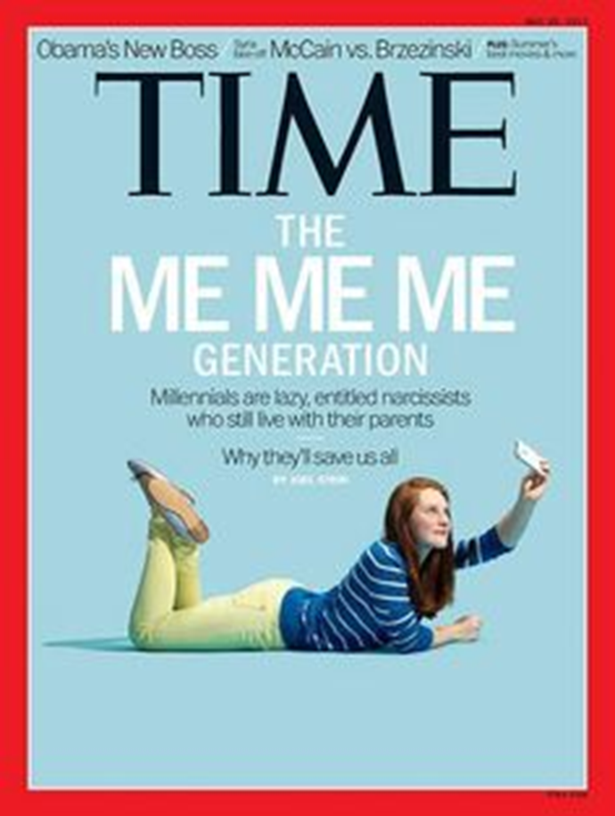
1980-1996 Millennials / Gen Y

Slide 9
Gen Z
1996 - 2012

Slide 10
Recruitment
Engage, Recruit and Retain
The new loyalty is engagement
Notes:
Session: You have to operate as close to the facts as possible to make effective decisions

Slide 11
Everything has changed
New Power vs Old Power
Flatten of the hierarchy
The “authority myth”

Slide 12
Growth
Learning styles
Education
Promotion

Slide 13
Community
Work and family balance
Environment

Slide 14
To be a contributor
Motivation across generations

Slide 15
Significance
Awards and Recognition

Slide 16
Organizational Fit
Communication style
Leadership

Slide 17
Building relationships

Slide 18
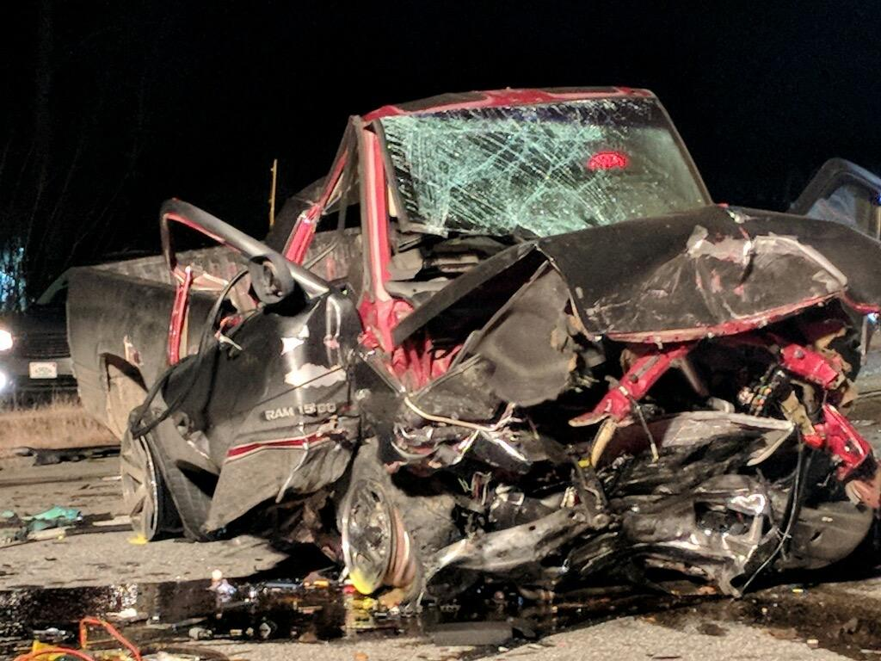
Build Resilience

Slide 19
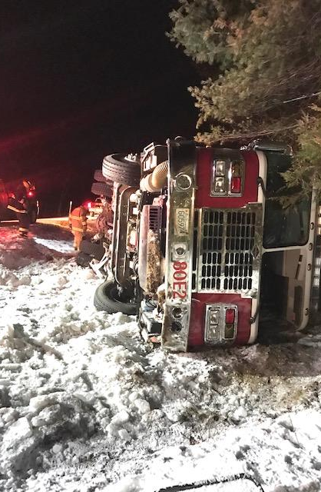
Protect your people from 3 things…

Slide 20
Generations still at work in 2022
GI, 1900 -1922, 50 Million
Silent, 1922 – 1945 50 Million
Boomers, 1945 – 1960, 76 Million
Xers, 1960 – 1980, 45 Million
Gen Y, 1980 – 1996, 80 Million
Gen Z, 1996 – 2012, 72 Million

Slide 21
