Slide 1


Modernizing Receivables in Government
2022
CONFIDENTIAL

Slide 2

Speaker
Glenn chernyak
Executive Director
Head of Receivables Product Solution Specialists
Commercial Banking
1

Slide 3

Technology, specifically mobile and cloud, transformed how constituents consume content and data
Global Figures of Internet Usage
5 billion
1.24x greater
  Total Internet Users
  Youth (ages 15-24) Use of Internet Compared to Other Age Groups
(Almost) Everyone is Connected
  People with Mobile Broadband Subscriptions
  Global Population with a
  Smartphone by 2026
91%
83%
Source: Measuring digital development: Facts and figures (2021). ITU
Payments are eating THE WORLD (2021)
2

Slide 4
Payments are eating the world – POWER+ Framework
  Platforms
  Super apps as a destination platform
  Chinese vs global usage
  Wallets
  75 million blockchain wallet users worldwide
  23x growth since 2015
  Real Time
  1.219 billion real-time transactions in the U.S. in 2020
  $700 billion of remittances in 2020
P
O
W
E
R+
  Online
  By 2023, online marketplaces are expected to make up 60% of e-commerce
  25% of financial service applications are abandoned due to friction during onboarding
  Embedded
  Total number of device connections is expected to grow to 41.2 billion in 2025
  47.8 million digital bank account openings in the U.S. by 2024
Source: Payments are eating THE WORLD (2021)

Slide 5
Top trends shaping the future of digital receivables
  Data
“The world is now awash in data and we can see consumers in a lot clearer ways” - Max Levchin, PayPal co-founder
Data is critical in providing customer tendencies, cash flow positioning, and potential risk offering insights to make educated business decisions
  Digital
People and businesses continue to move to digital invoicing allowing for faster receipt of payment
According to J.D. Power, the ‘Billing and Payment’ experience drives up to 58% of total customer satisfaction scores
  Automation
Optimizing invoicing and payments processes with automation streamlines payment transactions and increases accuracy while decreasing costs
Companies can reduce cost by 85% moving digital compared to paper invoicing
  Emerging Payments
Payment methods continue to evolve as more and more consumers lean into utilizing Digital wallets
Global digital wallet adoption rate is expected to reach 75% by 2025
  surpassing credit cards as most used payment method in 2025
  Fraud Protection
As payments move digital, fraud protection is highlighted as a top receivables focus
Capturing sensitive data ensuring PCI Compliance and NACHA Guidelines on account validation services is at the forefront heading into 2022
4

Slide 6


Meanwhile, organizations are also elevating digital transformation as a top priority
Board of Directors
Executives
Treasury & Payments
69%
Accelerated digital business initiatives after COVID
79%
Increased budgets for digital transformation
64%
Will accelerate digital transformation after COVID
1
Digital transformation in organizations have been estimated to accelerate by 6 years⁴
Source: 1. Gartner 2020; 2. Twilio via Forbes 2020; 3. JPM Proprietary Survey 2020; 4. Overall estimate of enterprise’ digital transformation – Twilio via Forbes 2020 (link)
5

Slide 7
What is driving digital adoption… Both payers and billers are motivated to go digital
Benefit
Payers
Billers
Digital tools reduce time in making payments by increasing convenience and access
Decreasing Days Sales Outstanding, because moving digital gets you paid faster
Payment Speed
High confidence that payment information will be guarded and delivered successfully
Decrease risk of fraud and achieve PCI Compliance with less effort
Security
Provide payer choice with an easy-to-use interface including multiple payment methods and channels
Digital interaction with payers improves client experience
Engagement
Digital tools enable payers to stay informed on end-to-end payment status
Drive business decisions with access to payment data insights
Data Access
6

Slide 8
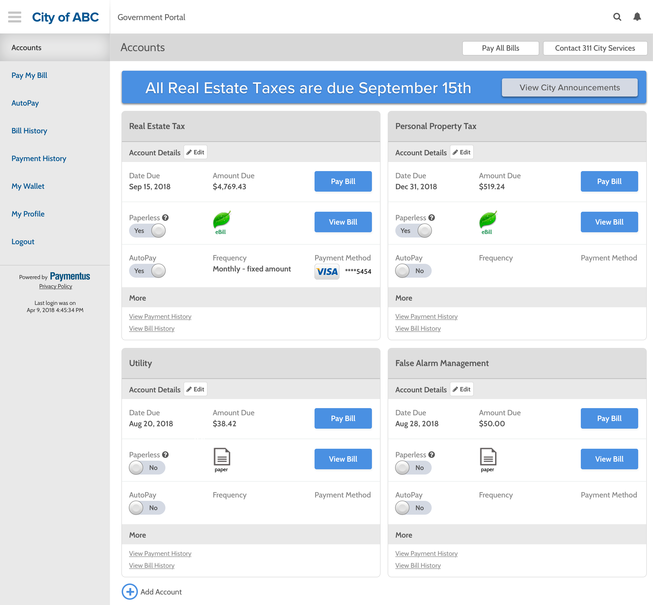
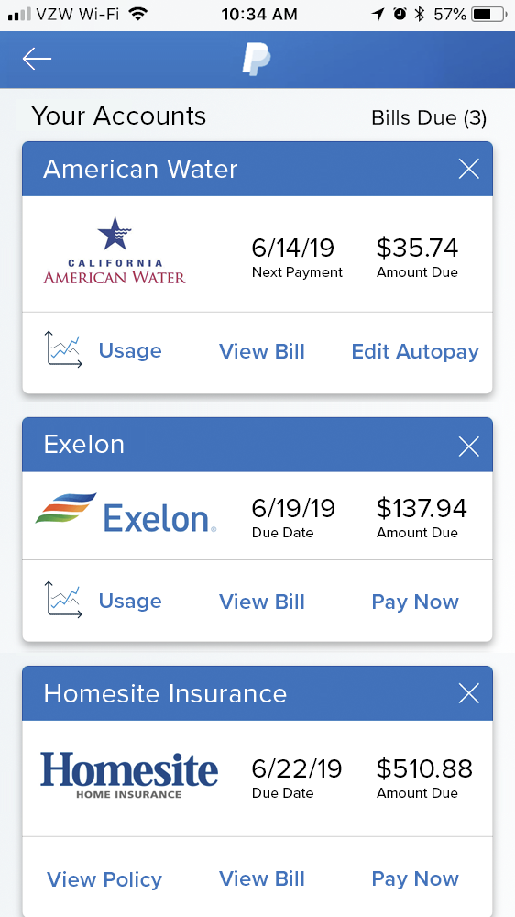
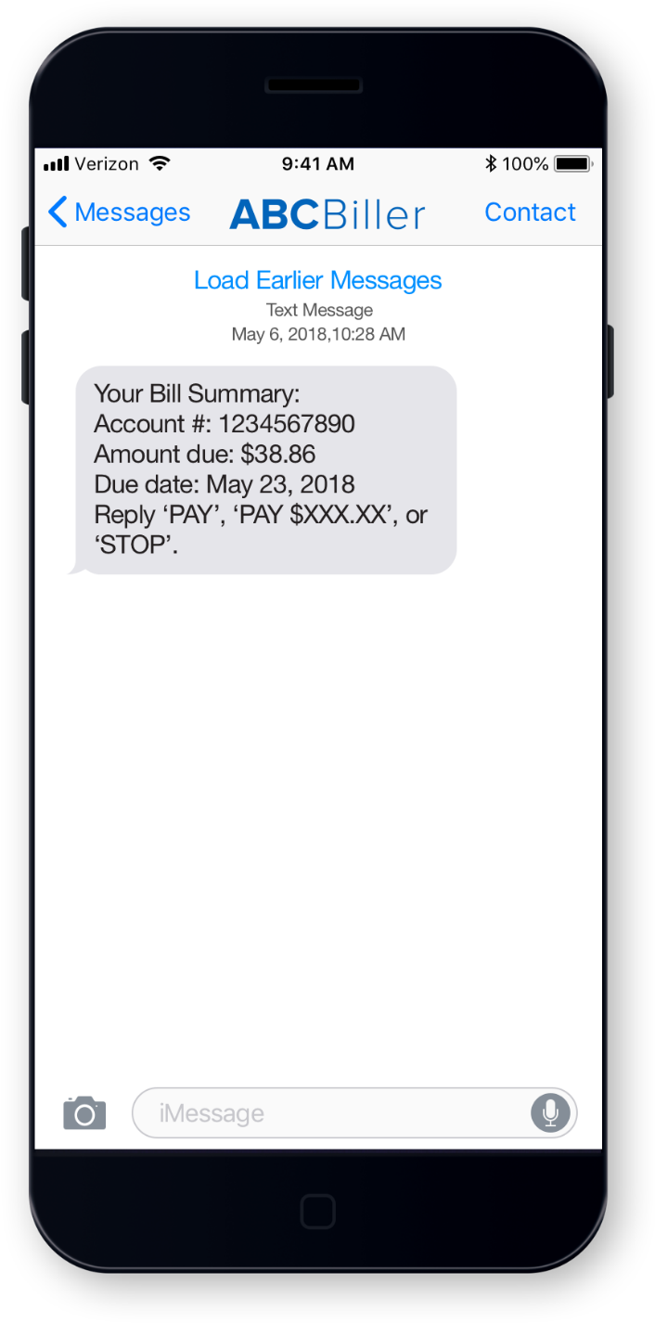
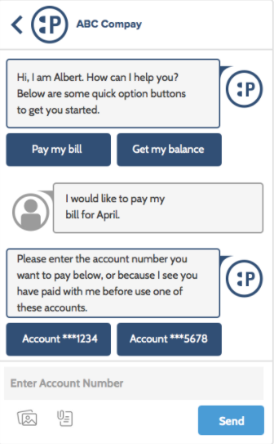
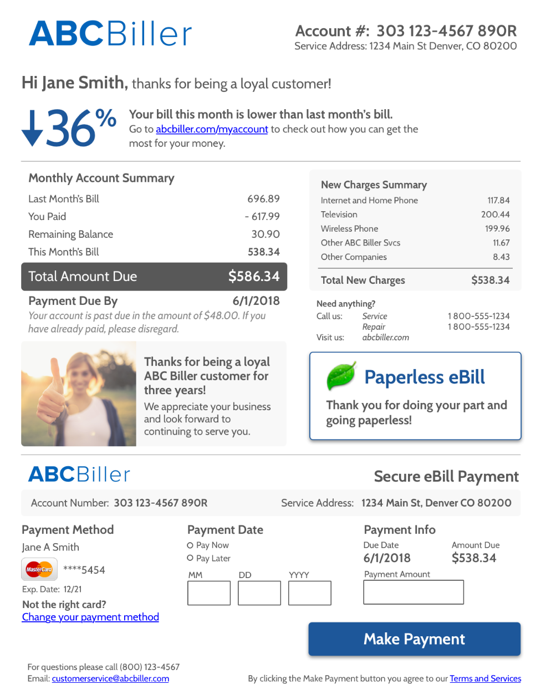

What is omnichannel versus multichannel and why should you care?
How many different interaction channels are used to interact with billers each year?
Average consumer: at least 2
Average millennial: 4
Portal
Mobile Apps
Text
Chat
Email / Secure PDF
Phone
Full visibility into all interactions / transactions in a single dashboard
Simplified reconciliation regardless of channel and payment method
Streamlined and intuitive experiences for constituents with minimal data entry
A unified, omnichannel platform provides your business…
Source: BlueFlame, Aite Group
7

Slide 9
Poll Question
Difficulty getting away from paper
Lack of visibility into transactions
Low security – fraud issues
What are your biggest challenges dealing with receivables?
Poor communication & engagement with constituents
Lack of customizable features
8
Notes:
Poll Question – so now we have our first interactive poll question
After hearing about some of the top key trends in the bill payment & presentment space what are the biggest challenges that your business faces today

Slide 10

Receiving payments can be challenging—but it doesn’t have to be
  THE SOLUTION: one platform to boost your payment potential
  YOUR CHALLENGE:
  Your constituents want an easy, convenient digital experience when paying their bills
  Your constituents want multiple payment methods and channel options
  You have high Days Sales Outstanding (DSO)
  Reconciliation can be difficult: Your end-to-end accounts receivable process is spread across several platforms
  Faster payment that makes it easier for your constituents to initiate funds—with our digital bill payment solution
  Single unified payment platform with 16 different payment channels
  Campaign manager and custom outbound alerts to drive engagement
  Self-service portal for more control for your constituents
9
Notes:
Before we attempt to solution for our clients, it is important to assess their needs. While no two clients are the same, there are a few universal challenges faced by clients in our receivables business:
Our clients’ payors want an easy and convenient experience when paying their bills.
Payors also want a wide variety of payment methods. Maybe a college student wants to pay his/her apartment utility bill. This student could have $50 in his checking account and $250 in his Venmo account, when he/she logs into their utility bill they love having multiple options for paying
Our clients want to reduce the number of days sales outstanding, always trying to achieve a faster means to funds
Our solution allows clients to solve for each one of this challenges:
Easier digital access w/ recurring payments allows for payors to initiate funds quicker, reducing the days payable outstanding for our clients.
The platform also brings in a variety of payment channels into one location– allowing the college student to pay his utility bill with ACH and Venmo.
Finally, the portal gives customers more control and provides more engagement w/ features like Campaign Manager, alerts, and servicing via the Client Agent Dashboard

Slide 11


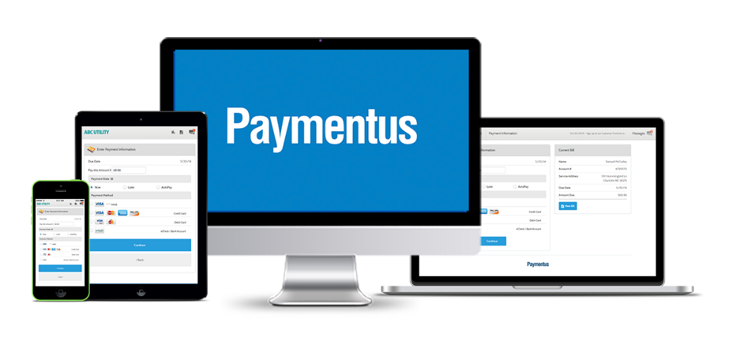

The platform should go where your constituents are
Legacy Providers / Single Channel Solutions
Modern providers
EBPP Solution
VS.
The Consumer is burdened with a disjointed service and limited functionality.
The Platform is delivered to the Consumer with access to extensive functionality.
You make communication, bill viewing, and payment submission easier by bringing capabilities to the constituent doorstep.
10
Notes:
Tom

Slide 12
Poll Question
Data intelligence and simplified reconciliation
Offering a variety of payment methods
Omnichannel bill presentment
Which feature functionalities resonate most for your business needs?
Communication management
Customizable platform
11

Slide 13
Drive more value for your constituents
Goal: a smart, agile and easy-to-use omnichannel solution with endless possibilities
Get paid faster when you make it easy for your constituents to pay
Pay quickly
Easily view and perform one-time bill payment—
no registration required
Pay automatically
Pay instantly with autopay. Simply set the date and
we’ll handle the rest
Pay on-the-go
Review balances and make payments in just a few clicks
Pay electronically
Go paperless with convenient eBilling options
Pay by email
Enjoy a convenient and interactive payment experience with bills emailed directly through
a secure PDF
Pay by Interactive Voice Recognition (IVR)
Let us take care of balance and payment inquiries
  Help them stay connected
  Mobile versatility allows them to connect in-browser with mobile Web or through our mobile App
  Fully integrated portal enhances the user experience end-to-end
  Timely notifications beyond payments keep your constituents informed via text, email or phone
12
Notes:
Our secure bill payment portal offers a full suite of services; however, Clients will be able to pick and choose from the full suite to have a solution that meets their exact needs. Clients’ payers will be able to make payments based on their preferred method. As our standard offering, they can quickly make a payment through a guest one time payment, set up autopay or pay via their mobile device. In addition to those services, our secure bill payment portal can go above and beyond that with allowing payers go paperless, pay by email or through an interactive voice response. These are just some of the multiple ways payers can make a payment; however’ Clients may not need the full suite of services. We will work with Clients to determine their needs and set up a solution that meets those needs.
Our secure bill payment portal goes beyond standard billing notifications to deliver timely alerts that keep customer's up-to-date on just about everything. For example, in the event of a power outage, you can remain in contact with your customers and send out updates as needed—all from a single platform. No need to manage multiple databases

Slide 14
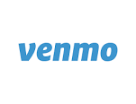
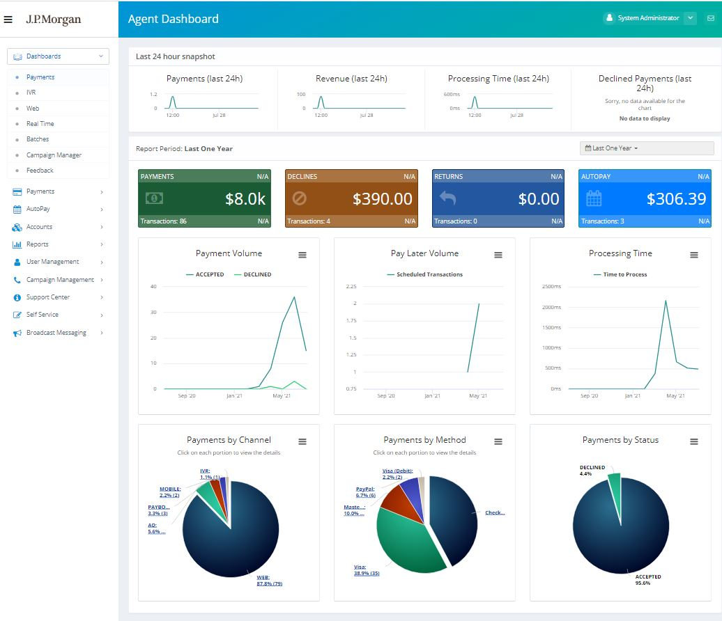
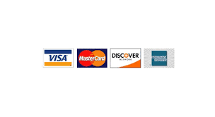



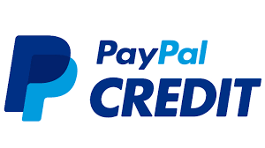
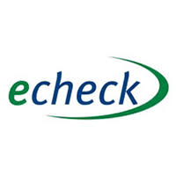

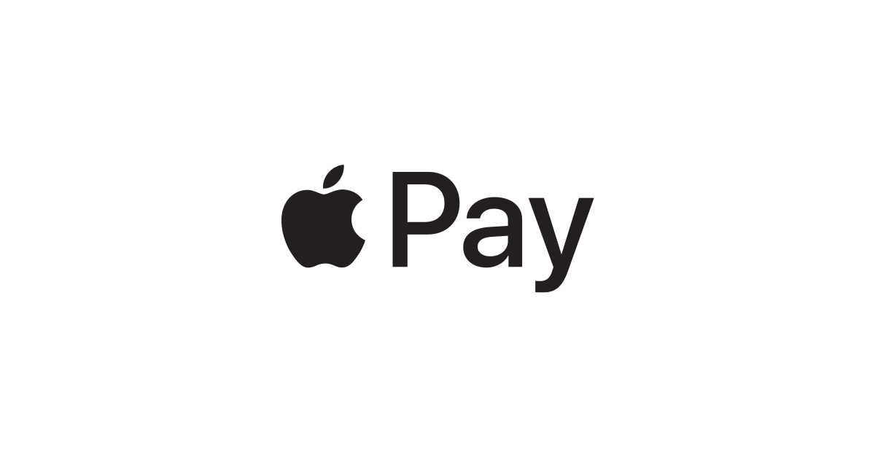
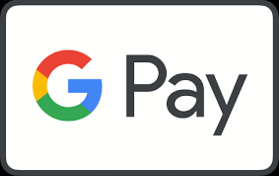
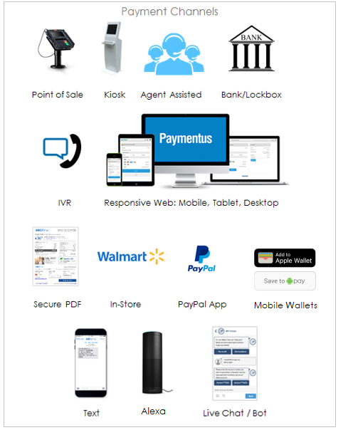
The right solution should provide 360º view into all payment channels
Provide your constituent an array of options to engage with you and pay!
Legacy Payment Methods
Emerging Payment Methods
A portal provides visibility into every payment in all channels
Payment Channels
EBPP Solution
13

Slide 15



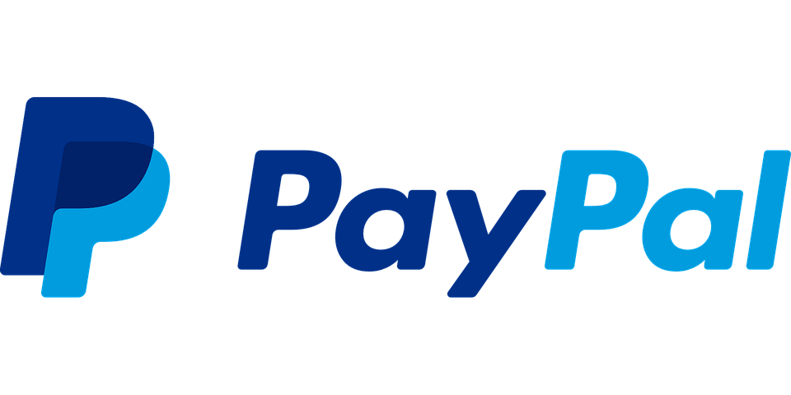
Government agency simplifies vendor bill payments via agency-wide Digital Bill Payment
  Government Agency seeks to:
  Eliminate multi-vendor hassles
  Modernize payment process via digital payments
  Implement a new EBPP solution
Government agency implements a single-vendor payment solution that’s scalable with DBP solution
Situation
  Various department-specific platforms increase difficulty to track & reconcile payments
  Limited payment options increases delay in payment process & result in non-payments
  High compliance costs for controls and security
Challenges
1
Agency adopts DBP solution to solve for multi-vendor management hassles
2
Citizens pay multiple bills at once 1 (parking tickets, dog permits, etc.) all on DBP platform
3
Citizens save digital payment information and opt to go paperless
4
Government Agency has a central view of all ePayments across all departments in Staff Portal
  Agency adopts unified solution via DBP:
  Fully hosted omni-channel payments via web, IVR, kiosk and mobile with several payment options
  Integrated payment reminders and auto-pay via text
  Ensures high level of payment security & compliance being Level 1 PCI Compliant
  Staff portal dashboard produces all-in-one real-time KPIs & reconciliation reports
Solution
Client Benefits
  Increased staff time savings due to decrease of processing payments by hand
  Reduced in-person traffic, which increased efficiency for both the agency and the citizen
  Enhanced Payment Certainty & Timeliness
  Reduced Operational Expenses
Results
  Decreased Reconciliation Burden
  Increased Online, Self-Service Payments
“DBP went above and beyond our utility collection needs. We’ve added everything from parks and recreation fees to dog permits. We collect payments faster, and our customer experience couldn’t be better.”
– Large North American City
  Increased Range of Payments on Single Platform
  Decreased Security & Compliance Burden
14
Notes:
P20210908134702

Slide 16
Utility organization optimizes bill payment options and call servicing via Digital Bill Presentment (DBP)
  Energy/Utility Company seeks:
  To enhance customer service and operational efficiency
  Solution to reduce call center volume and optimize IVR experience
  Potential new EBPP solution via DBP
Utility / energy company can enhance online service, security and reconciliation process with all-in-one DBP platform
Situation
  Limited payment options leads to more in-person traffic and higher call rates
  Frequent delinquencies derived by limited payment reminders from client
  Lack of sufficient controls and security
  Administrative burden of reconciling payments
Challenges
1
Utility company battles high costs related to compliance, servicing and reconciliation
2
Utility company adopts DBP user-friendly solution w/ multiple payment options
3
Customers utilize DBPs fully hosted IVR to make payments in less than 2 minutes
4
Utility company uses DBP dashboards for easy reconciliations
for all payment channels & types
  Company modernizes via DBP:
  Fully hosts omni-channel payments via web, IVR, kiosk and mobile with several payment options
  Recurring, proactive payment reminders via text, email or call per customer preferences
  Ensuring high level of payment security & compliance being Level 1 PCI Compliant
  Staff portal dashboard produces real-time KPIs & reconciliation reports
Solution
Client Benefits
  Enhanced Payment Certainty & Timeliness
  Reduced Operational Expenses
  $1 million in first-year savings, with:
  Increased Online, Self-Service Payments
  Decreased Reconciliation Burden
Results
34%
Increase in payment success rate
30%
Reduction of in-person traffic
102K
Calls eliminated
  Increased Range of Payments on Single Platform
  Decreased Security & Compliance Burden
“Our PCI scope has really reduced. We used to work with 3 vendors in order to provide the payment options we have now with DBP.”
– Customer Operations Technology Specialist
15

Slide 17
Poll Question
Less than 25%
25-50%
What percentage of your receivables are digital today?
50-75%
Over 75%
16

Slide 18
End-to-end digital transformation is critical to address the needs across the organization
Business
Payments
Treasury
  Keep on top of industry trends: for new constituent and supplier needs
  Meet user expectations: across constituents and suppliers
  Manage business model pivots: as industries are disrupted
  Enable user experience: for a simplified transaction
  Enhance constituent and supplier insights: with payments data
  Optimize payments: help provide more visibility to make the right payments at the right time
  Ensure optimal use of liquidity and minimize working capital
  Achieve operational efficiency: to help focus on strategic insights
  Develop an innovation ecosystem: to proactively explore new technology and solutions
Challenge your organization and your bank partners to accelerate your transformation together
17

Slide 19
When applied to the right use cases, technology can be a critical enabler for transformation
Fundamental transformation
Right use case
Technology as an enabler
  As consumer shifts continue to accelerate and also gain foothold in the wholesale space, businesses need end-to-end flexibility and agility
  Finding the right use case is critical to scaling the application of emerging technology
  It is also one of the largest barriers to adoption
  Applying emerging technology across the value chain can help enable organizations to:
    Offer optionality
    Engage real-time
    Gain efficiency
    Optimize data
18

Slide 20
Flexibility, agility, and efficiency enabled by technology will be the keys to success
1
On-demand engagement
  Constant connectivity allowing constituents and suppliers to engage whenever
2
Real-time experience
  End-to-end real-time infrastructure to support real-time payments, visibility, and experience across your organization
3
Optionality and choice
  Payment, capability, and connectivity optionality as consumer demands gain traction in wholesale
4
Data-driven insights
  Data visibility and usage of data for value-add to optimize operations and to enhance insights
5
Technology as an enabler
  Find the right use cases to scale emerging technology and enable change across your organization
19

