Slide 1
Resiliency Through Digital Transformation and Payment Automation
September 2022

Slide 2
Today's Presenters
Tom Gregory
Head of Commercial Distribution
Michael Gordon
New England Sales Manager

Slide 3
Today's Agenda
Introduction
Data Supporting Digital Transformation
Bottomline Technologies Survey
Strategic Treasurers Survey
Evolving Market
What is driving change
How are Banks responding
Digital Application

Slide 4
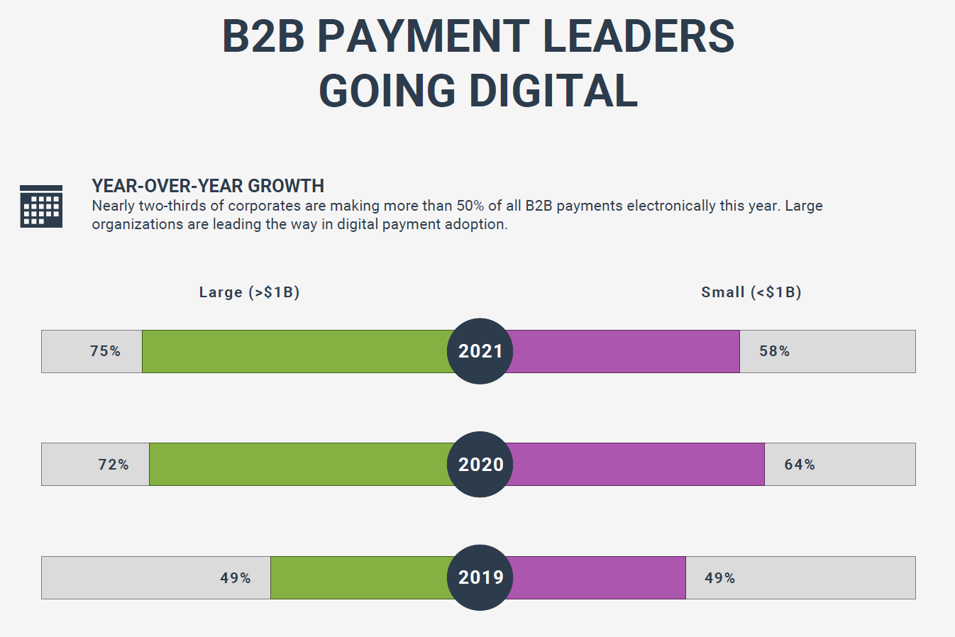

Slide 5
30%
79%
47%
Less than 30% of businesses make more than 70% of their payments electronically¹
of organizations experienced BEC fraud in the past year, 8% suffered a loss
of businesses say eliminating paper or implementing AP automation is a top priority for 2019 and beyond.³

Slide 6
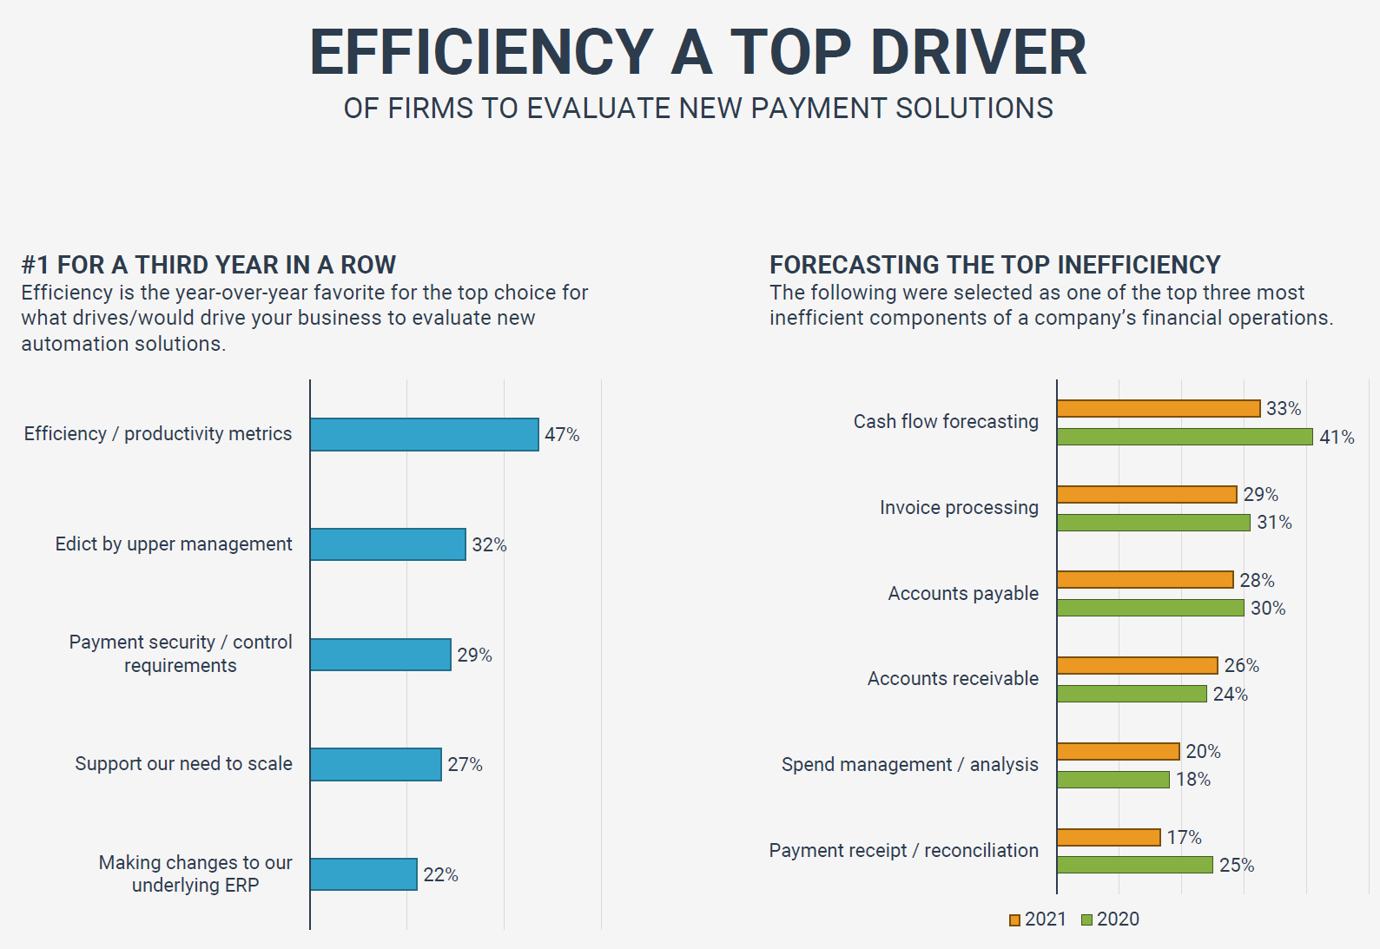

Slide 7
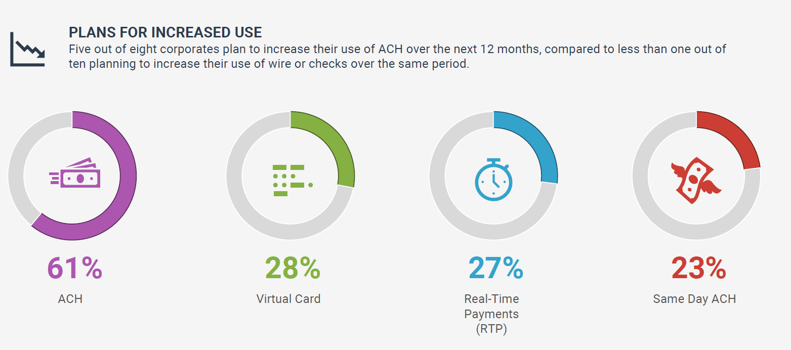

Slide 8
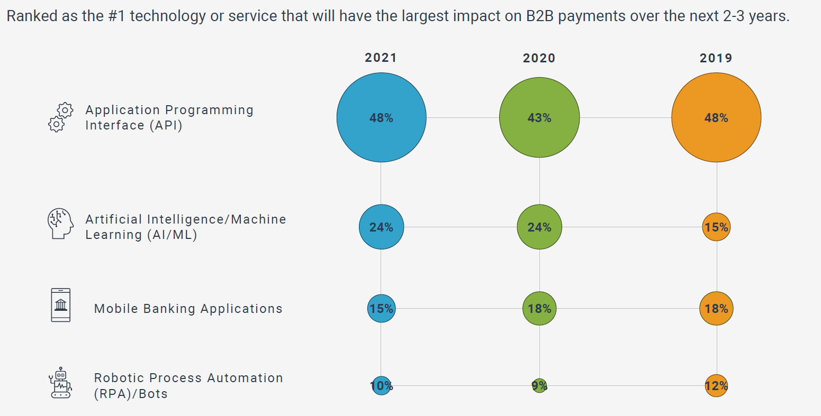

Slide 9
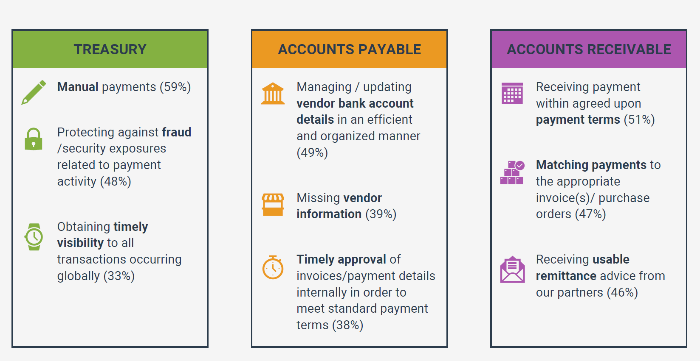

Slide 10
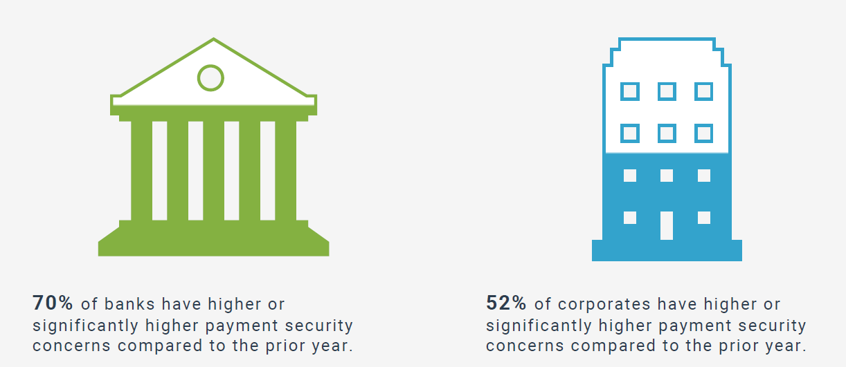
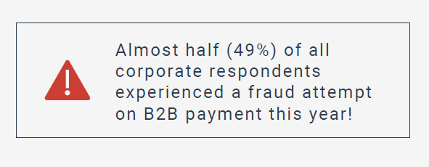

Slide 11
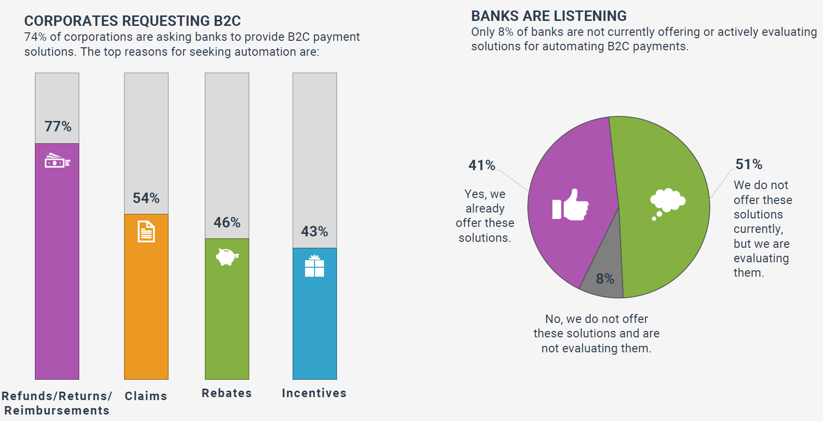

Slide 12
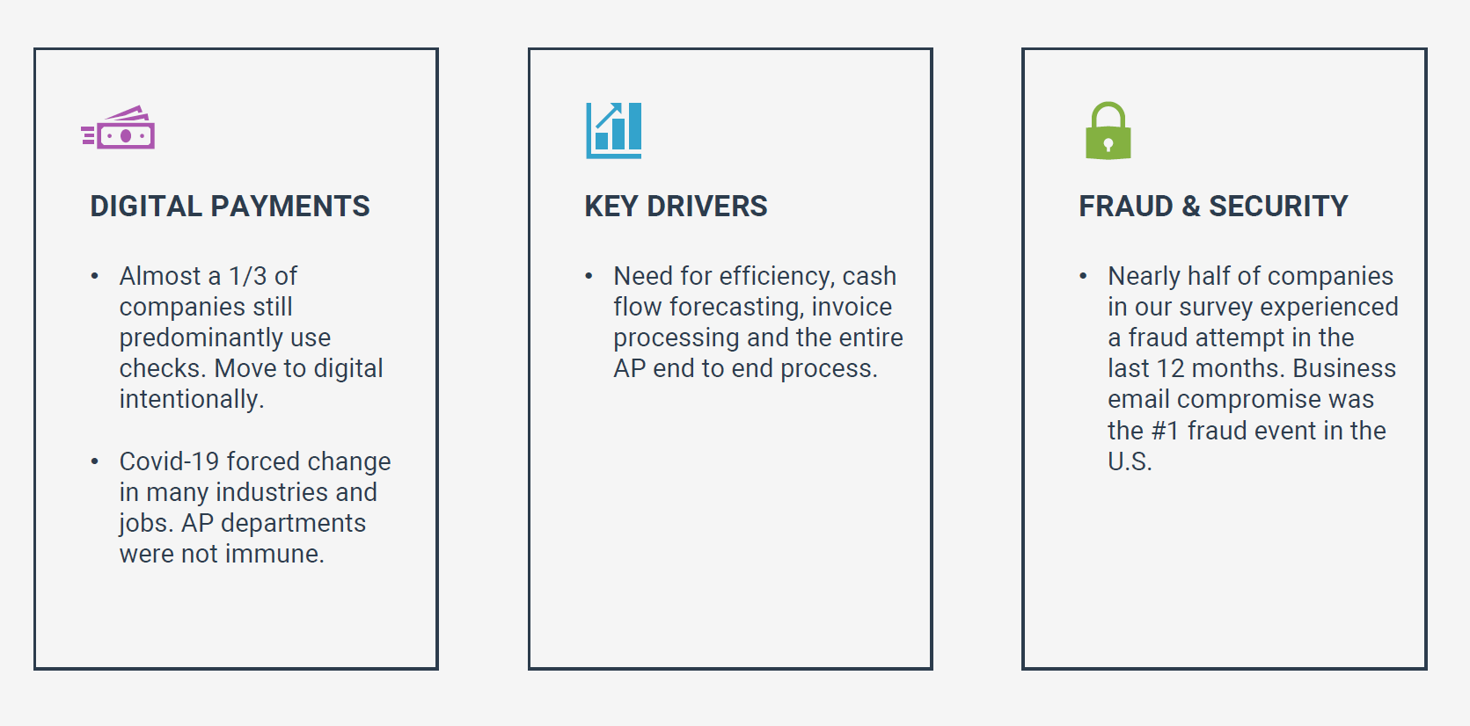

Slide 13
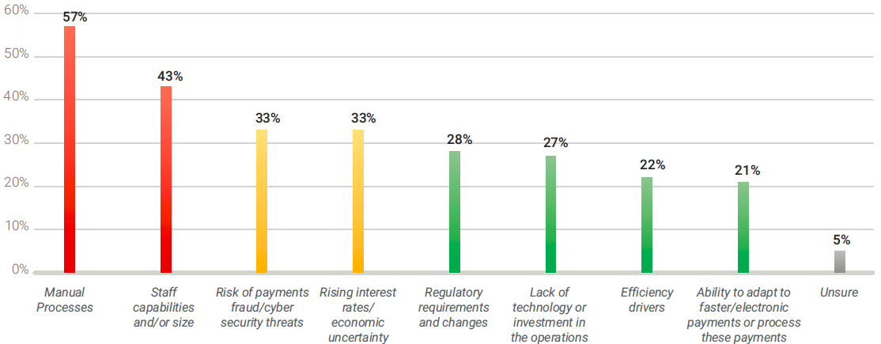
Treasury Perspectives Survey: What Are Your Top Operational Challenges?

Slide 14
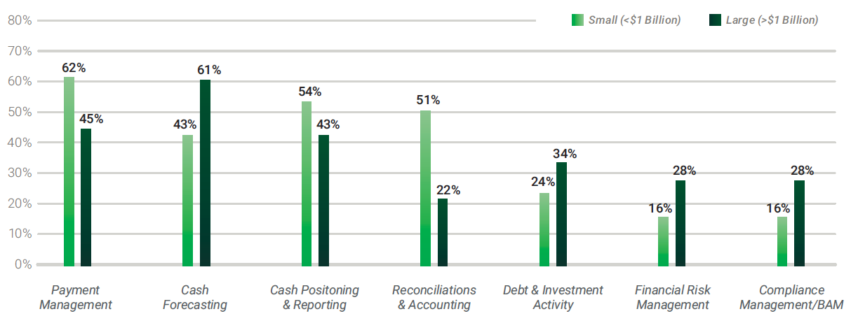
Treasury Perspectives Survey: What Activities Take the Most Time?

Slide 15
Evolving Market

Slide 16
Technology is changing your business, so we're changing how we operate
Evolving Workforce
Born Global
------------------------ Financial Environment Trends ---------------------------
Payment Innovation
Open Banking
Data and Analytics
Fraud and Cyber Risk
Emerging Technology
Emergence of Crypto
Gen-Z and Millennial Buying Power
Customer
Fraud and Cyber Risk
Notes:
Interview with John Thomas, EVP/Global Innovation at TD Bank
“There are two places in banking where there’s very significant mathematical asymmetry. One is in cyber risk. Banks have to get it right every day, 24 hours a day. But the bad actors only need to be right once in a blue moon. That’s asymmetry, and that presents a potential existential threat.”
BMO 2021 Digital Banking Summit
annually, the "Big 6" have spent roughly 10% of revenue on technology over the last five years
Credit Suisse
The top four banks in the US (~36% of deposits; ~50% of assets) have annual technology budgets totaling ~$40b, roughly equivalent to total aggregate private FinTech fundraising in 2020
TD Payments Briefing '21
Chase and Bank of America are both investing > $1B in digital development alone each year

Slide 17
Innovation trends in banking will drive business growth
Payments Innovation
Open Banking
Fraud & Cyber Risk
Emerging Technology & AI
Data & Analytics
Trends
Emerging payment rails are replacing paper checks.
36% of all B2B payments received by businesses in 2019 were made via check, down more than half from 2004. 67% of consumers prefer online payments.
The availability of external facing APIs is growing, enabling clients to access data and capabilities via the preferred user experience.
Fraudsters are evolving in the digital age, finding new ways to deceive companies and exploit vulnerabilities.
Blockchain, crypto currencies, and AI are being more widely adopted, creating both opportunities for new products and risks as the industry seeks to fully grasp the impact.
Real-time payments drives the need for real-time analytics to ensure treasurers can manage their working capital.
Implications
Covid-19 Pandemic has caused a surge in digital adoption.
Embedded banking capabilities will enable clients to access best of breed ecosystem capabilities through their bank provider based on their preferred channel.
Increased usage of analytics, training and cyber protection capabilities should be prioritized to detect and manage fraud.
Treasury teams should be informed on the implication of blockchain and distributed ledger technologies as the advances will create the new capabilities. New business models are being created and gaining traction.
Expect your bank to play a bigger role in data and analytics – provide more data to support payments decisions.
Notes:
Payment Innovation
36% of all B2B payments received by businesses in 2019 were made via check, down more than half from 2004
As of June 2021, TD is the #5 bank on the RTP network measured by transaction
Open Banking
Data aggregators FDX API use has grown 300% from 2019-2021 (5.3M to 22.0M consumer accts)
Fraud & Cyber
74% of companies were targets of payment fraud in 2020 – down from a record high 82% in 2018.
Emerging Tech
There was a 78% increase in total volume of crypto transactions from 2019 to 2020
Data & Analytics
Insights as a Service is emerging as a customer service valued component
Healthcare trends include:
Patient Engagement
Digital Innovation
Pricing Transparency
Integrated Payments Journey

Slide 18
Embedded Banking
Enterprise Resource Planning Centric
Realtime Transaction Information
Automatic Journal Entry and Reconciliation
Easy Payment
Smart Integration

Slide 19
Accounts Payable Digital Transformation
AP Information Capture and Approval Workflow
Credentialed Vendor Network – Closed Loop Network
Outsource Check Printing
Revenue Share
Fraud Prevention

Slide 20
Accounts Receivable Digitalization
Automated Reconciliation
Cash Application
Eliminate Manual Processing
Minimize Exception
Automated Reconciliation
Consolidate Payment Remittance Data (Lbx, ACH, Wire, Credit Card and Portals)
Machine Learning - predict future outcomes and automate routine labor-intensive tasks
Improved Straight Through Processing (STP)
Remittance Capture from Emails, Email Attachments, EDI Files, Portals, etc.

Slide 21
Faster Digital Payment Landscape
Real Time Payments (RTP)
Zelle
NACHA – Same-Day ACH
FedNow
Digital Wallets

Slide 22
Banks are investing today to prepare for the future
Extend
Expand
Elevate
CBDC/ Stable Coins wallets
Green/ESG deposits
Multi-bank cash flow forecasting
Insights as a service
Level of Innovation
Embedded Invoicing
Fraud Hub
Intelligent Cashflow
Digital Lending
ERP Integration
Digital Account Opening
Virtual Account Management
Time Horizon
Notes:
McKinsey 2021 Global Payments Report
Cash payments declined by 16 percent globally in 2020
United States - 24 percent decline
McKinsey expects cash usage to rebound to some extent in 2021, due to a partial return to past behaviors, fewer lockdowns, and a broader economic recovery, but evidence indicates that roughly two-thirds of the decrease is permanent.
Less cash usage is driving heightened interest in central bank digital currencies (CBDCs)
Real-time payments are playing an increasingly important role in the global payments ecosystem, with the number of such transactions soaring by 41 percent in 2020 alone, often in support of contactless/wallets and e-commerce. (17% in USA)

