Slide 1
Rethinking Budgeting

Slide 2
Agenda
About Rethinking Budgeting
Defining the Problem
Conflict Resolution
Rethinking Strategic Planning

Slide 3
About Rethinking Budgeting

Slide 4
Budgeting has been done the same for decades
Key Criticisms
Past decisions are frozen in place past the point at which they are affordable or relevant.
The traditional budget is not strategic.
Traditional budgeting is a “zero-sum game.”
Notes:
local governments have developed their budgets in essentially the same way for decades. First, that the budget is incremental. This means that last year’s budget becomes next year’s budget with changes at the margin. Second, the budget is built around line items—categories of spending like personnel, commodities, and contractual services, which are then grouped into departments and funds. People have criticized this approach for almost as long as it has been in use with local governments
If a department gets a grant from, say, state or federal government to increase staffing for a few years, those positions come to be regarded as part of the department’s baseline budget. Once the grant ends, the expenditure continues to be funded without an evaluation of whether those positions are creating sufficient value for the community to justify the cost. This same phenomenon occurs more widely but more subtly when entire budgets are carried forward and inflated from year to year without a good understanding of what services are being provided, at what cost, and for what benefit.
Spending is allocated to line items that concern the day-to-day operations of government. Line items like “travel,” “supplies” or “miscellaneous” don’t speak to how spending impacts big-picture results like public
safety, mobility, health, etc. Also, historical precedent is the primary determinant of how much money is allocated to each line item. This is backward-looking, not forwardlooking.
This means that for one party to win, someone else must lose. In the context of budgeting, this means, for example, that for one department to get more funding, another department must get less. Critically, in traditional budgeting, this is seen as a win for one department and a loss for the other. A zero-sum game promotes power dynamics that favor maintaining the status quo and encourages self-interested decision-making.

Slide 5
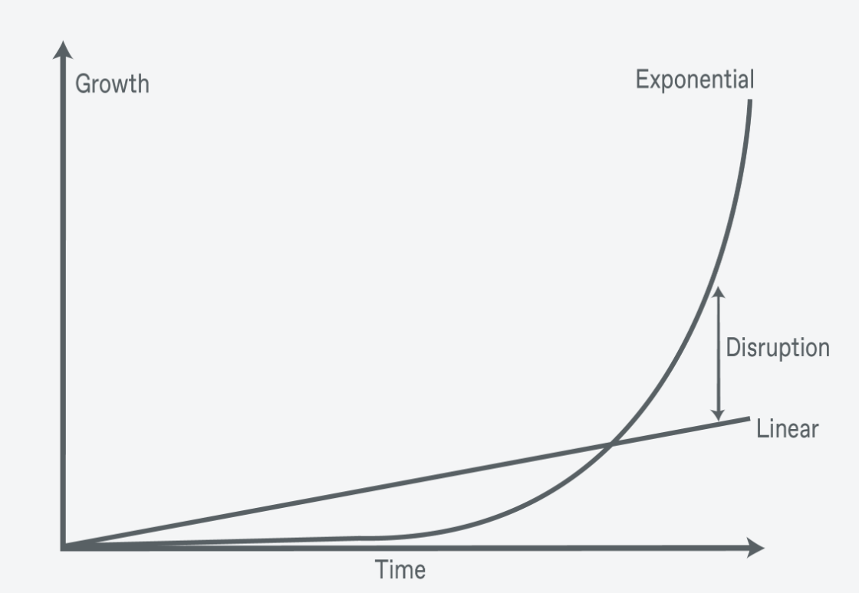
Budgeting has been done the same for decades
Incrementalism is slow to adapt to changing conditions
We live in rapidly changing times
Notes:
Local governments have long relied on incremental, line item budgeting where last year’s budget becomes next year’s budget with changes around the margin. Though this form of budgeting has its advantages and can be useful in times of stability, it also has important disadvantages.
The primary disadvantage is that it causes local governments to be slow to adapt to changing conditions. We live in volatile and uncertain times .

Slide 6
WhY Now?
Threats
Stagnant or Diminishing Revenues
Conflict
Volatility
Opportunities
Different mental models
Better understanding of how people decide
Technology
More awareness of fairness in the budget
Notes:
So what leads us to believe Rethinking Budgeting is a good idea? All the criticisms of traditional budgeting we described earlier are as valid as ever, but there are three threats that make traditional
budgeting less tenable than in the past.
Not all developments that favor a rethinking of the traditional budget are threats. There have been several positive developments that give us a greater chance of success than budget reformers in decades past.

Slide 7
PREVIEW Discussion Question:
Which of the threats or opportunities most resonate with your personal experience? Are there other threats to the status quo you think require rethinking budgeting?

Slide 8
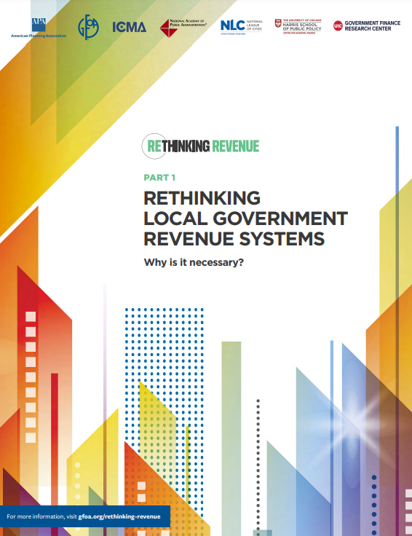
Stagnant or diminishing resources
The Rethinking Revenue Initiative
Gfoa.org/rethinking-revenue
Notes:
Much of the traditional budget’s success rests on distributing budget increases to enough stakeholders to maintain a stable governing coalition. However, the traditional budget does not have a good answer to resource declines. This is why we see across-the-board cuts as a common response to fiscal distress: Everyone is cut evenly. However, this does not optimally size or shape government to the conditions it faces.
Looking into the future, there are serious questions about local government’s ability to raise more revenue: Will the economy support it? Will citizenry support it?*,3 GFOA’s Rethinking Revenue initiative is intended to help modernize local government revenue systems, but it is also important that government spending plans be more adaptable to resource-constrained environments

Slide 9
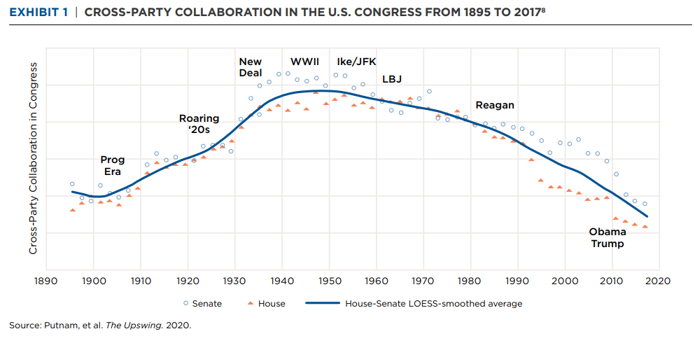
Conflict
Notes:
The defining conflict of our times is political polarization. During the heyday of the traditional budget, the 1950s through the 1970s, cross-party collaboration was almost at an all-time high of modern history (only exceeded by the period during World War II). We see this in Exhibit 1, which shows cross-party collaboration in the U.S. Congress from 1895 to 2017.** We also see today that cross-party collaboration has reached all-time lows
Political conflict is not limited to federal government officials. It affects the general public, too. As one group of political scientists put it, “the most significant fault line in the second decade of the twentyfirst
century [in America] is not race, religion, or economic status but political party affiliation.”4 This has expressed itself in civic activities, like a decline in split-ticket voting as well as personal
choices. For instance, political affiliation is becoming an important factor in choosing marriage partners than even education or religion. In such an environment, political polarization can’t help but
threaten local government as well, even if elections are nonpartisan.7
The traditional budget lessens conflict by relying on historical precedent. However, in an environment of severe conflict, where many people no longer believe that others have their best interests in mind, people may not be willing to accept historical precedent as a justification for how resources are distributed.

Slide 10
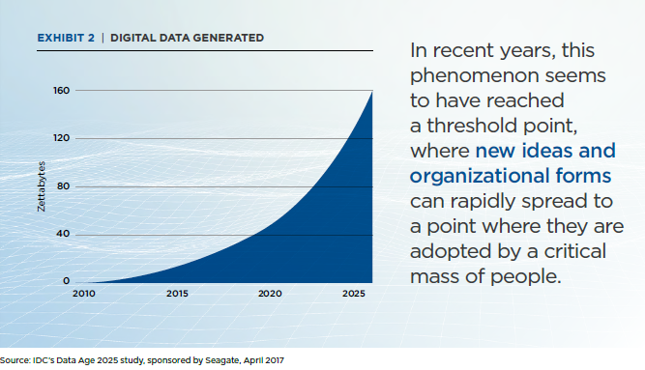
Volatility
Notes:
Perhaps the most important source of volatility that the modern budget must contend with is information. The amount of information and access to it has been increasing exponentially over the past decades.
In recent years, this phenomenon seems to have reached a threshold point, where new ideas and organizational forms** can rapidly spread to a point where they are adopted by a critical mass of
people. The result is rapid changes in public opinion and consequent demands on institutions. For instance, the role of social media in catalyzing social unrest and coordinating protest organizations
has been well documented.13 This volatility challenges the stability of established organizations. For example, the average life span of a company on the S&P 500 has shrunk from almost 60 years in the
1950s down to around 20 years currently.
The traditional budget is unsuited to this new and volatile information environment.15 First, the traditional budget relies on historical precedent for much of its legitimacy. New information and ideas,
by definition, do not defer to historical precedent. Second, the traditional budget does not have a good means for getting feedback from an environment that is subject to rapid change, much less a
means for changing if and when the need to do so is identified. For example, the traditional budget is organized by line items and departments, which are intended primarily to facilitate control of traditional spending plans.

Slide 11

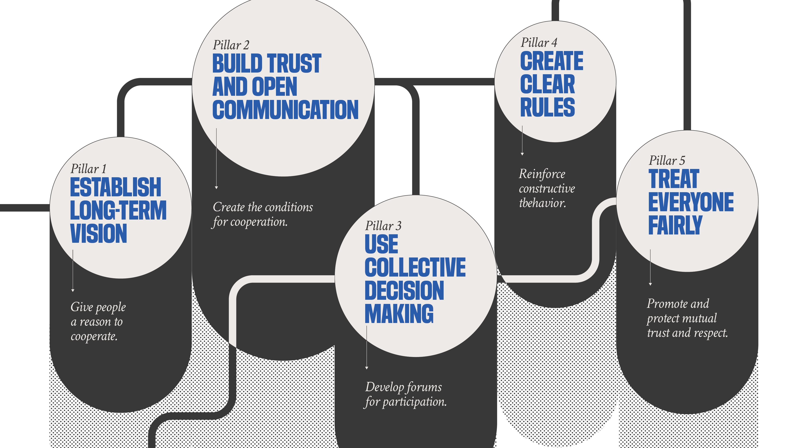
Different mental model:
Financial
Foundations
Framework
Notes:
Let’s move on the opportunities, starting with different mental models.
A mental model is a representation of how something works.18 The common mental model for traditional budgeting is the zero-sum game, where for one person to win, another must lose. This will lead to predictable and undesirable behaviors, such as padding budgets or exaggerating the risks of budget reductions or the resources needed to accomplish some task. GFOA’s Financial Foundations for Thriving Communities body of research offers a new mental model that suggests different, more adaptive behaviors. The Financial Foundations Framework is based on a Nobel Prize-winning body of work about
how to solve the challenges inherent in managing shared, publicly owned resources like a local government budget.19 It offers five “pillars” for thinking through shared resource problems like those commonly found in public budgeting (see Exhibit 4) and reaching sustainable decisions.

Slide 12
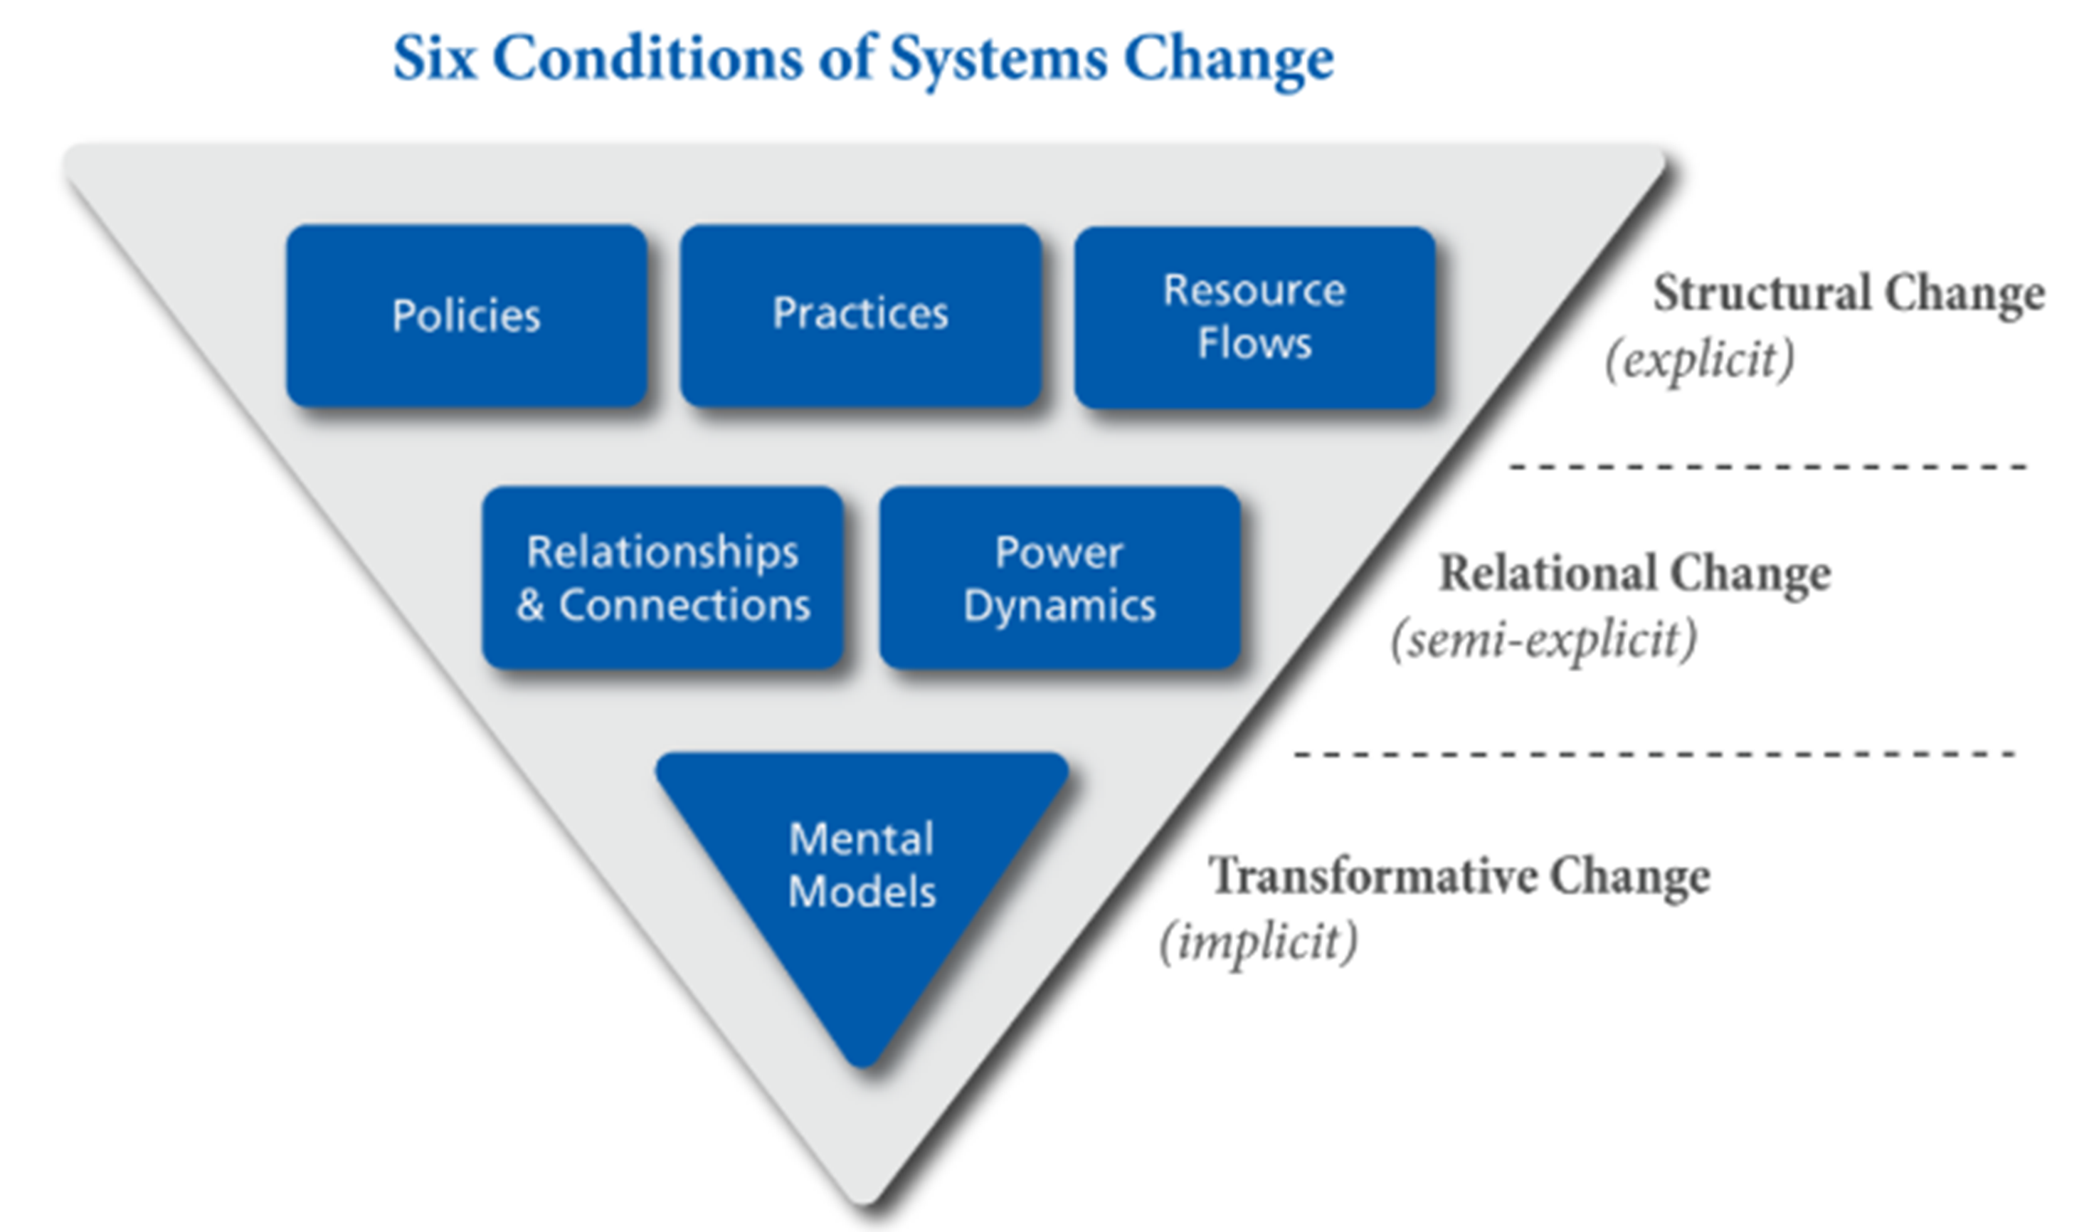
HOW FINANCIAL FOUNDATIONS ADDRESSES 3 LEVELS OF SYSTEMS CHANGE
Financial Foundations Impact
Emphasize particularly important policies, practices, resource allocation practices practitioners should adopt
--------------------------
The five “pillars” financial foundations cover these topics comprehensively.
--------------------------
Financial Foundations is based on solving “the tragedy of the commons.” The commons is a powerful mental model for thinking about local government resources.

Slide 13
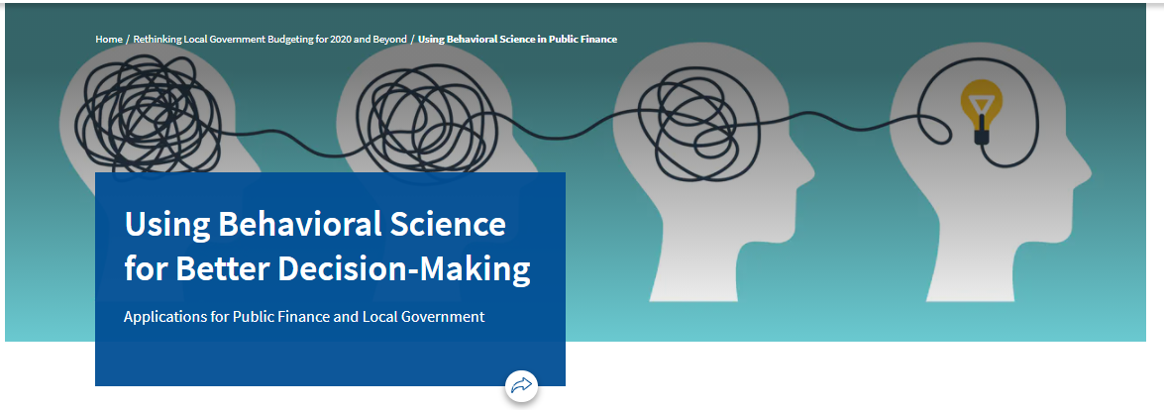
How people make decisions
GFOA.org/behavioral-science
"One of the best GFOA trainings I’ve ever participated in"
“Two thumbs up. It’d be more, if I had more thumbs.”
Notes:
this means we have a better understanding of the limits of rationality. All people engage in predictably irrational decision-making, commonly called “cognitive biases.” Scientific research on this
topic has gained a lot of attention in recent years (including two Nobel Prizes20), bringing more recognition of the role of irrationality in decision-making and the settings that might encourage
or discourage irrationality.
For example, one of the more important types of cognitive biases is “overconfidence bias.” This means that we underestimate future uncertainty, leading us to fail to question the assumptions behind our budget plans or look for reasons why our plans might be flawed. Another example is overestimating our ability to get X done with only Y dollars. By understanding cognitive biases and harnessing the power of behavioral science, we can design better decision-making systems.

Slide 14

More appreciation of Fairness in the budget
What's Fair?
Exploring the Behavioral Science of Justice and Fairness
Gfoa.org/fairness
“All public servants should read these”
-Timothy Riordan, GFOA President, 1995
Notes:
The conventional budget decreases or avoids conflict by relying on historical precedent. In decades past, however, income inequalities were far less and median real wages had been growing for many years.23 Also,
back then, people were not as aware of (or perhaps less concerned about) racial disparities.24 So, in the past, some potential conflicts were less acute and/or local governments were comfortable ignoring them. Today, it seems more people are interested in addressing these conflicts and are less willing to accept conditions that are regarded as unfair. Therefore, avoiding conflict is not really an option. The only good option is to handle it constructively. Hence, better budgeting and more attention to fairness in the budget could play a role in positively influencing some of the most important potential conflicts of our time.

Slide 15
Discussion Question:
Which of the threats or opportunities most resonate with your personal experience? Are there other threats to the status quo you think require rethinking budgeting?

Slide 16
Why We Need to Define the Problem

Slide 17
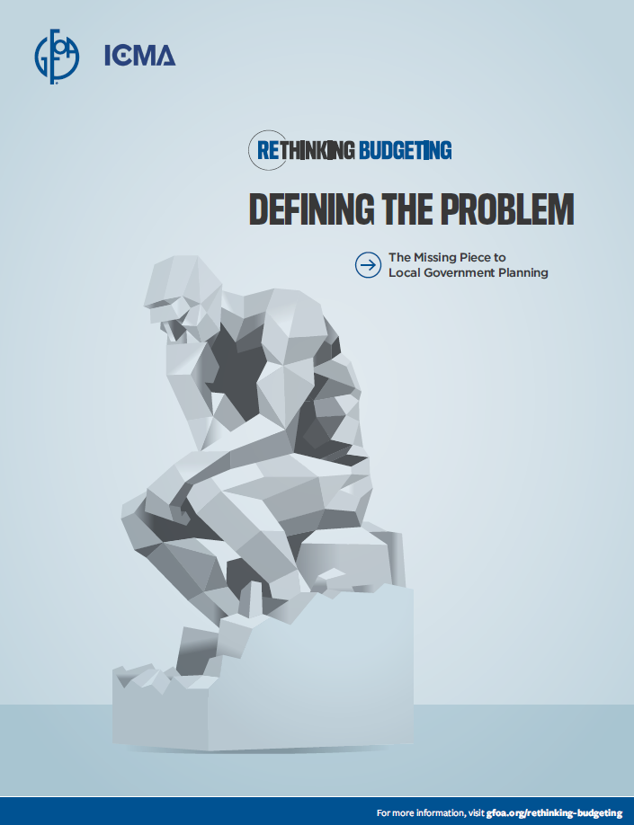
“A problem not fully understood is unsolvable, and a problem that is fully understood is half solved.”
-Charles Kettering, Inventor
Notes:
his famous quote from Charles Kettering holds great significance for local government planning and budgeting
The traditional budget process is inadequate for dealing with the complex problems that local governments are asked to deal with, such as degradation of the natural environment, encouraging economic
opportunity, drug addiction, and more.
The budget and planning process is ill-equipped to deal with these kinds of complex problems because they have characteristics that confound traditional planning and budgeting. Let’s explore these characteristics on the next slides

Slide 18
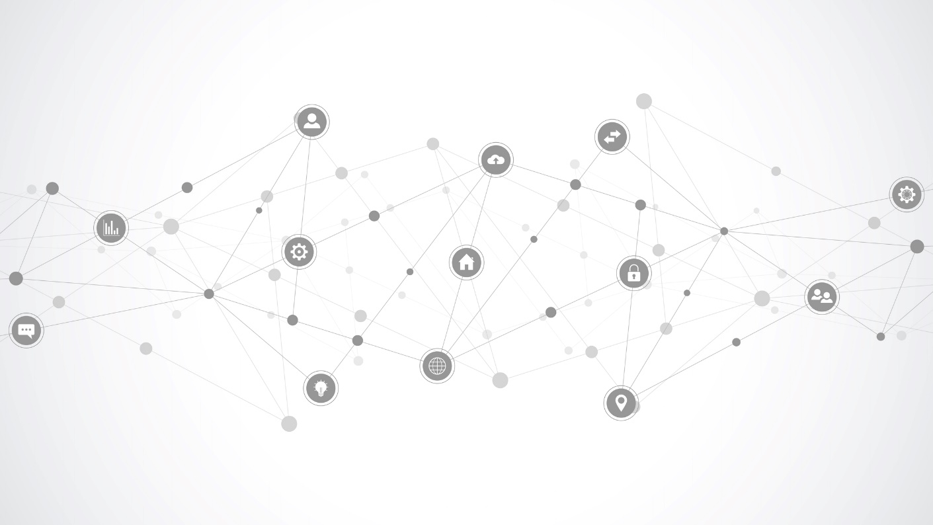
Complex problems are often…
Interconnected
Notes:
There are multiple interactive and possibly conflicting causal forces at play. For example, public safety is impacted not just by law enforcement practices but also by economic opportunity, the community’s trust in law enforcement, public health issues, and more. The solutions to complex problems are rarely contained within a single department or within local government. Other public, nonprofit and private organizations will need to be part of the solution. Yet the traditional budgeting and planning process tends to budget strictly by department, with cross-departmental collaboration rare and collaboration with outside organizations almost nonexistent.

Slide 19
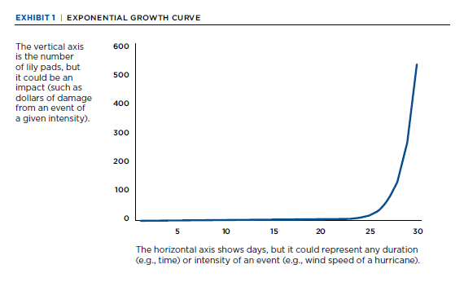
Complex problems are often…
Exponential
Notes:
Natural disasters like floods, fires and hurricanes are classic examples of an exponential risk. The potential damage increases at a nonlinear rate as the intensity of the event increases. Exponential risk also applies to other problems. For example, the summer of 2020 saw widespread civil unrest that rose and spread quickly after the murder of George Floyd. Exponential risk is particularly dangerous because it catches us by surprise. For example, consider the following problem: A lily pond starts with a single lily leaf. Each day the number of leaves will double: two leaves on the second day; four leaves on the third day; eight leaves on the fourth day; etc. If the pond is full on the 30th day, on which day is the pond half full?
If you said 15 days or so, you are not alone; but you are also wrong. The pond is half full on day 29 (if it is half full, doubling it makes the pond 100% full on day 30). On day 15 only a small fraction of the
pond is full. Exhibit 1 shows that at day 15, the number of lily pads doesn’t even register compared to the explosive growth that occurs later on. This same “hockey stick” shape applies to damages from many types of natural and man-made risks. Man-made exponential risks are exacerbated by social media and other information technologies because these technologies catalyze the risk. For instance, the role of social media in catalyzing social unrest has been well documented.
The traditional budget and planning process is not well suited to deal with exponential risk because the traditional process is linear. The basic underlying assumption is that the future will look like the past and incremental adjustments are made in revenues and expenditures from year to year

Slide 20
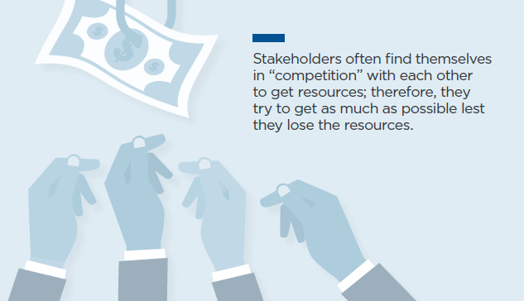
Complex problems ARE often…
Rivalrous
Notes:
There are often multiple competing interests that have to be addressed to make progress. The limitation of the traditional budget process is that conflicts are papered over by giving modest increases to participants and by not making big changes from year to year. The budget is often thought of by participants as a win-lose game. Also, the rivals involved in a complex problem often feel like they are in a win-lose game. It is hard to solve a winlose game (the complex problem) with another win-lose game (the traditional budget).

Slide 21
Design Principles for defining the problem

Slide 22
Reject zero-sum thinking | Provide procedural justice
Create psychological safety | Recognize and mitigate cognitive biases
Go beyond positions and understand interests | Introduce constraints

Slide 23
Reject zero sum thinking

Slide 24
PREVIEW of Discussion Question:
Which of the five “Pillars” represents the best opportunity for improvement in your budget?

Slide 25
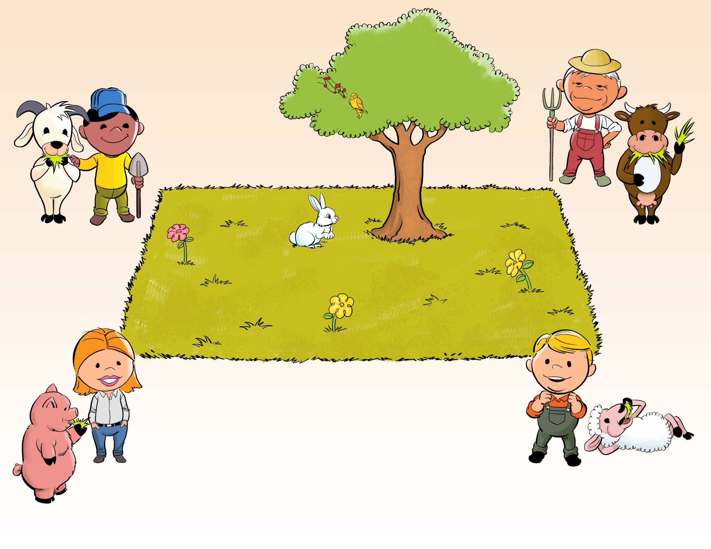
The Tragedy of the Commons
Notes:
Zero-sum thinking characterizes the “tragedy of the commons” and rivalrous problems.
There are many ways to reject zero-sum thinking.

Slide 26
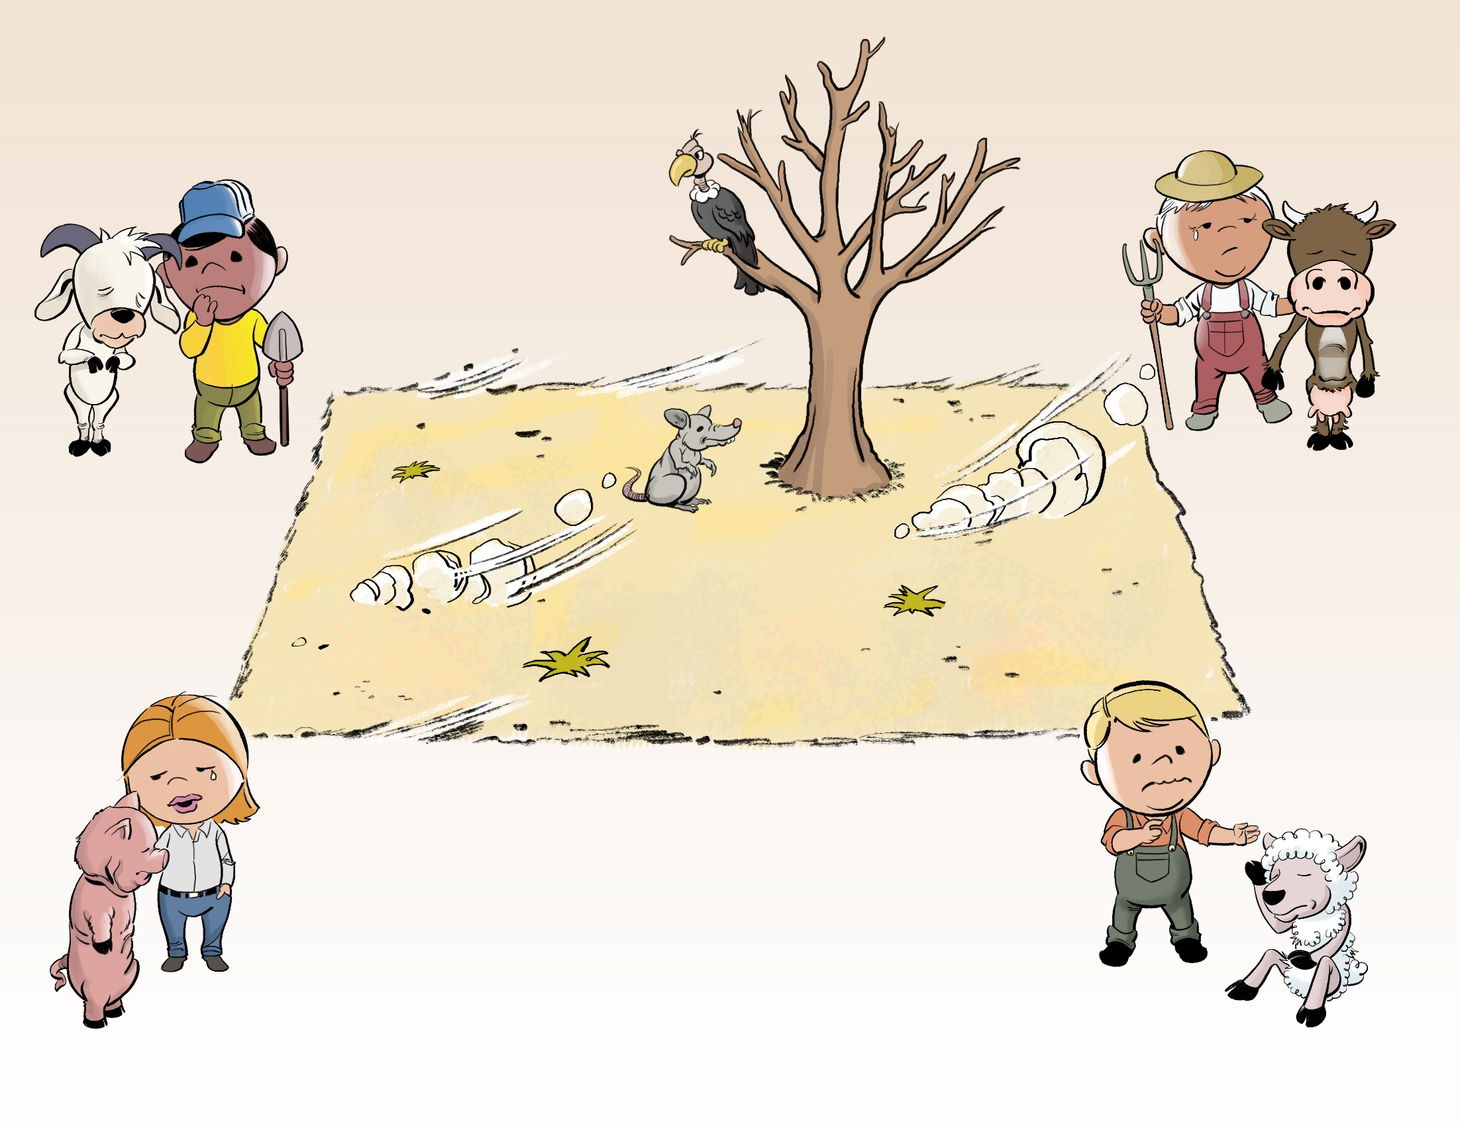
The Tragedy of the Commons

Slide 27
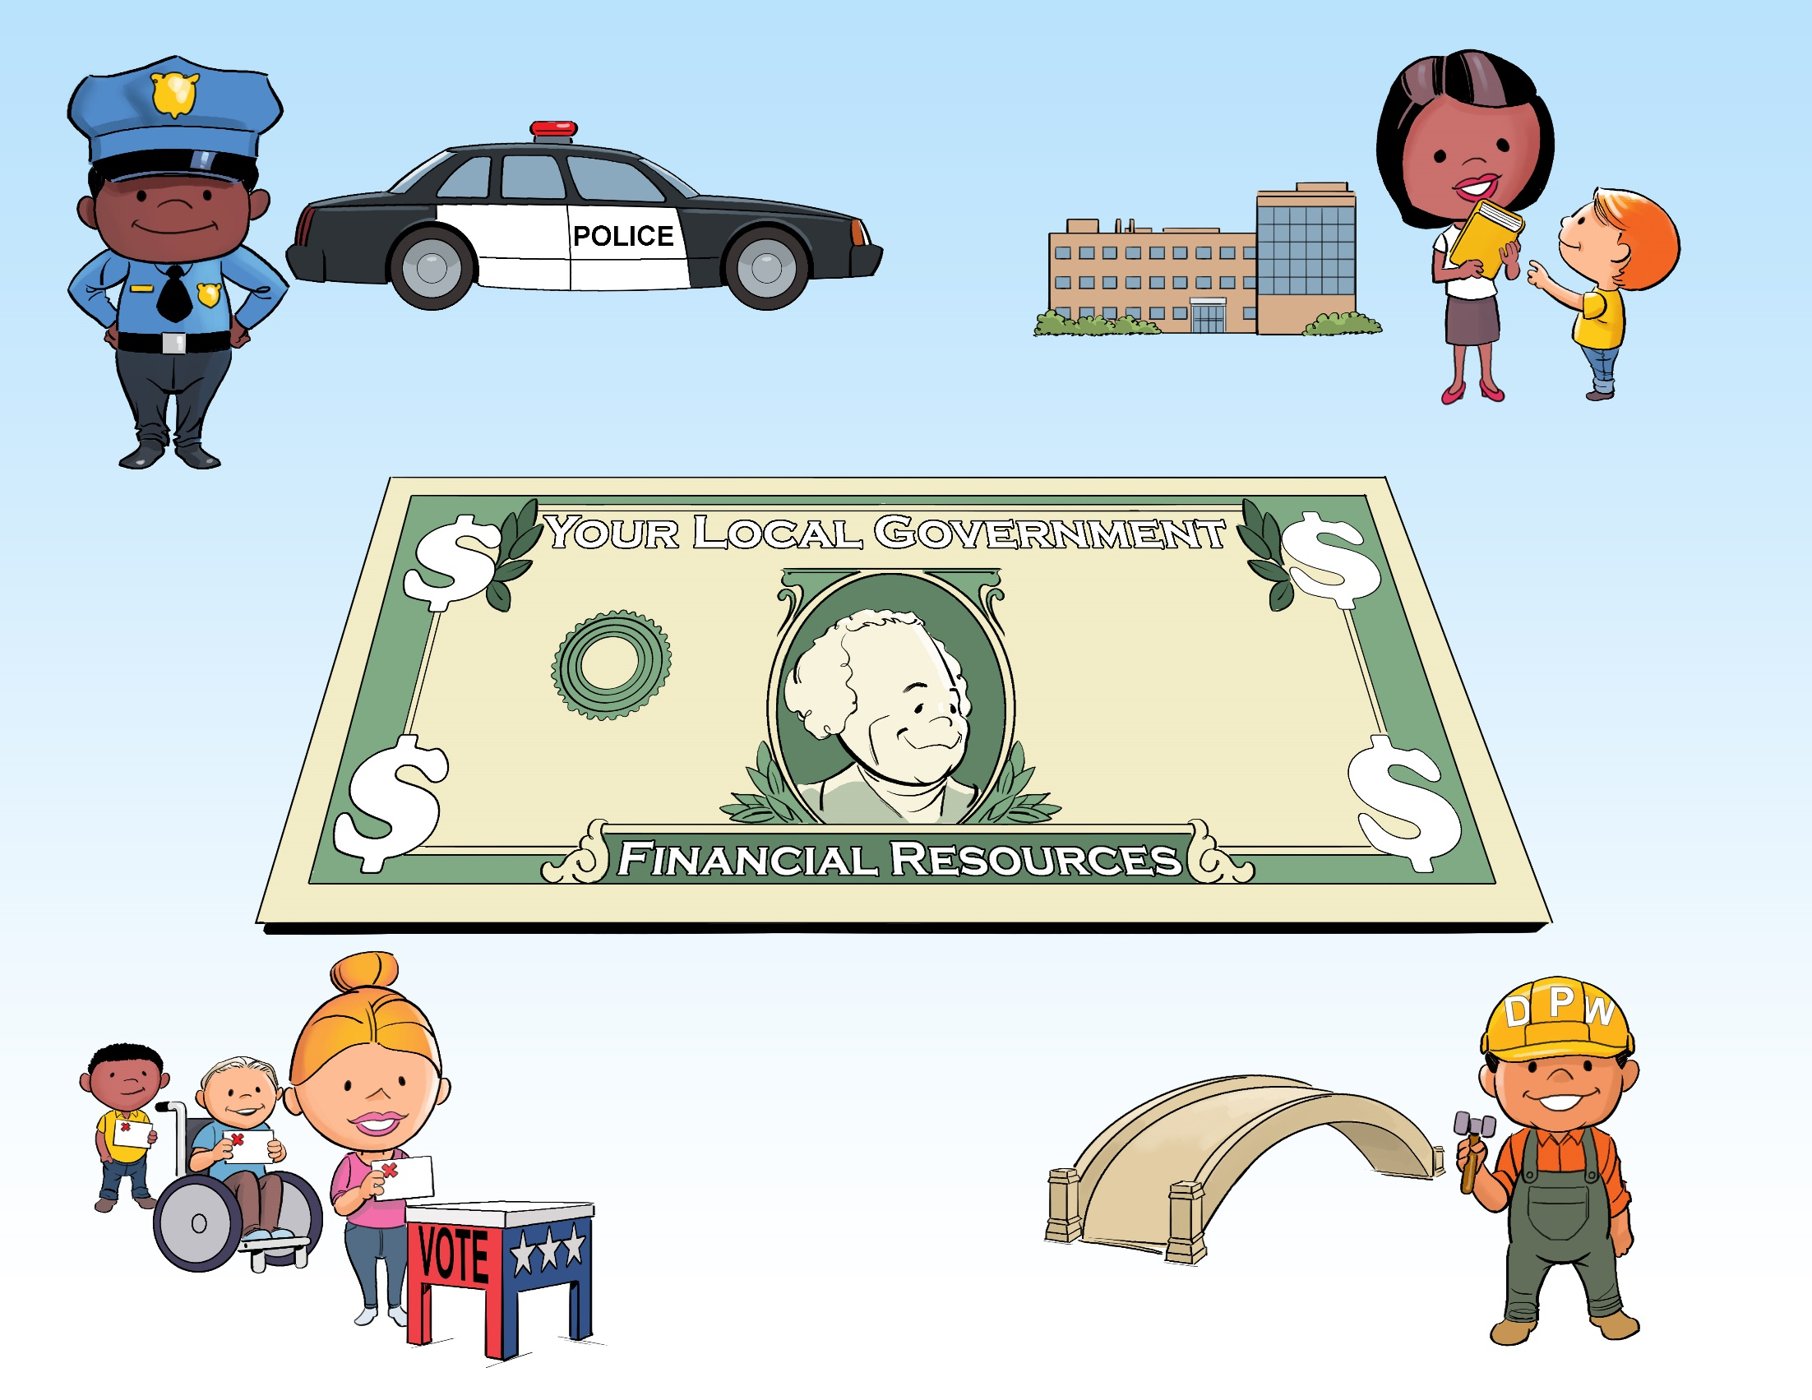
The Tragedy of Local Government?

Slide 28
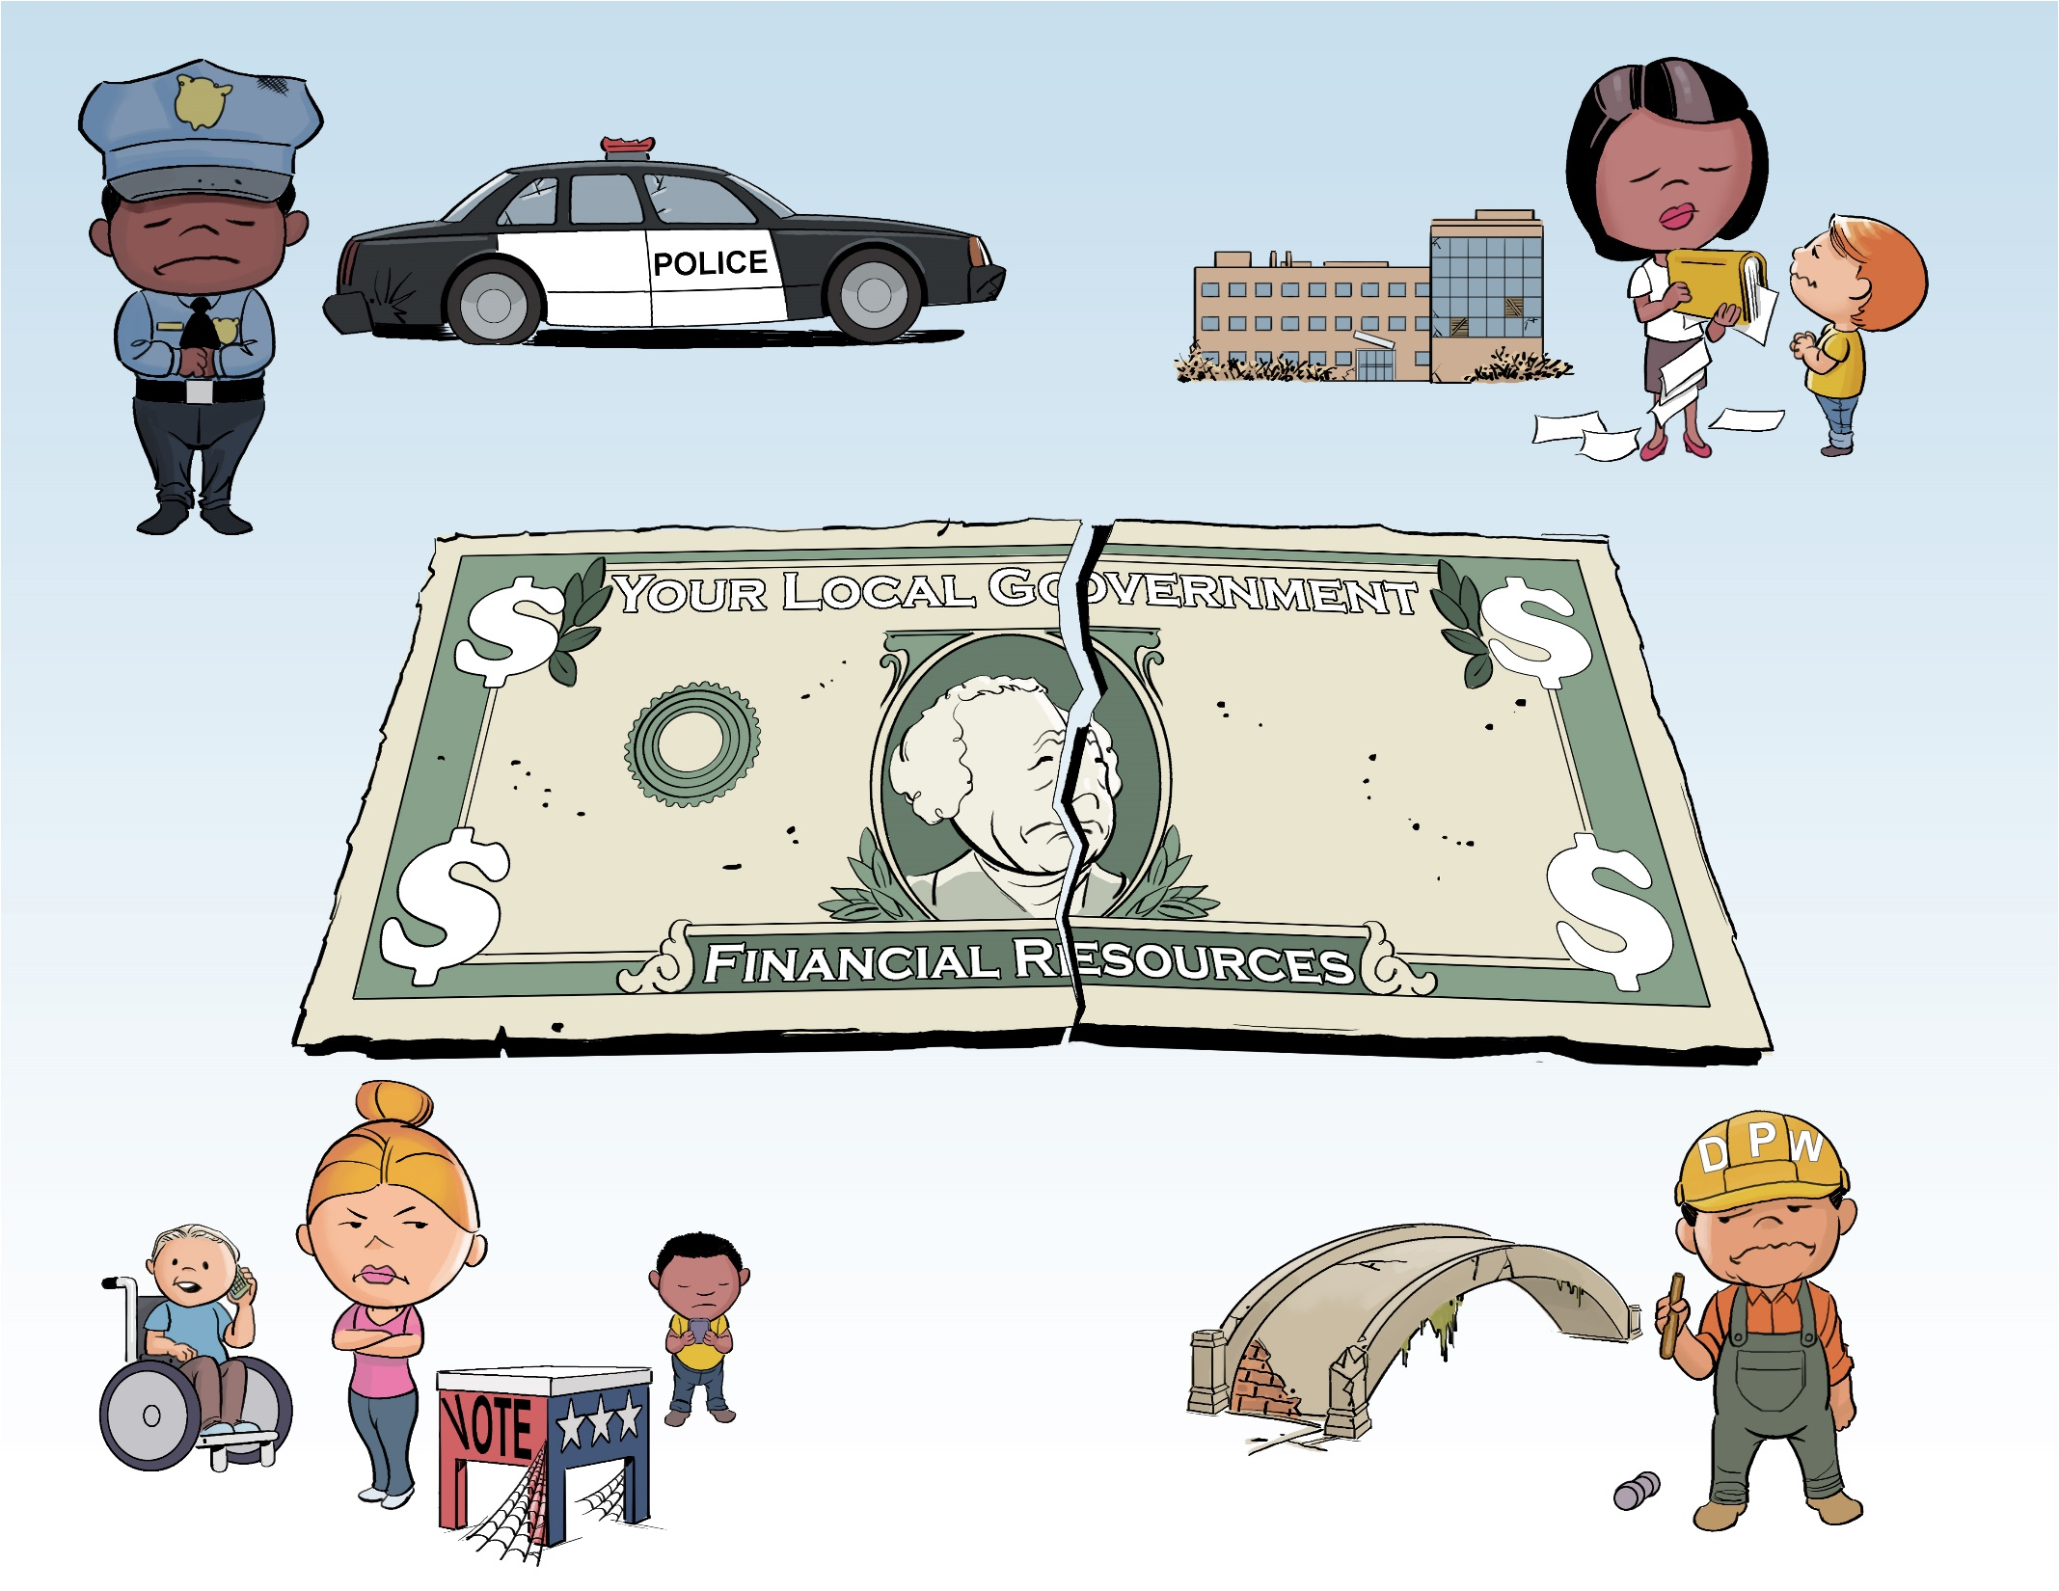

Slide 29
Different mental model:
Financial
Foundations
Framework
Notes:
GFOA’s “Financial Foundations for Thriving Communities” is a comprehensive approach that offers methods for addressing the tragedy of the commons and the win-lose dynamic inherent in it.

Slide 30
Discussion Question:
Which of the five “Pillars” represents the best opportunity for improvement in your budget?

Slide 31
Provide Procedural justice

Slide 32
PREVIEW Group Discussion
In your experience, how has either trust, or a lack of trust impacted the effectiveness of your work in budgeting? How have you addressed this in your work?
Notes:
MIke

Slide 33

Procedural Justice
Decisions are based on accurate information
Transparent & consistent decision-making criteria applied equally
Stakeholders given opportunity for input
Mistakes are recognized & corrected
Notes:
It is not always possible to avoid someone feeling a loss, which leads us to the second design principle: Provide procedural justice. Procedural justice is the sense that the process used to reach a decision was
fair. Are the decision-makers doing their best to be objective and neutral? Is it clear how the process works? Are participants treated with dignity, and do they have a voice? Providing procedural justice
is critical because people are more willing to accept a decision or action that goes against their selfinterest when they perceive that the process that led to the decision was fair and there is a level of
transparency concerning the process.9 Providing procedural justice helps stakeholders work through rivalrous problems by making people more willing to accept compromises to their preferred outcome

Slide 34
Traverse City Area Public Schools
Aging Facilities
Declining Enrollment
Declining Revenue
Difficult Decisions

Slide 35
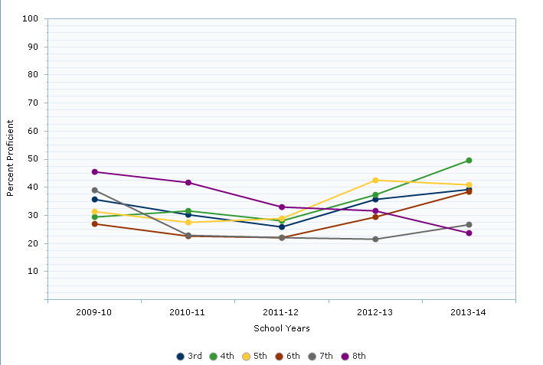
Range of State Average

Slide 36

“We love math! We love math!”
-A chant of 4th grade students at Westwoods Elementary

Slide 37
Group Discussion
In your experience, how has either trust, or a lack of trust impacted the effectiveness of your work in budgeting? How have you addressed this in your work?
Notes:
MIke

Slide 38
Introduce Constraints

Slide 39

Notes:
final design principle is to introduce constraints. Constraints put boundaries on the discussion. Without constraints, the participants in a conversation about a problem face a blank canvas. A blank canvas can be paralyzing because participants can be overwhelmed with possible choices. To illustrate a constraint, a meeting might be limited to defining the problem of street-level violence, specifically, as opposed to trying to define “public safety” more broadly or “community violence” (which could include domestic violence, which may or may not share common characteristics with street-level violence). Or it might be limited to street-level violence in a particular neighborhoodrather than the entire city

Slide 40
Financial Polices are decision-making Boundaries
Key Policies include
Reserves: How much to maintain? Acceptable uses?
One-time revenues: Acceptable uses?
Debt: How much can we incur? Acceptable repayment schedules?
Check out: https://www.gfoa.org/financial-policy-challenge

Slide 41
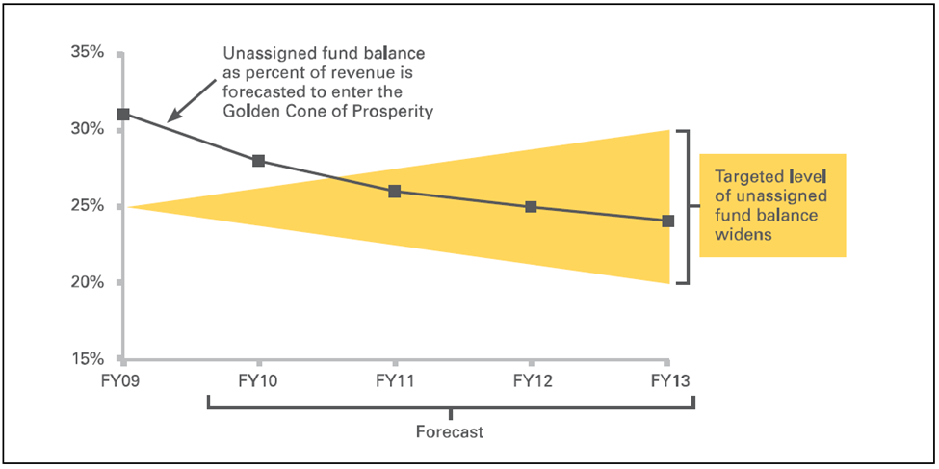
The Golden Cone of prosperity
Notes:
Highlighted Tempe in one of our most recent Financial Foundations webinars
Tempe has been using the golden cone of prosperity for about the last ten years to track the City’s goals related to its unassigned fund balance
Goal is for the unassigned fund balance to be equal to 25% of revenue
Track this over time and present a forecast; the band widens as you forecast out, due to higher uncertainty the further out you go
City council has become very familiar with this; the understand it; it helps them in their decision-making; they ask questions about how certain decisions they make today will affect the forecast in the future. Quite amazing considering that it can sometimes be difficult to get elected officials focused on the long-term

Slide 42
Take-Aways
Think about how the five financial foundations support challenging financial decisions
Integrate procedural justice into decisions
Put in place key financial policies

Slide 43

Perspectives
Conflict Resolution
Slides courtesy of…

Slide 44
The Problem
Social divisions and conflict have been spilling into the workplace, resulting in:
1
Increased conflict
2
Fear of speaking up
3
Decreased belonging
4
Decreased team effectiveness

Slide 45
Constructive dialogue is a form of conversation in which people who have different values, beliefs, and perspectives seek to build new ways to understand and interact with each other, even as they sustain commitments to their own principles and perspectives.

Slide 46

The rider and the Elephant
Controlled thinking
Automatic thinking

Slide 47
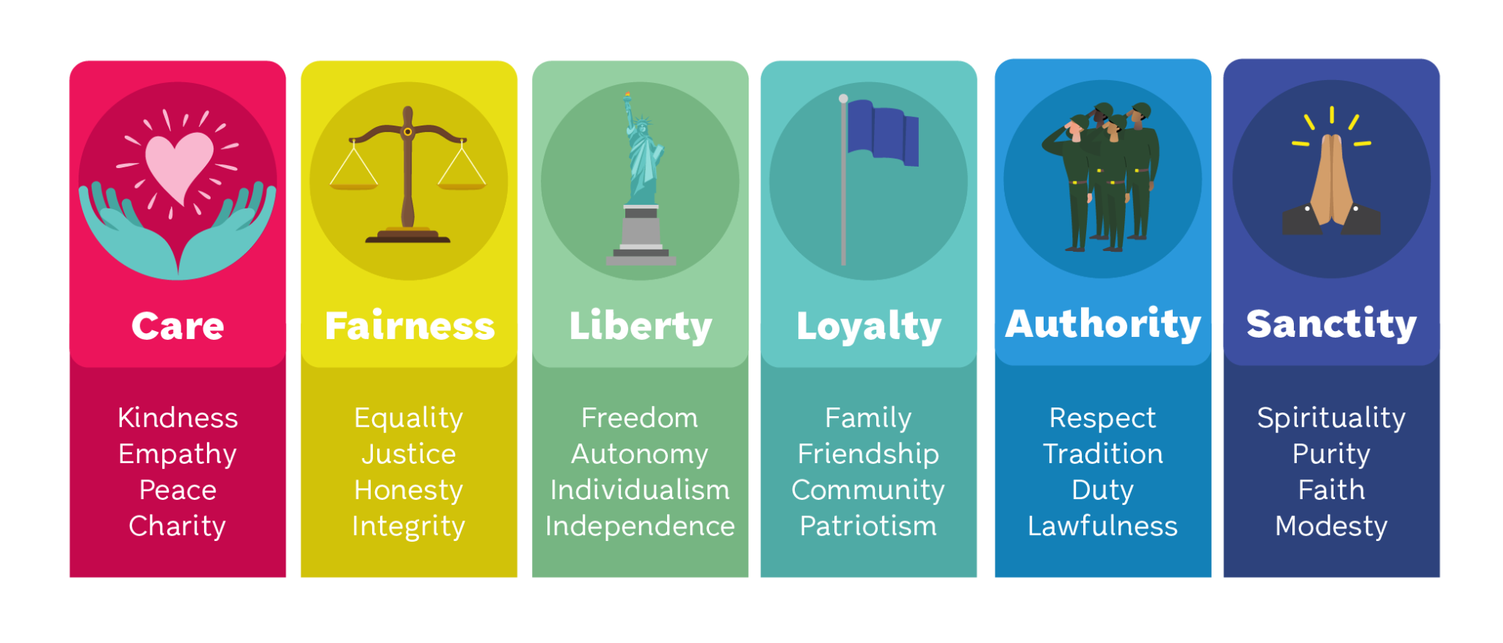
The six moral foundations

Slide 48




The back fire effect

Slide 49

Five principles of constructive dialogue
LET GO OF WINNING.
SHARE YOUR STORY AND INVITE OTHERS TO DO THE SAME.
ASK QUESTIONS TO UNDERSTAND.
ACKNOWLEDGE OTHERS’ EMOTIONS.
WHEN POSSIBLE, SEEK COMMON GROUND.

Slide 50
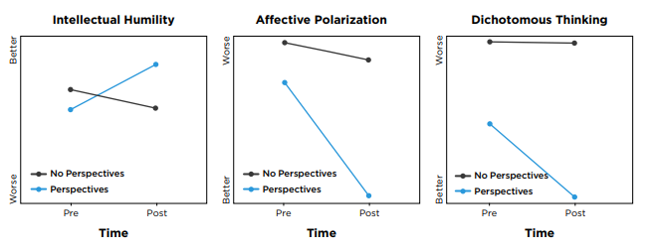
On average, participants rated their satisfaction with the program as a 9 out of 10.
Results from Our Nationwide Study

Slide 51
Take-Aways
Know your own moral foundations. Consider taking the Moral Foundations test at yourmorals.org
Recognize the moral foundations in policy conflicts. Look for which foundations are operative in arguments you encounter
Check out the gfoa.org/perspectives

Slide 52
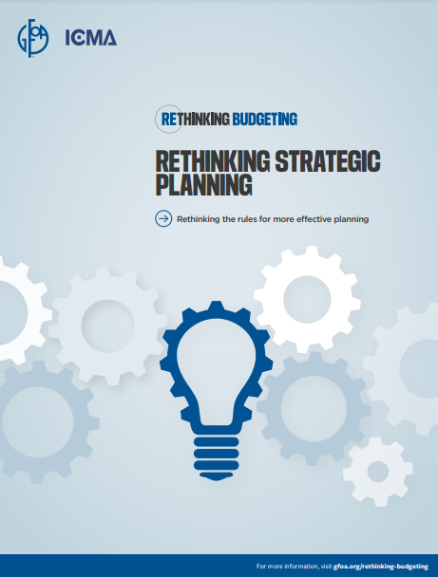
Rethinking Strategic planning
https://www.gfoa.org/materials/rethinking-strategic-planning
Notes:
Super brief intro to paper, topic

Slide 53
Three Unwritten rules of strategic planning

Slide 54
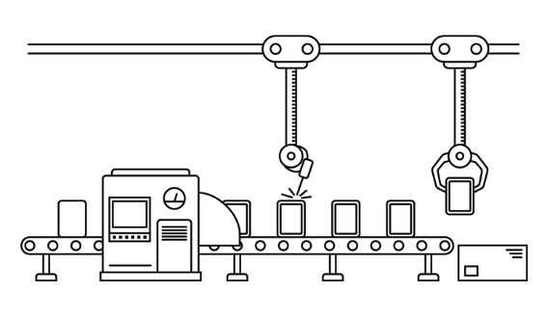


Rule 1
Drawbacks
Planning becomes too routine
Planning involves following prescribed steps, like developing a “vision statement.”
Routine can lead to cynicism about planning
Tail (document) might wag the dog (process)
Notes:
The routine steps of planning give a false sense of certainty about an uncertain future. The steps of planning serve as a (poor) substitute for strategies that will be robust under different possible futures.
Further, as steps become routine, they tend to lose the connection to what might have made them valuable. For example, many people are familiar with the eye rolls and maybe even audible groans that accompany the mention of a “vision statement.” These reactions are often well deserved, as many vision statements are generic boilerplate that could belong to any local government. However, a powerful vision is transformative of a local government, and I’ll give an example later in the presentation
Routinized planning can become oriented toward producing a planning document and not making sure the process is meaningful. This can be a case of the “tail wagging the dog,” where the “need” to produce a document diminishes the value of the process.

Slide 55

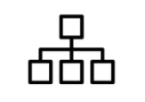
Rule 2
Drawbacks
Planning gets compartmentalized
Planning is done at a certain time, like once per year, as part of a process that precedes budgeting. It is done by certain people, like department directors, perhaps with support from budget staff
Day-to-day reality
Planning
Planning can be seen as top down, and expert-driven but….
About ½ to ¾ of people think it is better to rely on people with practical experience to solve pressing problems in society than to rely on experts.
Notes:
The second unwritten rule, that planning is done at certain times by certain people, often results in the compartmentalization of planning. For example, plans may be created by elected officials and executive leadership but seem irrelevant to the working lives of frontline staff and citizens (who sometimes have a better understanding of on-the-ground realities).
The second unwritten rule positions planning as a top-down process, performed by “experts” (usually staff). Right or wrong, society has developed a distrust of experts.

Slide 56


Rule 3
Drawbacks
Local governments are in a volatile environment
Long-term priorities should be stable over time, should cover all of what the organization
does, and drive department actions.
A strategic plan that tries to be comprehensive of everything risks producing bad strategy
Notes:
local governments are in a volatile environment. For example, information technology brings rapid changes in the economy and social movements. This volatility means that governments and their plans are at added risk of failing to adapt to changing conditions. A government may feel committed to achieving the goals or tasks in a strategic plan, even as they become irrelevant due to changing conditions.
The other part of the third unwritten rule is: Strategies should cover everything the organization does and drive department actions. A strategic plan that tries to include the whole organization risks producing a bad strategy for three reasons: First, an effective strategy is focused on a limited set of the most important issues. Local governments often offer a broad set of services (and departments). Focused strategies will rarely cover everything a government does. Second, proceeding from the mindset that a plan must cover everything may cause the government to root strategies in what the government is already doing. This is because if every department is expected to have a goal or task related to the strategy, it is easier to do if the strategy is based on what they are already doing! In some cases, current capabilities might be a fine basis for a strategy; but in other cases, they may not. Third, the exercise to reach a comprehensive plan can be exhausting for all involved, stretching resources to the breaking point.

Slide 57
Design Principles for Rethinking Strategic Planning

Slide 58
1. Accept uncertainty | 4. Develop a rolling planning process
2. Define the problem before defining the solution | 5. Make sure planning is collaborative
3. Provide focus by introducing constraints | 6. Make sure planning is fair

Slide 59
Accept uncertainty

Slide 60
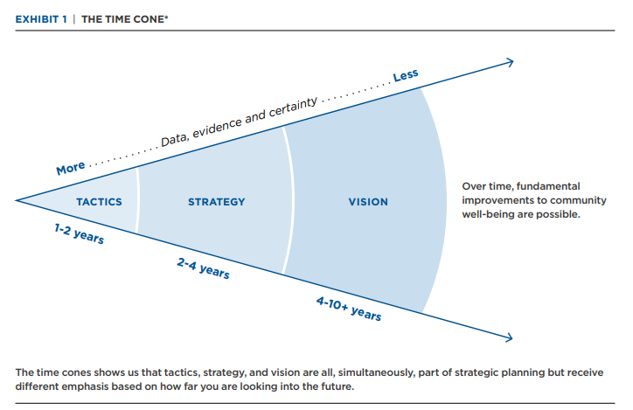
The Tragedy of the Commons
*Time cone is originally from: Webb, A. (July 30, 2019). How to do strategic planning like a futurist. Harvard Business Review.
Notes:
Uncertainty is uncomfortable. Traditional strategic planning offers the comfort of a structured process, but it can’t change that the future is largely unknowable. Accepting uncertainty doesn’t mean giving up on planning or strategy. It means that the approach to planning and strategy must accept our limited knowledge of the future. futurist Amy Webb advocates dispensing with timelines (a linear approach) and adopting time cones (an expansive, adaptive approach).
Four to 10+ years: Vision. The vision is an aspirational state for the community. It should be broad enough that it can conform to changes in strategy that go with newly elected leadership but not so broad as to be meaningless.
Two to four years: Strategy. Strategy defines the direction and priorities how the organization will achieve the vision. Two to four years is a proper time horizon for strategies because the future beyond two years is too fluid for tactics to be feasible. We use four years as an outer limit to correspond with the typical term of office for elected officials. The composition of a local government’s elected leadership is a key determinant of direction and priorities. This is not to say strategies should never look more than four years ahead. Making a difference in the complex problems local governments are asked to deal with might take more than four years! Rather, planning should give special attention to the two- to four-year time horizon.
One to two years: Tactics. Tactics are appropriate where there is more certainty about the environment. Examples might involve implementing new programs, abolishing obsolete or unaffordable programs, or fine-tuning existing services. Tactics have a direct connection to the budget but are not synonymous with it. Tactics are putting the strategy into action, and some actions may not fit neatly in the budget.

Slide 61
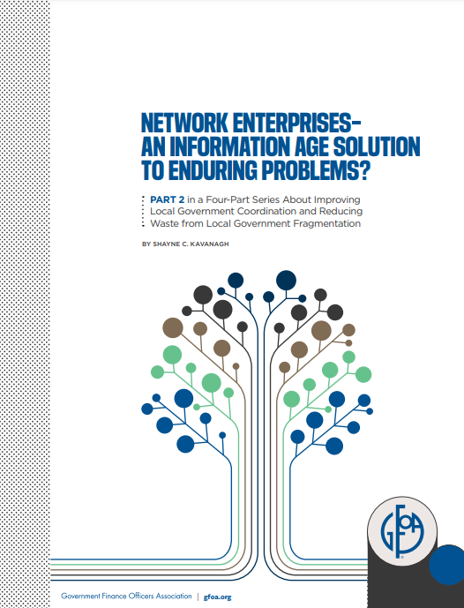
Transformative visions in local government
Network Enterprises
https://www.gfoa.org/materials/network-enterprises
Notes:
The San Antonio 2020 vision threads this needle. It also has proven staying power: It has survived three changes in mayoral administrations. Collaboration across the community to form and maintain the vision has been key to the vision’s longevity. Thousands of San Antonio citizens helped create the vision. Many public, private, and nonprofit organizations are active participants in moving the vision forward toward reality. You can read more about San Antonio’s vision and comparable efforts in other communities in this GFOA report.

Slide 62

Illustration of vision, strategy, tactics
Vision: Exceed state average for on-time graduation rates
Strategy: Mitigate summer learning loss
Tactics: Identify subjects where poor grades predict graduation problems. Concentrate summer learning on those subjects for students who don’t do well.

Slide 63
Rolling Plan

Slide 64
Goals of the rolling plan
Refine the strategies to consider the changing conditions and priorities.
Confirm the tactics that will be addressed in the budget
Notes:
Strategic plans should avoid over-specifying long-term goals that will be rendered obsolete by changing conditions. Further, the time cone tells us that strategy cannot be thought of as a straight line. Rather, adjustments will need to be made to respond to changing conditions. A rolling planning process should precede budgeting to update strategies and tactics,. The goal is not to produce a new “strategic plan” but rather to guide the budget process about where resources should be allocated.
First, refine the strategies to consider the changing conditions and priorities. Perhaps conditions have changed such that your underlying assumptions are less certain or more certain. Or maybe there are new opportunities or new problems to be considered. An example of the former might be a new grant that makes a strategy more cost-effective than it was before. An example of the latter might be that one of your strategies is not producing the results you thought it would. For instance, perhaps not enough kids are taking part in summer learning programs to make a big difference in graduation rates.
Second, confirm the tactics that will be addressed in the budget. This should flow from your refined strategies. Let’s continue our case of improving high school graduation rates. If your definition of the problem suggests a certain strategy will work well, then the budget should provide funding for pilot programs to try the strategies and for continued funding if the pilots prove successful.

Slide 65
What the rolling plan does not do
Change the vision
(Re)define the problem
Notes:
The vision. There should not be a need to change the vision from year to year. Bring up SA2020
Earlier, we advocated for defining the problem before defining solutions. This does not mean that the problem needs to be re-litigated each year. A problem can be analyzed once, then strategies developed, allies recruited to help, and strategies and partnerships refined from year to year

Slide 66
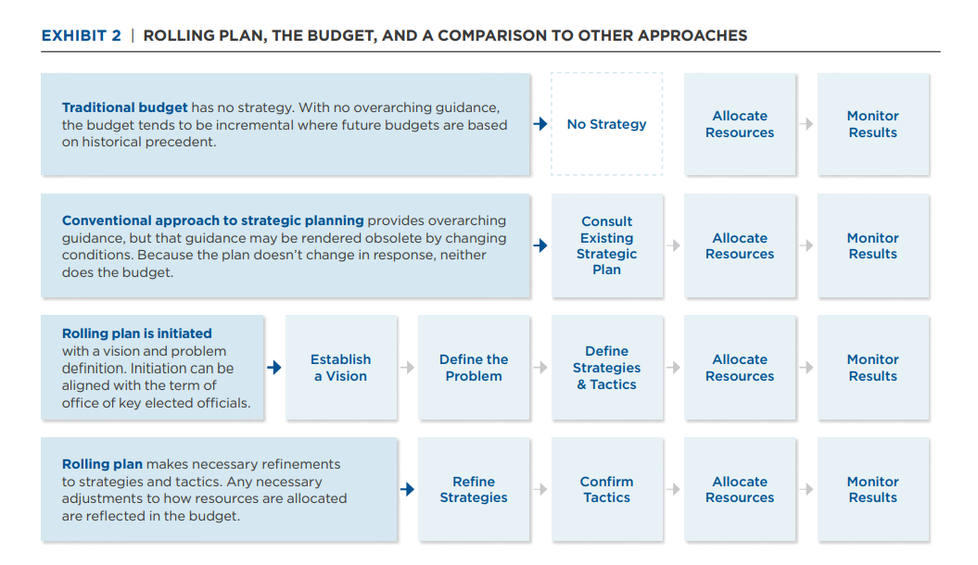

Slide 67
Take-aways
Focus planning on a small number of key issues
In a volatile environment a premium is placed on adaptability
Consider rolling plans as an adaptable, less resource intense type of strategic planning

Slide 68
Rethinking Public Engagement
Coming Soon

Slide 69

Rethinking Public Engagement
Recognize modern challenges to public engagement
Explore new solutions
Notes:
The budget is the most important policy document that local government produces. As such, it has been recognized for decades that local governments should do better on engaging people in the budget. The typical avenue for public engagement is limited to a public hearing or two, which typically happens after the important decisions have been made and, often amount to little more than an opportunity for people to air their grievances at a microphone
We contend that, in recent years, new forces have emerged that suggest that local governments need to consider public engagement in a new light. Before we examine these forces and their implications, we must recognize that public engagement is, perhaps, the most difficult part of budgeting. To make this problem easier to deal with we have broken it down into three phases
Planning is articulating a desired future state for the local government and its community.
Budgeting is allocating a local government’s limited resources.
Monitoring/reporting is making sure that the commitments made during planning and budgeting are lived up to and maintaining an understanding of the environment.
Today we will be focusing on public engagement primarily as it relates to planning, but much of what we say will have implications for budgeting too. As RtB progresses we will delve deeper into public engagement.

Slide 70
Group Discussion
What are your top challenges with engaging the public?
Notes:
MIke

Slide 71
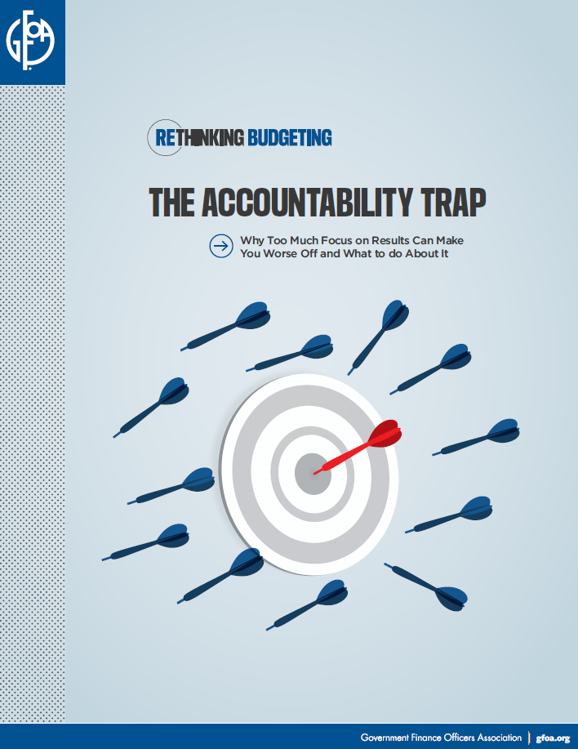
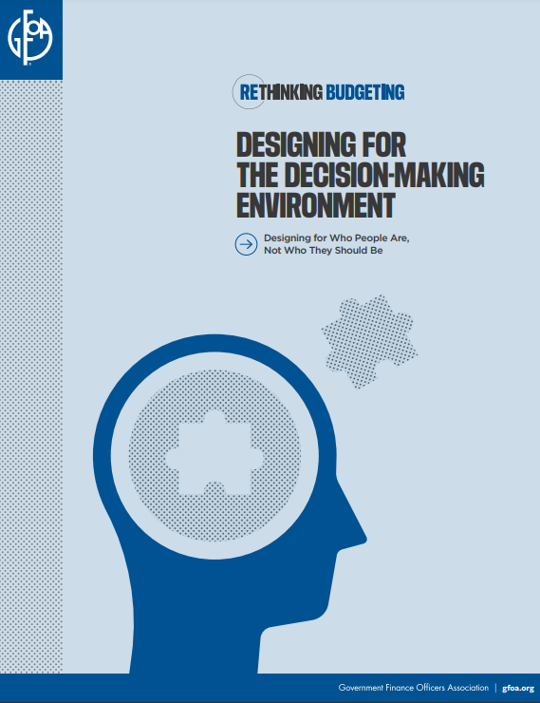
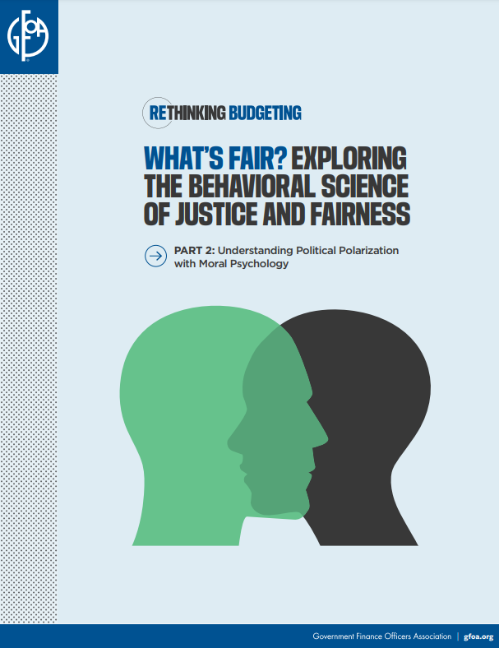
Resources (linked in @ Shayne Kavanagh)
Create Psychological Safety
Recognize & Mitigate Cognitive Biases
Go Beyond Positions & Understand Interests
gfoa.org/materials/
accountability-trap
gfoa.org/behavioral-science
gfoa.org/fairness

Slide 72
Group Discussion
What is your top opportunity to “rethink budgeting” in your community?
Notes:
MIke

