Slide 1
New England States GFOA 76th Annual Conference
Internal Controls in the Finance Office
September 11, 2023
Scott C. McIntire, CPA

Slide 2
What are Internal Controls?
Internal control is defined as – a process for assuring achievement of an organization’s objectives in operational effectiveness and efficiency, reliable financial reporting, and compliance with laws, regulations and policies.
1992 the Committee of Sponsoring Organizations of the Treadway Commission (COSO) produced the internal control framework which is used to develop and assess the internal control system. The Framework has five elements:
  Control Environment
  Risk Assessment
  Control Activities
  Information and Communication
  Monitoring Activities

Slide 3
Internal Controls
According to COSO – the three primary objectives of an internal control system are to ensure (1) efficient and effective operations (2) accurate financial reporting and (3) compliance with laws and regulations.
  Control Environment – Provide the foundation for the internal control system – fundamental discipline and structure.
  Risk Assessment – Analysis by Management (not the auditor) of relevant risks that interfere with achieving the objective.
  Control Activities – policies, procedures, and practices that ensure managements objectives are achieved and risk is mitigated. Segregation of duties, review and verification procedures, etc.
  Information and Communication – Supports all other control components by communicating control responsibilities to employees and by providing information in a timely manner so that employees can carry out the assigned tasks to mitigate risk.
  Monitoring – internal and external oversight by management or others to ensure that controls are effective and that processes and procedures are being complied adhered to.

Slide 4
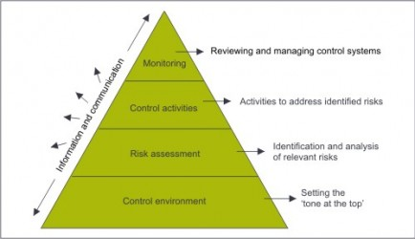
COSO 1992 Framework for Internal Controls

Slide 5
Where to Begin?
Establish/identify your goal and objective –
  Perhaps safeguarding of assets, completeness and accuracy of internal financial records/general ledger, and compliance with Organization’s Charter and budget ordinance.
Identify the high-risk areas within your community that may result in misappropriation of assets, or material misstatement to financial reporting.
  Collections – centralized and decentralized
  Assessments
  Payroll processing
  Cash Disbursements
  Account reconciliations
  Journal Entries
  Compensated Absences, Long-term Debt Liabilities, and Capital Asset records.

Slide 6
Where to Begin?
Collections – centralized and decentralized
  What controls are in place to reconcile collections to source documents? Receipts, permits issued, licenses issued, etc.
  Reconciling deposits to computer reports noting composition of receipts – cash versus check (lapping of funds).
  Review system for voided transactions and establishing protocols for voiding transactions.
Assessments
  Controls to ensure proper assessment of taxes, fees, etc.
  Who has controls to remove/abate assessments.
  Ability to review reports reflecting changes to valuations and assessments.
Payroll processing
  Approval of time reports/cards.
  Approval of payroll once processed – approving payroll registers.
  Controls over who can add personnel.
  Controls over who can change pay rates.
  Applying date extraction software to search for duplicate direct deposit accounts, fictitious social security numbers, or other unusual items.

Slide 7
Where to Begin?
Cash Disbursements
  Approval of vendor invoices.
  Process for adding vendors to the system.
  Maintenance of check stock.
  Maintenance of electronic signature key for electronically signed checks.
  Control over disbursing checks once processed.
  Process to ensure no missing checks (maintain a check log).
Account reconciliations
  As foolish and as simple as it may sound – reconcile cash accounts on a monthly basis.
  Reconciliation should be completed by someone independent of the cash disbursement function.
  Reconciliations should be compared to the General Ledger, signed by preparer, and also approved and signed by the Finance Director or other responsible party.
  Reconciliation of other significant balance sheet accounts should also be completed on a monthly or at a minimum, quarterly, basis – receivables, payables, interfund transactions, accruals, etc.

Slide 8
Where to Begin?
Journal Entries
  Journal entries are a way that management or others may try to manage/manipulate the bottom line or cover up a fraud/misappropriation.
  When possible, journal entries should be kept to a minimal.
  Utilize all modules within the accounting system to their potential.
  All journal entries should be signed by the preparer and approved by someone independent of the preparation process. Documentation should be maintained to support all journal entries.
  In order to monitor the controls over journal entries management should generate a report of journal entries, review the report on a periodic basis, and select entries to review supporting documentation.
  Management should save the reports to document the monitoring of the control activities.
  Compensated Absences, Long-term Debt Liabilities, and Capital Asset records.

Slide 9
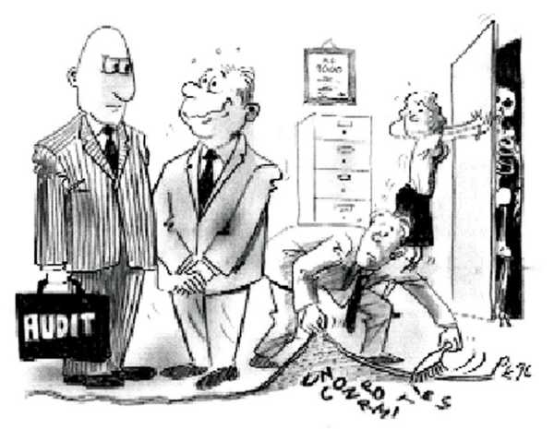
Lack of strong internal controls will eventually catch up to you.

Slide 10
Internal Controls – Different Types
Internal Controls:
  Policies and procedures established by organizations that are designed to prevent material errors in financial reporting
    Physical controls
    IT controls
    Reconciliation controls
    Inventory controls
    Document standardization
    Approval authorization

Slide 11
Internal Controls – What are they Not?
Governments have plenty of activities they perform simply to record transactions and generate financial statements. Many, if not most, of these activities are really just processes and not controls.
Processes differ from controls. Processes are the steps taken by personnel to run the business and record its activities.

Slide 12
Process vs. Control
Process – A series of actions that lead to a particular result
  May contain specific controls.
  Could lead to noncompliance.
  Should be evaluated to determine the possibility of noncompliance (i.e. “What Could Go Wrong”).
Control – Designed to prevent or timely detect noncompliance
  Must first consider the process of “What Could Go Wrong” before designing controls.
  May be viewed as part of a process, but need to be separately identified.
Analogy:
Square is to rectangle, as control is to process.
All squares are rectangles, just like all controls are processes.
However, not all rectangles are squares, just like all processes are not controls.

Slide 13
Understanding Internal Controls
Controls may be:
  Preventative – Designed to avoid an unintended event or result at the time of the transaction, or
  Detective – Designed to discover an unintended event or result after the initial processing has occurred but before the ultimate objective has concluded.
Controls may be:
  Entity-wide – Controls that apply to most, if not all, types of compliance requirements for one or more programs, or
  Specific – Controls that are considered operational-level controls that apply to individual types of compliance requirements.

Slide 14
Implementing Effective Internal Controls
Effective internal controls is not one event or circumstance but rather a dynamic and iterative process.
Embedded within this process are controls consisting of policies and procedures.
Internal controls are required to be established by an entity receiving federal awards and should be in compliance with either:
  The “Standards for Internal Control in the Federal Government” issued by the Comptroller General of the United States (the Green Book), or
  The “Internal Control Integrated Framework” issued by the Committee of Sponsoring Organizations of the Treadway Commission (COSO).

Slide 15
Components of Internal Control
The Green Book and COSO are both organized by five components of internal control:
  Control Environment
  Risk Assessment
  Control Activities
  Information and Communication
  Monitoring
In developing a system of internal controls, all five components MUST be present and functioning for it to be designed effectively

Slide 16
Summary of Green Book and COSO
Components and Principals of Internal Controls
The five components of internal control can be further broken down into seventeen principles:

Slide 17
Internal Controls – Common Examples
Segregation of Duties Controls
Physical Controls
Reconciliations
Reviews of Transactions (accounting and reporting conclusions)
Review of Financial Activity
IT Controls
Inventory Controls (physical counts)
Document Standardization
Approval Authorizations

Slide 18
Internal Controls – Common Examples
Segregation of Duties (“SOD” Controls)
  What risk do SOD Controls aim to prevent?
    Risk of Incompatible Duties
  Examples of Incompatible Duties
    Recording and Approving/Reviewing Transactions
    Asset Custody and Recordkeeping
    Sales Personnel extending credit terms to customers
    Setting up vendors and paying (or approving payment of) invoices to those vendors

Slide 19
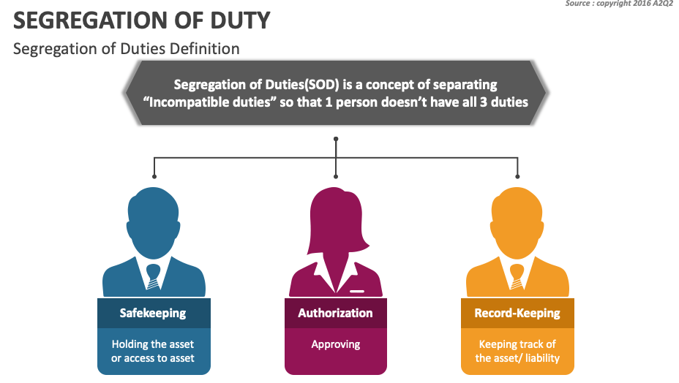

Slide 20
Examples of SOD
Process | Type of Access | Conflicted with
Inventory | Receive Goods | Inventory Processing
Fixed Assets | Fixed Assets Set Up | Fixed Assets Master File
Cash | Initiate Wire Transfers or Check | Approve Wire Transfers or Signs Check
 | Cash Receipts or Disbursements | Bank Reconciliation
Financial Accounting | Create GL | Post GL
 | Execute Opening & Closing of GL Periods
 | Chart of Accounts

Slide 21
Examples of SOD Cont’d
Process | Type of Access | Conflicted with
Accounts Payable (Expenditure, Purchase-to-Pay) | Create/Maintain Vendor | Create Requisition
 |  | Create PO
 |  | Process Payments
 |  | Process Invoice
 | Process Invoice | Receive Goods
Payroll | Enter Time | Run Payroll
 | Edit Payroll Master
Accounts Receivable and Sales (Revenue, Order-to-Cash) | Cash Receipts | Maintain A/R Records
 | Maintain A/R Records | Customer Master File
GITCs | Create change in Development/Test | Move change to Production

Slide 22
Internal Controls – Common Examples
Physical Controls
  Controlling access to cash or petty cash
  Controlling access to physical inventory
  Controlling access to valuable/vulnerable assets
Reconciliation Controls
  Reconciliation of Balance Sheet Accounts
    Comparison of balance sheet general ledger account to the details making up the total of the account
    Objective is to ensure the detailed activity is accurately reflected in GL balance
    Cash
    Accounts Receivable
    Accrued Liabilities
    Prepaid Expenses
    Inventory

Slide 23
Internal Controls – Common Examples
Review Controls
  Impairment Considerations
  Technical Accounting Matters
  Budget/Forecast to Actual Results
  Going Concern Evaluation
    Review controls may be of greater importance at smaller entities with smaller volumes of transactions
IT Controls
  Access to GL and other financially relevant systems
    Controls over granting access and removing access
    Controls relative to extent of access granted / roles in system
  Changes to GL and other financially relevant systems
    Controls to ensure any changes are properly implemented, approved

Slide 24
Internal Controls – Common Examples
Inventory Controls
  Full physical counts
  Cycle Counts
  Regardless of the frequency or extent of the counts, these counts by management are generally structured as a control to ensure the accuracy of the physical count of the inventory recorded in the GL – existence assertion.
Approval Authorizations / Policies
  Authority over approval of cash disbursements
    Example – Checks up to $1,000 require Accounting Manager approval, checks up to $5,000 require Controller approval, checks over $5,000 require CFO approval.
    Authority may be based on written policies or “governed by IT system.”

Slide 25
Internal Controls –
Reminder – Two parts of a control
Is the control properly designed?
    If properly executed, will the control appropriately achieve its objective?
    Will the control actually address the risk/WCGW (what could go wrong)?
Has the control been properly implemented?
    Is the control in place and is that control being used?

Slide 26
Control Deficiencies
These control problems are called “Control Deficiencies”.
When we identify a deficiency, we have to evaluate the extent of the deficiency.
There are three levels to describe the extent of a control deficiency:
  Control Deficiency – Basic control problem that could not reasonably lead to a material error.
  Significant Deficiency – Same as control deficiency but we as auditors believe the deficiency is important enough to communicate to TCWG (those charged with governance).
  Material Weakness – Control problem that COULD reasonably lead to material error.

Slide 27
Developing Policies and Procedures
Over Federal Grants
A federal grants policies and procedures manual is required and should –
  Be applicable to all federal grant awards of the entity.
  Contain the internal controls and grant management standards used by the entity to ensure that all federal funds are lawfully expended.
  Be reviewed periodically to ensure it is still in compliance with Uniform Guidance requirements.
All employees who deal with federal grants must be familiar with the policies and procedures and comply with all requirements.

Slide 28
Developing Policies and Procedures
Over Federal Grants
The federal grants policies and procedures manual is required to document –
  The entity’s financial management system
  Cash management procedures
  Procurement policies
  Procedures for determining the allowability of federal expenditures
  Monitoring responsibilities (for subrecipients)
Financial Management System (2 CFR 200.302)
  Federal regulations require grantees to use fiscal control and fund accounting procedures that insure proper disbursement of and accounting for federal funds
  Implementing and maintaining a proper accounting system is a fiduciary responsibility associated with receiving a federal award
Cash Management (2 CFR 200.305)
  Entity’s must minimize the time elapsing between the transfer of funds and the disbursement
  Interest earned amounts up to $500 per year may be retained

Slide 29
IT General Controls (ITGCs)

Slide 30

What are IT General Controls?
IT general controls (ITGCs) are the basic controls that apply to all the system components (such as applications, operating systems, databases), data, processes, and supporting IT infrastructure. The objectives of ITGCs are to ensure the integrity of the data and processes that the systems support.
These controls determine whether the key system or application in scope for the audit are ‘tuned up’. ITGC are essentially baseline controls that need to be designed and operating effectiveness before the auditor can effectively rely on the system/application or its output for the financial statement audit.

Slide 31
What are IT General Controls? Cont’d
Common ITGC’s include the following:
  Logical Access Controls
    Is the new assigned user access appropriate and approved by right individuals?
    Is access disabled for terminated employees in a timely manner?
    Is access modified appropriately for employees who transition to new roles within the Company?
    Is elevated/superuser access appropriate?
    Is access reviewed periodically for appropriateness?
  Computer Operations Controls
    Is backup of the database / software occurring based on predefined schedules?
    Is critical job / interface program working appropriately?
  Change Management Controls
    Are system changes requested, tested, and approved by appropriate personnel?
    Is appropriate segregation of duties considerations maintained by management throughout the process?
    Is new system development and implementation process (application, database or other infrastructure) adequately tested and approved prior to implementation?

Slide 32

Questions

Slide 33

Thank You!
marcumllp.com

