Slide 1
NEGFOA Looking Forward:
DC Update 2023 and Beyond

Slide 2

Roadmap
A look at the 118th Congress
Ongoing Implementation
  ARPA Closeout
  IIJA implementation
  Inflation Reduction Act hopes and dreams
Financial Data Transparency and You

Slide 3
Looking ahead at the 118th

Slide 4
New Ways and Means Members
Rep. Mike Carey (OH-15) | Rep. Blake Moore (UT-01)
Rep. Randy Feenstra (IA-04) | Rep. Michelle Steel (CA-45)
Rep. Michelle Fischbach (MN-07) | Rep. Greg Steube (FL-17)
Rep. Brian Fitzpatrick (PA-01) | Rep. Claudia Tenney (NY-24)
Rep. Nicole Malliotakis (NY-11) | Rep. Beth Van Duyne (TX-24)
What’s on Tap?
New Chairman - Jason Smith (MO-08)
IRS Focus
Child tax credit
Public finance priorities??
Notes:
There was an election in the Republican caucus for each leadership position of committees. We were surprised by the outcome of the Ways and Means committee because we thought it was going to be Rep. Buchanan out of Florida, but instead Jason Smith of MO was chosen. He’s from a pretty rural district and he’ll be guiding the agenda for the entire committee over the next 2 years
On every cmte there has to be a Republican majority. There are now 10 new GOP members on this committee and our #1 goal is to get them to join the House Municipal Finance Caucus. So if you see someone here who represents you, we need your help in the outreach to them.
Reminder: the House Municipal Finance Caucuse is a bipartisan effort so we’ll need to target both sides of the aisle.
One of the first things the committee did was pass a bill to clawback the increased funding for the IRS. We expect the IRS to receive even more scrutiny moving forward, as Republicans have campaigned on the premise that with more funding the IRS will audit middle class families
We are going to reintroduce our priorities (advanced refunding, bank qualified debt), but we’ll have more of an uphill battle on AR because most Republicans might not want to undo what they voted for in 2017.

Slide 5
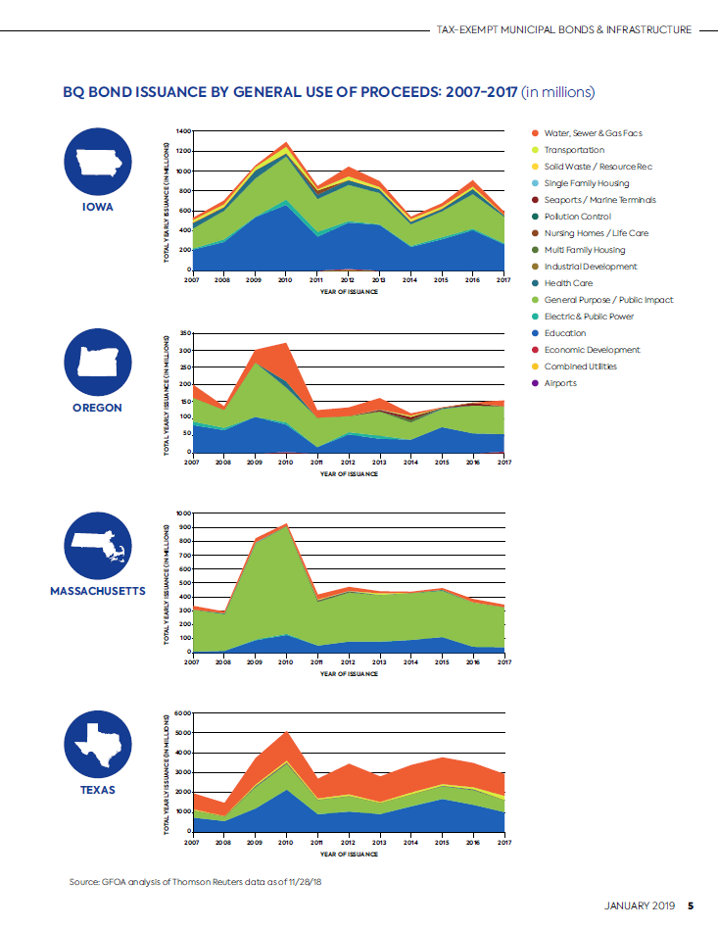
Refresher - Bank Qualified Debt (aka Small Issuer Exception)
  Small Issuer Exception allows smaller jurisdictions working with community banks to issue TE BQ debt
  Right now the cap is $10m per issuer, we are asking to raise the cap to $30m, pegged to inflation and based at the level of the borrower
    Cost- NOMINAL!
  Reintroduce legislation similar to HR 2634 LIFT Act (117th)

Slide 6
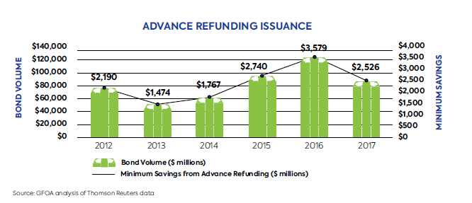
Refresher – Advance Refunding
  Savings of 3-8% of par foregone
  Reintroduce legislation similar to HR 2634 LIFT Act (AR, BQ, AIB)
  Reintroduce legislation similar to S479 LOCAL Infrastructure Act or HR 2288 Investing in Our Communities Act (bipartisan effort with 31 cosponsors from both parties)

Slide 7
Potential Distractions and Opportunities
Government Shutdown
Impeachment
Disaster Spending/Ukraine Aid
Health Care/Prescription Drugs
China Tariffs
Business Taxes and SALT
SAFE Banking
Executive Compensation Clawback

Slide 8
Ongoing Implementation

Slide 9
ARPA Update - Frequent Questions on Implementation
Registration woes at GAO (and SAM.gov)
Uniform Guidance and Government Services Spending
Definition of OBLIGATION for December 31, 2024
Chance to revise previously submitted reports?
Housing, Infrastructure and COVID-19 Eligible expenditures
Single Audit eligibility and Attestation
Distinction between vendors and subrecipients

Slide 10
By the Numbers
23,000 total CSLFRF prime recipients
Approx 7,500 entities eligible for Single Audit
Approx 5,000 have conducted a Single Audit
  500 have findings
Approx 2,500 eligible for Attestation
Approx 230 Attestation received
Approximately 4,600 of 23,000 have not yet filed a P&E Report

Slide 11
ARPA Flex
Implementation Notice and Comment
Official Comments Due by September 30

Slide 12

ARPA Update: One Thing is for Certain…

Slide 13
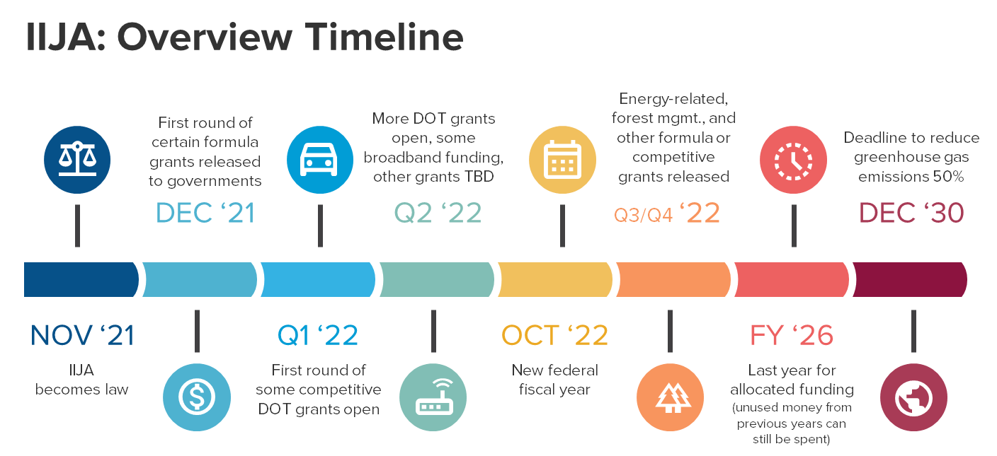
IIJA - Where are we now?

Slide 14
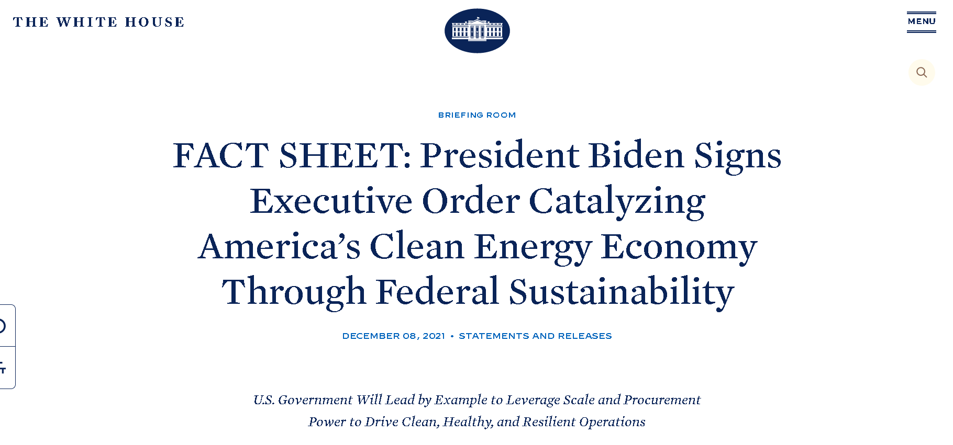
Focus on Sustainability and Partnering
Sustainability
  “Build Back Better”
  Grant programs and audits will include sustainability metrics
Partnering
  With your state
    Local and regional “significance” in the projects
    Nonfederal match will still be a requirement. 10 on water, 20 on roads
  With private partners
    Documenting P3 successes
    VFM Analysis associated with large projects (is privatizing cheaper/faster/better?)

Slide 15
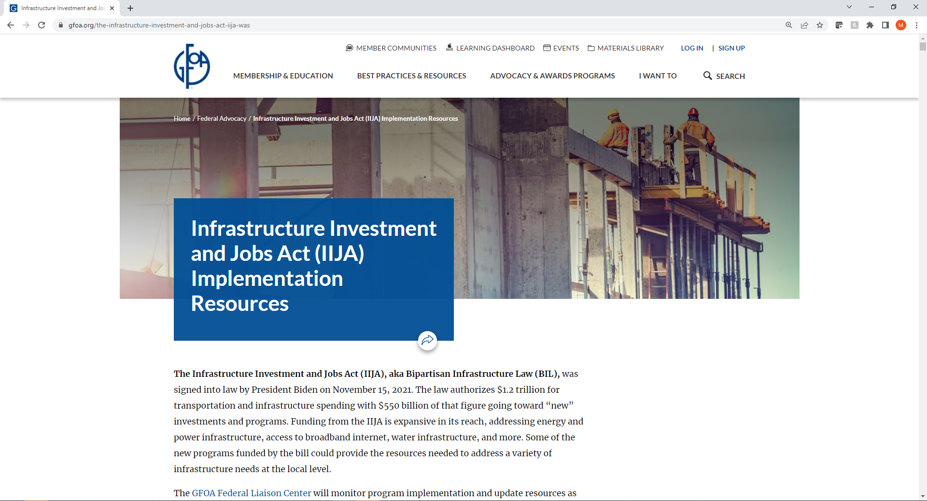
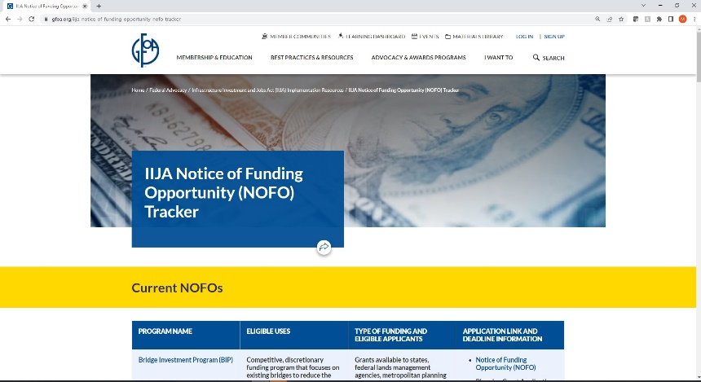
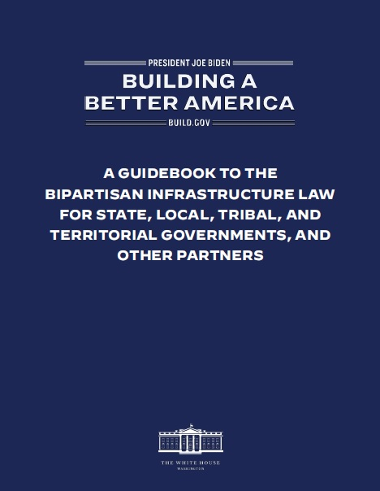
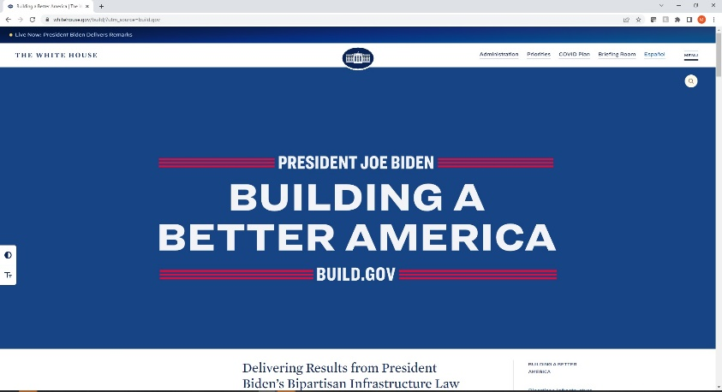
Further Resources (Link in Images)

Slide 16
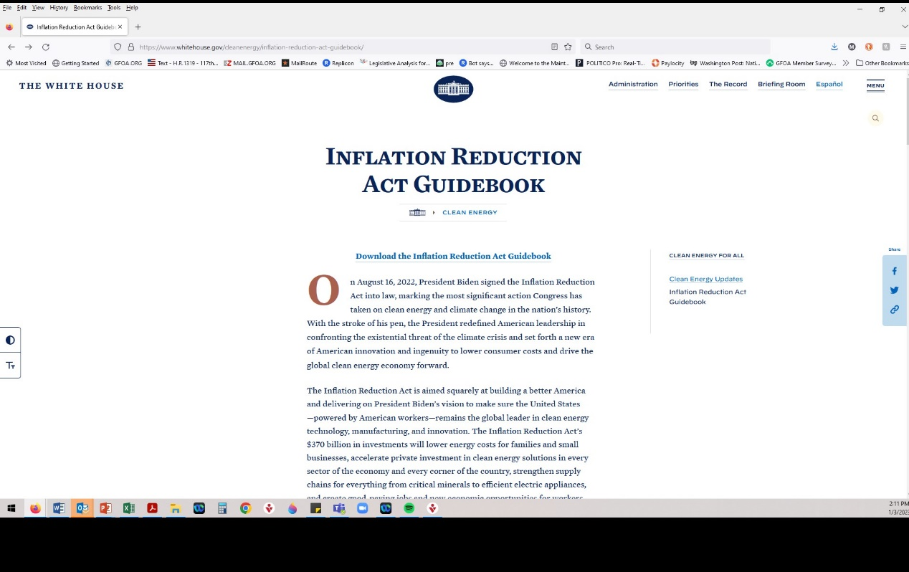
Inflation Reduction Act

Slide 17
IRA: Key Provisions
Tax Provisions
Health Care Provisions
Climate, Energy, and Infrastructure Provisions
Deficit Reduction
Energy Security
Prescription Drug Pricing Reform
Affordable Care Act Subsidies
Funding agricultural, environmental and conservation programs

Slide 18
Transportation Related Tax Credits
Commercial Clean Vehicle
Alternative Fuel Refueling Property
Alternative Fuel Excise Tax Credit
Electrification of police fleet, school buses, garbage trucks, etc.
Installing electric vehicle charging stations and related infrastructure
Purchasing alternative fuel for vehicle fleet
Covers upfront purchase
Covers upfront installation
Covers ongoing purchase of fuel
Low-income or non-urban areas only
Notes:
Tax credits typically requires election to be made on “tax return” for year in which project is placed into service. Looking for guidance from Department of Treasury if different process for public sector.
Project costs related to expected tax credit need to be paid as incurred; internal funds/reimbursement, interim financing, or other arrangements.
Be aware of timeline for receipt of tax credits/completion of project and window to file tax returns
Any over-issuance concerns if tax credit is used for other non-capital use?
This provision would create a new tax credit for qualified commercial clean vehicles placed in service by the taxpayer during the year. The credit would be the lesser of (1) 15% of the vehicle’s cost (30% for vehicles not powered by a gasoline or diesel internal combustion engine); or (2) the incremental cost of the vehicle relative to a comparable vehicle. Credit amounts cannot exceed $7,500 for vehicles weighing less than 14,000 pounds, or $40,000 otherwise. Eligible vehicles would have a battery capacity of not less than 15 kilowatt hours (7 kilowatt hours in the case of vehicles weighing less than 14,000 pounds) and be charged by an external source of electricity.
Only vehicles made by qualified manufacturers, who have written agreements with and provide periodic reports to the Treasury, could qualify. Taxpayers would be required to include the VIN on their tax return to claim a tax credit.
Tax-exempt entities would
Current law allows, through 2021, a tax credit for the cost of any qualified alternative fuel vehicle refueling property installed by a business or at a taxpayer’s principal residence. The credit is equal to 30% of these costs, limited to $30,000 for businesses at each separate location with qualifying property, and $1,000 for residences.
For business property (property subject to depreciation), the credit would be extended at a rate of 6% (30% if prevailing wage and registered apprenticeship requirements were met), with the credit limit increased to $100,000.

Slide 19
Production & Investment Tax Credits
Production Tax Credit
Wind
Biomass
Municipal solid waste
Geothermal
Hydropower, marine, hydrokinetic energy
Solar facilities
Geothermal facilities
BEGIN CONSTRUCTION BY JANUARY 1, 2025
Investment Tax Credit
Solar
Fiber-optic
Fuel cell
Small wind
Offshore wind
Combined heat and power
Waste energy recovery
Energy storage technology
Linear generators
Microgrid controllers
Dynamic glass and biogas property
BEGIN CONSTRUCTION BY JANUARY 1, 2025

Slide 20
Direct Payment in Lieu of Tax Credits
Direct payment in lieu of tax credits will allow tax-exempt entities to pursue renewable energy projects without relying on outside financing.
  Tax credit claimed after project placed into service
Projects may be 100% financed with tax-exempt bonds and receive a production tax credit (PTC) or investment tax credit (ITC).
  If this combined financing is used, the tax credit will be reduced by up to 15%.
Credits available for tax years beginning after December 31, 2022 and are effective through 2032
The IRA is BOTH domestic energy and domestic labor (for construction that begins after January 29,2023)
Notes:
Treasury Announces Guidance on Inflation Reduction Act’s Strong Labor Protections
By pairing climate investment with the creation of good-paying jobs, the Inflation Reduction Act’s unparalleled investments to fight the climate crisis will help improve job quality in clean energy industries and incentivize the expansion of workforce training pathways into these jobs.
Workers should benefit from the clean energy economy they’re helping build. The guidance announced today provides firms greater clarity on how to meet the labor standards embedded in the bill to maximize the available tax credits
To maximize many of the available clean energy and climate tax incentives, firms need to pay workers a “prevailing wage” and employ a certain number of apprentices from registered apprenticeship programs. In the guidance announced today, the Treasury Department provided greater clarity for these provisions.
Both the prevailing wage and apprenticeship requirements apply to the following tax incentives:
Advanced Energy Project Credit
Alternative Fuel Refueling Property Credit
Credit for Carbon Oxide Sequestration
Clean Fuel Production Credit
Credit for Production of Clean Hydrogen
Energy Efficient Commercial Buildings Deduction
Renewable Energy Production Tax Credit
Renewable Energy Property Investment Tax Credit
The prevailing wage requirements also apply to the following tax incentives:
New Energy Efficient Home Credit
Zero-Emission Nuclear Power Production Credit
In general, taxpayers that wish to take advantage of an enhanced clean energy tax benefits must ensure that all laborers and mechanics are paid the applicable prevailing wage, including fringe benefits, for all hours performing construction, and in some cases alteration or repair, on the site of the work of a qualified facility. A prevailing wage is the combination of the basic hourly wage rate and any fringe benefits rate, paid to workers in a specific classification of laborer or mechanic in the area where construction, alteration, or repair is performed, as determined by the Secretary of Labor. The Wage and Hour Division posts labor classifications and their prevailing wage rates in wage determinations on sam.gov.Review our guide to help you navigate sam.gov.

Slide 21
The Financial Data Transparency Act

Slide 22
Evolution of Federal Government Digitizing Data
FFATA:
DATA Act
GREAT Act
The Federal Funding Accountability and Transparency Act (FFATA) signed into law on September 26, 2006
The Digital Accountability and Transparency (DATA) Act signed into law on May 9, 2014
The Grant Reporting Efficiency and Agreements Transparency (GREAT) Act signed into law December 30, 2019
Intent is to empower every American with the ability to hold the government accountable for each spending decision.
The FFATA legislation requires information on federal awards (federal financial assistance and expenditures) be made available to the public via a single, searchable website, which is www.USASpending.gov.
Mandates structured data standards for government with objectives to 1) establish government-wide financial data standards and increase the availability, accuracy, and usefulness of Federal spending information, 2) amend the Federal Funding Accountability and Transparency Act (FFATA), and 3) develop Government-wide data standards to simplify financial reporting and improve the quality of spending data.
Requires standardization of data reported by grants recipients. The GREAT Act aims to modernize reporting by grants recipients, reduce burden and compliance costs, and strengthen oversight and management of Federal grants.
Standards had to be established within two years of enactment (by December 2021). Standards for audit-related information reported as part of the Single Audit, within three years of enactment (December 2022).

Slide 23

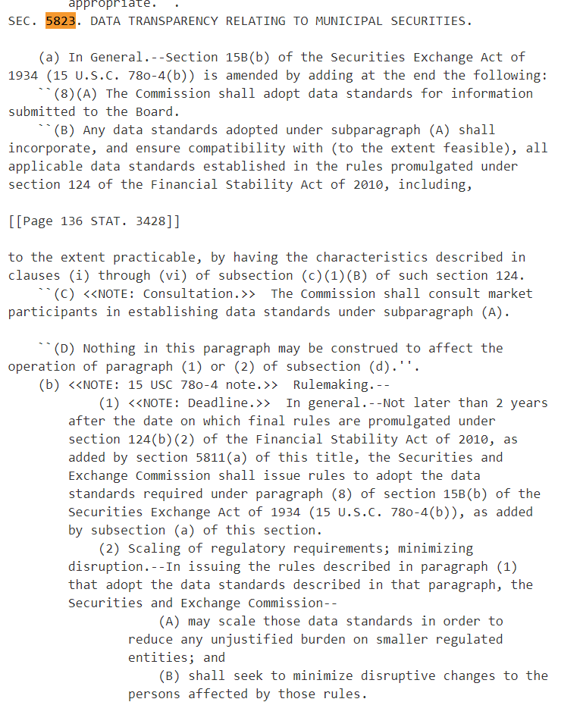
S4295, Financial Data Transparency Act
Where did it come from?
Who supported the legislation? Why?
Who is paying attention to state and local government reporting?
How did it pass?
Notes:
S4295
Establish (New) Data Standards
Reporting of Financial Information
Why unfunded mandate?
Reconfiguration of financial systems
Implementation of new software
Authorizes “joint rulemaking” of entities with no jurisdiction
Identical taxonomies across all types of public entities

Slide 24
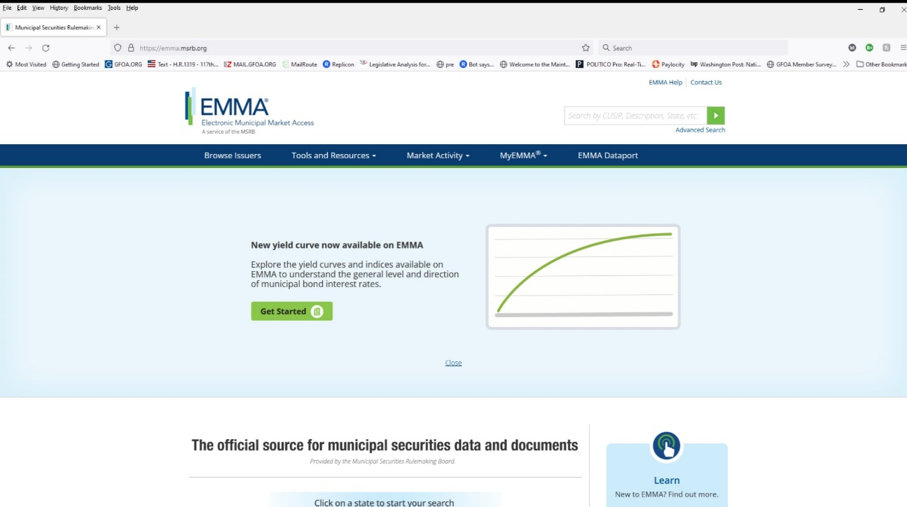
Who Will This Affect?
Any municipal entities required to submit financial information to the Municipal Securities Rulemaking Board
  All primary issuers – Frequent or Infrequent
  All component units of primary issuers
  Roughly 38,000 issuers in Electronic Municipal Market Access (EMMA)

Slide 25
FDTA: When can we expect it to happen?
Two Years
Two Years

Slide 26
What is the Law?

Slide 27
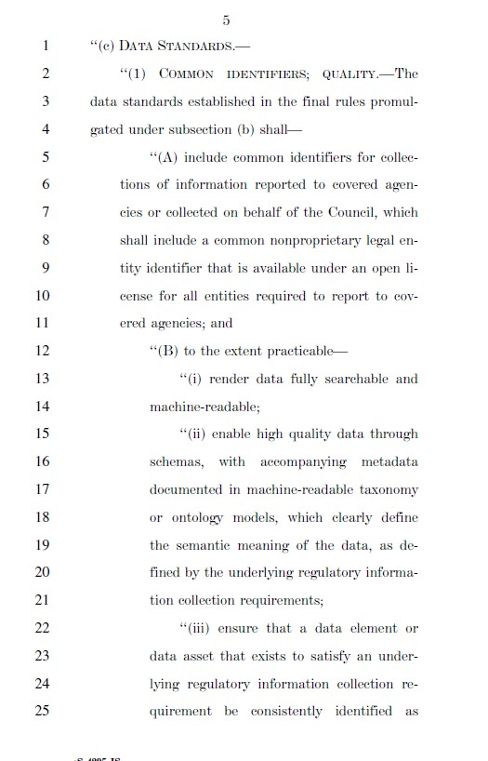
FDTA – Data Standards Sec. 101
“(1) COMMON IDENTIFIERS; QUALITY.—The data standards established in the final rules under subsection (b) shall—
“(A) include common identifiers for collections of information reported to covered agencies or collected on behalf of the Council, which shall include a common nonproprietary legal entity identifier that is available under an open license for all entities required to report to covered agencies; and
“(B) to the extent practicable—
  “(i) render data fully searchable and machine-readable;
  “(ii) enable high quality data through schemas, with accompanying metadata documented in machine-readable taxonomy or ontology models, which clearly define the semantic meaning of the data, as defined by the underlying regulatory information collection requirements;
  “(iii) ensure that a data element or data asset that exists to satisfy an underlying regulatory information collection requirement be consistently identified as such in associated machine-readable metadata;
  “(iv) be nonproprietary or made available under an open license;

Slide 28
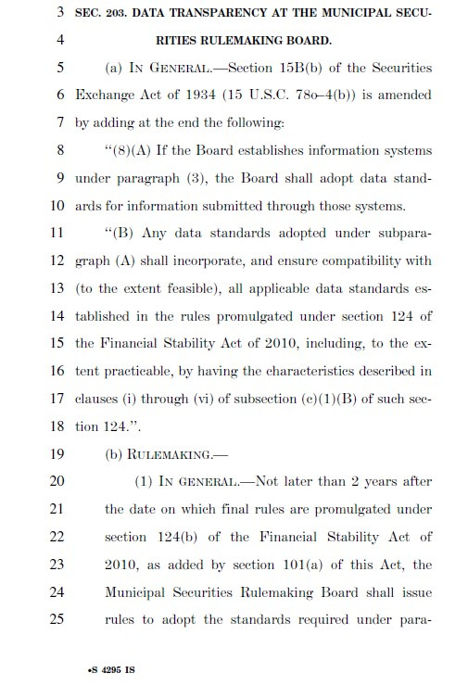
FDTA – Municipal Securities Sec. 203
‘(8)(A) The Commission shall adopt data standards for information submitted to the Board.
“(B) Any data standards adopted under subparagraph (A) shall incorporate, and ensure compatibility with (to the extent feasible), all applicable data standards established in the rules promulgated under section 124 of the Financial Stability Act of 2010…
  (C) The Commission shall consult market participants in establishing data standards under subparagraph (A)….
  (b) RULEMAKING.—
    (1) IN GENERAL.—Not later than 2 years after the date on which final rules are promulgated … as added by section 5811(a) of this title, the Securities and Exchange Commission shall issue rules to adopt the data standards required …
    (2) SCALING OF REGULATORY REQUIREMENTS; MINIMIZING DISRUPTION.—(the SEC shall…)
      (A) may scale those data standards in order to reduce any unjustified burden on smaller regulated entities; and
      (B) shall seek to minimize disruptive changes to the persons affected by those rules.

Slide 29
“Data Standard”
The term ‘data standard’ means a standard that specifies rules by which data is described and recorded.

Slide 30

Key Terms: Open Source (nonproprietary)
Open Source
  The term open source refers to something people can modify and share because its design is publicly accessible.
  Some software has source code that only the person, team, or organization who created it—and maintains exclusive control over it—can modify. This is "proprietary" or "closed source" software.
  Open source software is different. Its authors make its source code available to others who would like to view that code, copy it, learn from it, alter it, or share it.
Notes:
In communications and computing a machine-readable medium, or computer-readable medium, is a medium capable of storing data in a format easily readable by a digital computer or mechanical device (rather than human readable). The result is called machine-readable data or computer-readable data.
Traditional word processing documents and portable document format (PDF) files are easily read by humans but typically are difficult for machines to interpret.

Slide 31
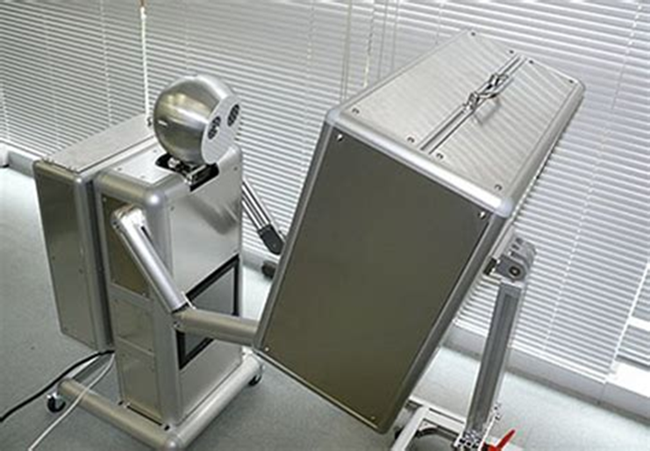
Key Terms: Machine Readable
Machine Readable
  Format in a standard computer language (not English text) that can be read automatically by a web browser or computer system. (e.g.; xml).
  Other formats such as extensible markup language (XML), (JSON), (XBRL) or spreadsheets with header columns that can be exported as comma separated values (CSV) are machine readable formats.
  It is possible to make traditional word processing documents and other formats machine readable but the documents must include “enhanced structural elements”

Slide 32
What Might it Look Like?

Slide 33
Best Case: Process Might Look Like This
Charts of Accounts
Pension
Operating
Capital
Conversion
ACFR
.pdf
Artificial
Intelligence
Output
.xml

Slide 34
Worst Case: Output Might Look Like This
Airports, Universities, Counties, States, Water Systems, Cities…
One Single Financial Report

Slide 35
Financial Reporting Shakeup
F
D
T
A
????

Slide 36
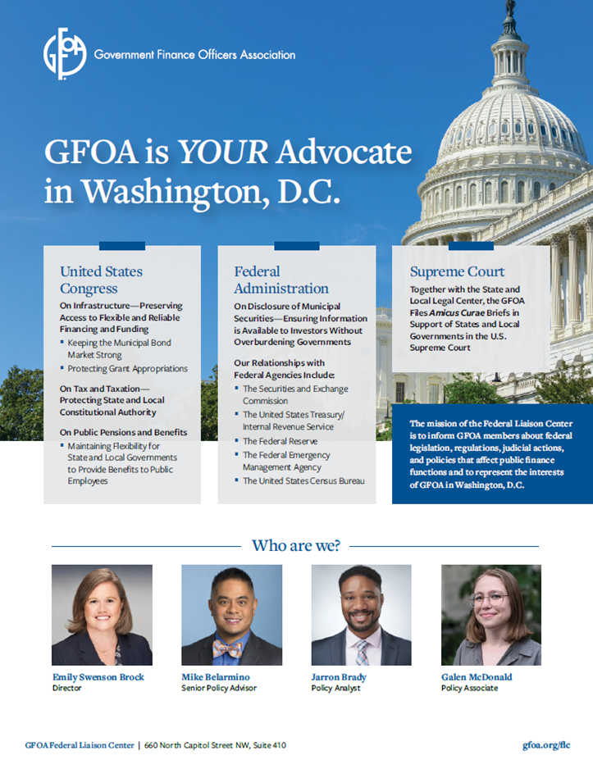
We Are YOUR Advocate In DC

Slide 37
THANK YOU!
Emily Brock
ebrock@gfoa.org
FLC Director
Michael Belarmino
mbelarmino@gfoa.org
Senior Policy Advisor
Jarron Brady
jbrady@gfoa.org
Policy Analyst
Galen McDonald
gmcdonald@gfoa.org
Policy Associate

