Slide 1
BRINGING BALANCE AND PRODUCTIVITY TO THE WORKPLACE
Trish Hart
MBA, Health Care Administration
Stress Management Specialist
Integrative Health & Well-Being Coach
Certified Mindfulness Instructor

Slide 2
Take 60 seconds TO ARRIVE

Slide 3
VALUE YOUR ENERGY

Slide 4
WHY IS HAPPINESS IMPORTANT?
Benefits Include:
13% Increased Productivity
Increased Creativity
High Engagement
Less Absenteeism
Improved Employee Retention
60% genetics, 10% situational & 40% is in your control

Slide 5
Human Performance and Stress

Slide 6
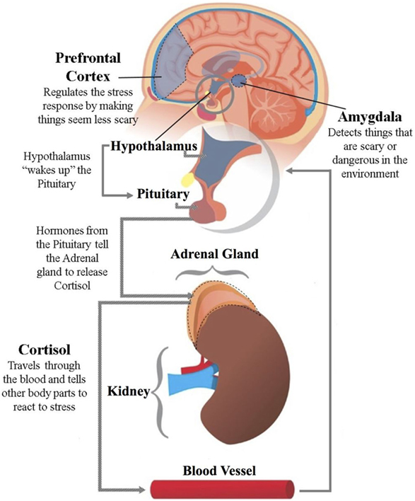
WHAT IS HAPPENING UNDER THE HOOD
Notes:
\

Slide 7
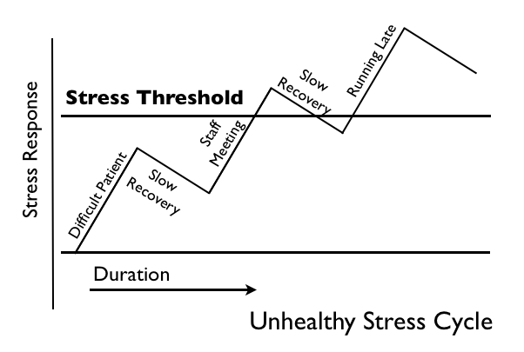
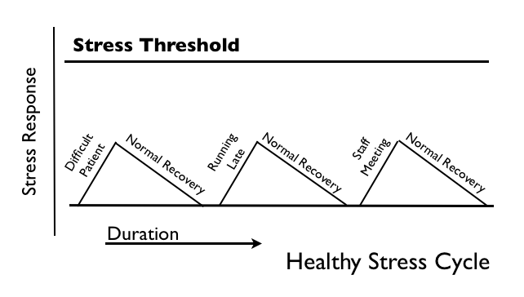
Stress Is a Cycle We Must Complete

Slide 8
Notes:
The vagus nerve is also a key part of your parasympathetic “rest and digest” nervous system.
It influences your breathing, digestive function and heart rate, all of which can have a huge impact on your mental health.
Activating this nerve basically tells your brain that you are calm and relaxed, while stimulating the parasympathetic nervous system to slow your heart rate and respiration and lower your blood pressure.
The cool thing about understanding this, it that we can stimulate our vagus nerve to send a message to our bodies that it’s time to relax and de-stress.
.
Actually, The receptors in your nose run directly to your amygdala (the fear center of your brain), this is the only sense that has this direct path to your fight or flight system.
The moment we anticipate stress in any form, most of us tend to stop breathing and hold our breath. Breath holding activates the fight/flight/freeze response; it tends to increase the sensation of pain, stiffness, anxiety, or fear.
PNS-breaks
SNS=gas

Slide 9
Between stimulus and response there is always a space. In that space is the power to choose our response. In our response, lies our growth and our freedom. ― victor frankl

Slide 10
WHY MINDFULNESS?
Helps us respond to situations according to our best intentions, rather than our habits.
Improves physical, mental & emotional health
Improves performance
Helps us strengthen social connections
Enhances decision making, problem solving & intuition
More effective team management & interpersonal skills
Increased cognitive flexibility & open-mindness
Fewer judgement errors
More ethical decision making

Slide 11
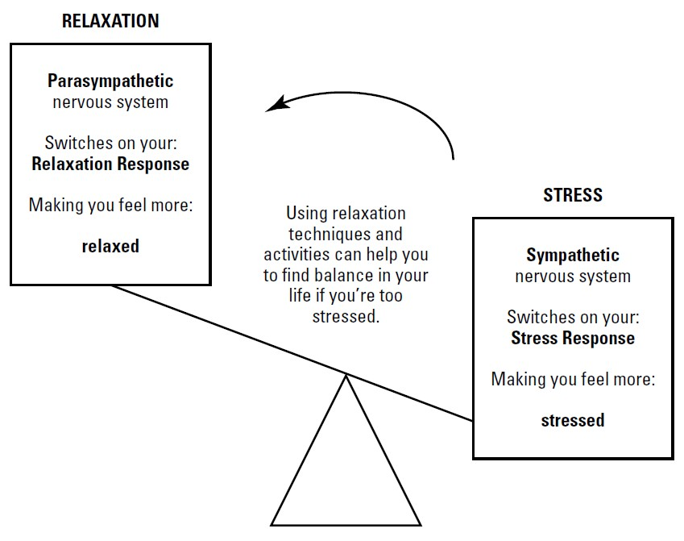
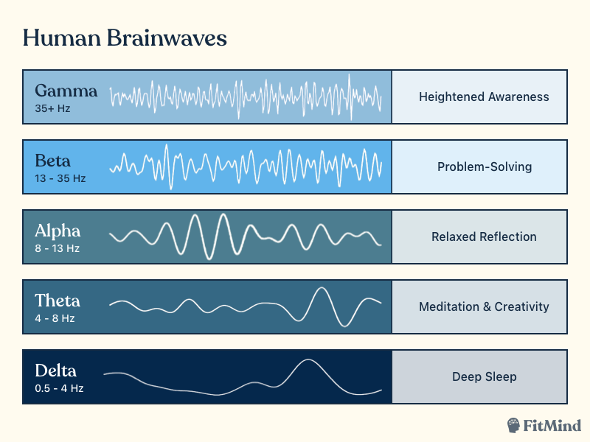
CALM IT WITH eliciting your THE RELAXATION RESPONSE

Slide 12
WAYS TO SOFT BOOT THE BRAIN

Slide 13
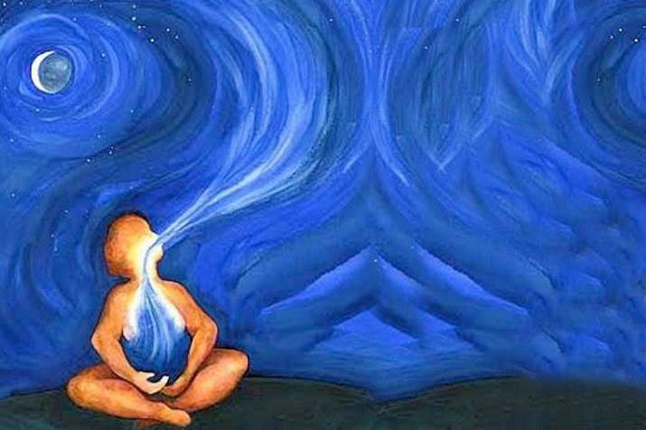
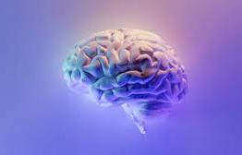
finding the edge when you have fallen off POWERFUL WAYS to re-REGULATE YOUR NERVOUS SYSTEM
PAUSE
Am I breathing?
PROCEED
Power of a Sigh (is a life saving antidote)
Where are my feet?
HALT Check-in (hungry, angry, lonely, tired?)
Are my basic needs met?
Tense & Release (release stress systematically from head to toe)
Escape Hatch in a chair (fold forward with elbows on thighs)
Countdown Breath (count your exhale 10 to 1)
Am I listening?
Power of a Self Compassion

Slide 14
PRACTING SELF COMPASSION
Mindfulness
Common humanity
kindness

Slide 15
Make Peace with “Perfect”
Let go of all-or-nothing thinking
Do what you can, when you can
Set small, manageable goals
Take action to feel more in control

Slide 16
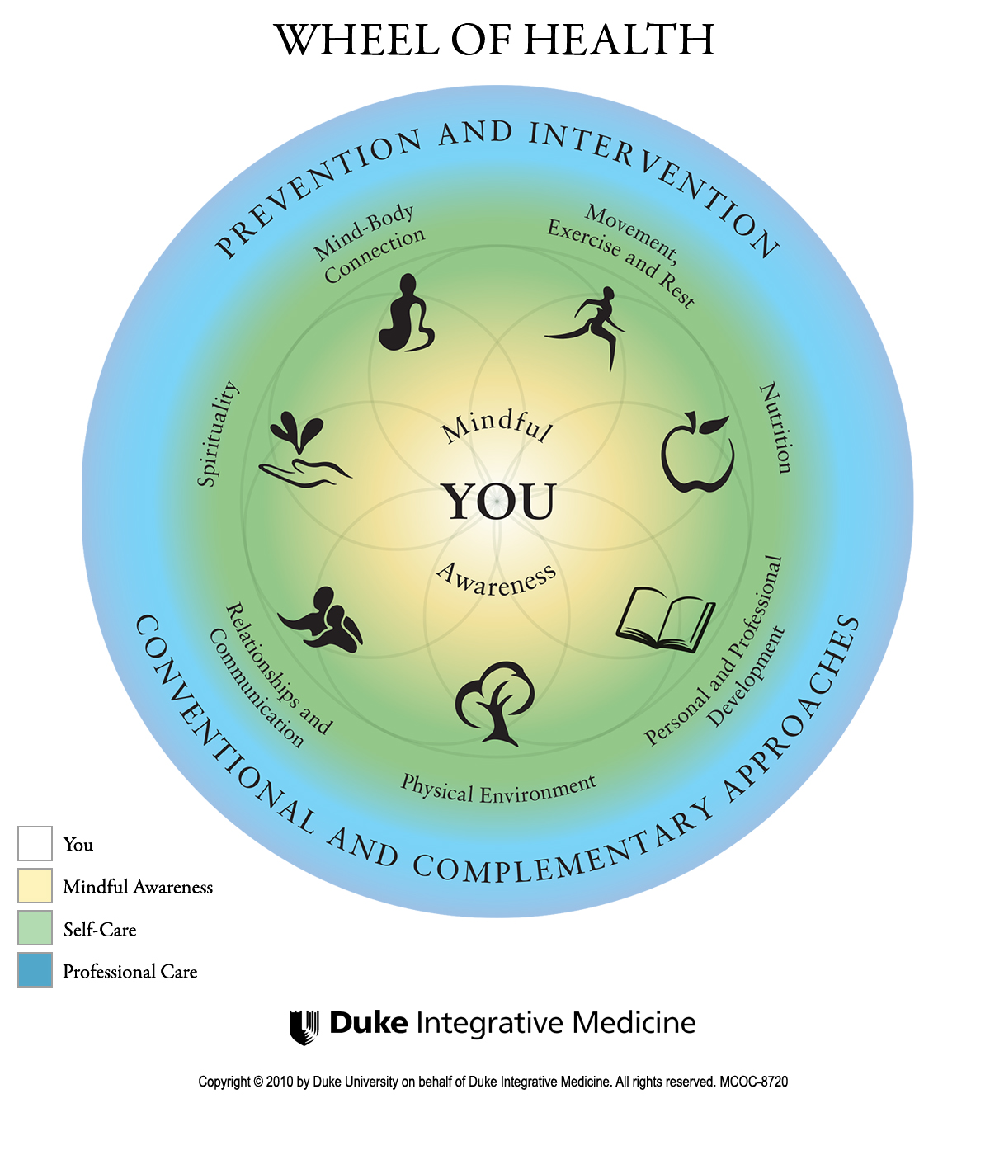
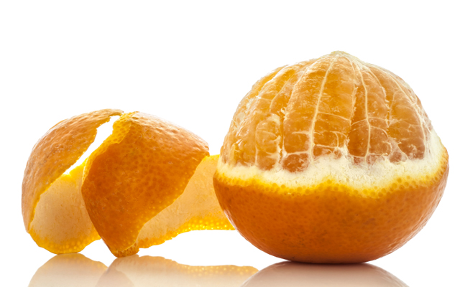
Managing stress and navigating self-care
Self Care Has Layers and Boundaries

Slide 17
What are your rituals before and after work?

Slide 18
Keep your stool balanced
SLEEP
NUTRITION/HYDRATION
EXERCISE
COMMUNITY

Slide 19
WHAT is on PATH TO Lasting HAPPINESS?
CONNECTION
MORE NATURE
ATTITUDE OF GRATITUDE
SAVORING
LAUGHTER
LESS TECHNOLOGY
THE HELPER'S HIGH
Notes:
So what is the path that will lead us to happiness?
Today I’m going to answer this question of how by presenting several scientifically proven intentional ways of thinking, or practices that if you infuse into your life will dramatically increase your happiness. These certainly are not all of them… but they are some of the most prominent in the field of positive psychology and starting point for us to explore today.

Slide 20
Our Epidemic of Loneliness and Isolation
a 29% increased risk of heart disease;
a 32% increased risk of stroke
a 50% increased risk of developing dementia for older adults.
Cultivating a culture of connection.
Notes:
Surgeon General Dr. Vivek Murthy annoiuced the news on May 3 this year-being lonely is equivalent to 2 packs of cigarettes a day
"In the last few decades, we've just lived through a dramatic pace of change. We move more, we change jobs more often, we are living with technology that has profoundly changed how we interact with each other and how we talk to each other.
"And you can feel lonely even if you have a lot of people around you, because loneliness is about the quality of your connections.”
Across age groups, people are spending less time with each other in person than two decades ago. The advisory reported that this was most pronounced in young people aged 15-24 who had 70% less social interaction with their friends.
Murthy said that many young people now use social media as a replacement for in-person relationships, and this often meant lower-quality connections.

Slide 21
Active Listening
Eye Contact
Paraphrase
Ask questions
Express empathy
Use engaged body language
Avoid judgment
Avoid giving advice

Slide 22
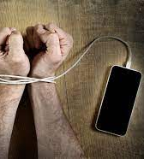
Cut Back on Tech
Ask Yourself….
W What For ?
W Why Now?
W What Else?
*Source- Katherine Price “How to Break Up with Your Phone”
Notes:
RAISE YOUR ZOOM HAND...Is your phone the first thing you say good morining to and the last thing you say good night to?
We check out phones every 15 seconds
Huberman –isolation
Check your use.... mine was 6 hours!
Yes its dopamine but
Do you know it puts you into a stress response and negatively impacts your sleep?
Catherine Price wrote a book "How to break up with your phone..., in here she provides the 3 WS
What are you checking your tehnology for?
Why now
What else could you be doing

Slide 23
Nature does Nurture
Notes:
In addition, by being outdoors, you are automatically exposed to the sun, and its invigorating, stimulating, life-giving power which is known to greatly improve our mood. It is also a natural source of vitamin D and a crucial protection against disease.
Science is also demonstrating what we intuitively know: Nature makes us happy, and studies have shown that even our brain changes from getting outside! More specifically, the frontal lobe, the part of our brain that’s hyper-engaged in modern life, deactivates a little when one is outside. Alpha waves, which indicate a calm but alert state, grow stronger.
Scientists have also found overwhelming evidence that being in nature has a profound impact on our brains and our behavior. It helps us to reduce anxiety, brooding, and stress, and it increases our attention, capacity, creativity, and our ability to connect with other people.
Even the use of nature as a form of therapy, called Ecopsychology, has gained the interest of scientists, researchers and nature enthusiasts and it has grown in popularity. A recent study, published in The Journal of Positive Psychology, found that even spending as little as five minutes outdoors was linked to a significant mood boost. Even more noteworthy, a study published in Frontiers in Psychology revealed that just a twenty-minute nature experience was enough to significantly reduce levels of the stress hormone, cortisol. Get this, if one spent a little more time immersed in a nature experience, 20 to 30 minutes sitting or walking, cortisol levels drop at their greatest rate.

Slide 24
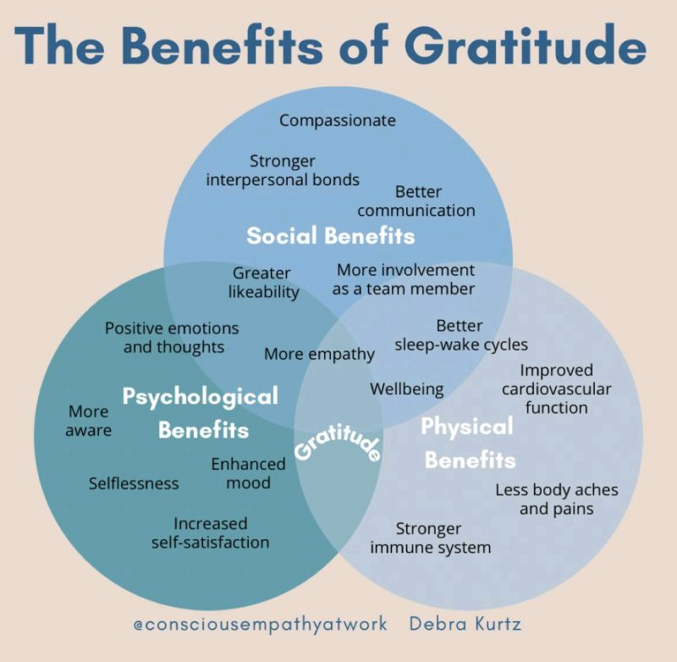
How Does It Work?
Psychologists break down gratitude into three phases:
Appreciation
Goodwill
Expression

Slide 25
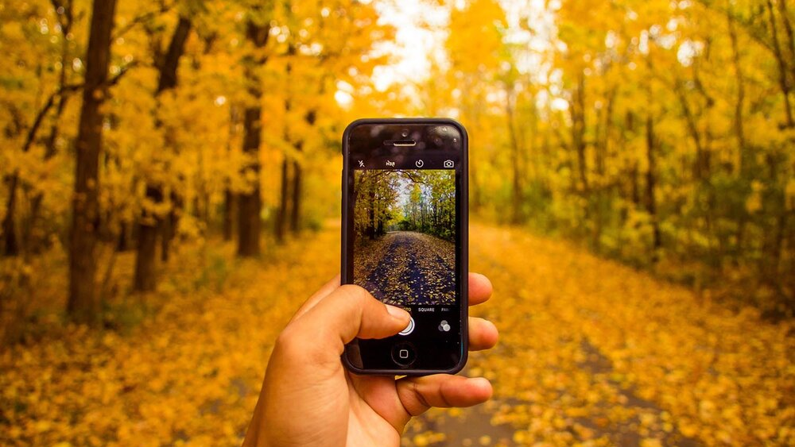
SAVORING

Slide 26
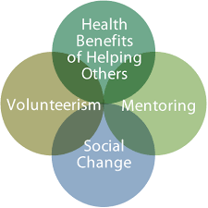
THE HELPER’S HIGH
“If you want happiness for an hour, take a nap. If you want happiness for a day, go fishing. If you want happiness for a year, inherit a fortune. If you want happiness for a lifetime, help somebody.”
-Chinese Proverb

Slide 27
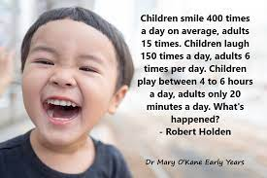
LAUGHTER IS THE BEST MEDICINE

Slide 28
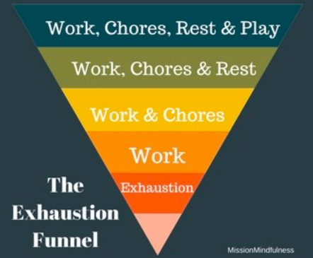
A quick way to recognize your own energy

Slide 29
TAKE YOUR VACATION DAYS!

Slide 30
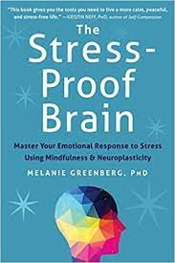
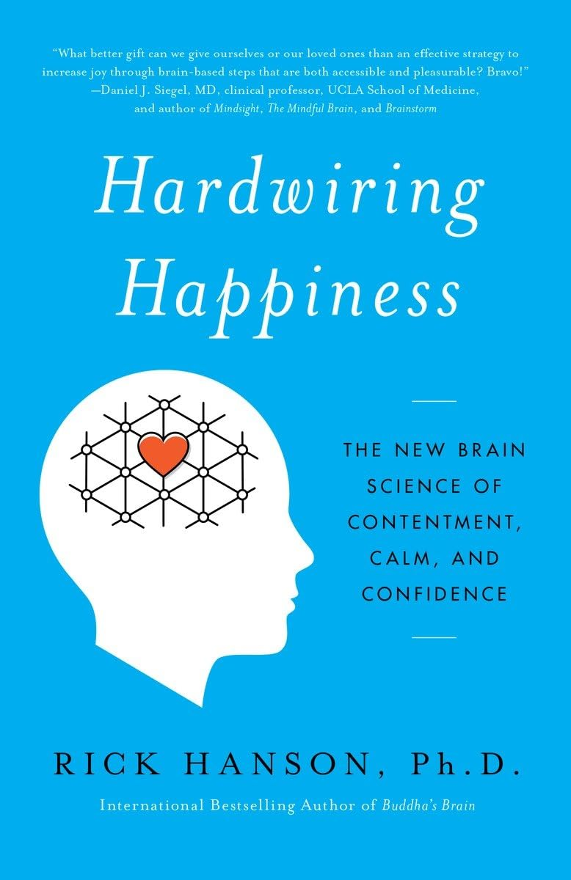
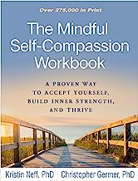
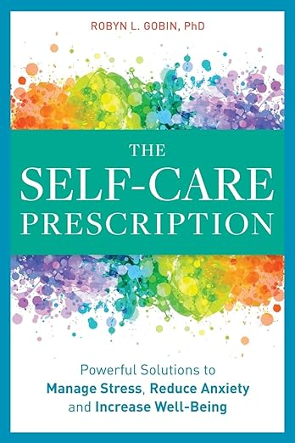
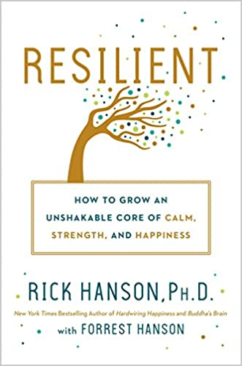
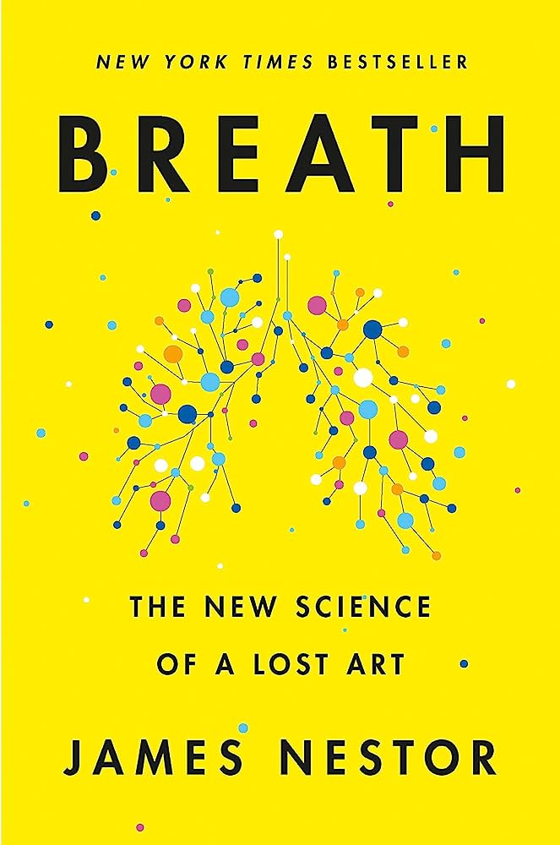
Valuable Resources
Apps:
Insight Timer
Calm
Websites:
Psychology Today
Harvard Business Review
Huberman Lab
Dr. Mark Hyman

Slide 31
Hacking happiness

