Slide 1
New England GFOA: arpa obligated funds
Presented by:
Jim Powers, CPA
April 18, 2024

Slide 3
Agenda
Review changes in the federal definition of “obligations” as they relate to ARPA funds
Review specific restrictions related to obligating and spending ARPA funds to remove any confusion
Better prepare communities to wrap up the ARPA grants without any surprises

Slide 4
Timelines of Guidance
May 10, 2021 - Treasury issued an interim final rule implementing the SLFRF program
January 6, 2022 - Treasury issued a final rule that responded to public comments
April 1, 2022 - The Final Rule became effective
December 29, 2022 - The Consolidated Appropriations Act, 2023 was enacted, amending the SLFRF program to provide additional flexibility for recipients to use SLFRF funds to respond to natural disasters, building critical infrastructure, and supporting community development
August 2023 - Treasury issued an interim final rule expanding the eligible uses for SLFRF to include Emergency relief from Natural Disasters, Surface Transportation Projects, and Title I Projects
Recipients may use SLFRF funds for these new eligible uses for costs incurred beginning December 29, 2022. Consistent with the existing eligible uses discussed in the 2022 final rule, recipients must obligate SLFRF funds for these new eligible uses by December 31, 2024. Recipients must expend SLFRF funds obligated to provide emergency relief from natural disasters by December 31, 2026. Recipients must expend SLFRF funds obligated for Surface Transportation Projects and Title I projects by September 30, 2026.
November 2023 - Treasury issued an interim final rule to amend the definition of an “obligation” set for the in Treasury regulations with respect to the SLFRF

Slide 5
Background
The Coronavirus State and Local Fiscal Recovery Funds (SLFRF) program authorized by the American Rescue Plan Act (ARPA), delivered $350 billion to state, territorial, local, and Tribal governments across the country to support their response to and recovery from the COVID-19 public health emergency.
While we are approaching the end of this grant program, it is important to recognize and plan for the best use of your community’s funds, while reducing the risk that you will need to send funds back to the federal government (this happens more than people realize – it happened with Cares funding).
From the Final Rule - ARPA funds may only be used for costs incurred within a specific time period, beginning March 3, 2021, with all funds obligated by December 31, 2024, and all funds spent by December 31, 2026.

Slide 6
Background (continued)
On page 357 of the SLFRF Final Rule the U.S. treasury clarifies its definition of “obligation”. “In the final rule, Treasury is also maintaining the deadlines by which funds must be obligated (i.e., December 31, 2024) and by which such obligations must be liquidated (i.e., December 31, 2026). The December 31, 2024 deadline by which eligible costs must be incurred is established by statute. Treasury is finalizing its interpretation of “incurred” to be equivalent to the definition of “obligation,” based on the definition used for purposes of the Uniform Guidance.”
§ 200.71 of the Uniform Guidance defines “Obligation” as such. “When used in connection with a non-Federal entity's utilization of funds under a Federal award, obligations means orders placed for property and services, contracts and subawards made, and similar transactions during a given period that require payment by the non-Federal entity during the same or a future period.”
Title 34 § 75.707, provides a table that shows when a grantee makes obligations for various kinds of property and services

Slide 7
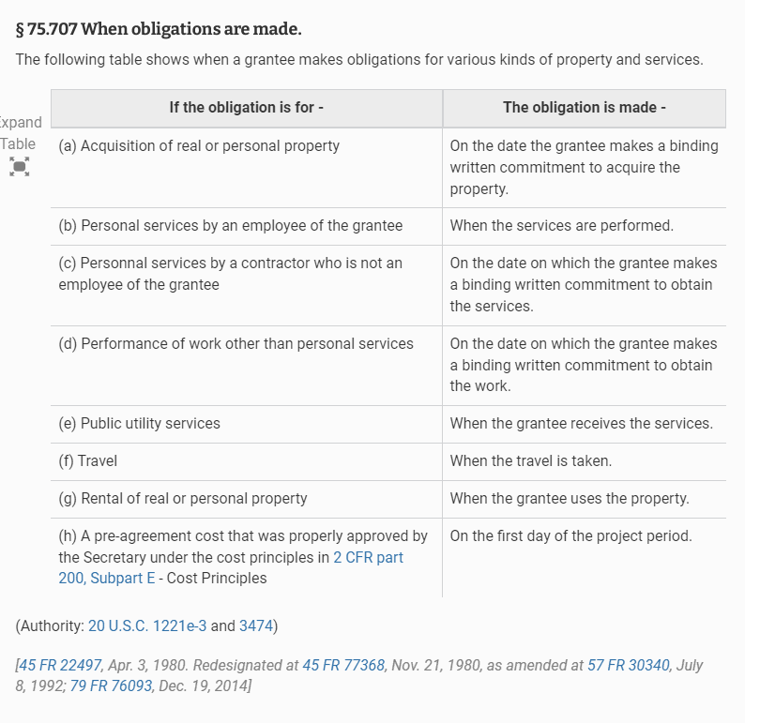

Slide 8
Definitions
Acquisition of property
On the date the grantee makes a binding written commitment to acquire the property
Personal services by an employee of the grantee
When the services are performed
Only payroll costs for hours worked through 12/31/2024 would be eligible
Personal services by a contractor who is not an employee of the grantee
On the date on which the grantee makes a binding written commitment to obtain the services.
As funds cannot be “re-obligated” after 12/31/24, recipients should limit these obligations to those that are irrevocable or set amounts, as much as possible. Otherwise, if the amount comes in lower, or service is canceled, the released funds would have to be returned to the Treasury. In addition, if the project extends past 12/31/26, any bills paid after that date would not be allowable.

Slide 9
Definitions (continued)
Performance of work other than personal services
On the date on which the grantee makes a binding written commitment to obtain the work.
As funds cannot be “re-obligated” after 12/31/24, recipients should limit these obligations to those that are irrevocable or set amounts, as much as possible. Otherwise, if the amount comes in lower, or work is canceled, the released funds would have to be returned to the Treasury. In addition, if the project extends past 12/31/26, any bills paid after that date would not be allowable.
Public utility services
When the grantee receives the services
Travel
When the travel is taken
Rental of real or personal property
When the grantee uses the property
*Note - Having City Council or Select Board approve a project does not qualify as “obligated” for federal grant funds purposes.

Slide 10
November 2023
Treasury issued the Obligation interim final rule (Obligation IFR) to address recipients’ questions and comments regarding the definition of obligation. The Obligation IFR clarifies the definition of “obligation” in Treasury’s implementing regulations for the SLFRF program and provides related guidance to give additional flexibility and clarity to recipients to support their use of SLFRF funds.
Treasury also released an Obligation Interim Final Rule Quick Reference Guide that provided the option to change the application of the obligation deadline to subrecipients.

Slide 11
November 2023
Subrecipients are not subject to the December 31, 2024 obligation deadline. The obligation deadline applies to the recipient of the SLFRF funds, and a cost is considered to have been incurred once a recipient enters into a subaward or contract that obligates the recipient to cover the cost. Neither subrecipients nor contractors need to take additional steps to obligate funds.
If a subrecipient cancels a project after December 31, 2024, or does not spend all funds obligated, those funds cannot be re-obligated and would need to be returned to the Treasury.

Slide 12
Allowable Under the Revised Definition of Obligation
Reporting and Compliance Requirements
Funds expended to comply with SLFRF reporting and compliance requirements, including in connection with the preparation and submission of recipients’ required reports, review of subaward reports or subrecipient monitoring generally, maintenance of data and reporting tools, and review and processing of invoices.
Single Audit Costs
Funds expended for the conduct of audits required by the Single Audit Act, including on audit costs, on preparation for such audits, and on audit resolution, including funds spent by pass-through entities to carry out their responsibilities related to audit resolution of subawards.
Record Retention and Internal Control Requirements
Expenditures to comply with records retention requirements and other expenditures necessary to ensure program integrity through the closeout of the award.

Slide 13
Allowable Under the Revised Definition of Obligation (continued)
Property Standards
Expenditures on insurance, inventory and other recordkeeping requirements, and maintenance of equipment and other expenditures made to comply with the property standards of the Uniform Guidance (2 CFR 200.310 - 200.316).
Environmental Compliance Requirements
Expenditures to comply with environmental requirements, including to obtain environmental permit renewals.
Civil Rights and Nondiscrimination Requirements
Expenditures related to comply with civil rights and nondiscrimination requirements, including the investigation of complaints arising from SLFRF-funded projects.

Slide 14
Allowable Under the Revised Definition of Obligation (continued)
In each case, these would include costs, calculated in compliance with the rules for compensation charged to federal awards set out at 2 CFR 200.430, of recipient personnel whose time is required to comply with these requirements:
To take advantage of this additional flexibility, recipients must (1) determine the amount of SLFRF funds the recipient estimates it will use to cover such expenditures, (2) document a reasonable justification for this estimate, (3) report that amount to Treasury by April 30, 2024, with an explanation of how the amount was determined, and (4) report at award closeout the final amount expended for these costs.
Recipients may not include within this estimate any expenditure that will be made after December 31, 2026, other than administrative expenditures necessary to close out the SLFRF award in accordance with the Uniform Guidance.
Other than such closeout expenditures, recipients must expend all SLFRF funds by the end of the period of performance regardless of whether they continue to have expenses of the type outlined above after that date. A recipient’s estimate of the amount that it expects to expend must be reasonable, based on the considerations listed at 2 CFR 200.404. If a recipient’s estimate exceeds what is ultimately expended, the recipient must return the excess funds to Treasury. Treasury will update the SLFRF Compliance and Reporting Guidance to reflect the additional reporting requirements

Slide 15
Allowable Under the Revised Definition of Obligation (continued)
Treasury is clarifying that after December 31, 2024, recipients are permitted to replace a contract or subaward entered into prior to December 31, 2024, if:
The recipient terminates the contract or subaward because of the contractor or subawardee’s default, because the contractor or subawardee goes out of business, or because the recipient otherwise determines that the contractor or subawardee will not be able to perform under the contract or carry out the subaward; or
The recipient and contractor or subrecipient mutually agree to terminate the contract or subaward for convenience; or
the recipient terminates the contract or subaward for convenience if the contract or subaward was not properly awarded (such as if the contractor was not eligible to receive the contract), there is clear evidence that the contract or subaward was improper, the recipient documents its determination that the contract or subaward was not properly awarded, and the original contract or subaward was entered into by the recipient in good faith.

Slide 16
Plan NOW to make the best use of ARPA funds and avoid the chance of needing to send funds back to Treasury.

Slide 17
Questions?
Jim Powers, CPA
Jim.Powers@marcumllp.com

