Slide 1
New England GFOA: Improving your MD&A
Presented by:
Scott McIntire, CPA
April 18, 2024

Slide 2
Agenda
MD&A refresher from 20 years ago
April 16-18: New reporting model scheduled to be voted on
GASB ?
Effective fiscal years beginning after June 15, 2025
FY 26
CY 26
Expect changes to MD&A requirement
What do readers want to know?
Make it easy on the reader and include in MD&A
Graphs and charts can enhance

Slide 3
MD&A Requirements GASB 34
A brief discussion of the basic financial statements
Condensed financial information derived from government-wide financial statements comparing current year to the prior year
An analysis of the government’s overall financial position
An analysis of balances and transactions of individual funds
An analysis of significant variation between original and final budget amounts
A description of significant capital asset and long-term debt activity
A discussion by governments that use the modified approach to report some or all of their infrastructure assets
A description of currently known facts, decisions, or conditions that are expected to have a significant effect on financial position or results of operations

Slide 4
MD&A Requirements GASB ?
Introduction
Financial Summary
Detailed Analyses
Significant Capital Assets and Long-term debt activity
Currently known facts, decision or conditions

Slide 5
MD&A Requirements GASB ? Continued
Retains comparisons between the current and prior year
Why balances and results changed (year over year)
Avoid unnecessary duplication
Avoid “boilerplate” by presenting the most relevant information
Distinguish between primary government and component units

Slide 6
MD&A Requirements GASB ? Continued
Budgetary comparison information
Required to be RSI
Variance between Final Budget and Actual amounts
Variance between Original Budget and Final Budget
Analysis of significant variances presented in notes to RSI (not MD&A)

Slide 7
GASB ?
Governmental Funds
Removed from the project and not included in a final statement
Enterprise Funds
Subtotal for Operating income (loss) and noncapital subsidies
A definition of subsidies
Government Wide Financial Statements
Stay tuned – Not for today
Effective FY beginning after June 15, 2025 (earlier application encouraged)
Fiscal year 2026
Calendar year 2026

Slide 8
What Readers Want to Know – Ideas to improve MD&A
Government-wide – Governmental Activities
NPL, and related deferrals
Funding practice
NOL, and related referrals
Funding practice
Unrestricted NP (and the changes)
Look to the Basic FS reconciliation of Fund Basis to Statement of Activities
Pension and OPEB expenses can vary substantially year over year
“Net Cost” of providing services
Rapid debt repayment
Compared with asset depreciation
Comparison of Depreciation Expense and Debt Service

Slide 9
Pension Funding Status
The City/Town Contributory Retirement System’s most recent actuarial valuation is as of January 1, 2022. The following table outlines key elements from the Funding Valuation and GASB 68 Report:
 | Funding Valuation 1/1/22 | GASB 68 Report 1/1/22
Actuarial Accrued Liability (AAL) | $ 251,018,257 | $ 251,018,259
Actuarial Value of Assets (AVA) | $ 260,164,732 | N/A
Plan Fiduciary Net Position | N/A | $ 285,499,121
Unfunded Accrued Liability (UAAL) | (9,146,475) | N/A
Net Pension Liability (Asset) | N/A | (34,480,862)
Funding Ratio (AVA/AAL) | 103.6% | 113.7%
Assumed Discount Rate | 7.75% | 7.75%

Slide 10
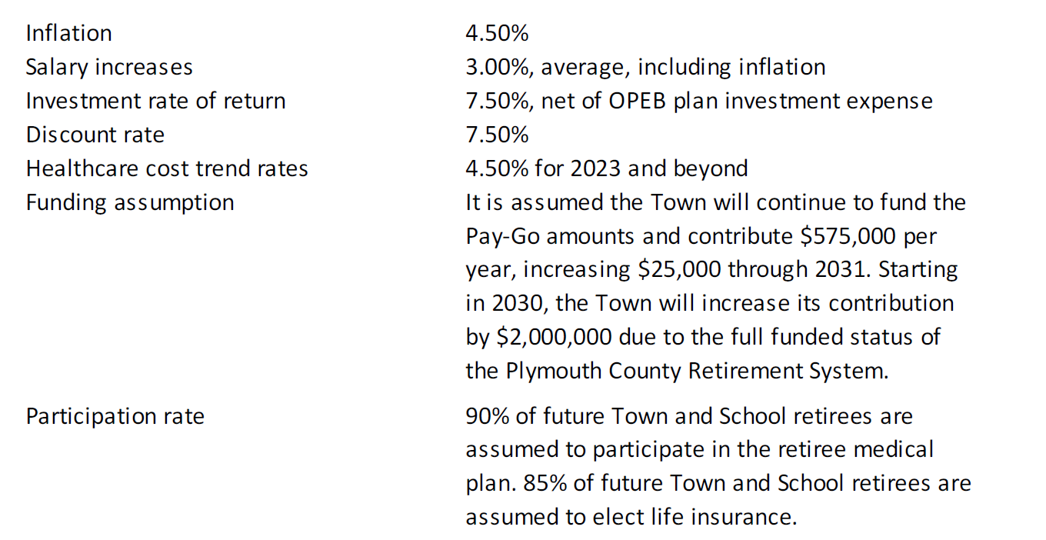
Actuarial Assumptions and Other Inputs
The net OPEB liability was determined by an actuarial valuation as of January 1, 2020, using the following actuarial assumptions, applied to all periods included in the measurement, unless otherwise specified:

Slide 11
Required Supplementary Information – Schedule of Net OPEB Contributions
 | 2022 | 2021 | 2020
Schedule of Contributions
Actuarially determined contribution | $ 8,317,548 | $ 17,525,422 | 16,060,161
Contributions in relation to the actuarially determined contribution | 5,649,557 | 6,189,544 | $6,114,966
Contribution deficiency | $ 2,667,991 | $ 11,335,878 | $9,945,195
Covered employee payroll** | $ 63,295,924 | $ 60,641,944 | 61,024,354
Contributions as a percentage of covered employee payroll | 8.90% | 10.50% | 10.50%
**Contributions are not based on a measure of pay; therefore, “covered employee payroll” is presented above.

Slide 12
OPEB Expense and Deferred Outflows of Resources and Deferred Inflows of Resources Related to OPEB
 | Deferred Outflows of Resources | Deferred Inflows of Resources
Contributions subsequent to the measurement date | $ 771,295 | $ -
Difference between expected and actual experience | 142,090 | 2,228,124
Change in assumptions | 48,021,223 | -
Net difference between projected and actual OPEB investment earnings | - | 1,039,805
Total | $ 48,934,608 | $ 3,267,929

Slide 13
OPEB Expense and Deferred Outflows of Resources and Deferred Inflows of Resources Related to OPEB
Other amounts reported as deferred outflows and inflows of resources related to OPEB will be recognized as increases (decreased) in OPEB expense as follows:
Year Ended June 30:
2023 | $ 10,060,683
2024 | 10,036,706
2025 | 10,246,776
2026 | 9,690,055
2027 | 4,594,764
Thereafter | 266,400
Total | $ 44,895,384

Slide 16
What Readers Want to Know
General Fund
Unrestricted Fund Balance
Committed
Assigned
Unassigned
Unassigned Fund Balance
% of Appropriations (or compared with your policy)
Trends
Use of Fund Balance
For what?
Operations
Capital
OPEB
Transfer
Transfer in From a recurring revenue source?
Transfer out Cash capital

Slide 18
MD&A Tell the Story!
At the end of the current fiscal year, unassigned fund balance of the General Fund was $15,697,815, while total fund balance was $26,092,817. Unassigned fund balance increased by $1,968,204, primarily from favorable budgetary results of $7,654,570, less “Free Cash” of $700,000 used to supplement the fiscal year 2022 budget, less “Free Cash” of $2,876,404 used for the fiscal year 2023 capital budget and OPEB contribution, and less “Free Cash” of $2,250,000 to add to the debt stabilization fund for fiscal year 2023. As a measure of the General Fund’s liquidity, it may be useful to compare both unassigned fund balance and total fund balance to General Fund expenditures. Refer to the table below.
General Fund | June 30, 2022 | June 30, 2021 | Change | % of General Fund Expenditures*
Committed fund balance | $ 7,910,827 | $ 6,135,950 | $ 1,774,877 | 7.20%
Assigned fund balance - encumbrances | 2,44,175 | 2,798,872 | (314,697) | 2.30%
Unassigned fund balance | 15,697,815 | 13,729,611 | 1,968,204 | 14.30%
Total fund balance | $ 26,092,817 | $ 22,664,433 | $ 3,428,384 | 23.80%

Slide 19
Governmental Funds – Statement of Revenues, Expenditures, and Changes in Fund Balances
 | General Fund
Excess of Revenues over Expenditures | $ 1,818,719
Other Financing Sources (Uses)
Proceeds of bonds | -
Bond Premiums | -
Transfers in | 1,631,398
Transfers out | (21,733)
Total Other Financing Sources (Uses) | 1,609,665
Change in Fund Balance | 3,428,384

Slide 20
Transfers – Are they from a recurring revenue source?
Governmental Funds: | Transfers In | Transfers Out
General Fund | $ 1,631,398 | $ 21,733
Nonmajor Governmental Funds:
Special revenue funds | 30,405 | 1,004,787
Capital project funds | 421,964 | 362,926
Subtotal – Nonmajor Governmental Funds | 2,083,767 | 1,389,446
Business-Type Funds
Water Fund | 553,805 | -
Sewer Fund | 9,692 | 38,500
Electric Division | - | 1,125,838
Subtotal – Business-Type | 563,497 | 1,164,338
Total | $ 2,647,264 | $ 2,553,784

Slide 21
What Readers Want to Know – What Was Fund Balance Used For?
Other Financing Sources (Uses)
 | Original Budget | Final Budget | Actual | Variance
Use of Fund Balance:
Operating Budget | 450,000 | 2,200,000 | 2,200,000 | -
Capital budget | 2,176,404 | 3,156,404 | 3,156,404 | -
Transfer to stabilization funds | 2,900,000 | 2,900,000 | 2,900,000 | -
OPEB trust fund contributions | 250,000 | 250,000 | 250,000 | -
Prior year carryforwards | - | 2,597,642 | 2,597,642 | -
Transfers in | 3,240,100 | 3,240,100 | 3,640,114 | 400,004
Transfers out | (3,925,000) | (4,425,000) | (4,447,347) | (22,347)
Other Financing Sources (Uses) | 5,091,514 | 9,919,156 | 10,296,813 | 377,657
Overall Budgetary Excess | 0 | 0 | 10,562,526 | 10,562,526

Slide 22
Financial Highlights
The City/Town consolidated its Fund Balance Policy into the Financial and Fiscal Policy, adopted September 5, 2018. The new policy retained the goals initially set in 2016. The policy establishes an unassigned General Fund balance goal of 10.00% of the prior years’ operating budget. The Operating Budget for fiscal 2021 totaled $98,931,048. As of June 30, 2022, unassigned fund balance for the general fund was $9,933,328 or 10.04% of the prior years’ operating budget compared to 7.92% as of June 30, 2021 (as restated).
The amended fund balance policy goes on to state that the level of fund balance is not to fall below 8.33% of the operating budget. Once the City/Town achieves an unassigned fund balance equal to 10.0% of the City/Town’s Operating Budget, and any excess above 12% will be allocated toward any combination of the following:

Slide 23
What Readers Want to Know
Enterprise Funds
Statement of Cash Flows
Does Net Cash provided by Operations cover principal and interest costs?

Slide 24
Proprietary Funds – Statement of Cash Flows
 | Water Fund | Sewer Fund
Cash Flows From Operating Activities
Receipts from customers and users | $ 10,054,910 | $ 7,100,686
Payments to vendor for goods and services | (3,235,818) | (4,875,175)
Payments to employees for services | (2,644,947) | (393,505)
Receipts from employees and employer | - | -
Payments of employee benefits and expenses | - | -
Net Cash Provided By (Used For) Operating Activities | 4,174,145 | 1,832,006
Cash Flows From Noncapital Financing Activities
Interfund transfers in (out), net | 553,805 | (28,808)
Net Cash Provided By (Used For) Noncapital Financing Activities | 553,805 | (28,808)
Cash Flows from Capital and Related Financing Activities
Acquisition and construction of capital assets, net of disposals | (2,420,295) | (1,523,741)
Proceeds from bonds | - | 732,829
Proceeds from bond premiums | - | 191,000
Principal payments on bonds | (1,472,370) | (383,000)
Interest expense | (510,481) | (222,610)
Capital contributions | - | 300,000
Net Cash (Used For) Capital and Related Financing Activities | (4,403,146) | (905,522)

Slide 25
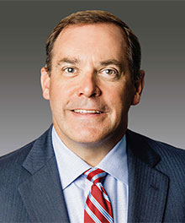
Questions?
Scott McIntire, CPA
Scott.McIntire@marcumllp.com

