Slide 1


Municipal Debt 101
New England States GFOA
Annual Meeting
September 17, 2024
Presented By:
MATTHEW A. SPOERNDLE, Phoenix Advisors, LLC
CHRISTIE D. JEAN, Robinson & Cole LLP

Slide 2


WHAT IS A MUNICIPAL BOND?
Indebtedness issued by a government entity, promising to repay borrowed money at a fixed rate of interest over a specified time period
  “munis” are issued to fund day-to-day obligations and finance capital projects
Short Term (Note) vs Long Term Debt Obligations
Applicable Uses of Proceeds
Nature of Obligations
  G.O. / Special Assessment / Revenue / Conduit Financings
Bond Ordinance Adoption by Legislative Body
  Appropriation and Authorization

Slide 3
Pre-Issuance
Identify Capital Priorities / CIP
  Wants versus needs
Assemble Finance Team
  The Issuer, Bond Counsel, Financial Advisor, Paying Agent, BOE Rep, Engineer, Underwriter (if necessary)
Determine Method of Funding Projects
  Cash
  Debt (Bonds/BANs)
  Grants (State/Federal)
  Combination of above

Slide 4
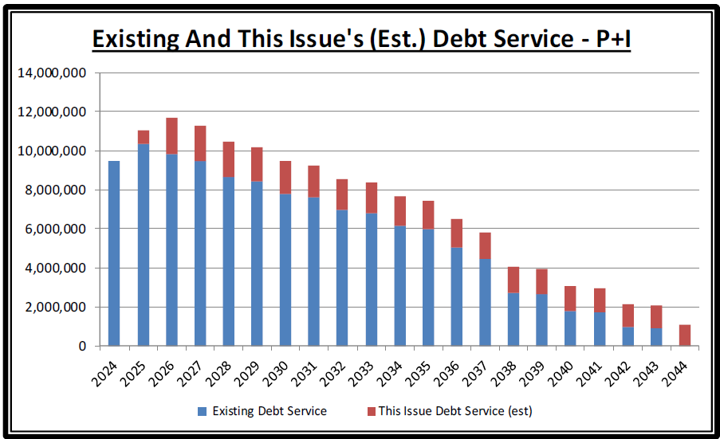
Pre-Issuance
Develop Financing Plan
  Short-term versus Long-term Financing
    Impact of Grants
    Project Cash Flows
  For Bonds – Determine Structure
    Review existing debt service
    Analyze Budget Impacts
    Term (useful life, etc.)
    Statutory limitations
    Rating implications
  Future needs
  Consolidate ordinances and existing BANs

Slide 5
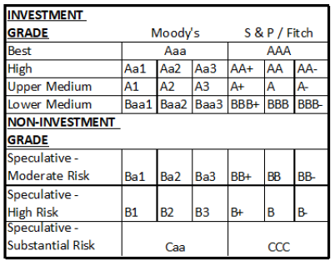
Pre-Issuance
Debt Authorization Requirements
  Bonds and BANs
    Bond Ordinance
Credit Ratings
  Critically important
  Public!
  Which Rating Agency to use?
    Moody’s/S&P/Fitch/Kroll
    Historic Relationships
    Recalibrations
    Tend to have slightly different focus
    Market Acceptance
    Almost always done over via conference call
      Would in-person and/or a tour add-value?

Slide 6
Pre-Issuance
  Effective presentations to rating agencies
    First of all – Remove Politics from the Process!
    Key Personnel Only
    Preparation is Essential
    Awareness of new criteria and factors
    Be Proactive
  The Presentation Document:
    Incorporate Trend AND Comparative Analyses
    Tax Base (growth, new developments/redevelopments)
    Fund Balance
    Operating Results
    Debt Ratios
    Policies
    Things beyond your control
    Leave no stone unturned! (good or bad…)

Slide 7
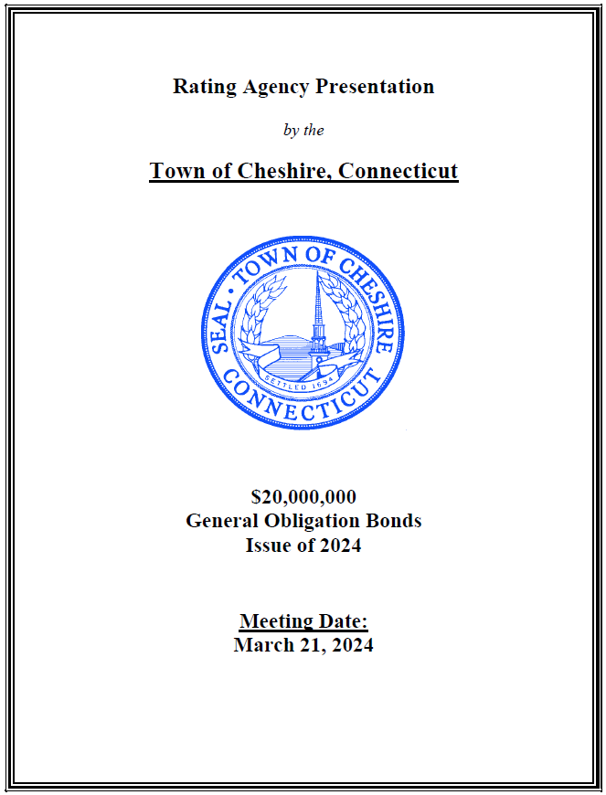
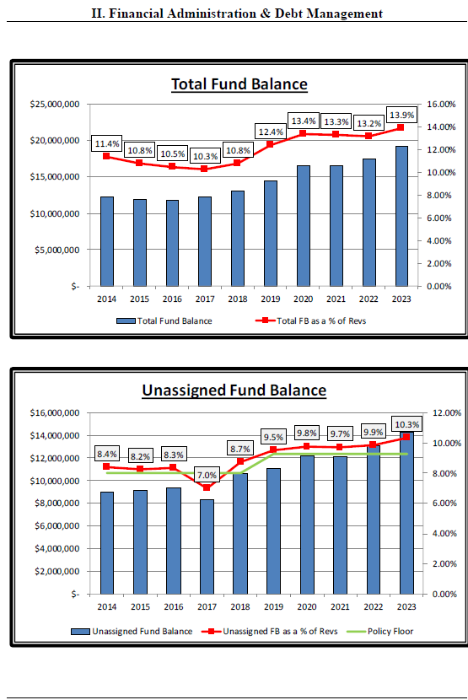
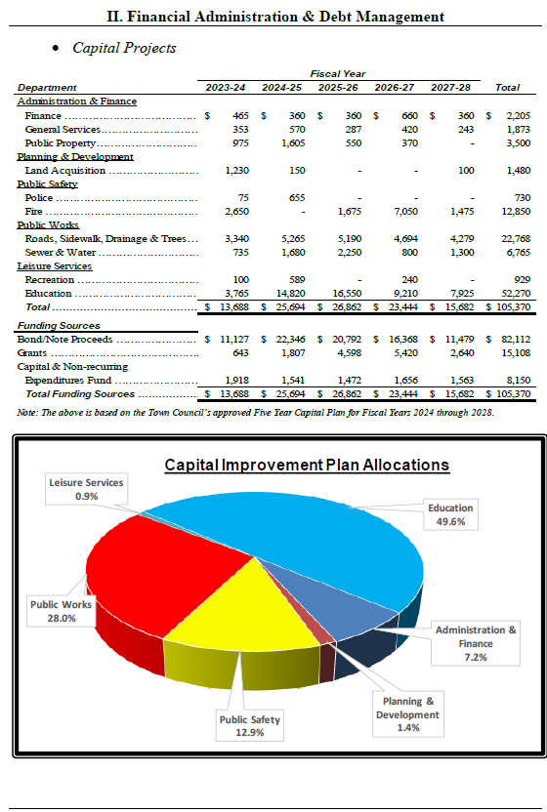

The Rating Presentation

Slide 8
Manner of Issuance
C.G.S. § 7-370
“Any municipality . . . which issues bonds, notes or other obligations pursuant to the provisions of the general statutes or any special act may designate the manner in which such bonds, notes or other obligations shall be issued and the person or persons by whom they shall be signed and shall provide for keeping a record of the same or shall authorize any official or municipal body to make such designations and to take such actions. Any such municipality may authorize its selectmen or board of finance or other officers or board to determine the rate or rates of interest or discount which such bonds, notes or other obligations shall bear and the time or times at which interest on such bonds, notes or other obligations shall be payable, or to establish the method or manner for making such determinations, and to determine all other terms, details and particulars pertaining to the issuance and sale of such bonds, notes or other obligations, including the time or times for payment of principal, subject to the provisions of the general statutes concerning the time or times at which bonds, notes or other obligations shall mature. Any bonds, notes or other obligations issued pursuant to the general statutes or any special act may be sold at public sale on sealed proposals or by negotiation in such manner, at such price or prices, at such time or times and on such other terms and conditions as the municipality issuing such bonds, notes or other obligations, or the officers or board delegated the authority to issue such bonds, notes or other obligations, may determine. The provisions of this section shall not affect the authority of the selectmen of any town to issue bonds where so authorized by special act.”

Slide 9

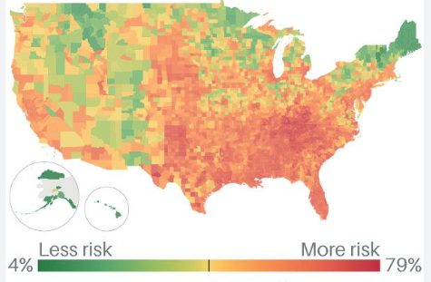
Bond Counsel’s Focus… “Five W’s”
Who, what, where, when, why?
  Details of the Issuer and the sale, as well as the purpose of these bonds
  OS usually set up in 7 parts giving an overview of the municipality and it finances (a detailed resume)
Part – I Bond Information
  Authorization and Purpose
  Description of the Bonds
  Use of Proceeds
  Climate Change
  Cybersecurity
  Tax Matters
  Continuing Disclosure
Part II – Issuer
  Form of government
  Principal officials, organizational chart
  Specific details of the municipality (school systems, employees)
Part III – Economic and Demographic Data
  Major employers
  Population Trends
  Housing inventory

Slide 10

“Five (5) W’s” cont’d
Parts IV & V – Tax Base Data; Debt Summary
  Major employers
  Population Trends
  Housing inventory
  Largest Taxpayers
  Debt Statement
  Clean Water Fund Program
  Debt Authorized But Unissued
Part VI – Financial Administration
  Budgetary Procedures
  Pension Plans
  OPEB
Part VII – Legal and Other Information
  Litigation disclosure
  Financial statements
  Transcripts and closing documents
Notes:
Make sure to review ENTIRE disclosure documents, KEEP our notes and sources on information , VIEW it from the perspective of what would be important to an investor, collaborate with other contributors (ma, municipal officials)

Slide 11
Issuance
    Method of Sale
  Competitive vs Negotiated
  Is a Direct Purchase on option (ie: Bank Loan)
  For competitive issues, which bid platform?
Redemption provisions (aka: Call Feature)
Distribution/Marketing of the Offering documents
Evaluation of Bond Insurance*
    Timing Considerations
      Interest Rate Environment
      Supply/Demand
      Holidays
      Major economic releases
      Fed Expectations
      ELECTIONS

Slide 12
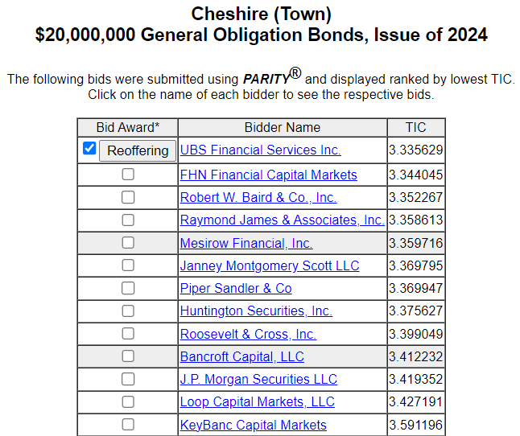

Bond Sale
    What impacts the end results??
    Evaluation of Bids
      NIC v TIC
    Making the formal award
    Distribution of sale results
      Communication to the marketplace
      Begin “closing process” (DTC, Bidder, Paying Agent)
        Settlement letters, etc
      Coordinate document signing

Slide 13
Closing Documents
  Signature and No Litigation Certificate
    Certification of municipal officials that bonds were executed in municipality’s name, adopts those signatures, and certifying that they’re authorized to sign on municipality’s behalf, and stamp its seal, and most importantly, that there’s not litigation surrounding that process
  Certificate re POS
    Municipal officials certifying that what’s listed in the POS is true and doesn’t contain any “untrue statement of a material fact” or “omit to state a material fact” necessary to make the statements therein not misleading, and confirming that since the release of the POS the municipality’s financial condition hasn’t had a material or adverse change (SEC Rule 10b-5 standard)
  Certificate of Incumbency
    Municipal clerk confirming signatures of key officials who are charged with signing on municipality’s behalf
  Receipt for the Purchase Price
    From municipality to purchaser of the obligations, acknowledging that purchase price has been received, including principal amount of the bonds, premium and interest (if any)
  Award Letter
    From municipality to the purchaser of the bonds, acknowledging winner bid and any premium offered and has been accepted by municipality
Notes:
““It shall be unlawful for any person . . . to make any untrue statement of a material fact or to omit to state a material fact necessary in order to make the statements made, in the light of the circumstances under which they were made, not misleading . . . .” (Prohibits misstatements of material fact or misleading omissions of material fact in offer, purchase, or sale of securities)

Slide 14
Closing Documents (cont’d)
  Continuing Disclosure Agreement
    Municipality promising to provide information required by the Securities and Exchange Commission Rule 15c2-12(b)(5) (filing annual financial reports and operating data, timely notice of the occurrence of material events on EMMA, i.e. rating changes, bond calls, payment delinquencies, etc., and timely notices of failure to file financial information)
  Tax Regulatory Agreement (Tax Certificate) and IRS Form 8038-G
    Tax documentation in order to establish that the use of proceeds of the tax-exempt bonds meets the applicable requirements of the Internal Revenue Code and Treasury Regulations (to allow the interest on the bonds to be excluded from federal income tax); includes Issue Price and municipal advisor certificates
  Escrow Agreement (Refunded Bonds)
    Used in refundings to outline procedures to pay off the refunded bonds
  Bond Purchase Agreement (Negotiated)
    Contract between municipality and the underwriter/purchaser laying out the purchase price, terms and conditions for the closing, representations and warranties, documents delivered at closing, etc.
  Any other documents required by the BPA
    Certifications from municipal officials re litigation, etc., copies of ratings, bond insurance policies if any, etc.
  Facsimile Authorization
    Facsimile signatures are copied on the bond or note forms
Notes:
(i) principal and interest payment delinquencies; (ii) non-payment related defaults, if material; (iii) unscheduled draws on debt service reserves reflecting financial difficulties; (iv) unscheduled draws on credit enhancements reflecting financial difficulties; (v) substitution of credit or liquidity providers, or their failure to perform; (vi) adverse tax opinions; the issuance by the Internal Revenue Service of proposed or final determinations of taxability, Notices of Proposed Issue (IRS Form 5701-TEB) or other material notices or determinations with respect to the tax status of the Bonds, or other material events affecting the tax status of the Bonds; (vii) modifications to rights of Bondholders, if material; (viii) Bond calls, if material, and tender offers; (ix) defeasances; (x) release, substitution, or sale of property securing repayment of the Bonds, if material; (xi) rating changes; (xii) bankruptcy, insolvency, receivership, or similar event of any obligated person; (xiii) the consummation of a merger, consolidation, or acquisition involving any obligated person or the sale of all or substantially all of the assets of any obligated person, other than in the ordinary course of business, the entry into a definitive agreement to undertakeany such an action or the termination of a definitive agreement relating to such actions, other than pursuant to its terms, if material; (xiv) appointment of a successor or additional trustee or the change of name of a trustee, if any, if material; (xv) incurrence of a Financial Obligation by any obligated person, if material, or agreement to covenants, events of default, remedies, priority rights, or other similar terms of a Financial Obligation of any obligated person, any of which affect Bondholders, if material; and (xvi) default, event of acceleration, termination event, modification of terms, or other similar events under the terms of a Financial Obligation of any obligated person, any of which reflect financial difficulties.

Slide 15

Post Issuance
    Debt service payments
      When, how much, to whom?
      Paying Agent / Depository Trust Company (DTC)
    Continuing Disclosure
      Annual financial information
      Material events
    Investment of bond proceeds (if applicable)
      Arbitrage Considerations

Slide 16
Other Topics
    Refinancings (aka “Refundings”)
      What are they?
      How are they evaluated?
      How are they discovered?
      What should you do?
      Assemble Finance Team
      Authorizations Needed
    Refunding Bond Ordinance
    Approval process is slightly different

Slide 17
Questions?

