Slide 1
Government Finance Officers Association of the United States and Canada
Advancing excellence in government finance to build thriving communities

Slide 2
GFOA Overview

Slide 3
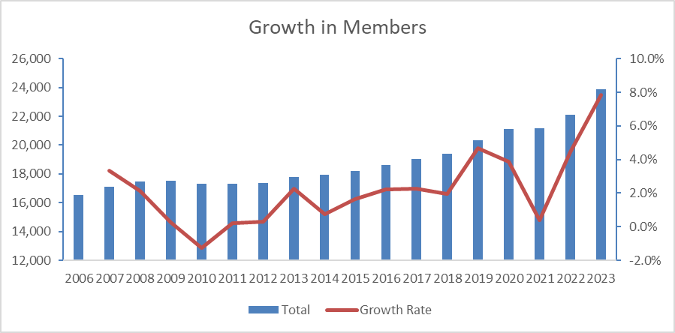
GFOA Overview
23,500+ individual members
7,800+ member organization
Approximately 75 staff
18-member board
Several committees, task forces, and advisory groups

Slide 4
Notes:
GFOA's 2024 Governmental GAAP Update is the premier online governmental accounting event of the year. We’ll be offering the GAAP Update on November 14 with an encore presentation on December 5. Join this year’s program to get last-minute pointers on standards being implemented now, including GASB 100, Accounting Changes and Error Corrections and GASB 101, Compensated Absences. Plus, don’t miss important updates on GASB 102, 103, and 104. Register early and save. Just click the QR code on the screen or visit gfoa.org/gaap-update.

Slide 5
Notes:
We encourage you to learn more about and join GFOA’s Affinity Groups. We recently launched the Alliance for Smarter School Spending and re-launched the Young Professionals Network and Utility Finance Forum. Keep watch for the Community for Canadian Issues coming this summer.

Slide 6
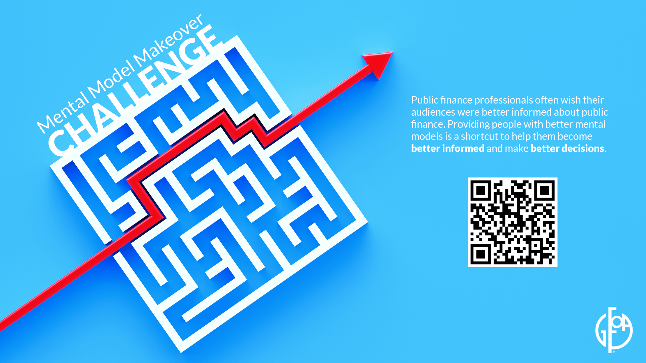
Notes:
Mental models are representations of how we think about complex problems. By upgrading the mental models that elected officials and the public have available to them, they can more easily navigate public finance decisions. Help us make these upgrades, and one lucky winner will receive an all-expense-paid trip to #GFOA2025 in Washington, D.C. Scan the QR code to learn more about GFOA’s latest challenge.

Slide 7
Notes:
Rethinking Financial Reporting is a fact-based examination of the costs and benefits of the current model of financial reporting and how it can be improved. This is important research for local governments. We’ve compiled many resources on our website including new research, surveys, and more. Scan the QR code for more details.

Slide 9
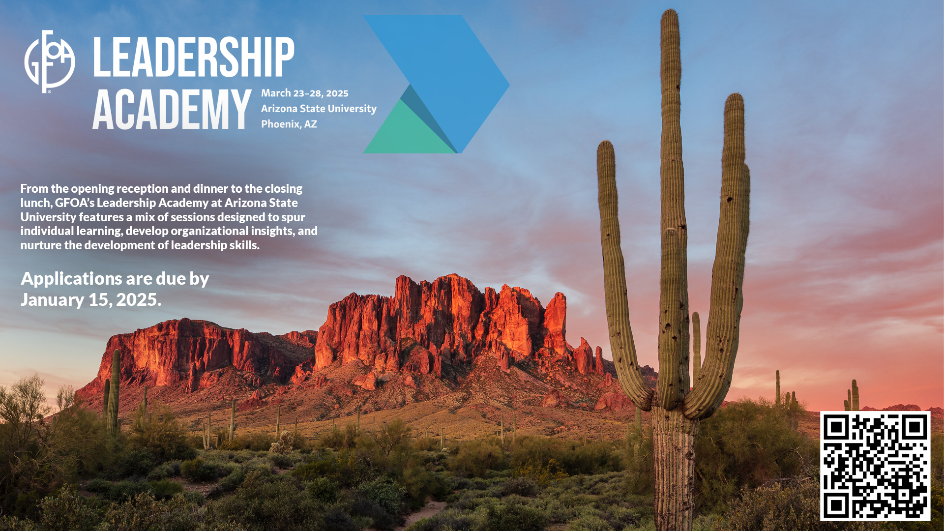
Notes:
Advance your professional development, foster connections, and engage in collaboration with your peer by attending GFOA’s Leadership Academy, March 23-28, 2025 at Arizona State University. This intensive week-long training features a mix of sessions designed to spur individual learning, develop organizational insights, and nurture the development of leadership skills. Sessions are intended to balance the role of the financial professional in state and local government with key trends in leadership for the public sector. The deadline to apply is January 15, 2025.

Slide 10
Leadership Academy Overview

Slide 11
Major Topics
Self Assessing Your Strengths
Characteristics of Great Government Organizations
Leadership Skills for the 21st Century
Leading a Government Finance Workforce
Building a Culture of Innovation
Power, Politics, and Budgeting
Rethinking Public Engagement
Case Studies and Local Experiences

Slide 12
Notes:
The Certified Public Finance Officer program is designed to equip individuals for prominent roles by enhancing fundamental skills and deepening knowledge of best practices and standards in public finance. Through the certification process, you'll gain the expertise needed to actively contribute to decision-making processes within your government and community. Take charge of projects and lead professionals in a substantive and impactful manner. More than 900 of your public finance peers have become certified. Learn more at gfoa.org/CPFO.

Slide 13
Certified Public Finance Officers
Program Overview
Notes:
The CPFO program was initially launched in 1999 with five exams. Since the initial exams were published, nearly 1,000 individuals have earned the CPFO designation.
In 2020, the GFOA executive board approved changes to the program, and brough the program back in-house to GFOA. The relaunch changed the enrollment requirements and restructured the exams from five to seven, to separate the Compensation, Procurement and Risk Assessment topics into their own exams.

Slide 14
Who Should Enroll?
Entry-level professionals seeking a position in the local government public finance field
Mid-career professionals interested in leadership roles
Senior Finance Officers looking to refresh their knowledge and best practices
Notes:
No matter where you are in your career, we believe the program will prepare you to lead decision-making efforts for your government and community.

Slide 15
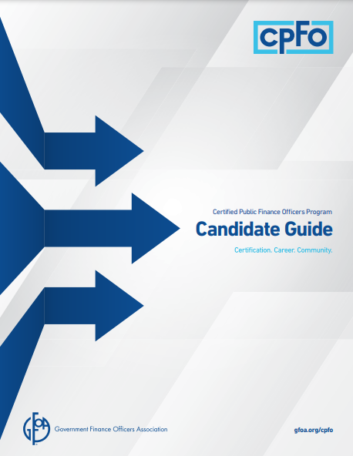
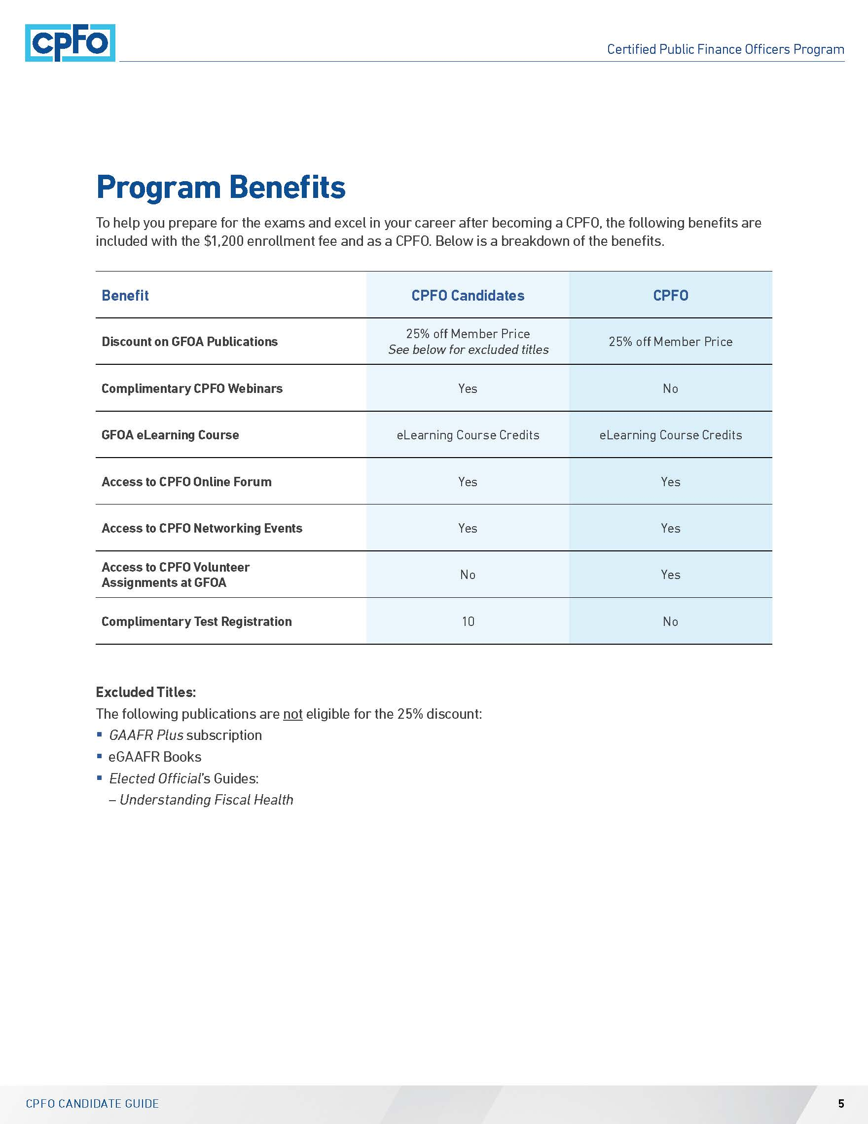
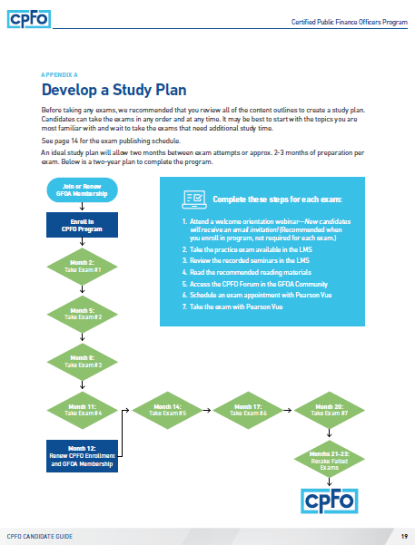
CPFO Candidate Guide
Go to www.gfoa.org/cpfo to view the CPFO Candidate Guide
Notes:
The CPFO Candidate Guide includes all the details about completing the program.

Slide 16
Steps to Get Started
1
Join or update GFOA membership
2
Enroll in the Program – $1,200
3
Begin studying! – Choose the exam where you’re the strongest
Continue to Exams…
Notes:
The seven steps to complete the program:
The CPFO Program supports the core beliefs of GFOA, including ethics, leadership principles, competencies in public finance, and recognizes members who have made the commitment to obtain knowledge and skills to remain current with industry best practices.
The CPFO enrollment fee includes two years of participation, ten exam attempts, and access to a CPFO Prep product in the LMS. Overall, candidates have five years to complete the program.

Slide 17
Steps to Complete
4
Continue studying!
5
Take the exam – remote or in-person with Pearson Vue
6
Pass the exam & begin studying for the next one
7 Pass all 7 exams & earn the CPFO
Notes:
To complete the program, you must be a member of GFOA and pay the annual CPFO enrollment fee until you pass all seven exams. If you need to update your membership, please go to gfoa.org/join to submit updated information.

Slide 18
Seven CPFO Exam Topic Areas
Accounting & Financial Reporting
Compensation & Benefits
Debt Management
Planning & Budgeting
Treasury & Investment Management
Procurement
Risk Assessment
100 questions – Accounting, Debt, Planning, and Treasury
75 questions - Compensation, Procurement, and Risk
Minimum Passing score is 80% for each exam.
Each question is multiple-choice with four options and is worth one-point. There are no unscored questions on the exams.
Notes:
Four exams consist of 100 questions. Compensation, Procurement and Risk Assessment, which are 75 questions each.
Candidates have two hours to complete an exam. The passing score for all of the exams is 80%. Each question is multiple-choice with four options and is worth one-point. There are no unscored questions on the exams.
Exam scores are available immediately after finishing the exam.
GFOA also provides exam accommodations for various needs. Contact CPFO staff for more details.
If a candidate fails an exam, they must wait two weeks after the first failed attempt and four weeks after subsequent failed attempts before retaking that exam.

Slide 19
Two-year Study Plan
Month 1 | Enroll in the CPFO program for $1,200
Month 3 | Exam #1
Month 6 | Exam #2
Month 9 | Exam #3
Month 12 | Exam #4
Month 15 | Exam #5
Month 18 | Exam #6
Month 21 | Exam #7
Month 24 | Pass all of the exams and begin using the CPFO designation
Notes:
GFOA is recommending a two-year study plan that allows for 2-3 months of preparation per exam with an estimated 500 hours of studying. A two-year plan includes ten exam attempts.
Ten exam registrations are included with the enrollment fee and can be used anytime during the two-year window.
Our objective is to have candidates complete the program within two-years, so they can continue with their professional goals.

Slide 20
Complete these steps for each exam
Review the content outline for the exams on the website
Access the CPFO Candidate Community in the GFOA Community Forum for study tips
Review the study terms handout in the LMS
Take the practice test available in the LMS
Review the recorded courses in the LMS and/ or
Read the recommended reading materials on the website
Schedule an exam appointment using Clarus
Take the exam with Pearson Vue
Notes:
For each exam, we recommended completing all of these steps. For a visual of this slide, please see the “Develop a Study Plan” graphic in the CPFO Candidate Guide.

Slide 21
Study Resources
CPFO Candidates receive:
Access to recorded GFOA training seminars relevant to the exam topic areas. Over 20 unique training opportunities with 130 hours of content!
Short practice tests to gauge knowledge in topic areas
Study Terms and Concepts Handouts
Access to CPFO Candidate Forum
e-Learning Course Credits
25% Discount on most GFOA Publications
Notes:
Upon enrolling in the program, candidates receive access to a CPFO prep product in the Learning Management System (Or LMS) with recorded eLearning Courses and short practice tests.
Candidates also receive $420 in eLearning Course credits per year of enrollment and 25% off GFOA publications.

Slide 22
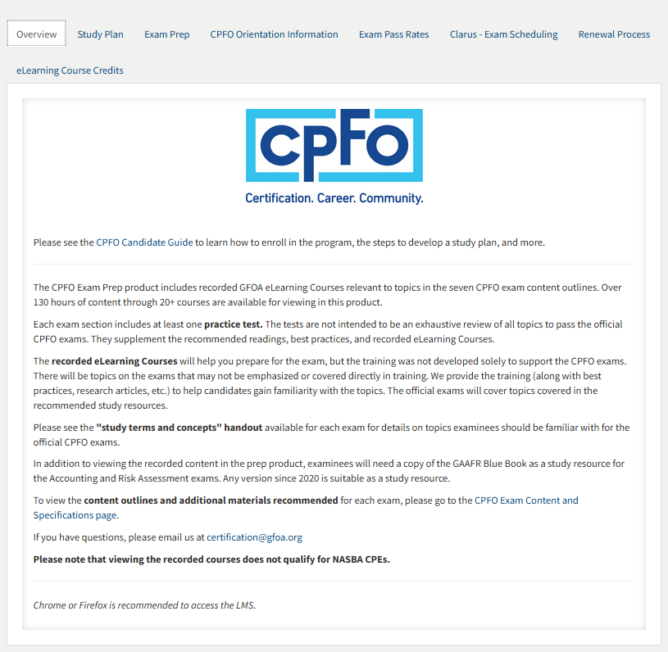
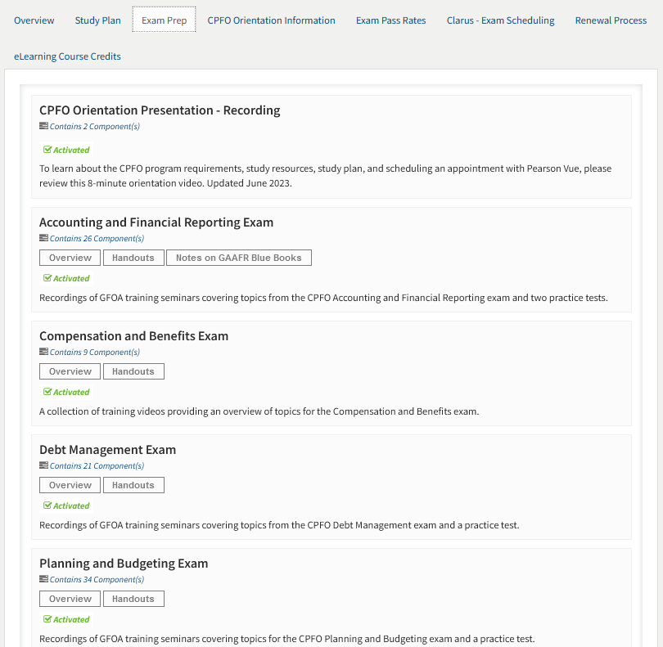
CPFO Prep Product
Notes:
CPFO Candidates receive access to a prep product with over 130 hours of content, short practice tests, study guides for each exam, orientation information, exam pass rates updated quarterly, instructions to schedule exams, and information on how to use the annual eLearning Course credits.

Slide 23
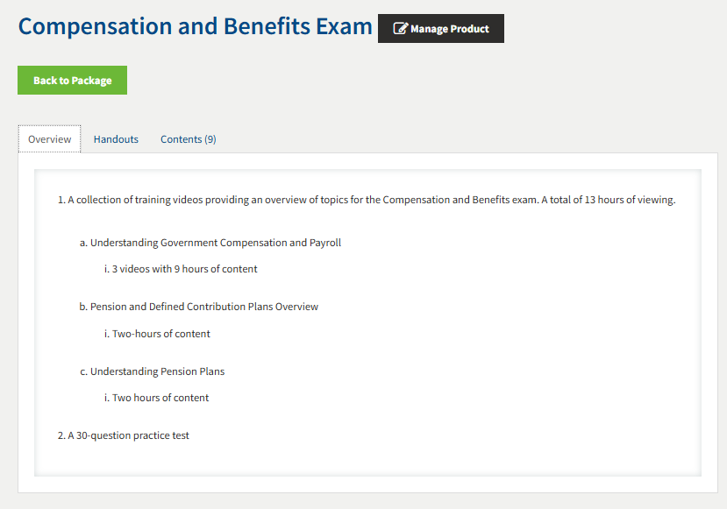
Compensation and Benefits Section (1)
Notes:
This is an example of the Compensation and Benefits section. Each exam has a dedicated section with an overview, handouts (including the study guide) and the recorded courses in the “contents” tab.

Slide 24
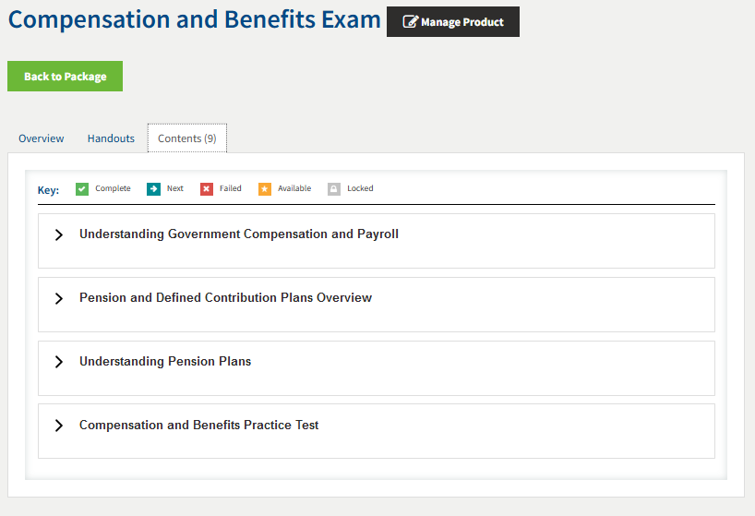
Compensation and Benefits Section (2)

Slide 25
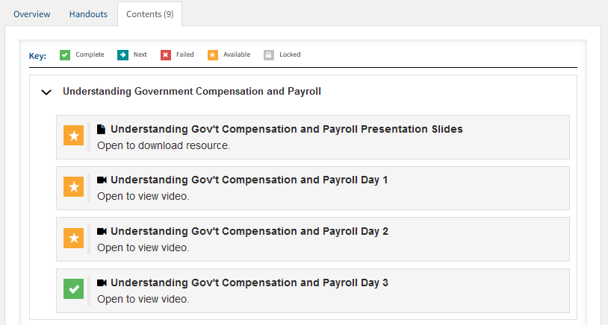
Compensation and Benefits Section (3)

Slide 26
After Earning the CPFO Designation
Membership with GFOA
CPFO Annual Maintenance Requirements
Begins January 1, after completing all exams
15 CPEs
3 GFOA Engagement Credits
gfoa.org/cpfo-members
CPFO Annual Membership Fee
$175 – begins January 1st, following the first full calendar year
Example, if you earn the certification in 2023, you will initially be invoiced in January 2025. If you earn it in 2024; the first invoice is in January 2026.
Benefits – $170 eLearning Course Credits per year
Notes:
The program will encourage ongoing participation in and knowledge of GFOA’s resources including best practices, conferences, networking groups, and partnerships with other organizations to prepare members to better serve their governments and communities.

Slide 27
CPFO Updates for State Association Partners

Slide 28
Alternative Tests
Any state/regional GFOA organization is eligible to partner with the CPFO program to develop partner programs that either allow candidates the opportunity to reduce redundancy between similar programs or allow the state/regional GFOA organization to develop a complimentary CPFO exam focused on the specific finance environment within the state or region.
GFOA offers two opportunities for partnership:
Notes:
In March 2024, the GFOA executive board approved policy updates for the program. The full details can be found in the CPFO Policies and Procedures manual.

Slide 29
Alternative Tests – Option 1
Current State/Regional Certification. State/Regional GFOA associations, or similar organizations with a mission to support government finance with current certification programs is eligible to become a GFOA Certification Partner. Participants in certification programs offered by GFOA Certification Partner are eligible for the following benefits:
Receive credit for passing up to three (3) GFOA exams or completion of similar exams from the Certification Partner.
To become a GFOA Certification Partner and offer exams that would qualify to meet GFOA program requirements, Certification Partners must:
Enter into an agreement with GFOA outlining details of relationship between GFOA and Certification Partner
Submit once every three (3) years a copy of eligible exams for review by GFOA.
Exams must meet the following criteria:
Similar exam standards to GFOA and similar level of exam difficulty
Exam coverage for at least 75% of topics listed at https://www.gfoa.org/content-and-specifications-of-cpfo-exams
Exam length no less than 75% of GFOA exam.
After a Certification Partner is approved, candidates enrolled in GFOA’s CPFO program may submit proof of completed exam for credit towards a GFOA exam. In the event a GFOA Certification Partner offers combined exams, proof of passing the questions applicable for GFOA’s exam will be used to determine successful completion.
Notes:
For programs such as Florida, South Carolina, and Texas, to name a few, they can now partner with GFOA to receive approval for their designation holders to bypass up to three CPFO exams to avoid duplicating their efforts.

Slide 30
Alternative Tests – Option 2
New State/Regional Certification. State/Regional GFOA associations, or similar organizations with a mission to support government finance without current certification programs are eligible to become a GFOA Certification Partner by working with GFOA to develop an additional exam focused on specific environment within the region/state. To become a Certification Partner, organizations must:
Enter into an agreement with GFOA outlining details of relationship between GFOA and Certification Partner
Work to develop an additional exam and develop standards for exam updates and quality assurance.
Agree to use GFOA partners to administer exams and work with GFOA to publish exams
GFOA will collect standard CPFO fees plus fees identified by the Certification
Partner for enrolling in the additional certification program. GFOA will charge GFOA Certification Partner a fee equal to $150 for candidates enrolling in the additional program. GFOA Certification Partners have the ability to set their own fees for candidates.
Candidates passing the additional exam will not be recognized as CPFOs until all GFOA program criteria are satisfied.
Notes:
For state associations that do not have a CGFO program, they are encouraged to develop an exam specific to best practices in their state that can serve as an eighth exam so their members can earn the CPFO and a state-specific designation.

Slide 31
CPFO Council – New Governance Structure
GFOA’s Executive Director will appoint up to nine (9) individuals to the CPFO Council to serve staggered 3-year terms. CPFO Council members will provide ongoing subject-matter expertise, technical guidance, or support for CPFO Program relationships. The CPFO Council will comprise current CPFOs, representatives of partnership organizations, university faculty, associate members of GFOA, and other stakeholders.
CPFO Council Positions:
At-Large Members (3)
Current CPFO (3)
Representative of Partnership Organization (1)
Academic Representative (1)
and a Public Member Representative (1)
Notes:
To abide by certification program best practices, the CPFO program now has its own governance structure. The first meeting will take place this fall. This group will focus on the exam development process and various program policy updates.

Slide 32
Enrollment Scholarships
GFOA is providing two CPFO enrollment scholarships for each state association to award to its members per year.
Scholarship Value: $1,200 enrollment fee for two years of participation
You are encouraged to award the scholarships to individuals not currently enrolled in the CPFO program (The CPFO enrollment fee is non-refundable for current candidates).
Main Enrollment Requirement: A current and paid GFOA membership
For more info, go to: https://www.gfoa.org/cpfo-enrollment-scholarships
Participating
Associations:
AZ
CA
KS
MA
MI
NV
OH
VT
WI
WPFN
LGHN
NBFPA
Notes:
General information and a reminder for state associations to utilize their enrollment scholarships.

Slide 33
General Program Updates
Since relaunch in April 2021 (data as of 5/1/24)
1,215 candidates enrolled
794 are active
336 did not renew
85 have earned the CPFO
Since the final exam was published in June 2023, 70 have completed the program
Program Goals: 20 new candidates per month & 12 new CPFOs per month!
445 Current CPFOs (after 2023 requirements drop conducted in April 2024)
226 – Legacy
219 – New requirements
Notes:
Provided for attendees. You don’t need to cover this slide.

Slide 34
Program Timeline
March 2020 | New policies, procedures, and program structure approved
January 2020 | Enrollment and exams paused
April 2021 | Enrollment reopen ($60 per year) Accounting & Financial Reporting exam available
August 2021 | Treasury & Investment Management exam available
February 2022 | Planning & Budgeting exam available
March 2022 | Debt Management exam available
October 2022 | Procurement exam available
February 2023 | Risk Assessment exam available
June 2023 | Compensation & Benefits exam available New two-year fee structure implemented ($1,200 for two years) Launched new exam management platform - Clarus
March 2024 | New CPFO governance approved
June 2024 | New council members appointed
Notes:
Provided for attendees. You don’t need to cover this slide.

Slide 35
Questions?
Contact us at certification@gfoa.org
Go to www.gfoa.org/cpfo for more information

