Slide 1
NESGFOA
MuniAuction®: Competitive Municipal Bond and Note Auction Update
September 18, 2024

Slide 2
Company Overview

Slide 3
Grant Street Group Overview
Founded in 1995
Headquartered in Pittsburgh, PA
500 employees based in North America
Over 175 developers, infrastructure, and IT specialists
Over 225 project managers, business analysts and product staff

Slide 4
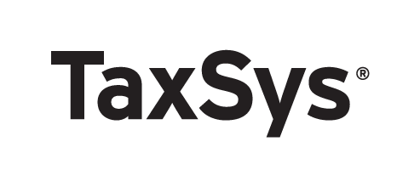
Company Services
Online auctions of fixed-income securities
Web-based tax collection and billing
Electronic payment processing

Slide 5
Auction Experience
Since 1997:
174,000
Auctions
$13.0 T
In Volume
6,800
Issuers

Slide 6
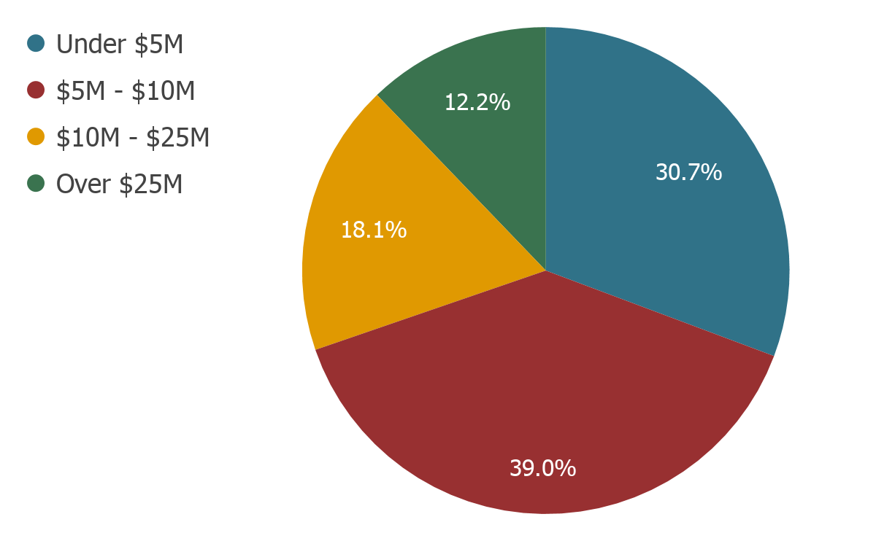
MuniAuction: Transaction Size

Slide 7
What Distinguishes MuniAuction from Parity?

Slide 8
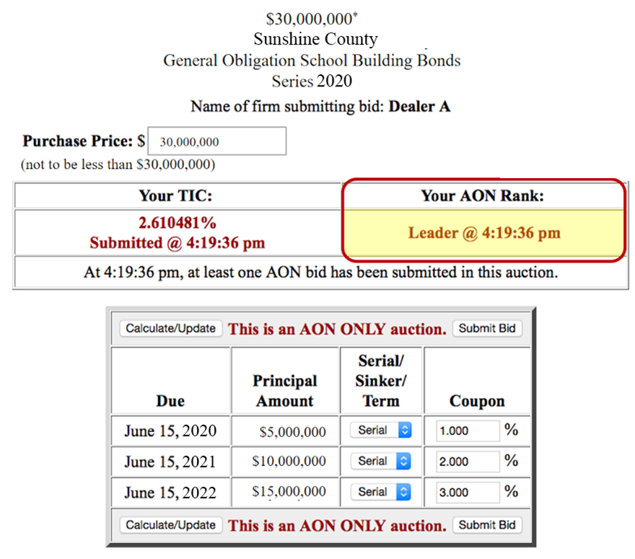
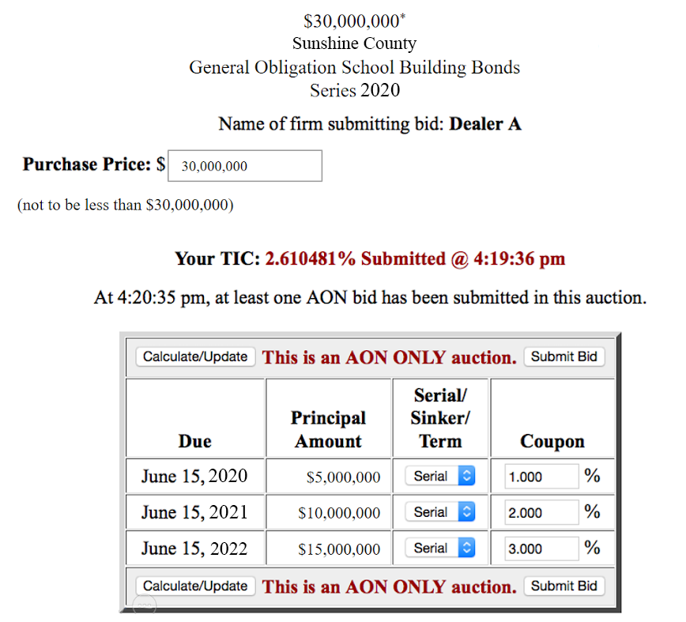
Open and Closed Transactions
Closed Auction
Open Auction
Bidders see their status and have an opportunity to improve their bid.

Slide 9
MuniAuction Experience and Services

Slide 10
Auction Services
We provide full service support for our clients:
Provide training to bidders and issuers
Review governing documents prior to sale
Post notice of upcoming auctions
Handle communications with dealers
Test auction parameters and calculations
Create live and trial auctions
Release final results

Slide 11
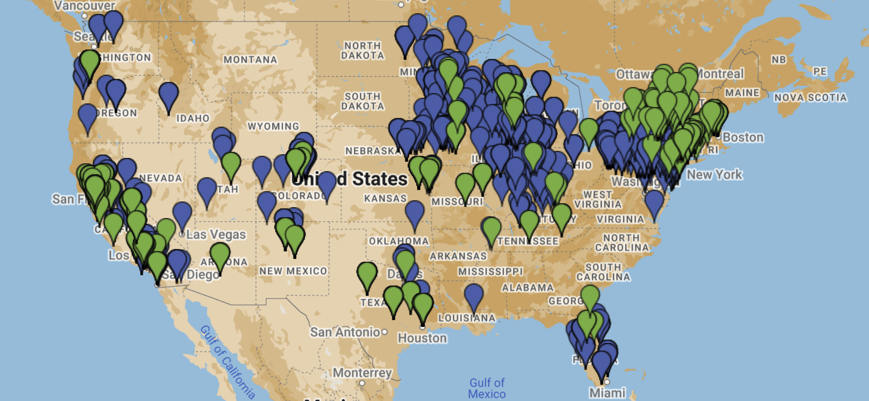
National Issuance Map
Bond Issuer
Note Issuer

Slide 12
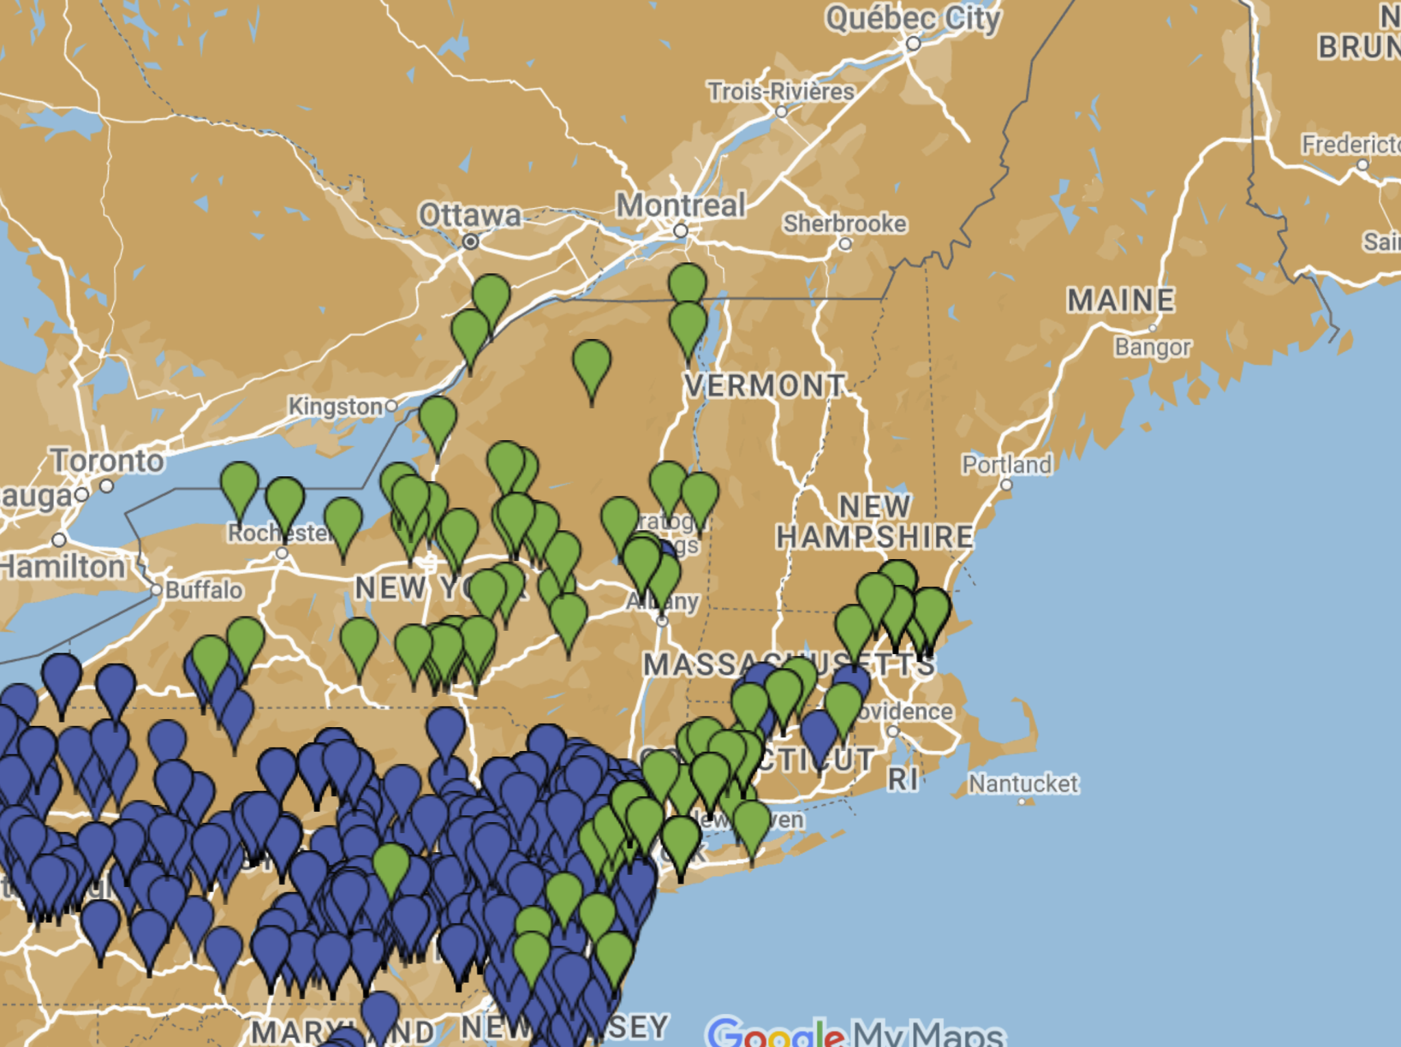
New England Sales
Bond Issuer
Note Issuer

Slide 13
New England Success Story
Town of Fairfield, CT
Since 2008:
14 Bond auctions totaling over $325,000,000
17 Note auctions totaling over $290,000,000

Slide 14
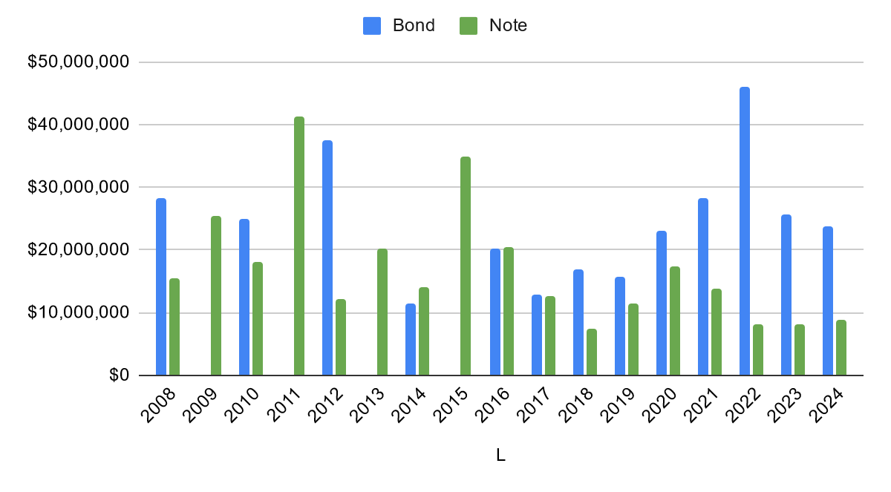
Fairfield, CT Bonds/Notes

Slide 15
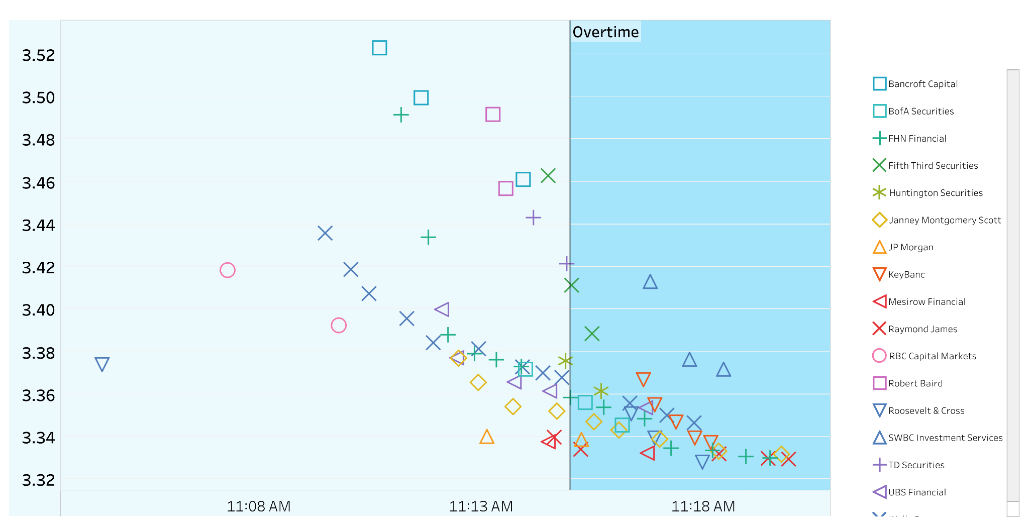
Town of Fairfield, CT
$33,890,000 General Obligation Bonds, Issue of 2024
77 bids by 17 bidders
5 Two Minute Rule Extensions

Slide 16
Most Recent New England Success Story
Town of Farmington, CT
2024
First MuniAuction bond sale

Slide 17
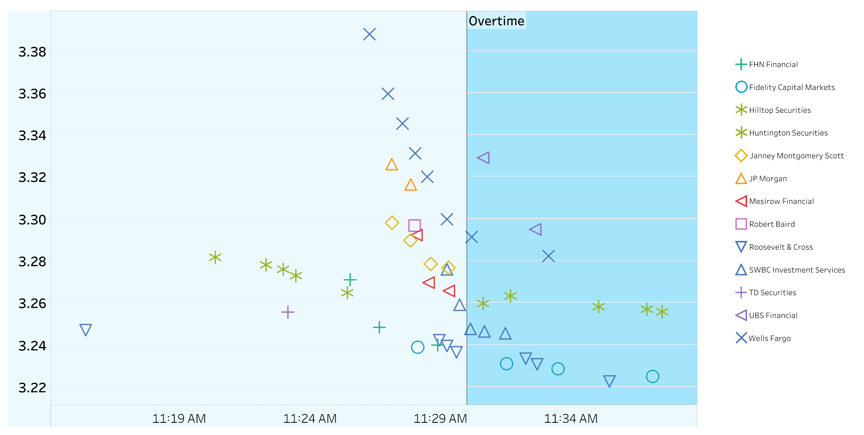
Town of Farmington, CT
$31,000,000 General Obligation Bonds, Issue of 2024
50 bids by 13 bidders
6 Two Minute Rule Extensions

Slide 18
Open Auction Advantages

Slide 19
Why Open Auctions?
Open auctions increase:
Transparency
Competition
Efficiency

Slide 20
Auction Theory: October 2020 Nobel Prize in Economic Science
Paul R. Milgrom and
Robert B. Wilson
Professors of Economics at Stanford University

Slide 21
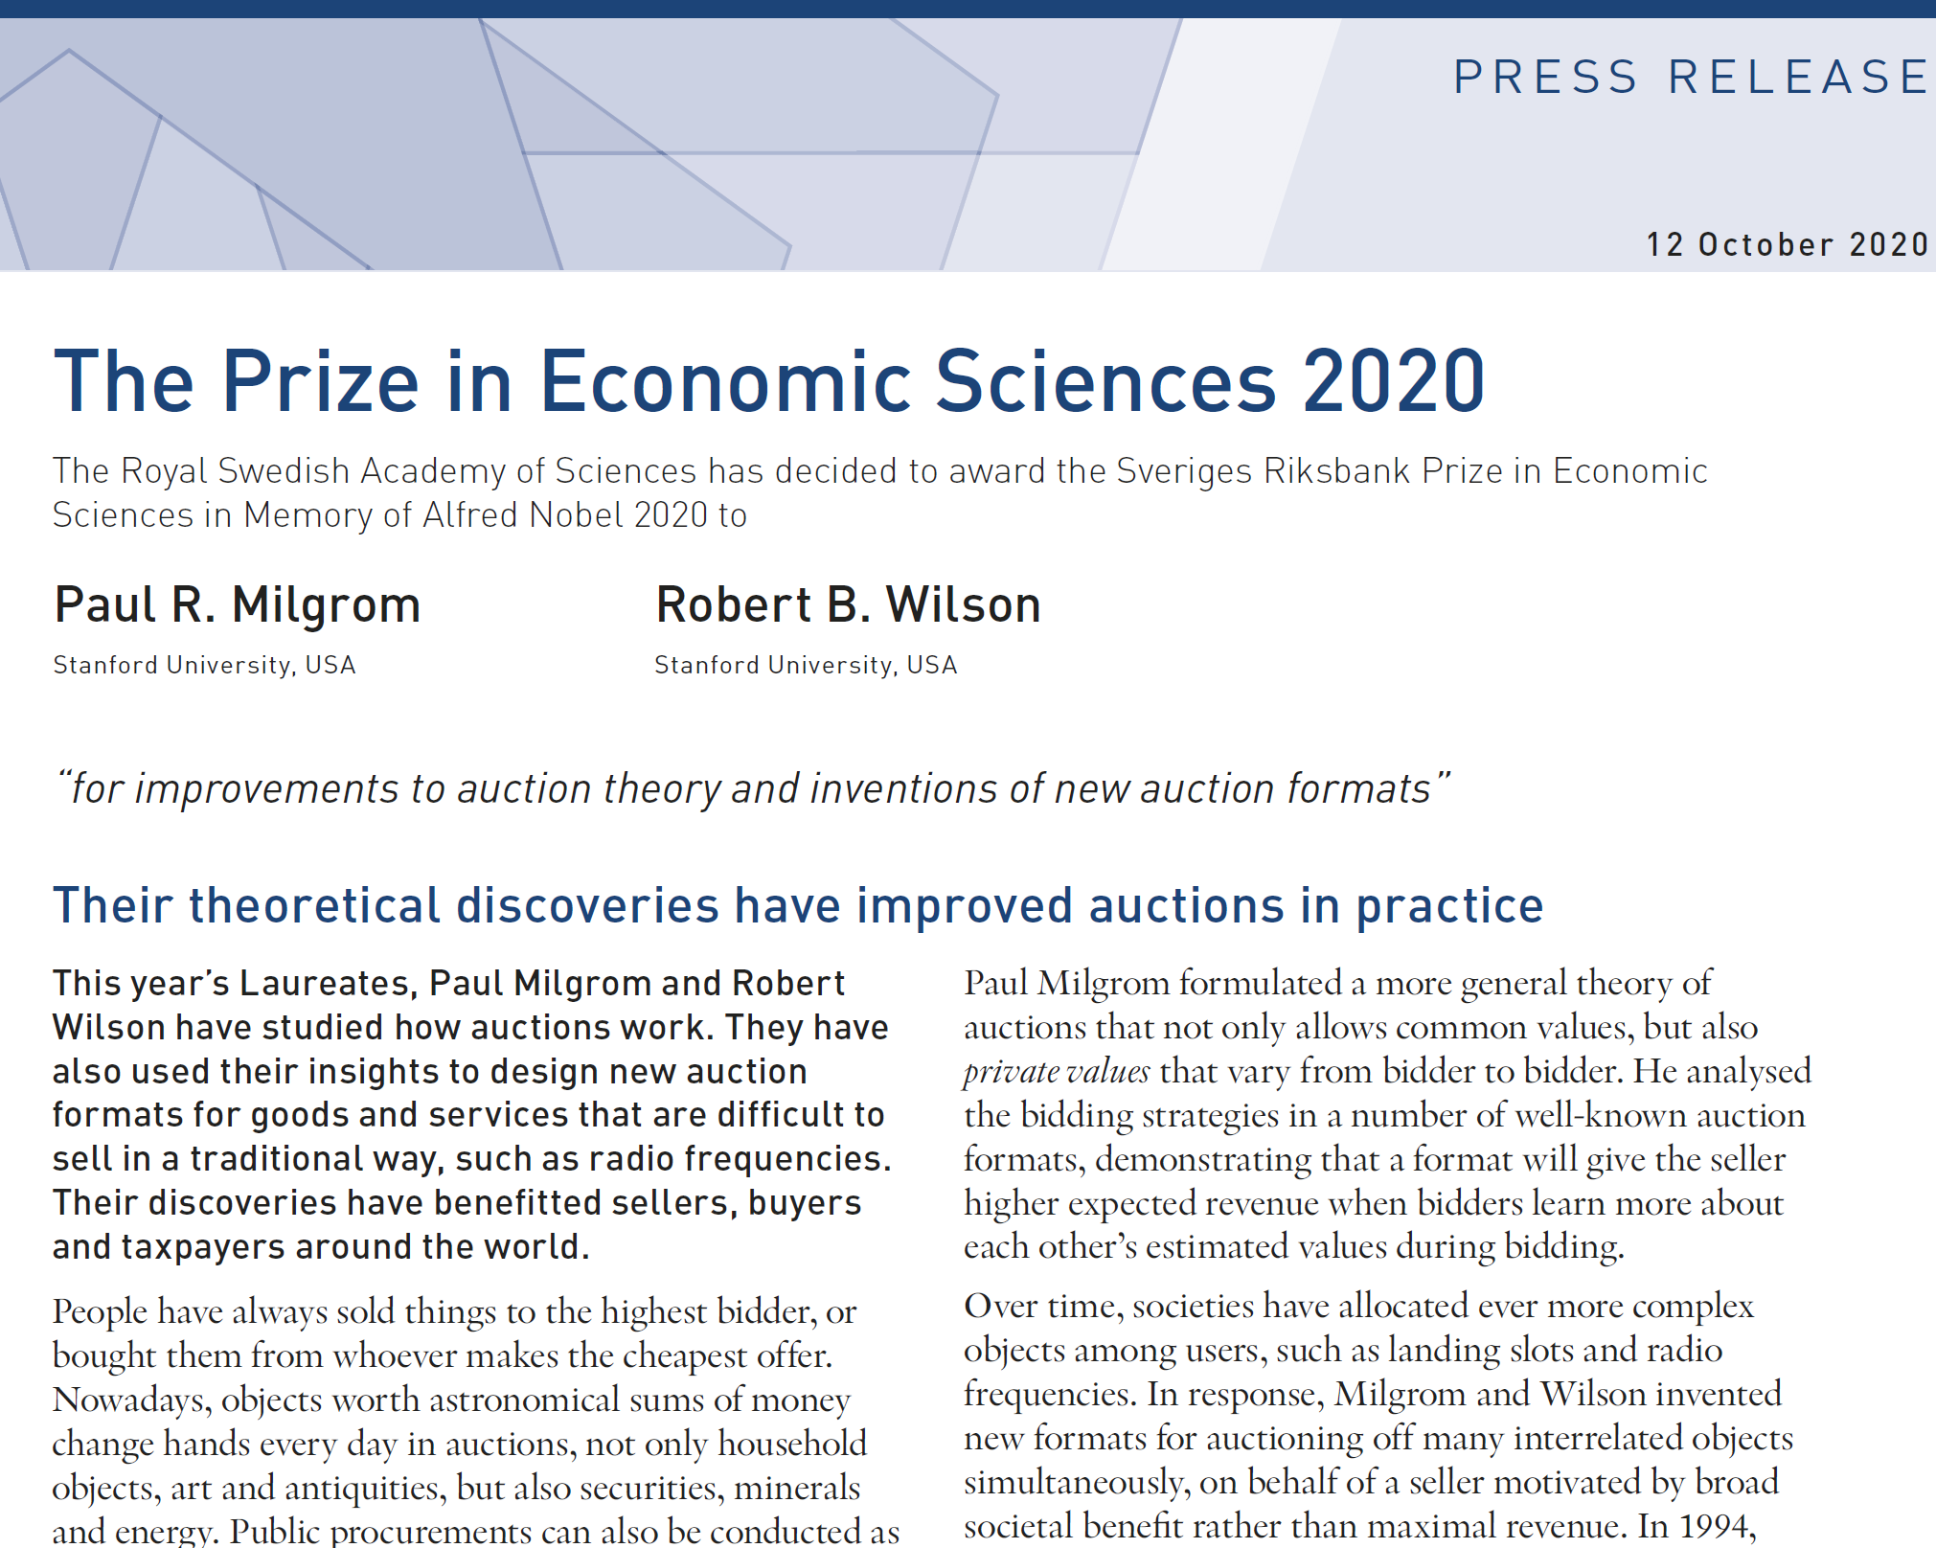
Auction Theory: October 2020 Nobel Prize
“ a format will give the seller higher expected revenue when bidders learn more about each other’s estimated values during bidding.”

Slide 22
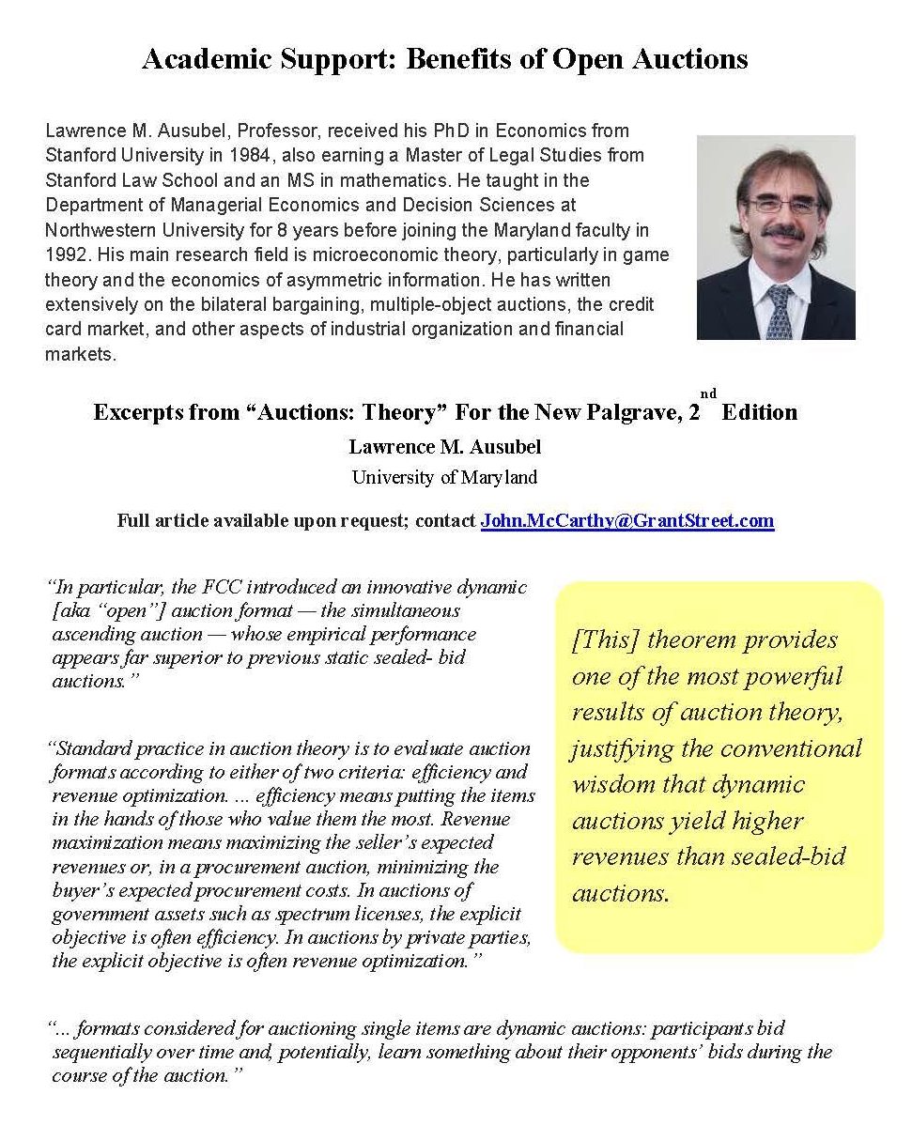
Auction Theory
Lawrence M. Ausubel
Professor of Economics
University of Maryland
Auctions: Theory
New Palgrave, 2nd Edition
Copies of the paper available upon request

Slide 23
Open Auction Savings
With a
0.01%
Basis point improvement
On a
$20M
20-year bond issue
Issuers can realize
$20K In savings

Slide 24
Open Auction Replays
Date | Issuer / Description | State | Ratings | Amount
8/14/2024 | Town of Farmington General Obligation Bonds, Issue of 2024 | CT | Moody's: Aaa S&P: AAA | $31,000,000
6/20/2024 | Town of Fairfield General Obligation Bonds, Issue of 2024 | CT | Moody's: Aaa S&P: AAA | $33,890,000
7/26/2022 | City of Stamford General Obligation Bonds, Issue of 2022 | CT | Fitch: AAA; S&P: AA | $40,000,000
6/29/2017 | Town of Fairfield General Obligation Bond Anticipation Notes | CT | Moody’s: Mig1; S&P: SP1+; Fitch: F1+ | $12,645,000

Slide 25
?
Questions

Slide 26
John McCarthy John.McCarthy@GrantStreet.com

