Slide 1
Managing Contribution Volatility in a Well-Funded DB Plan
Jennifer M. Castelhano, FSA Principal and Consulting Actuary Milliman, Inc.
SEPTEMBER 16, 2024

Slide 2
Sources of volatility
Assumption changes
→ Reduction of interest rate
→ New mortality tables
→ Results of formal experience studies
Liability experience
→ Economic: pay increases, cost of living adjustments
→ Demographic: turnover and retirement patterns, longevity, disabilities
Investment experience: volatility can be 8-10x larger than liability experience

Slide 3
Basic contribution math | ^{Poorly} Well Over Funded Funded Funded Plan Plan Plan
1. Accrued Liability | $360,000,000 | $360,000,000 | $360,000,000
2. Actuarial Value of Assets | 190,000,000 | 350,000,000 | 400,000,000
3. Unfunded Accrued Liability: (1) - (2) | 170,000,000 | 10,000,000 | (40,000,000)
4. Funded Ratio: (2) / (1) | 53% | 97% | 111%
5. Amortization Period | 20 | 20 | 20
6. Amortization Growth Rate | 2.00% | 2.00% | 2.00%
7. Past Service Cost: (3) amortized over (5) | 12,600,000 | 700,000 | (3,000,000)
8. Total Normal Cost | 9,300,000 | 9,300,000 | 9,300,000
9. Expected Employee Contributions | 4,500,000 | 4,500,000 | 4,500,000
10. Expected Administrative Expenses | 100,000 | 100,000 | 100,000
11. Net Normal Cost: (8) - (9) + (10) | 4,900,000 | 4,900,000 | 4,900,000
12. Interest on (7) + (11) to start of FY | 1,200,000 | 400,000 | 100,000
13. Actuarially Determined Contribution: (7) + (11) + (12) | 18,700,000 | 6,000,000 | 2,000,000

Slide 4
Suppose assets go down by 10% but everything else stays the same | ^{Poorly} Well Over Funded Funded Funded Plan Plan Plan
1. Accrued Liability | $360,000,000 | $360,000,000 | $360,000,000
2. Actuarial Value of Assets | 171,000,000 | 315,000,000 | 360,000,000
3. Unfunded Accrued Liability: (1) - (2) | 189,000,000 | 45,000,000 | 0
4. Funded Ratio: (2) / (1) | 48% | 88% | 100%
5. Amortization Period | 20 | 20 | 20
6. Amortization Growth Rate | 2.00% | 2.00% | 2.00%
7. Past Service Cost: (3) amortized over (5) | 14,000,000 | 3,3000,000 | 0
8. Total Normal Cost | 9,300,000 | 9,300,000 | 9,300,000
9. Expected Employee Contributions | 4,500,000 | 4,500,000 | 4,500,000
10. Expected Administrative Expenses | 100,000 | 100,000 | 100,000
11. Net Normal Cost: (8) - (9) + (10) | 4,900,000 | 4,900,000 | 4,900,000
12. Interest on (7) + (11) to start of FY | 1,300,000 | 500,000 | 300,000
13. Actuarially Determined Contribution: (7) + (11) + (12) | 20,200,000 | 8,700,000 | 5,200,000
Increase in contribution | 8% | 45% | 260%
 | $1,500,000 | $2,700,000 | $3,200,000 4

Slide 5
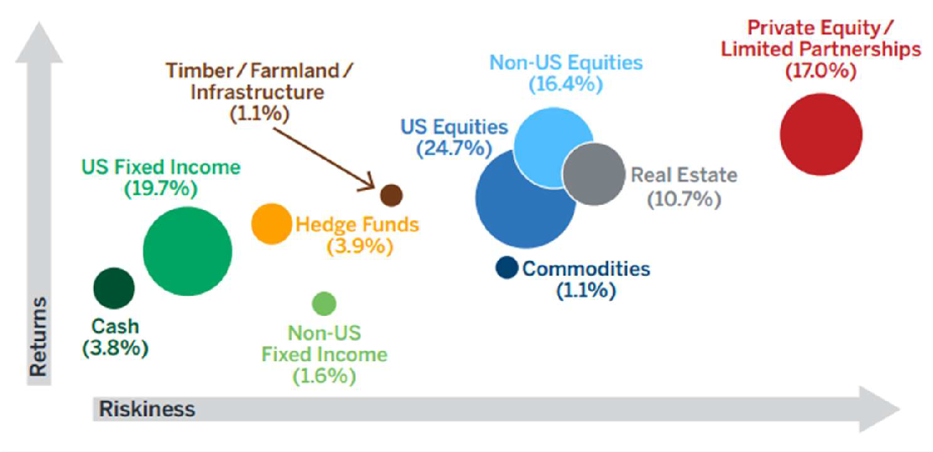
Plans already manage volatility: investment allocation
Aggregate asset allocation of 100 largest US public pension plans Milliman 2023 Public Pension Funding Study
Note: The expected return and riskiness metrics are based on Milliman’s capital market assumptions as of June 30, 2023.

Slide 6
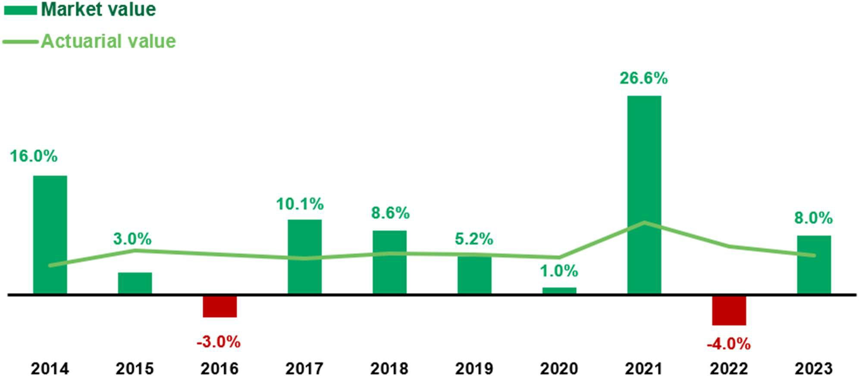
Plans already manage volatility: asset smoothing

Slide 7
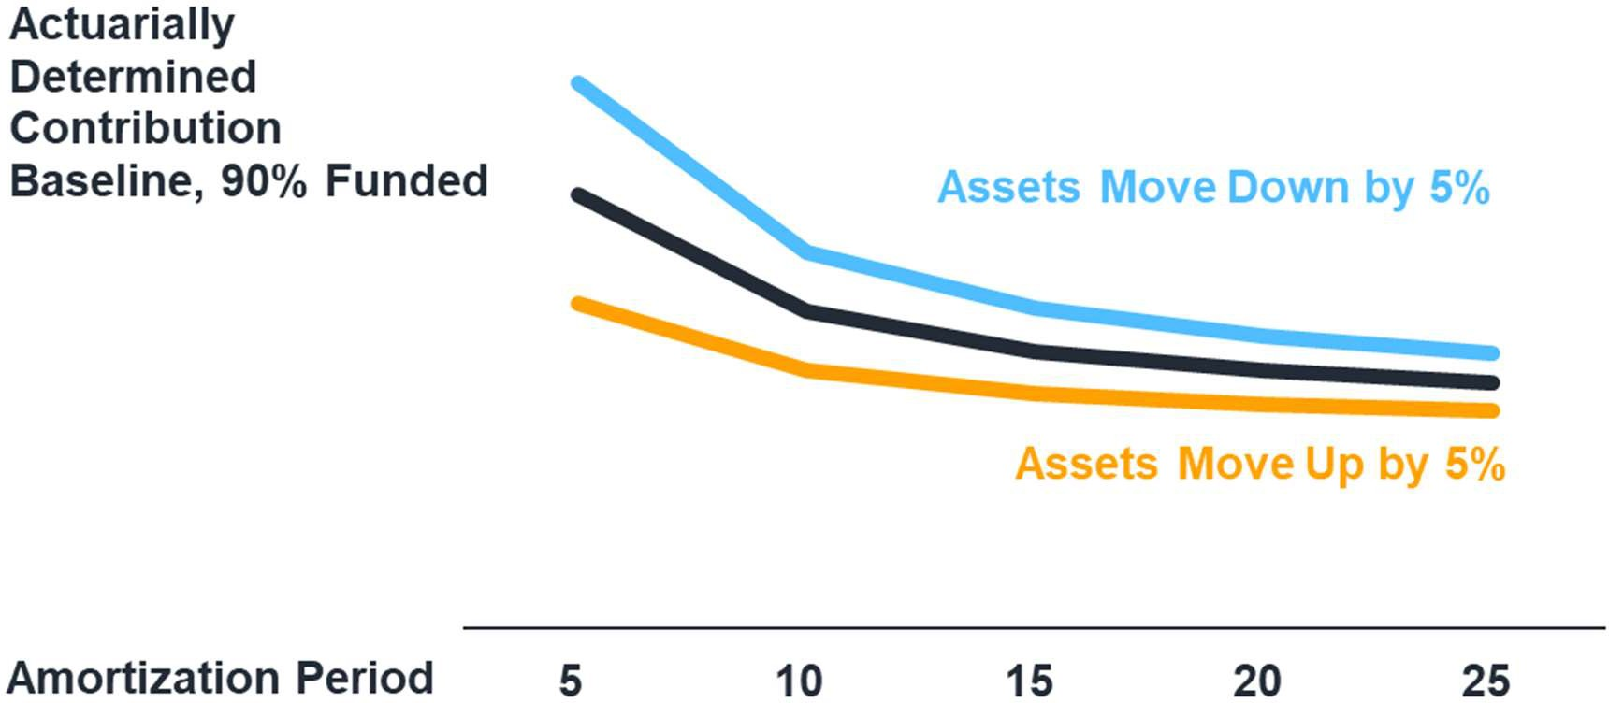
Plans already manage volatility: amortization period

Slide 8
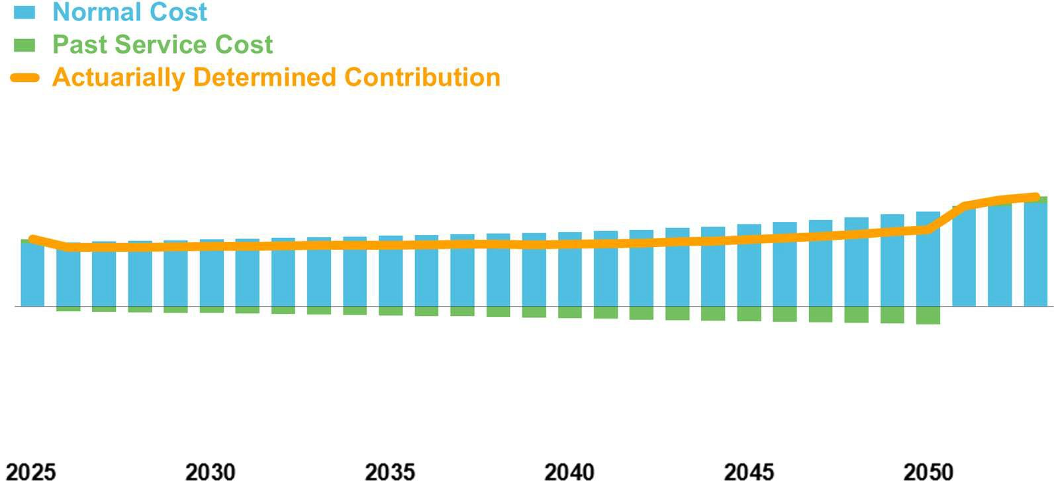
Illustration of mechanics of traditional funding policy
Plan is fully funded at July 1, 2023
Interest rate = 6.25%
Amortization growth rate = 2.25%
5-year asset smoothing
Amortize UAL with 20-year closed amortization period; once period reaches 10 years, will shift to 10-year layered bases

Slide 9
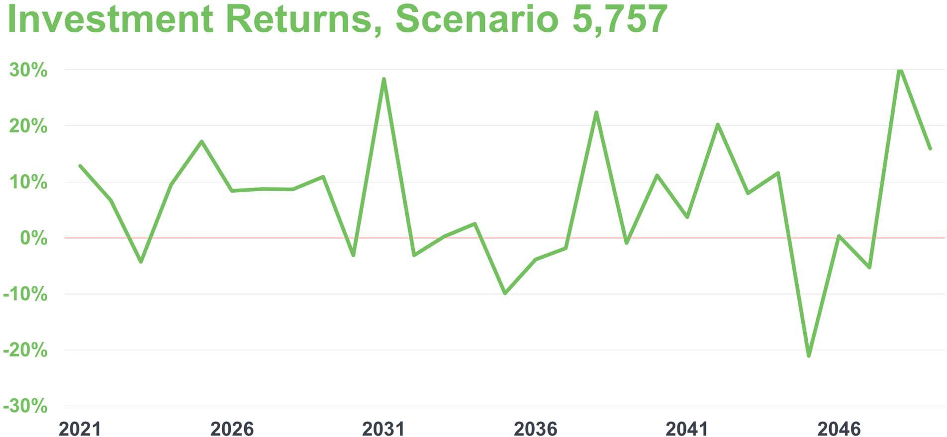
Introduce investment volatility to study its impact

Slide 10
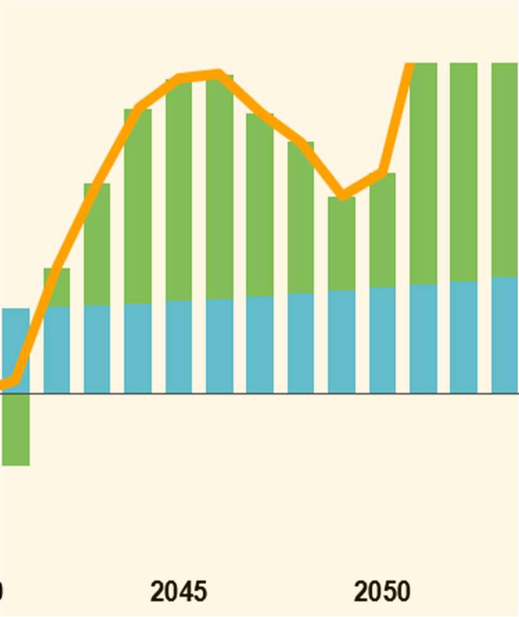
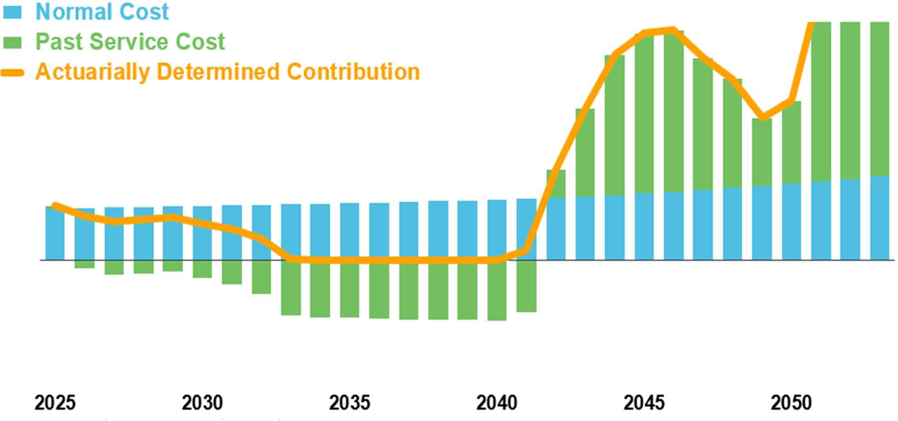
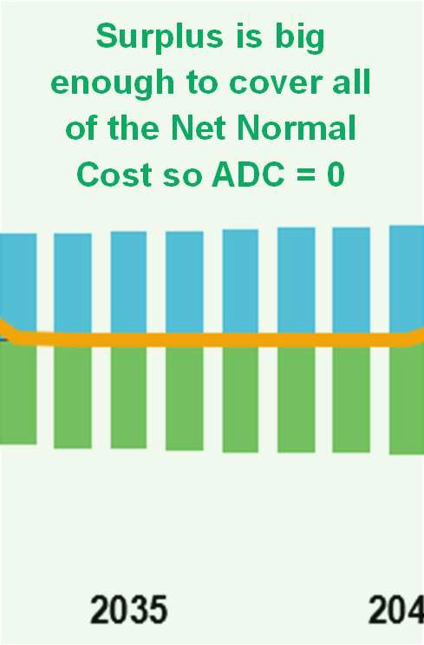
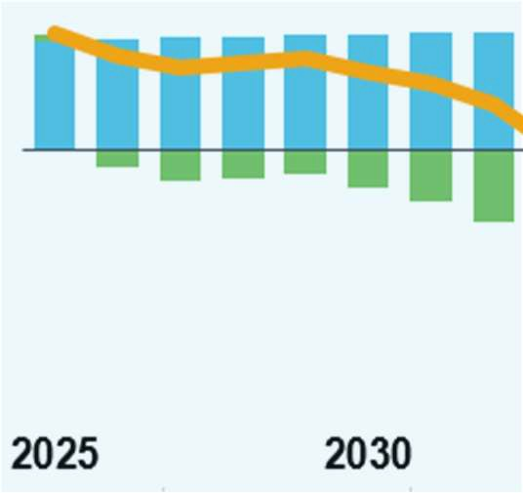
Impact on contributions with traditional ADC funding policy
$17m
Surplus is big enough to cover all of the Net Normal Cost so ADC = 0
100% funded at the start;
ADC = Net Normal Cost = $4.3 m
Slightly over 100% funded; surplus is used to cover part of the Net Normal Cost
Market losses drop plan to below 100% funded; ADC = Normal Cost + Past Service Cost

Slide 11
New approach #1: deliberately build up a funding cushion
Avoid the temptation to use surplus to subsidize the Net Normal Cost
Continue to pay the full Net Normal Cost even if the plan becomes modestly overfunded
Take contribution “holidays” only once the funded ratio reaches a target of 110%, or 125%, or even 150%
Messaging around this approach is important, to head off pressure to improve benefits when the plan is overfunded

Slide 12
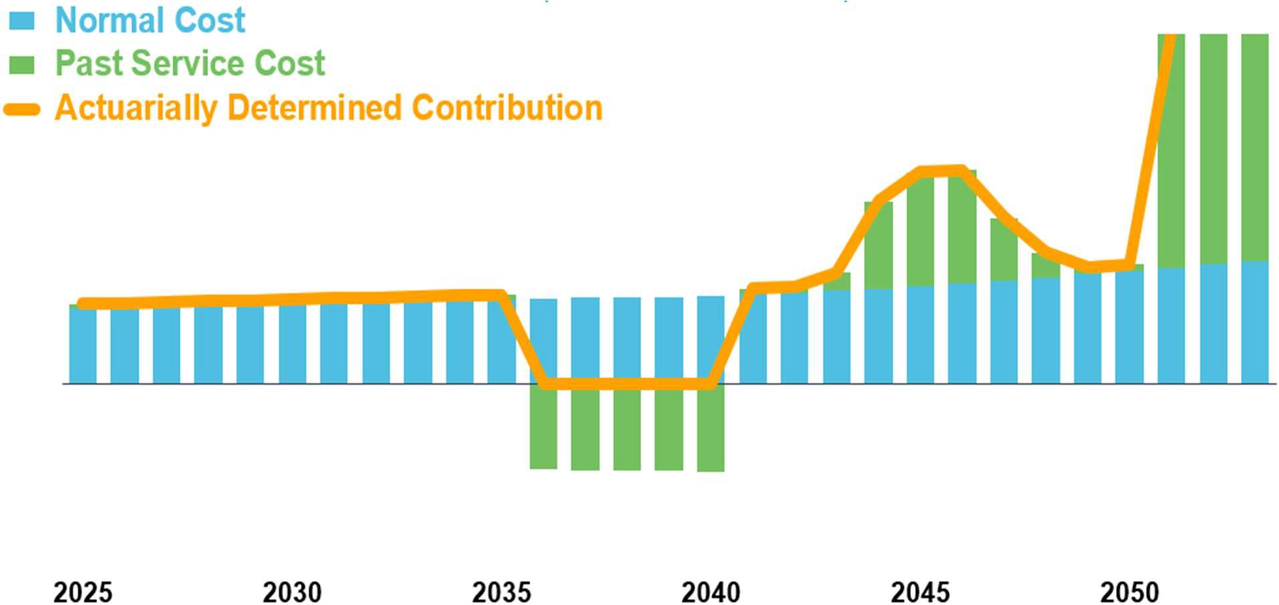
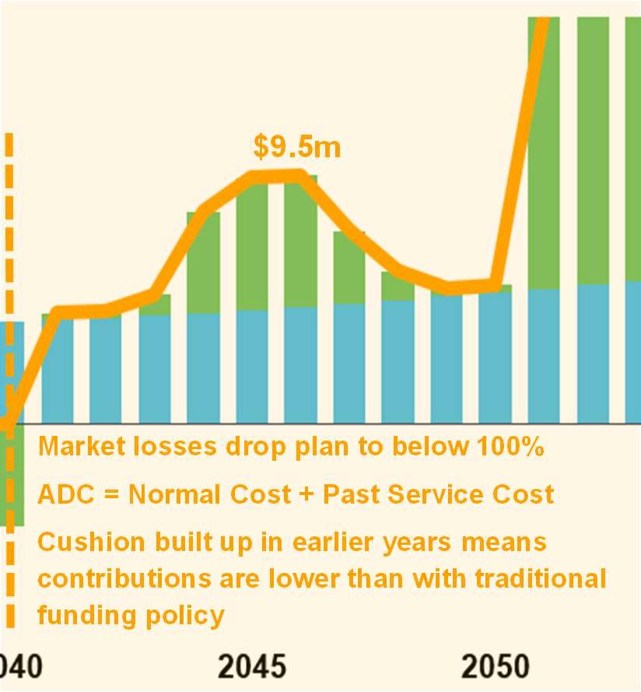
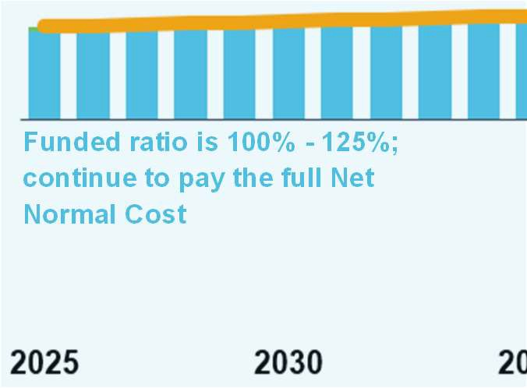
Same scenario but with new approach #1, 125% target
$9.5m
Market losses drop plan to below 100% ADC = Normal Cost + Past Service Cost
Cushion built up in earlier years means contributions are lower than with traditional funding policy
Funded ratio is 100% - 125%;
continue to pay the full Net Normal Cost
Over 125%; okay to take a “holiday”

Slide 13
New approach #2: set up a pension reserve fund
Establish with an up-front transfer (excess surplus, one-time revenues) or built up over a period of years
Reserve funds can be invested up to 50% in equities: better than a general fund, not as good as a pension trust
Reserve fund is tapped if the Actuarially Determined Contribution increases a lot
→ e.g., trigger threshold is set at a 4% increase in ADC
→ Operating budget pays first 4% of the increase
→ Reserve fund pays the remainder of the increase
Reserve fund can be replenished when market returns are strong
→ e.g., if ADC goes down, budget 100% of the ADC from the prior year
→ Contribute the ADC to pension trust and contribute the budgeted remainder to reserve fund
→ End the replenishment if the reserve fund is sufficiently large relative to the pension liability

Slide 14
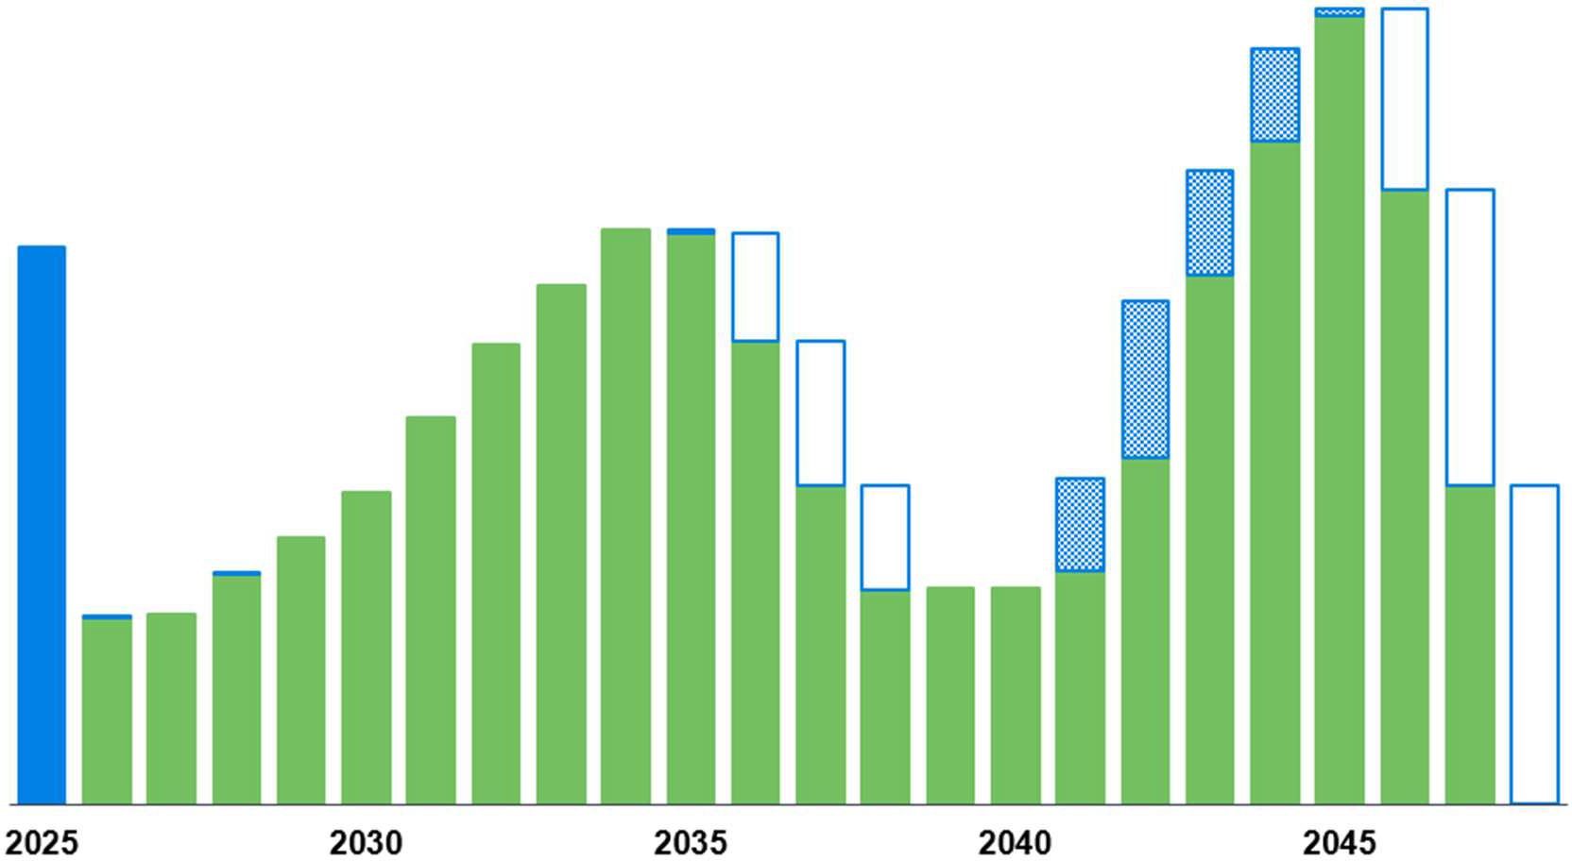
New approach #2: set up a pension funding reserve fund
Reserve fund is used to pay part of ADC when markets are down
Budget savings are diverted to reserve fund when markets are up
Contributions from operating budget to pension trust
Initial transfer to reserve fund

Slide 15
New/old approach #3: fixed contributions
It is normal in some regions to fund DB plans with a fixed contribution rate
No contribution volatility!
Complete departure from the concepts underlying an Actuarially Determined Contribution
Can back into the implied amortization period to verify if it is reasonable (or infinite!)
Typically no mechanism to adjust the contribution rate to reflect plan’s experience
Contribution rate may not be sufficient to bring the plan to fully funded within a reasonable period of time
→ May have been established years ago based on a higher interest rate assumption and out-of- date mortality tables
→ May be embedded in statute or collectively bargained and therefore difficult to adjust

Slide 16
New approach #4: fixed / sticky contributions
Contribution smoothing: move 20% of the way from last year’s ADC to this year’s ADC
Contribution smoothing with conditions: same as ordinary smoothing, but contribution goes down only if funded ratio is over 120%
Fixed with conditions:
→ Contribution is fixed initially as x% of pay based on 10-year amortization of UAL
→ Funded ratio 95%-120% → pay fixed contribution
→ Funded ratio below 95% → switch to ADC = Normal Cost plus 25-year amortization
→ Funded ratio over 120% → switch to ADC = Normal Cost
Use long-range stochastic analysis to monitor the sufficiency of the contribution

Slide 17
New approach #5: risk-based funding policy
Increase (“load”) the Accrued Liability based on a range of risk factors
Investment Considerations
Portfolio volatility Portfolio liquidity
Presence / absence of a well-defined investment policy
Pay basis: frozen / career / final base / final gross incl OT, sick days Subsidized forms of annuities; non-level benefits; lump sum options Subsidized early retirement
Disability: high rate / subsidized benefits / low bar to qualifying
Cost-of-living feature DROP feature
History of contributions relative to ADC
Plan Benefits / Features
Plan Sponsor
Actions
Best practices: annual valuations, experience studies, audits

Slide 18
New approach #5: risk-based funding policy
Step 1: evaluate riskiness of the plan Step 2: determine load
Category | Score
Portfolio volatility standard deviation 10-12 | 1
Portfolio liquidity illiquid assets < 10% of total | 0
Investment policy robust | 0
Benefit accruals 3-year final average pay | 1
Subsidized optional forms traditional annuities only | 0
Subsidized early retirement unreduced Rule of 85 | 1
Disabilities requires Social Security; low incidence | 0
Automatic cost-of-living feature fixed 1.5% | 1
DROP feature none | 0
History of contributions relative to ADC below 95% | 1
Best practices good | 0
SUM OF RISK FACTORS | 5
Sum of Increase in Risk Accrued Factors Liability
0 0%
1-2 5%
3-4 10%
5 15%
6 20%
7 25%
8 30%
9 35%
10+ 40%
Step 3: calculate risk-adjusted ADC
using 115% of Accrued Liability

Slide 19
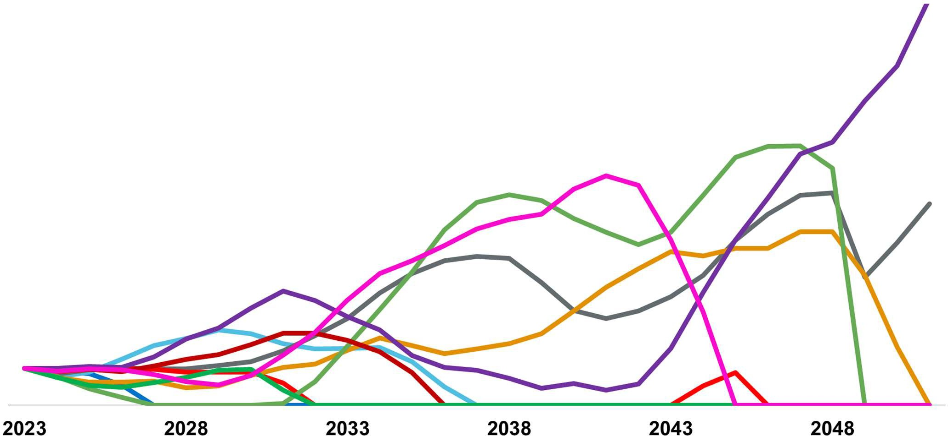
How can you tell which approach is best for your plan?
Run long-range forecasts under a wide variety of investment scenarios

Slide 20
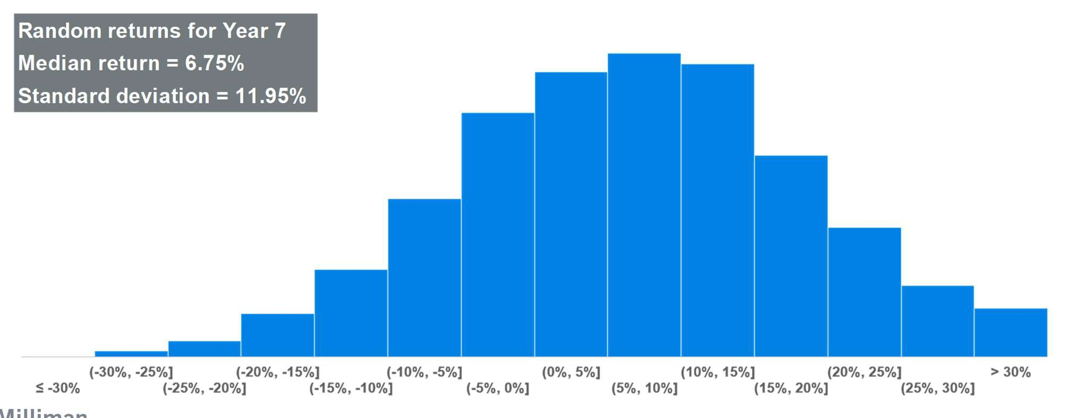
Stochastic (Monte Carlo) analysis
Enables analysis to be conducted across a very large number of scenarios
Randomly generate investment return scenarios for the next 20-30 years
For each year of each scenario determine assets, liabilities, cash flows, ADC, etc.

Slide 21
Calculate key metrics across all of the scenarios
Highest / lowest / average ADC across the projection period
Volatility of ADCs (e.g., standard deviation)
Net present value of ADCs
Funded ratio at the end of the projection period
How many times does the ADC increase by more than x%?
How many times does the ADC go down?
How often is the reserve fund depleted before the end of the projection period?
How many years is the ADC lower with Funding Policy B compared to the current funding policy?

Slide 22
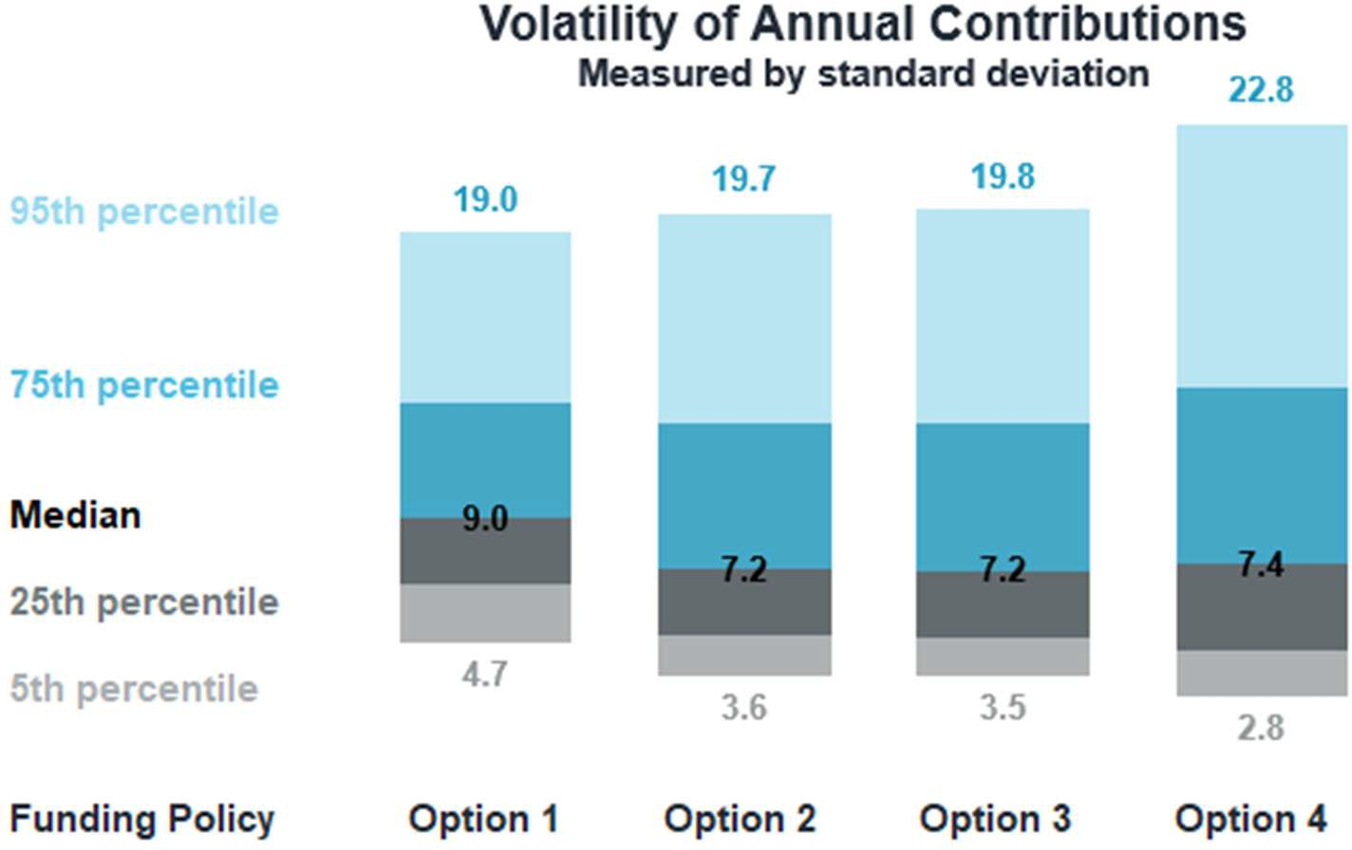
Repeat process for different funding methods
Range of results across 10,000 scenarios

Slide 23
Thank you
Jenn Castelhano
Jenn.Castelhano@milliman.com

