Slide 1
US Economic Update Steve Andrews Webster Bank’s Economic Ambassador
Notes:
Needs @ 12,000 total jobs to move into positive territory
All Govt jobs -3,500 (including casinos)

Slide 2
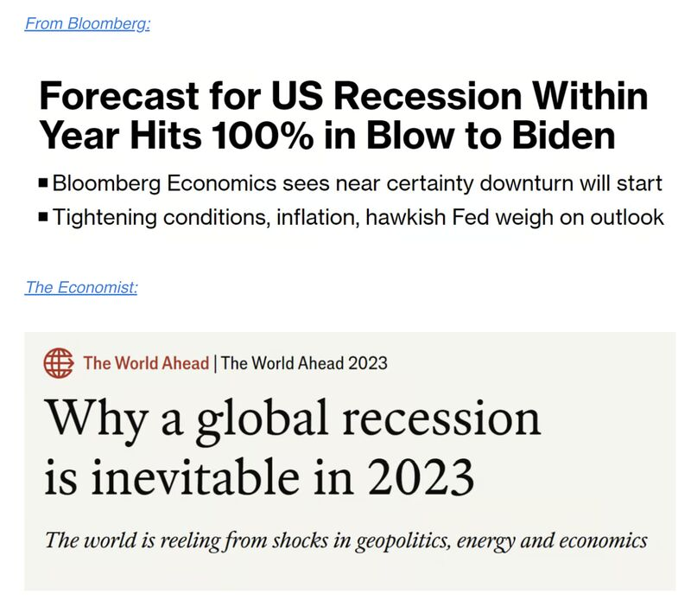
2023 Economic Outlook
Notes:
Needs @ 12,000 total jobs to move into positive territory
All Govt jobs -3,500 (including casinos)

Slide 3
2024 General Economic Outlook
Recession Likely
Will Fed Remain in “Time Out” Mode?
Will Employment and Wages Support Consumer Spending?
The Rise in Inflation will Lift Long-Term Rates
Global Growth Tepid Due to High Rates
Risks: Geopolitical
Politics
Inverted Yield Curve
Notes:
Needs @ 12,000 total jobs to move into positive territory
All Govt jobs -3,500 (including casinos)

Slide 4
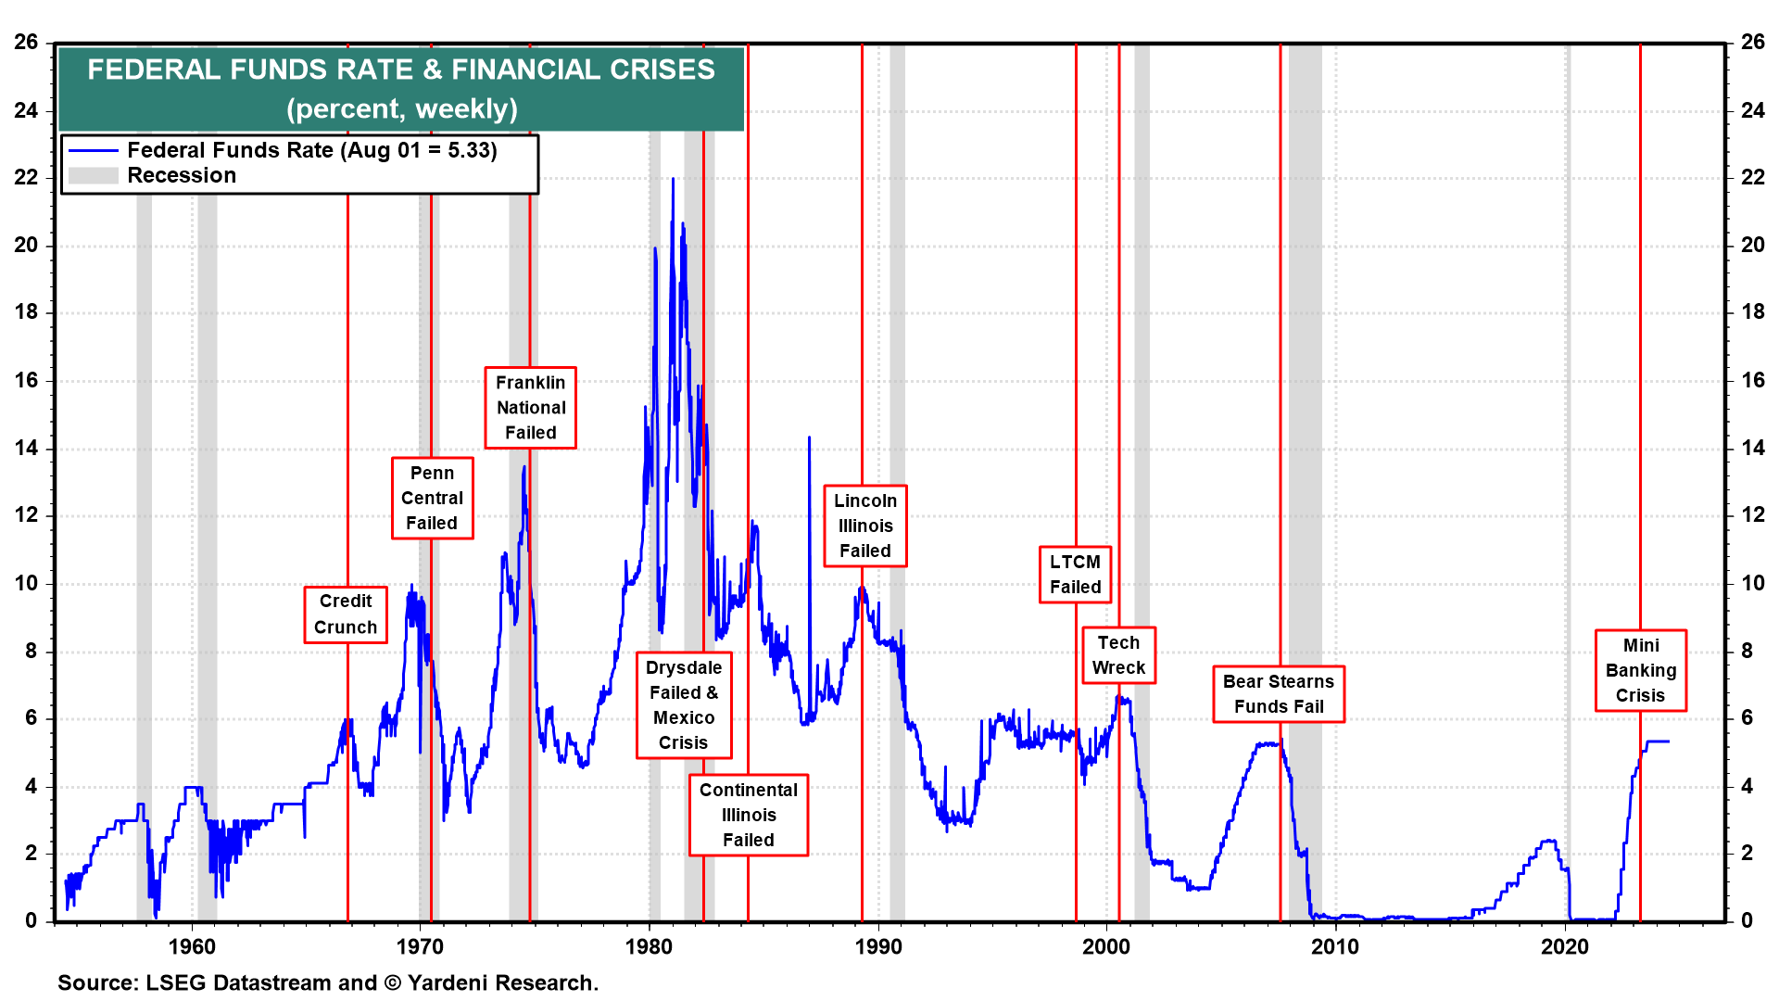
The Fed Funds Rate over Time
WWWWWWWWWWWWWWWWWW
WWWWWWWWWWWWWWWWWW
WWWWWWWWWWWWWWWWWW
Notes:
We like to look at consumer credit per household (chart). The average household has $38,600 of consumer credit with $10,200 in revolving credit and $28,400 in nonrevolving credit. These are all at or near record highs.
Delinquency rates remain low, though the rate for consumer credit cards is relatively high at 10.9% for balances that are due by 90 days or more (chart).

Slide 5
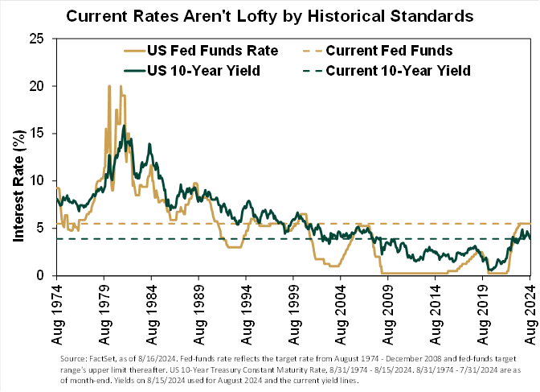
Notes:
Needs @ 12,000 total jobs to move into positive territory
All Govt jobs -3,500 (including casinos)

Slide 6
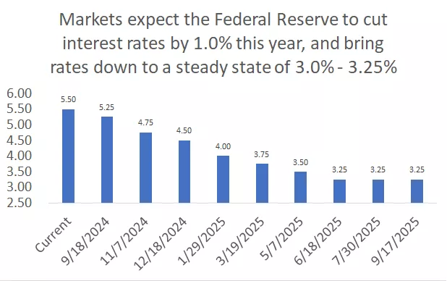
Source: CME FedWatch as of 9/6/2024.
Notes:
Needs @ 12,000 total jobs to move into positive territory
All Govt jobs -3,500 (including casinos)

Slide 7
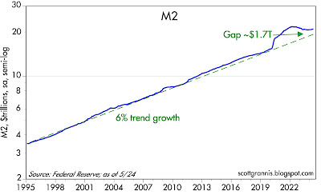
Inflation Trigger
Notes:
Chart #1 illustrates how the almost $5 trillion of "extra" M2 growth has gradually disappeared. The green line extends the growth rate of M2 from 1995 through 2019). Currently, M2 stands only about 9% above where it might have been without the Covid distortions.

Slide 8
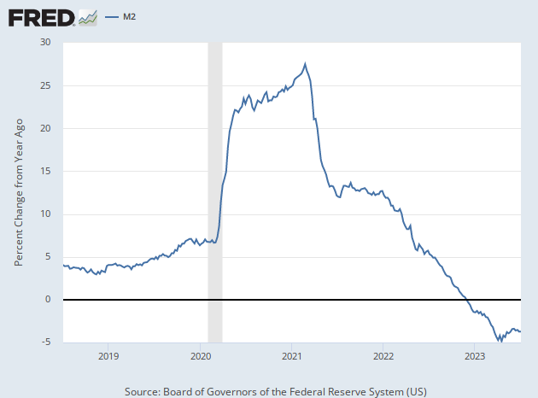
M2 (Money Supply in Checking/Savings/CDs/Short Term accounts)
Board of Governors of the Federal Reserve System

Slide 9
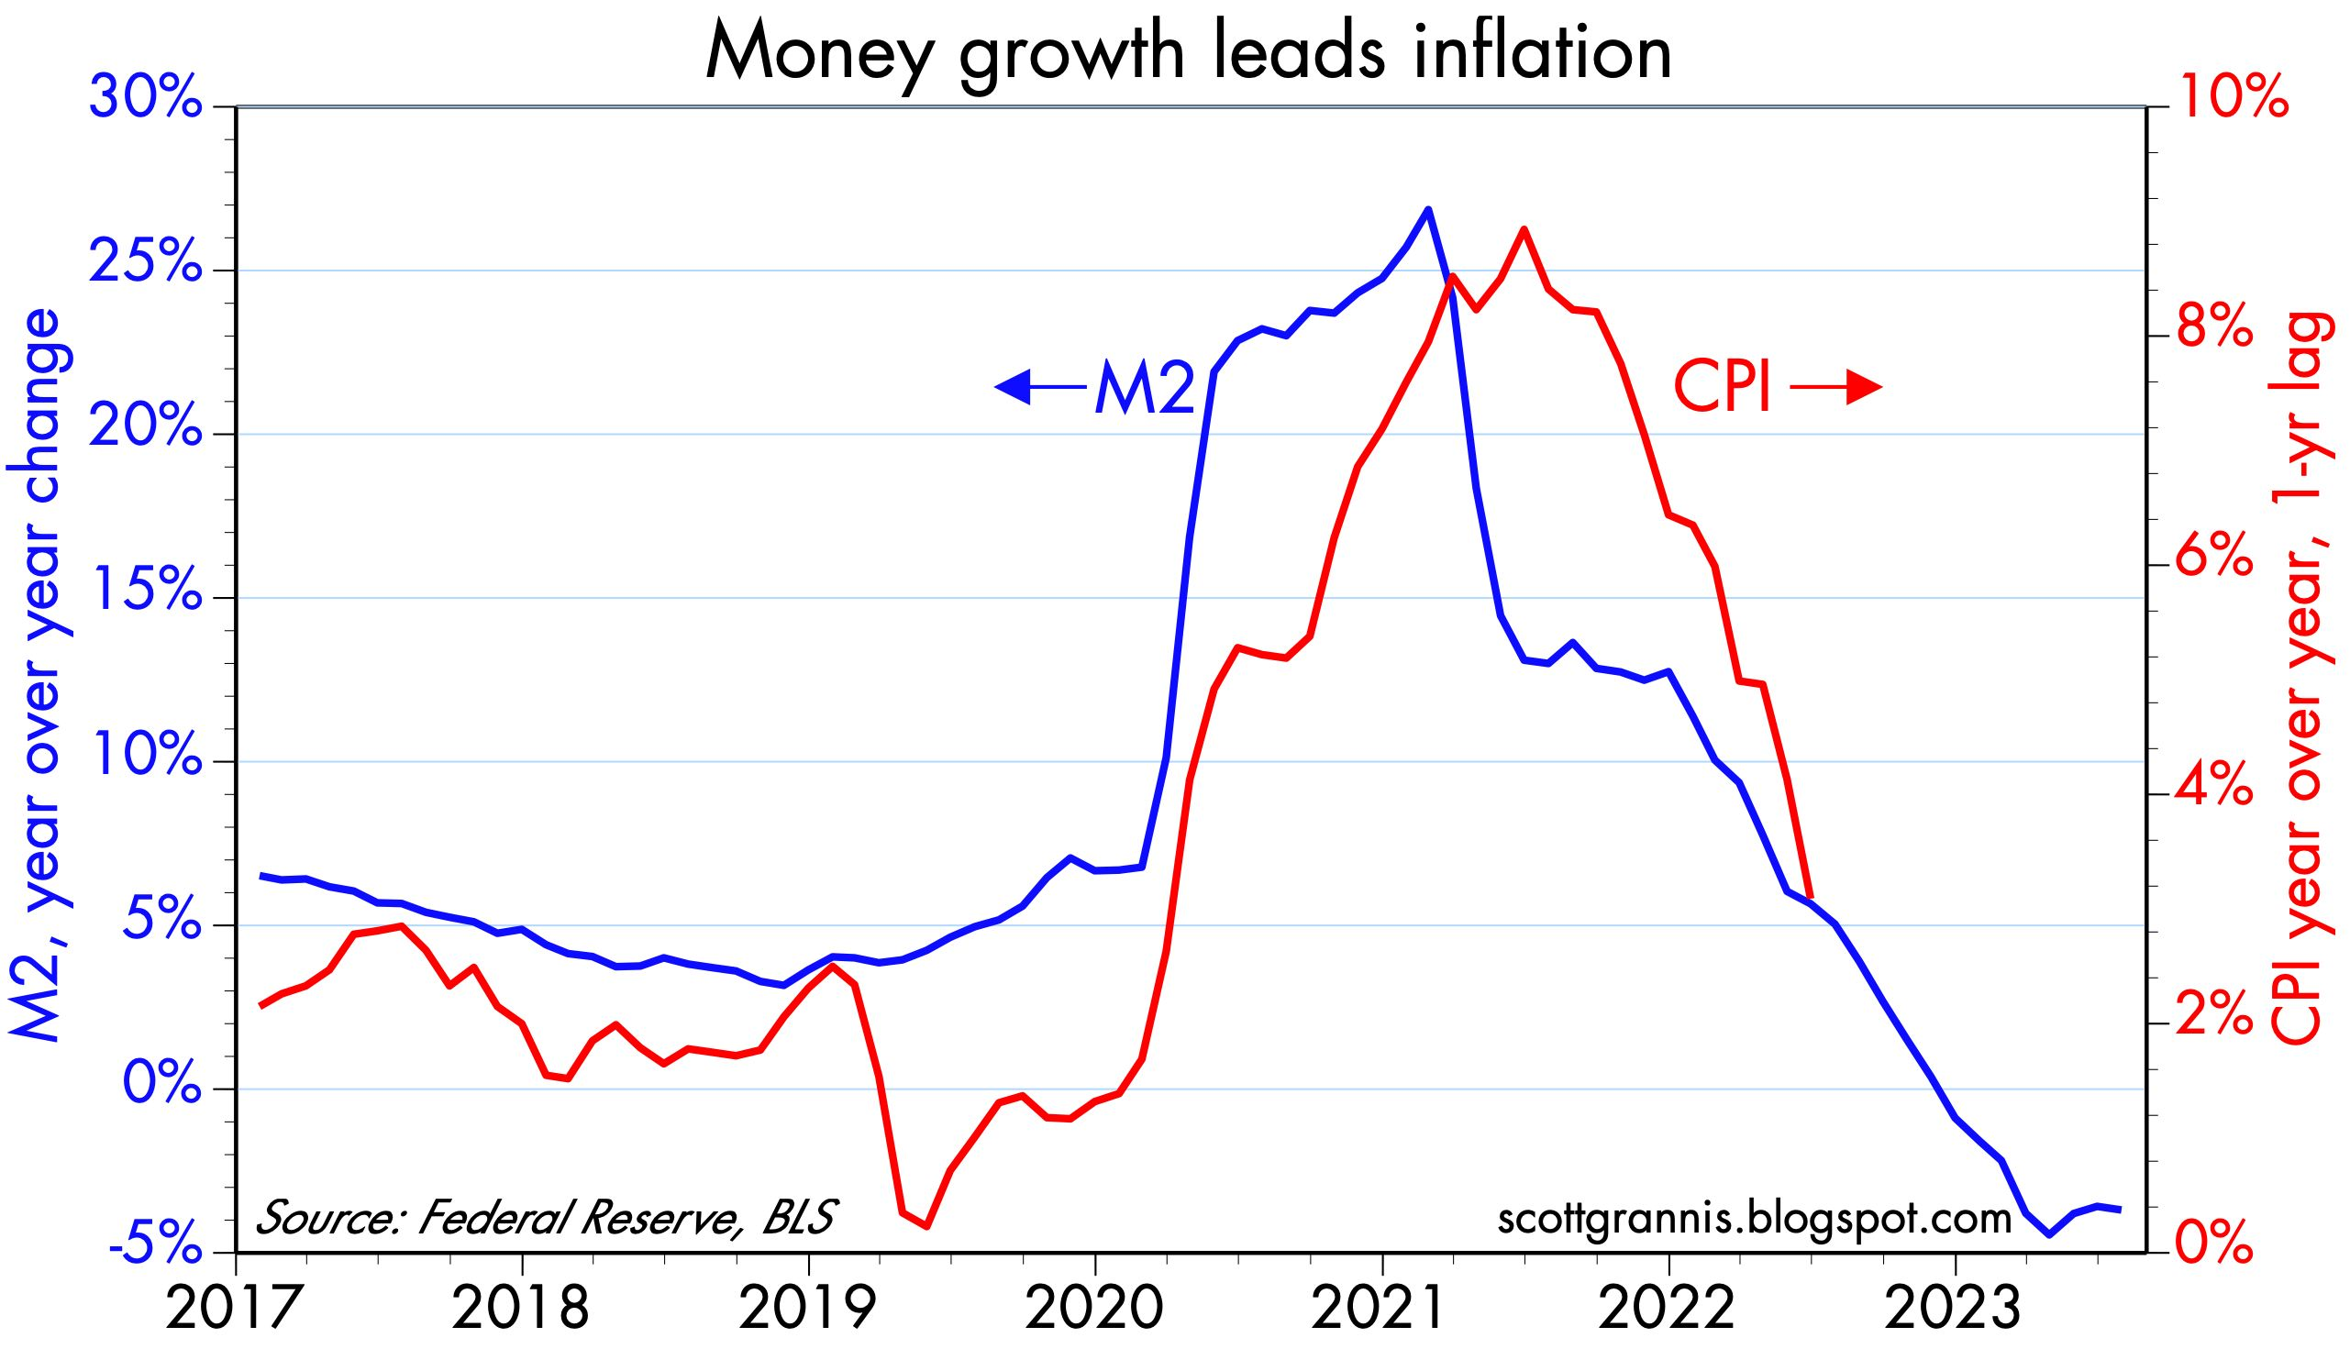
2024 General Economic Outlook
M2 Growth Leads Inflation
Notes:
Needs @ 12,000 total jobs to move into positive territory
All Govt jobs -3,500 (including casinos)

Slide 10
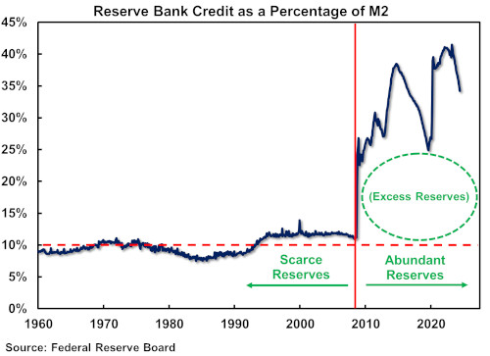
The Fed
WWWWWWWWWWWWWWWWWW
WWWWWWWWWWWWWWWWWW
WWWWWWWWWWWWWWWWWW
Notes:
We like to look at consumer credit per household (chart). The average household has $38,600 of consumer credit with $10,200 in revolving credit and $28,400 in nonrevolving credit. These are all at or near record highs.
Delinquency rates remain low, though the rate for consumer credit cards is relatively high at 10.9% for balances that are due by 90 days or more (chart).

Slide 11
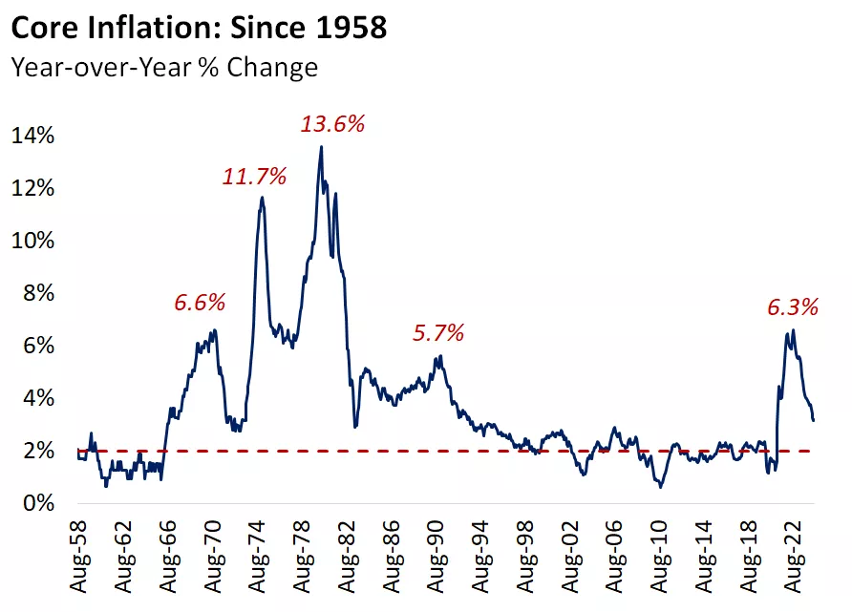
2024 General Economic Outlook
A picture of inflation peaks through history shows we've been here before.
Notes:
Needs @ 12,000 total jobs to move into positive territory
All Govt jobs -3,500 (including casinos)

Slide 12
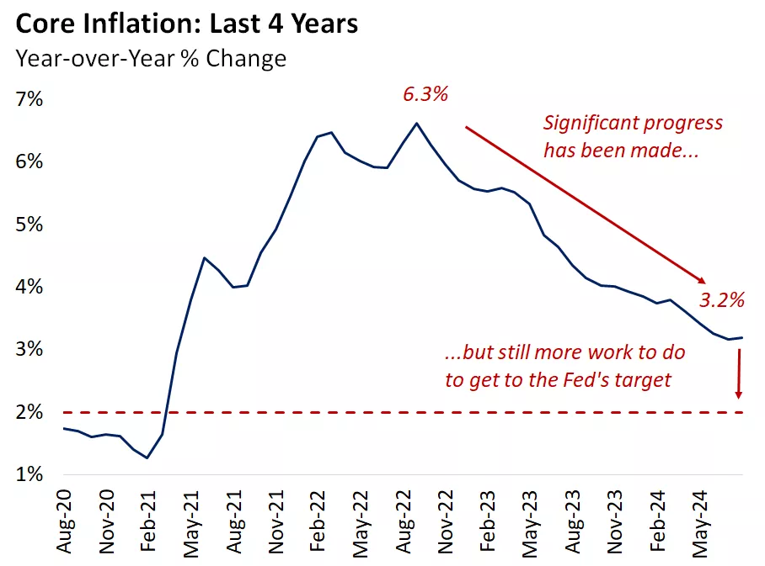
Notes:
Needs @ 12,000 total jobs to move into positive territory
All Govt jobs -3,500 (including casinos)

Slide 13
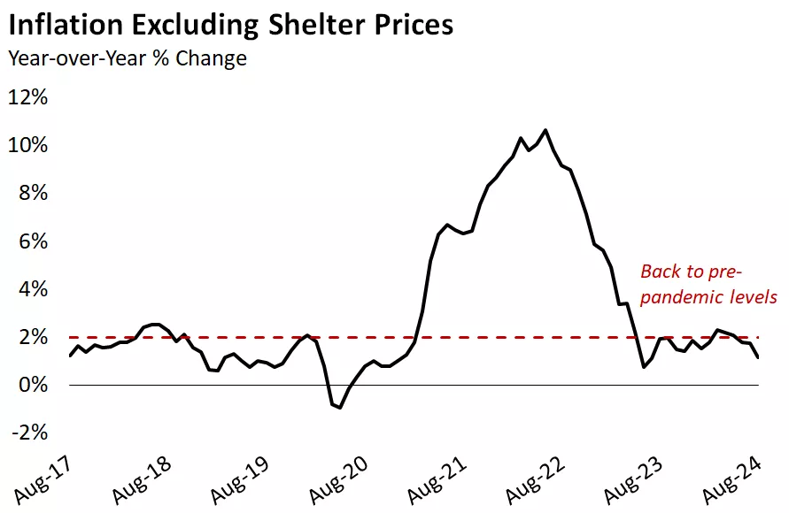
2024 General Economic Outlook
Notes:
Needs @ 12,000 total jobs to move into positive territory
All Govt jobs -3,500 (including casinos)

Slide 14
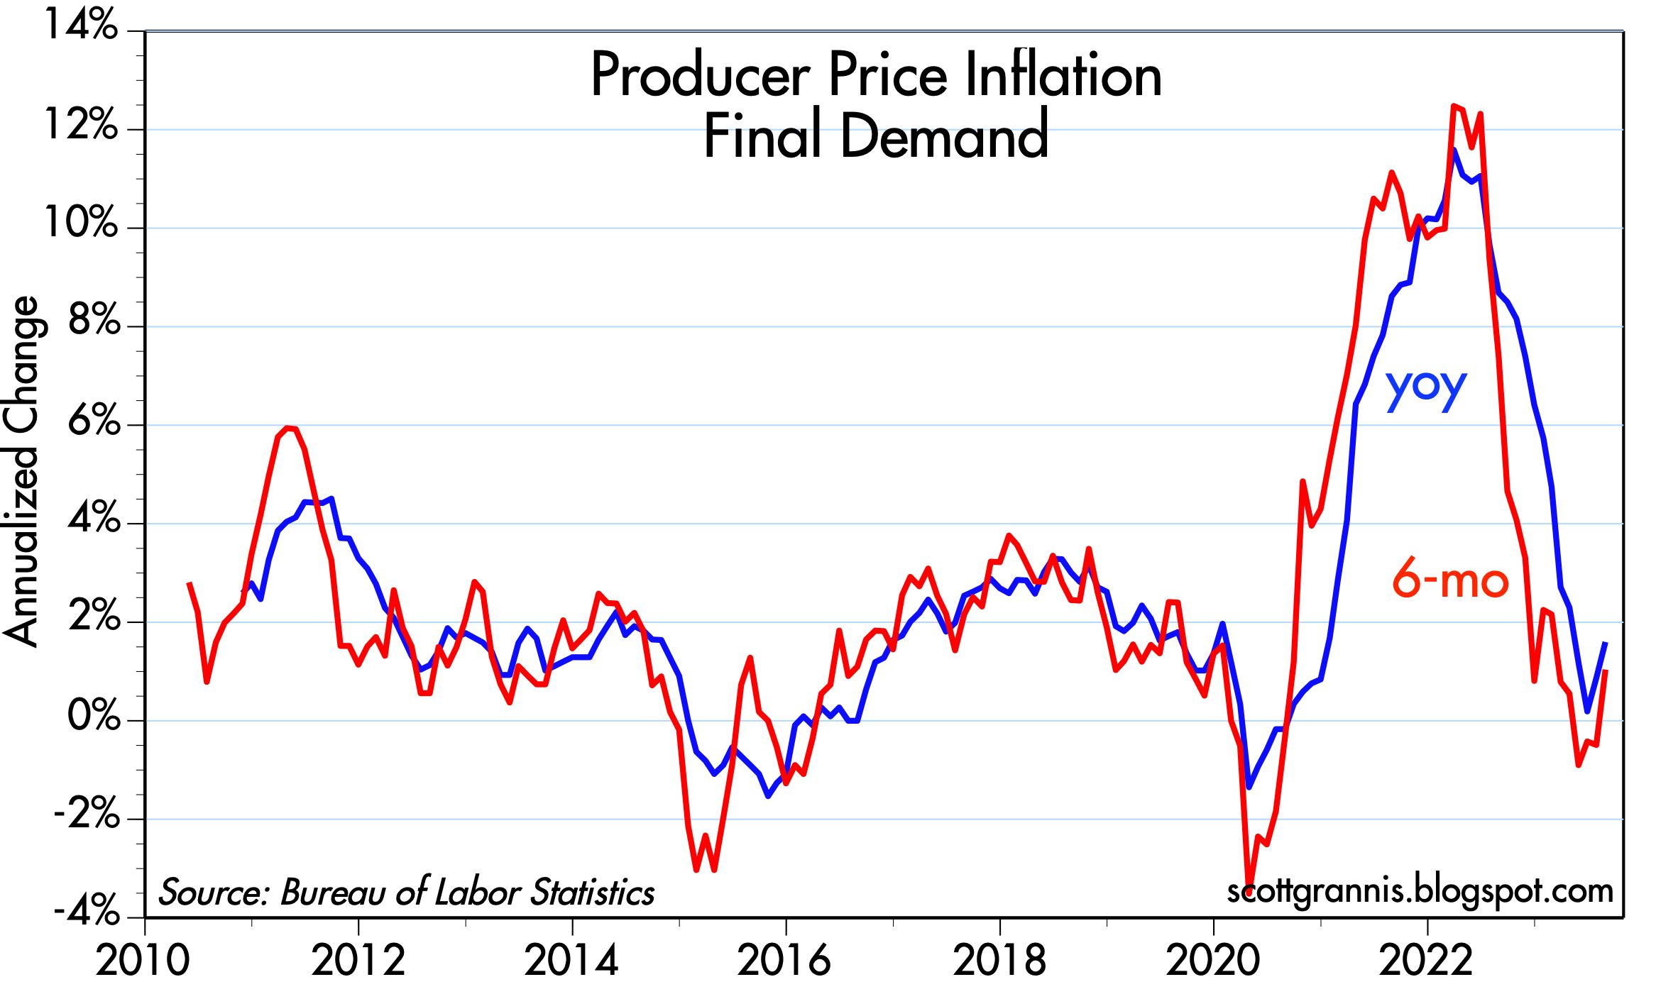
WWWWWWWWWWWWW
WWWWWWWWWWWWW

Slide 15
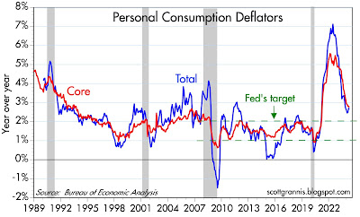
PCE Inflation

Slide 16
2024 General Economic Outlook
Notes:
Needs @ 12,000 total jobs to move into positive territory
All Govt jobs -3,500 (including casinos)

Slide 17
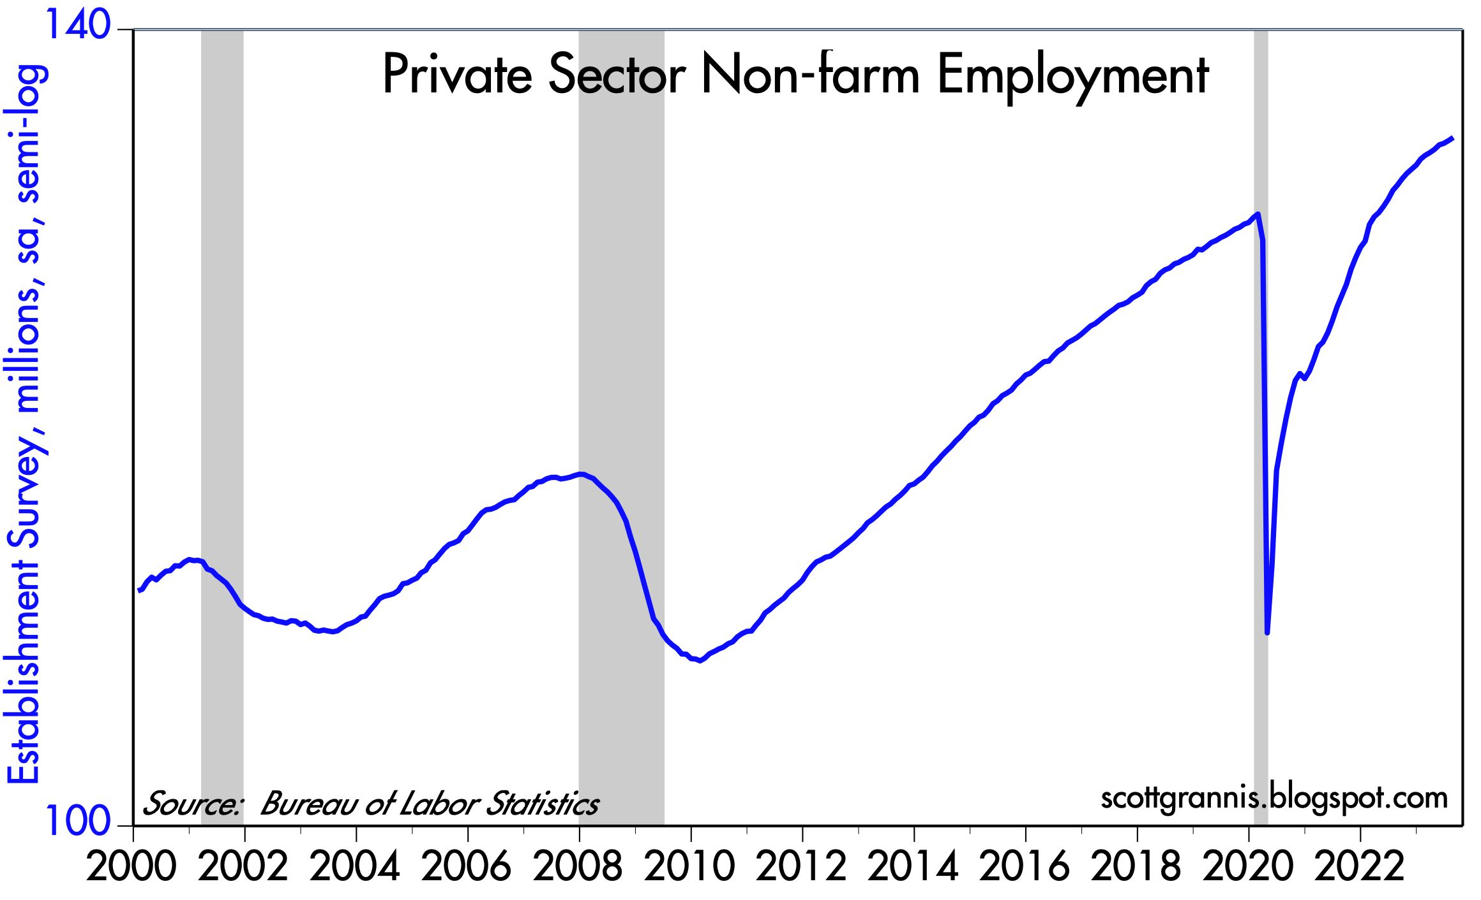
US Employment
WWWWWWWWWWWWWWWWWW

Slide 18
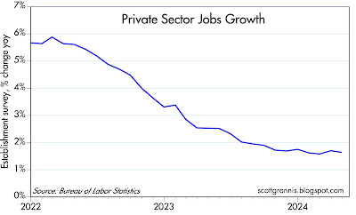
US Employment
WWWWWWWWWWWWWWWWWW

Slide 19
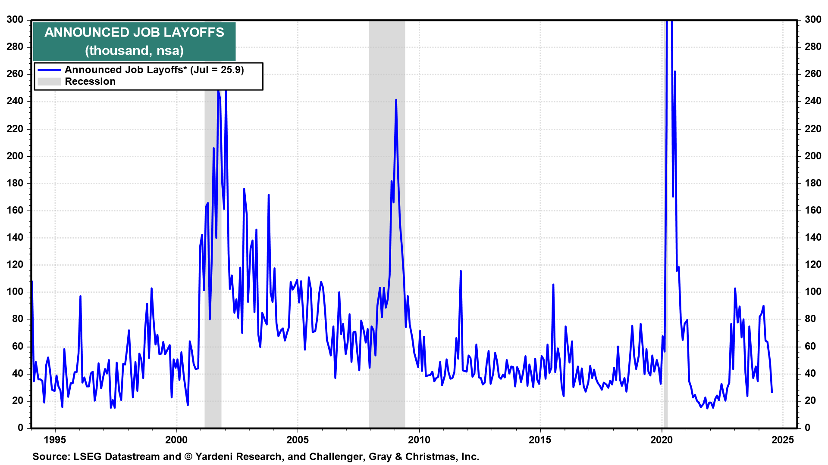
Employment
WWWWWWWWWWWWWWWWWW
WWWWWWWWWWWWWWWWWW
WWWWWWWWWWWWWWWWWW
Notes:
We like to look at consumer credit per household (chart). The average household has $38,600 of consumer credit with $10,200 in revolving credit and $28,400 in nonrevolving credit. These are all at or near record highs.
Delinquency rates remain low, though the rate for consumer credit cards is relatively high at 10.9% for balances that are due by 90 days or more (chart).

Slide 20
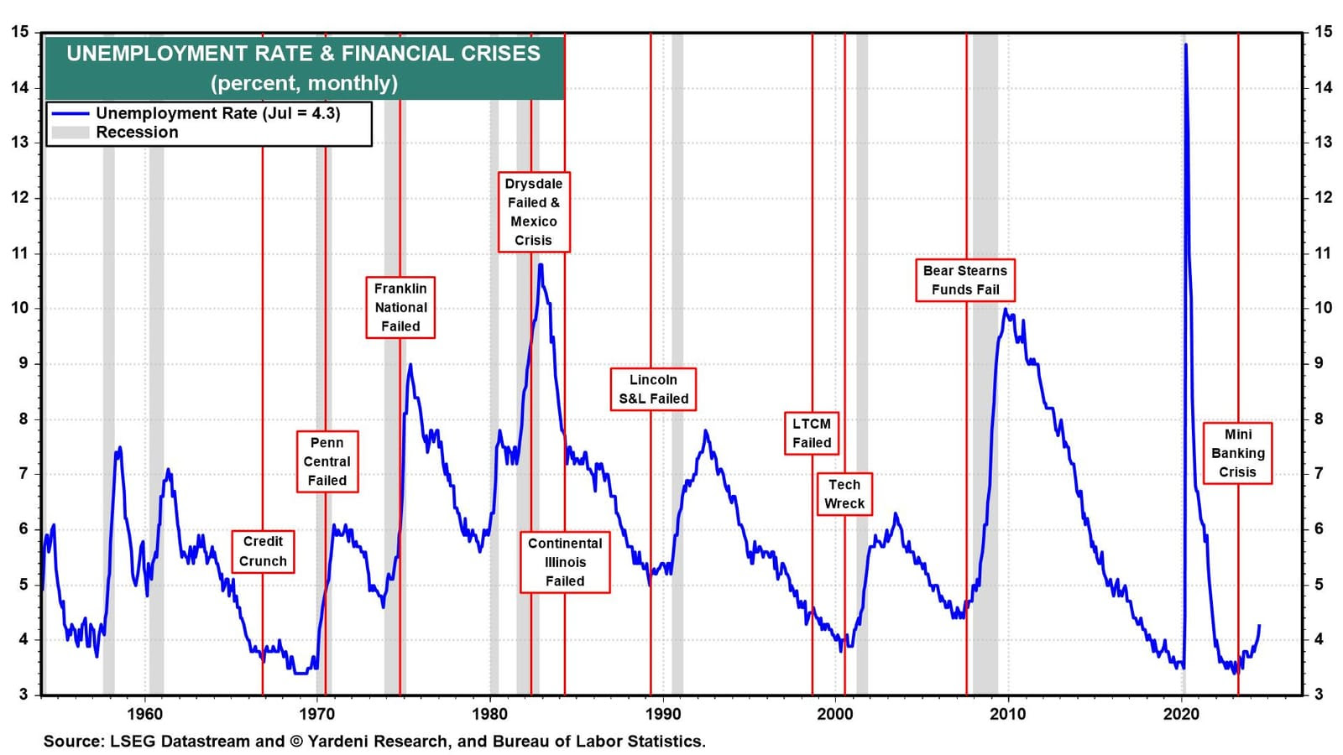
Unemployment
WWWWWWWWWWWWWWWWWW
WWWWWWWWWWWWWWWWWW
WWWWWWWWWWWWWWWWWW
Notes:
We like to look at consumer credit per household (chart). The average household has $38,600 of consumer credit with $10,200 in revolving credit and $28,400 in nonrevolving credit. These are all at or near record highs.
Delinquency rates remain low, though the rate for consumer credit cards is relatively high at 10.9% for balances that are due by 90 days or more (chart).

Slide 21
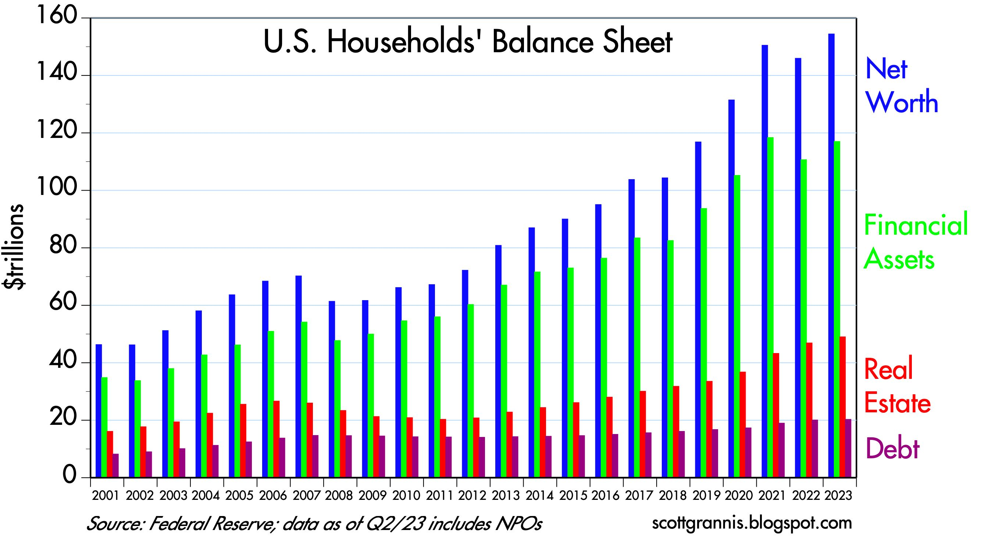
Record Household Net Worth
WWWWWWWWWWWWWWWWWW
WWWWWWWWWWWWWWWWWW
WWWWWWWWWWWWWWWWWW

Slide 22
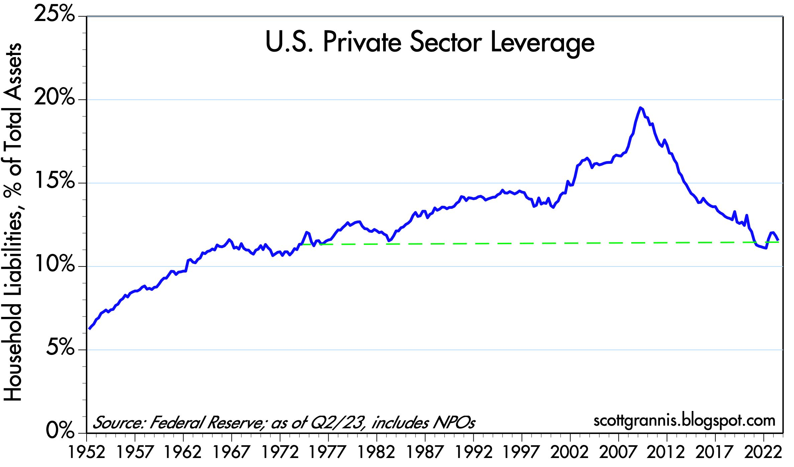
WWWWWWWWWWWWWWWWWW
WWWWWWWWWWWWWWWWWW

Slide 23
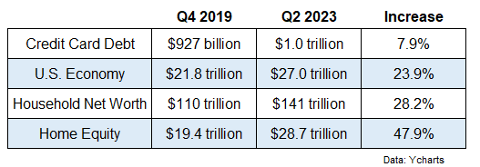
US Credit Card Debt
Ycharts

Slide 24
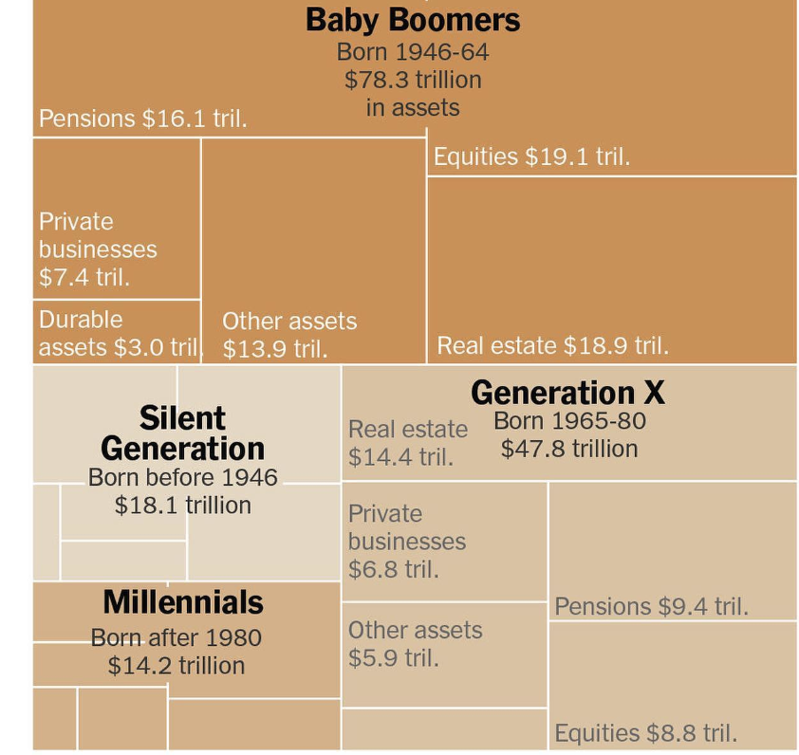
Baby Boomers Hold Half of the Nation’s $140 Trillion in Wealth
Federal Reserve

Slide 25
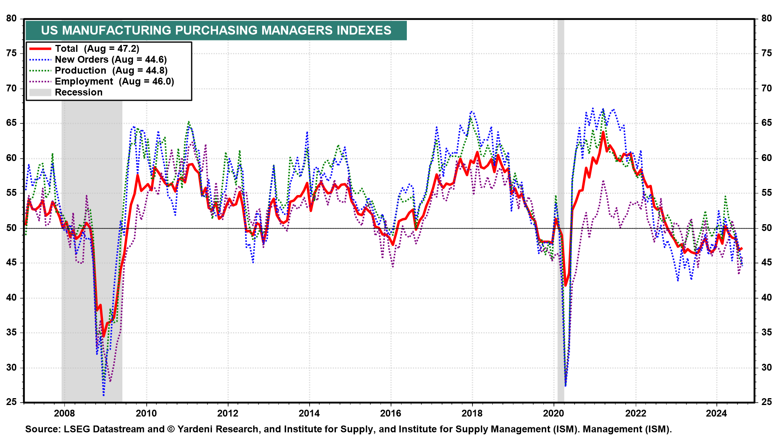
US Manufacturing
WWWWWWWWWWWWWWWWWW
WWWWWWWWWWWWW
WWWWWWWWWWWWWWWWWW
WWWWWWWWWWWWWWWWWW

Slide 26
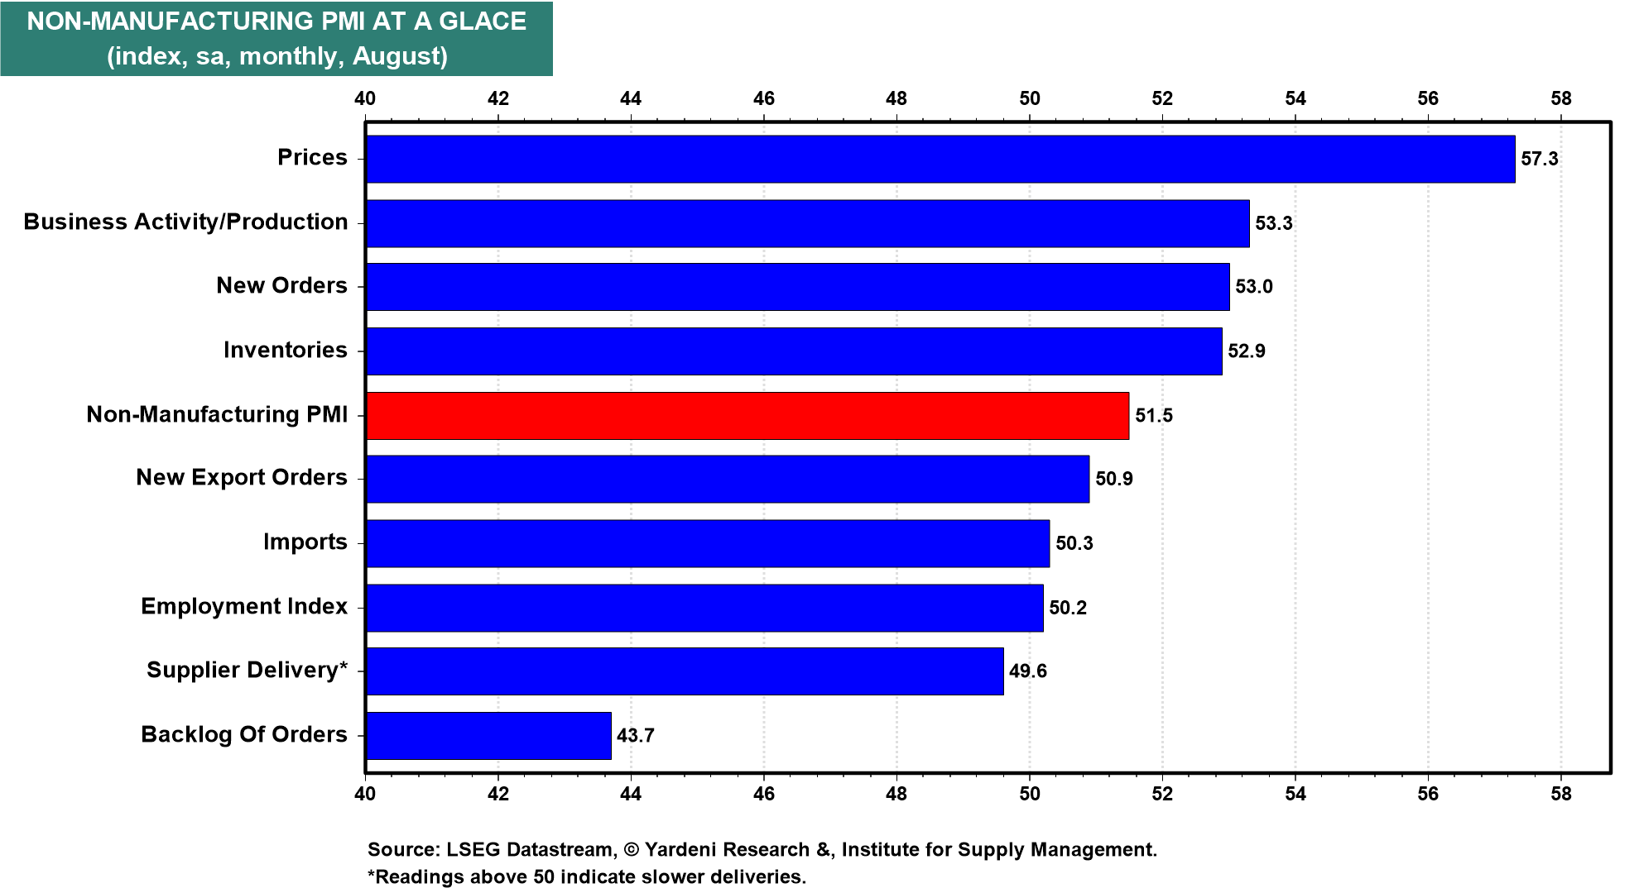
US Services Sector
WWWWWWWWWWWWWWWWWW
WWWWWWWWWWWWWWWWWW
WWWWWWWWWWWWWWWWWW
WWWWWWWWWWWWW

Slide 27
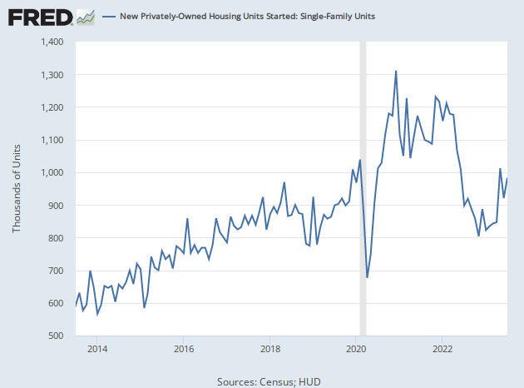
New Privately-Owned Housing Units Started: Single Family Units
Census; HUD

Slide 28
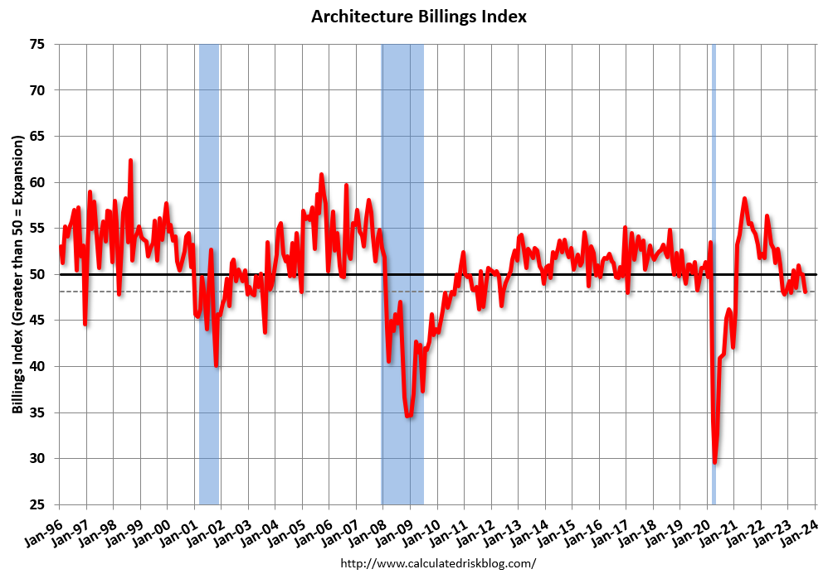
Commercial Real Estate – Architecture Billings Index
WWWWWWWWWWWWWWWWWW
WWWWWWWWWWWWWWWWWW
WWWWWWWWWWWWWWWWWW
Notes:
Northeast (50.6); South (49.9); Midwest (48.1); West (45.8)
Sector index breakdown: commercial/industrial (51.5); institutional (49.4); mixed practice (firms that do not have at least half of their billings in any one other category) (46.9); multifamily residential (44.1)
August, the value of newly signed design contracts declined for the first time since April, indicating that fewer clients signed contracts for new projects than in the prior three months.
Through this pause has taken pressure off tight staffing conditions across the profession, there is considerable uncertainty over the direction of future activity.”

Slide 29
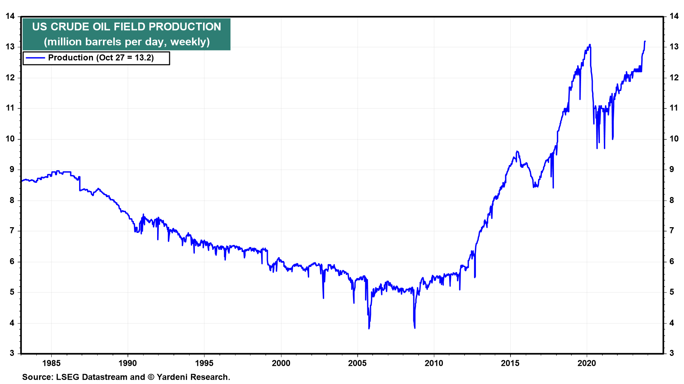
WWWWWWWWWWWWW
WWWWWWWWWWWWW
Notes:
We’ve recently observed that the headline and core CPI inflation rates were both 2.0% in September excluding shelter. Of course, the Fed tends to give more weight to the PCED inflation rate. The headline and core inflation rates for this measure of consumer prices were 3.4% and 3.7% during September (Fig. 9 b
Excluding rent, the headline and core PCED inflation rates were down to 2.8% and 3.0% in September (Fig. 10 below). Both are down sharply from their 2022 peaks of 7.4% and 5.9%.

Slide 30
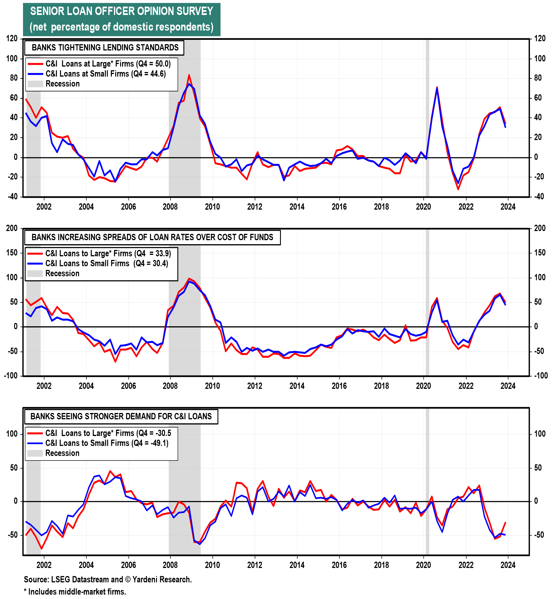

Slide 31
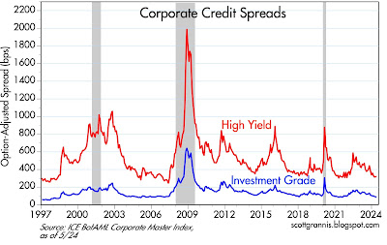
Systemic Risk to US Financial System
BBBBBBBBBBBBBBBBBBBBBBBBBBBBBB
WWWWWWWWWWWWWWWWWW
WWWWWWWWWWWWW

Slide 32
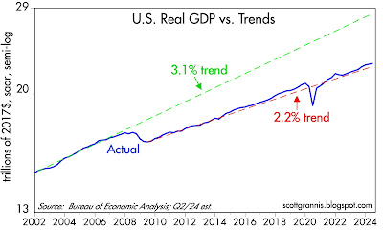
GDP Growth
Notes:
It's not surprising, then, that the economy can only muster sub-par growth, as Chart #3 demonstrates. The 3.1% trend growth line (green) began in 1965, only to finally break down in the wake of the Great Recession and its avalanche of transfer payments. 2.2% per year seems now to be the new norm, as the red line illustrates. Had 3.1% prevailed, the economy today would be about 25% bigger. What a difference a 1% annual shortfall in growth can make after 17 years!

Slide 33
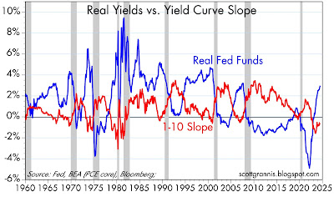
Recession Indicators
WWWWWWWWWWWWWWWWWW
WWWWWWWWWWWWWWWWWW
WWWWWWWWWWWWWWWWWW
Notes:
We like to look at consumer credit per household (chart). The average household has $38,600 of consumer credit with $10,200 in revolving credit and $28,400 in nonrevolving credit. These are all at or near record highs.
Delinquency rates remain low, though the rate for consumer credit cards is relatively high at 10.9% for balances that are due by 90 days or more (chart).

Slide 34
Real Short-Term Rates Today
Fed Funds Rate: 5.33%
PCE Inflation: 2.50%
Real Fed Funds: 2.83%
Notes:
10/28

Slide 35
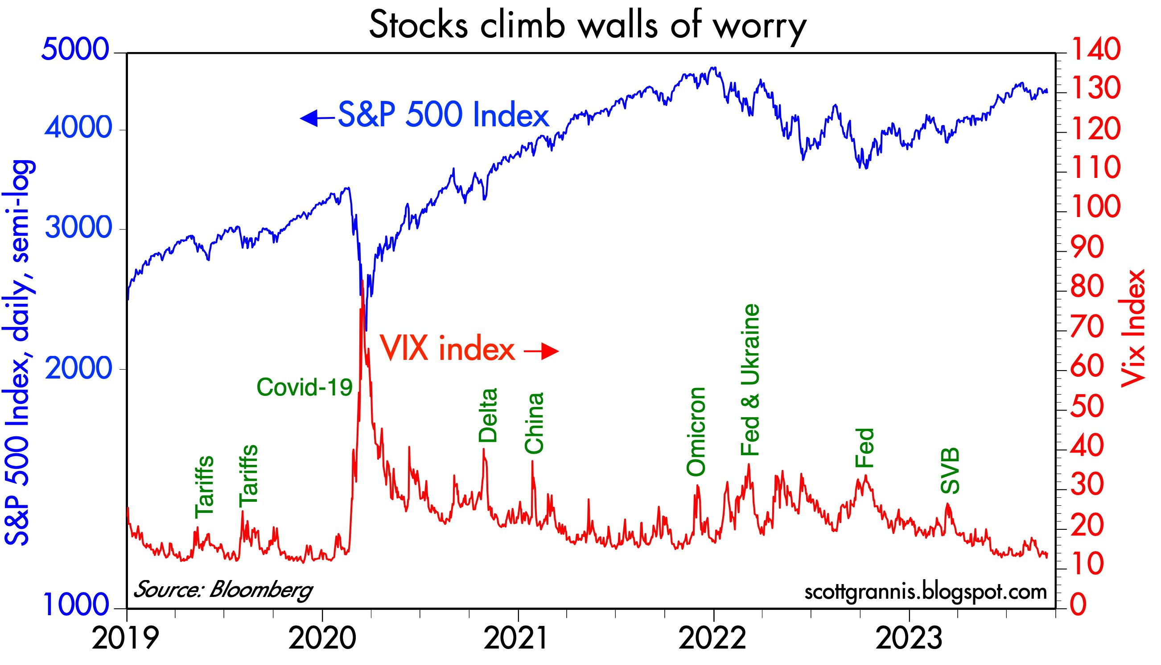
Stocks climb walls of worry
WWWWWWWWWWWWWWWWWW
WWWWWWWWWWWWWWWWWW
WWWWWWWWWWWWWWWWWW
WWWWWWWWWWWWW

Slide 36
2025 Economic Outlook
Recession Unlikely
Fed Rate Cuts Support Growth
Employment and Wages Support Consumer Spending
Tech Revolution = “Roaring 20’s”
Global Growth Edges Up
Risks: Geopolitical
Politics
? ? ?
Notes:
Needs @ 12,000 total jobs to move into positive territory
All Govt jobs -3,500 (including casinos)

Slide 37
US Debt and the Economy
Net Worth: $236,000,000,000,000
Annual Income: $ 27,000,000,000,000
Sam’s Debt: $ 37,000,000,000,000
US Debt is 137% of GDP
Notes:
10/28

