Slide 1
Investment Strategies for the Next Rate Cycle
77th Annual Fall Conference
2024

Slide 2
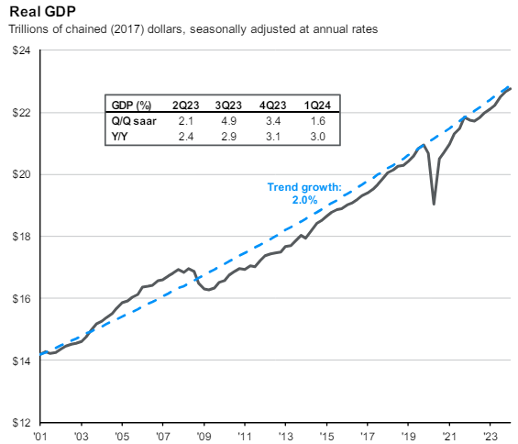
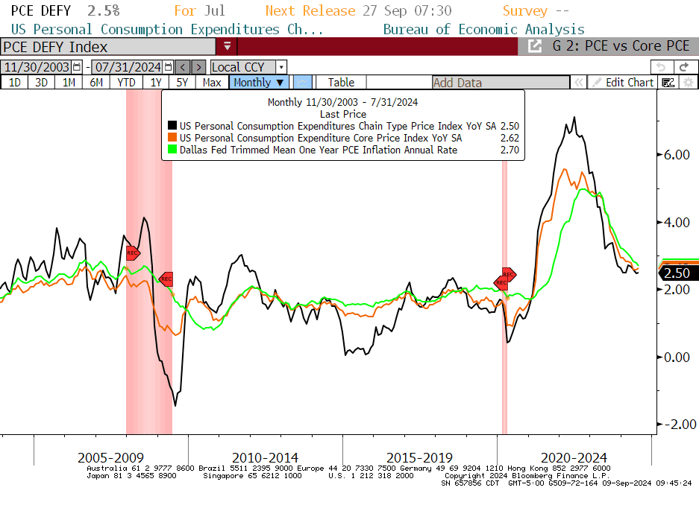
Market Conditions & Fed Expectations
Economic and Inflation Data:
Q2 2024 GDP = 2.8%, Q1 = 2.3%, Q4 = 3.4%, Q3 = 4.9%
+142k non-farm payroll jobs in August, Unemployment Rate = 4.2%
Full time & temp workers declining
Average Hourly Earnings 3.8% YOY vs 3.0% pre-pandemic
Labor Force Participation = 62.7% vs 63.4% pre-pandemic
CPI = 2.9%, Core CPI = 3.2%, 10yr Breakeven Inflation = 2.13%
ISM Manufacturing contracting
Leading Indicators negative for 29 of the last 31 months
Fed Policy:
Fed has left rates unchanged at 5.25-5.5% since July 26, 2023
Dot Plot shows 25bp of cuts in 2024
Fed Funds Futures pricing in 70% chance of 25bp rate cut in September, 30% chance of 50bp and 100-125bp by year-end.
“Quantitative Tightening” still running $65B/mo
Fed Balance Sheet now down $1.8 Trillion since April 2022 peak
“Recent indicators suggest that economic activity has continued to expand at a solid pace. Job gains have remained strong, and the unemployment rate has remained low. Inflation has eased over the past year but remains elevated. In recent months, there has been modest further progress toward the Committee’s 2 percent inflation objective.
The Committee seeks to achieve maximum employment and inflation at the rate of 2 percent over the longer run. The Committee judges that the risks to achieving its employment and inflation goals have moved toward better balance over the past year. The economic outlook is uncertain, and the Committee remains highly attentive to inflation risks.”
- June 12, 2024 FOMC Statement

Slide 3
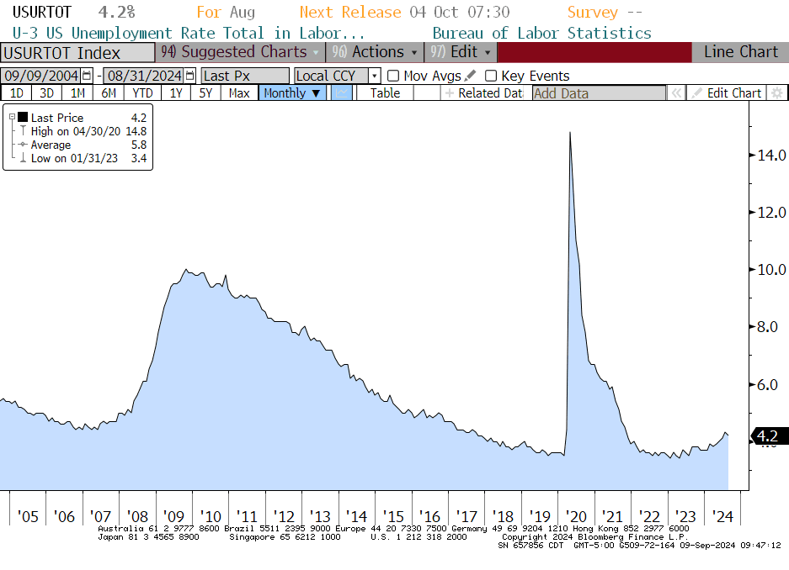
The Fed’s Dual Mandate
Unemployment Rate
Personal Consumption Expenditure (PCE) Price Index
The Fed’s dual mandate of maximum unemployment and price stability is in a comfortable place

Slide 4
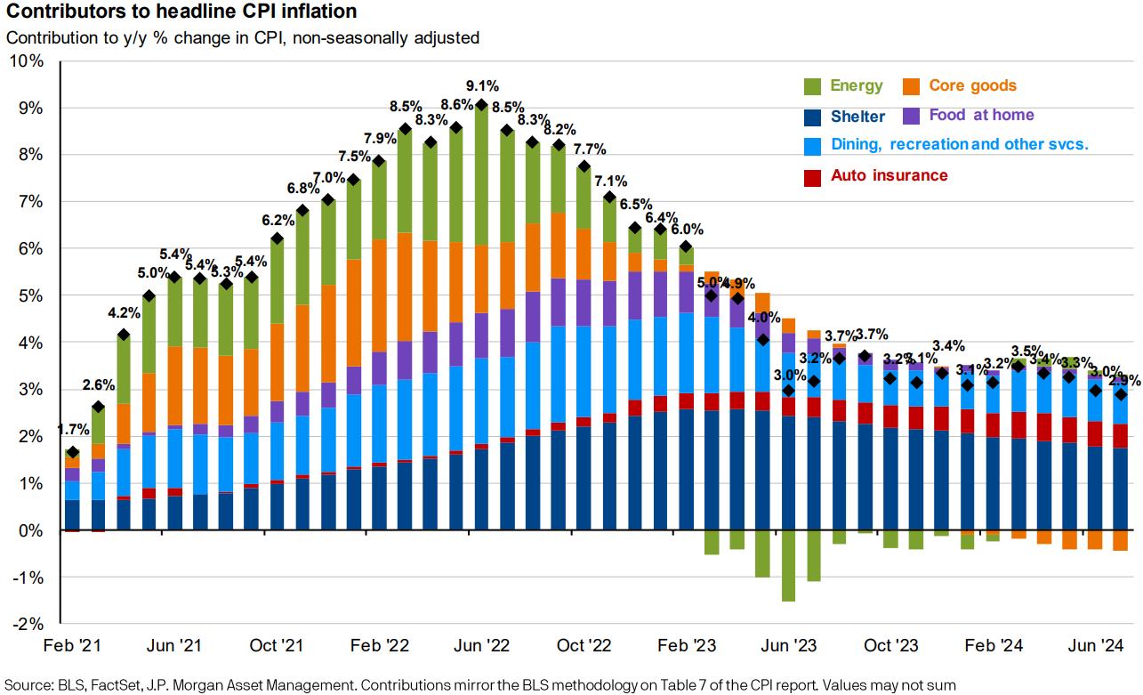
Consumer Inflation
Consumer inflation continues to normalize, shelter slowly coming down

Slide 5
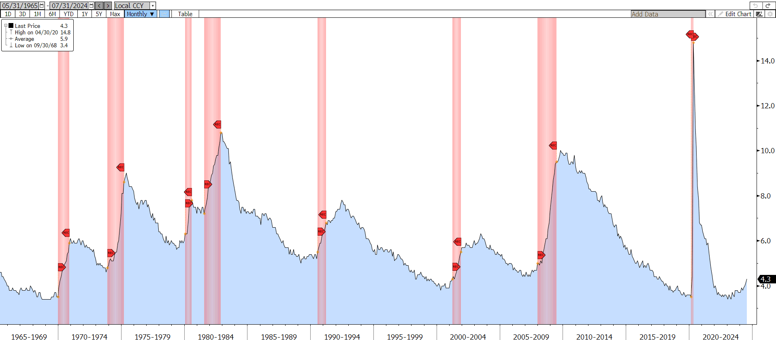
Unemployment Rates vs. Recessions
1981-82
7.2 -> 7.2
0.0
1980
5.6 -> 6.3
+0.7
1990-91
5.0 -> 5.5
+0.5
1973-75
4.6 -> 4.8
+0.2
2007-09
4.4 -> 5.0
+0.6
2001
3.8 -> 4.3
+0.5
2020
3.5 -> 3.5
0.0
1969-70
3.4 -> 3.5
+0.1
2024
3.4 -> 4.3
+0.9
It’s not the level that matters, it’s the change

Slide 6
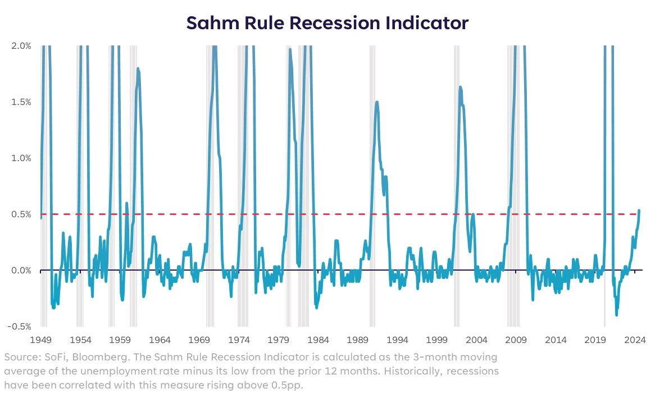
Sahm Rule Triggered

Slide 7
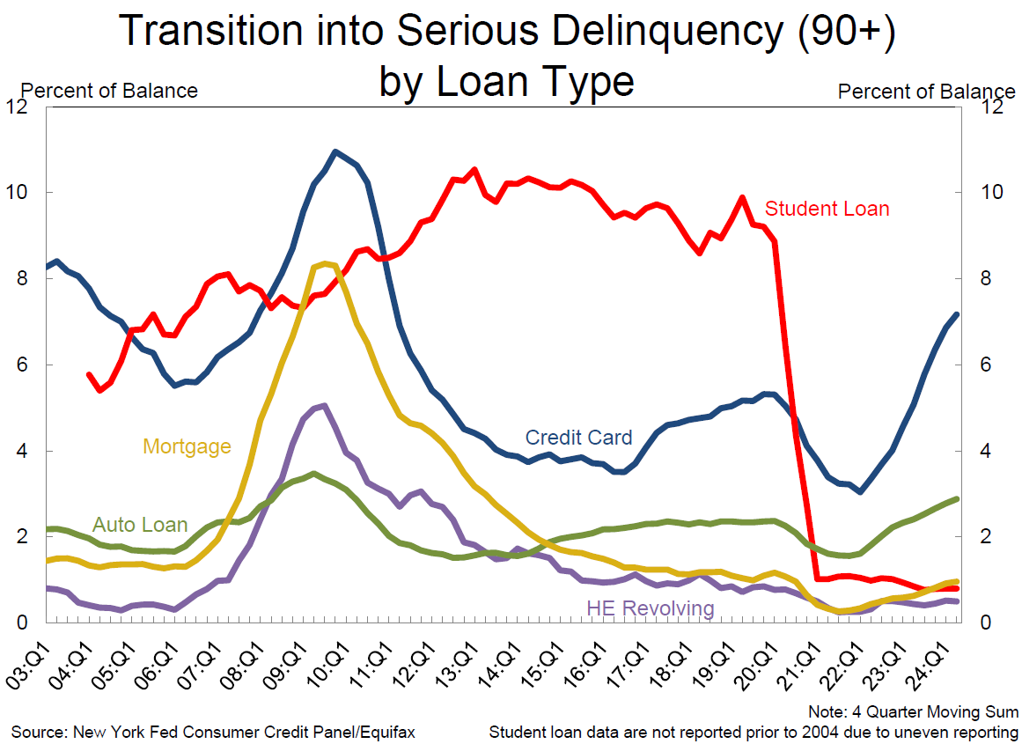
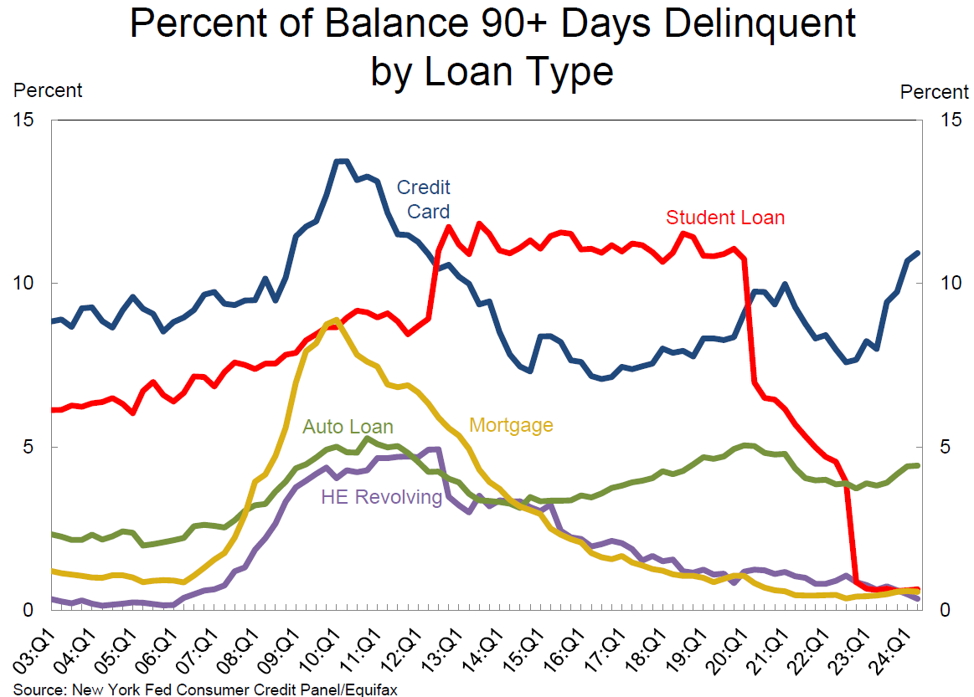
Pressure on Consumers
Consumers are falling behind on credit card & auto loan payments

Slide 8
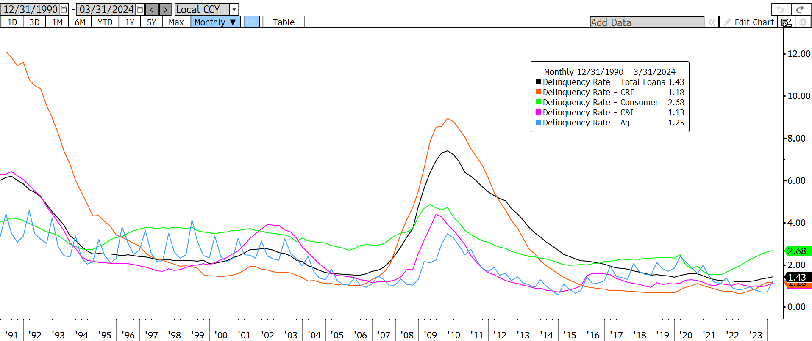
Bank Delinquencies
Bank delinquencies remain low outside of consumer loans

Slide 9
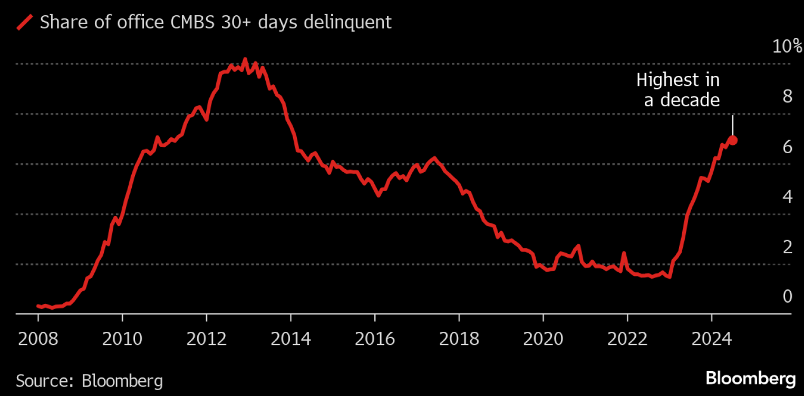
Office commercial real estate
Office CRE is the most at risk with delinquencies at decade high’s

Slide 10
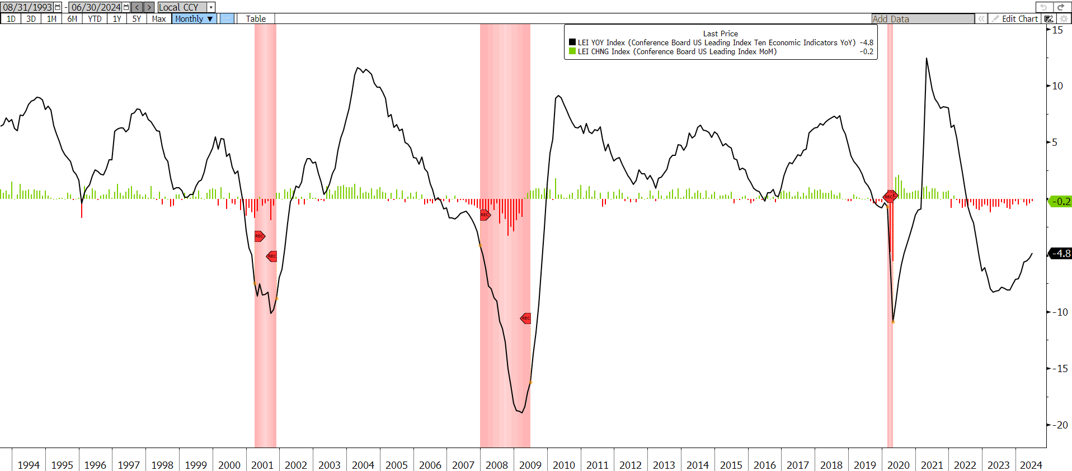
Leading Economic Indicators
Leading economic indicators have been negative for 29 out of the last 31 months

Slide 11
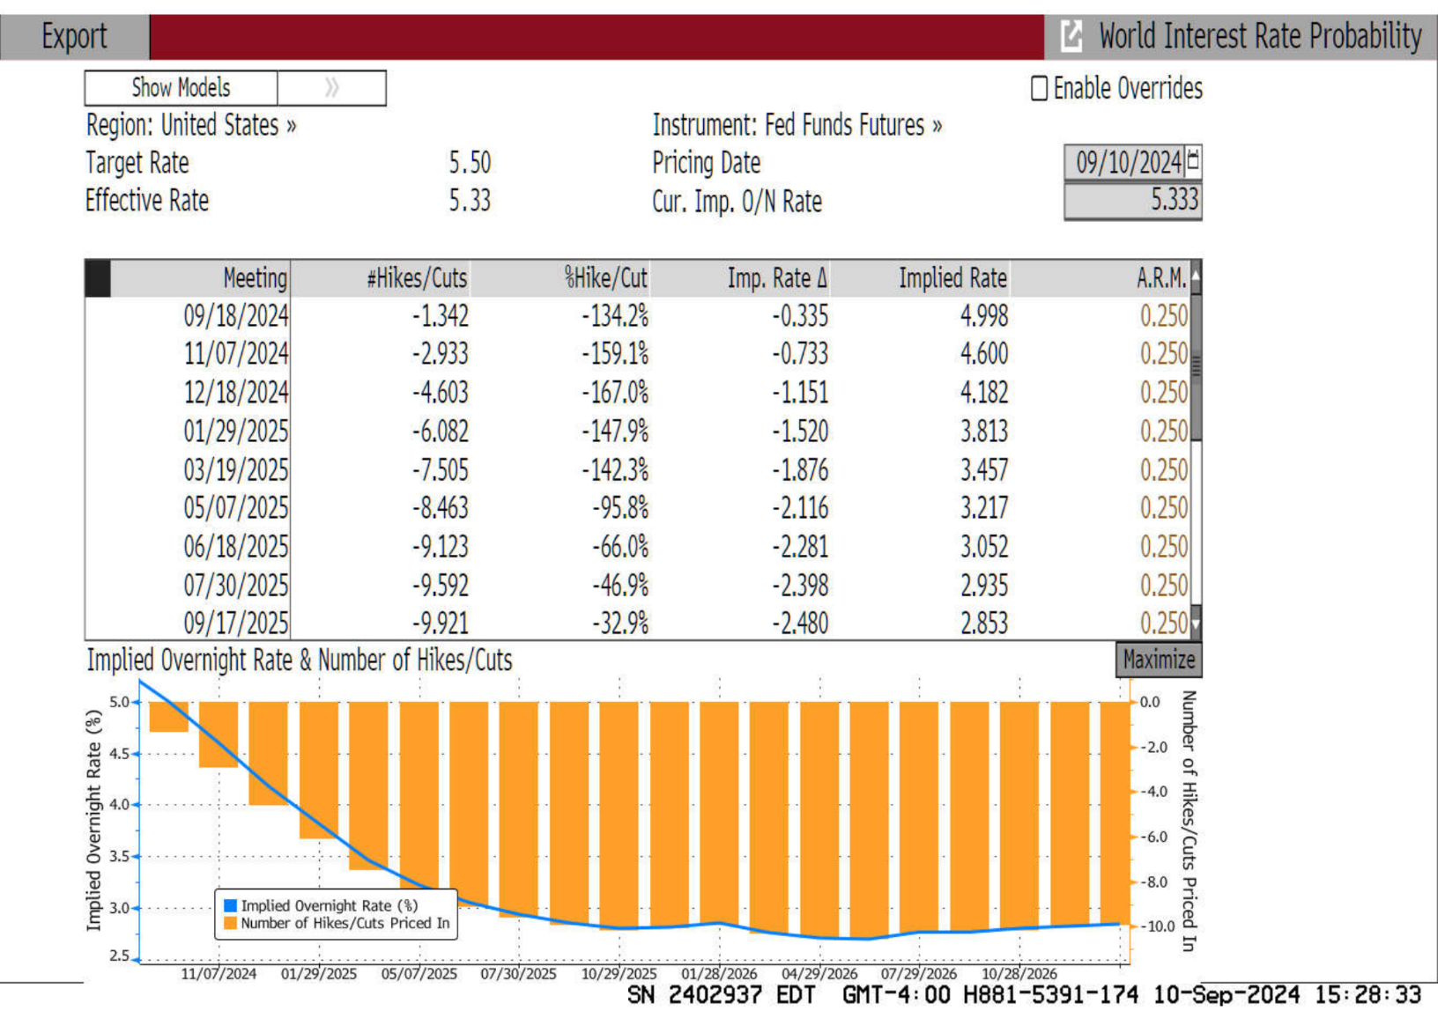
Interest Rate Probabilities
Bloomberg WIRP screen
Current Rate
Next Fed Meeting
Assumed Rate Move
5.333 - 0.335 = 4.998
Current Rate
Imp. Rate Δ
Implied Rate
% Chance of a Single Cut
0.25 * -134.2% = -0.335
Assumed Rate
%Hike
Imp. Rate Δ
Cumulative Rate Δ
The model is implying 248bps of rate cuts over the next 12 months
The market is leaning toward the Fed having to make more aggressive rate cuts sooner rather than later

Slide 12
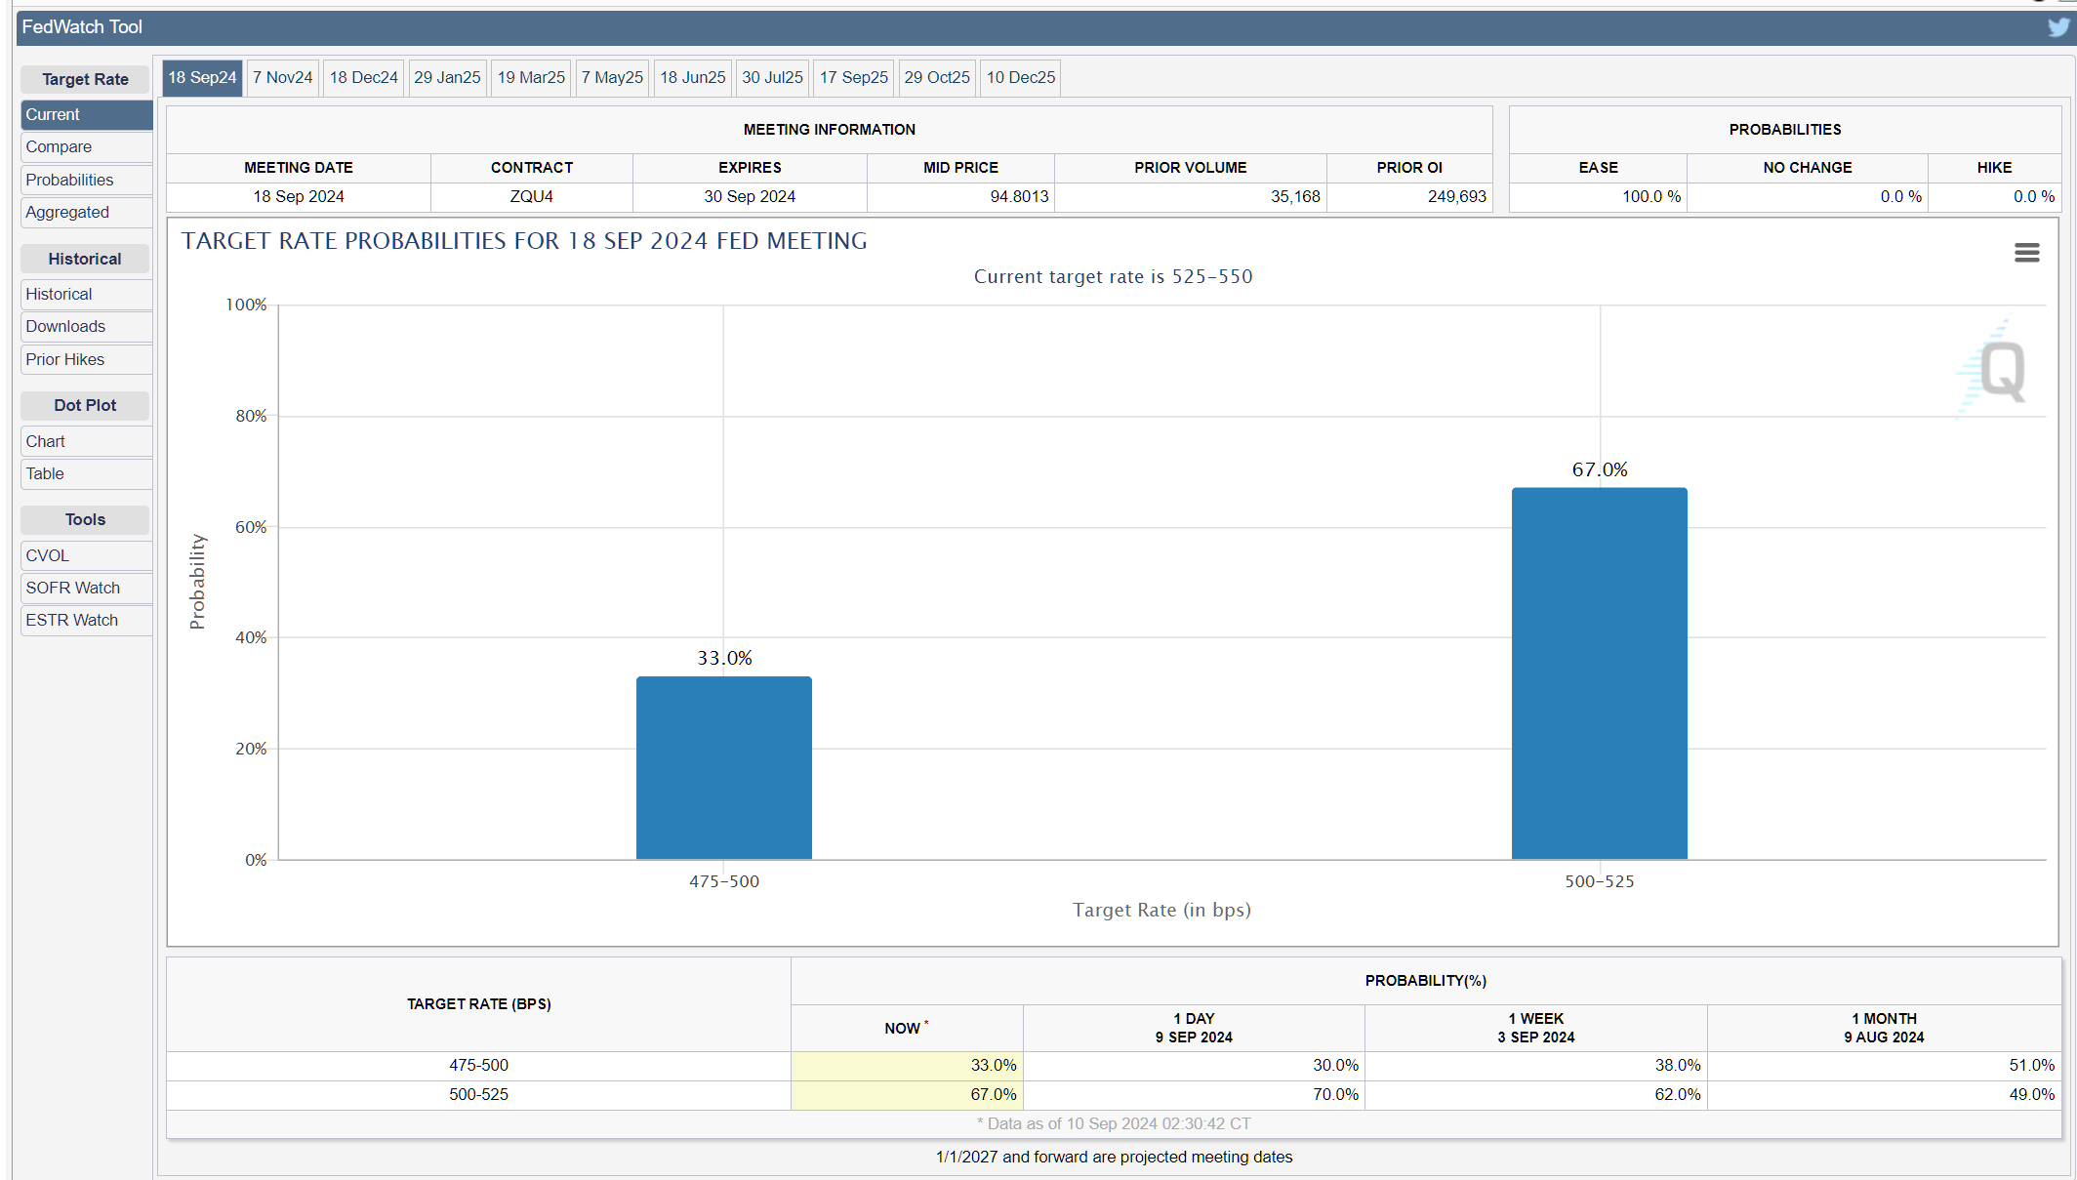
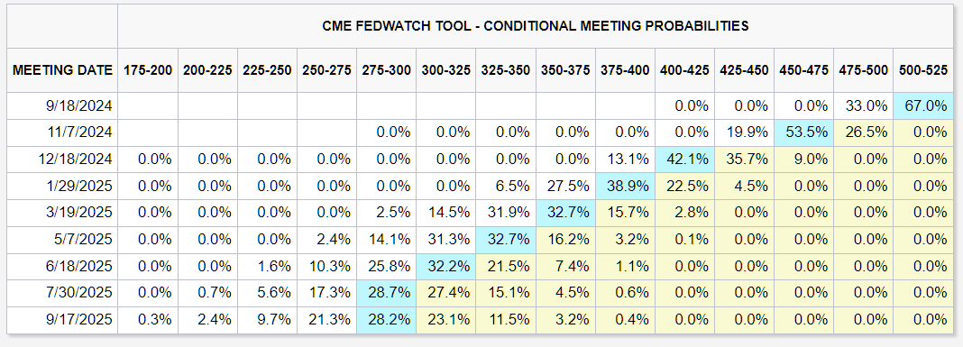
CME Fed Watch Tool
Current Rate
Projected Path of Rates
The CME Fed Watch Tool is showing a projected 225bps of rate cuts in the next 12 mos
Rate Probabilities
The CME fed watch tool shows 100% chance of a cut with 55% chance of a 25bps cut and 45% of a 50bps cut

Slide 13
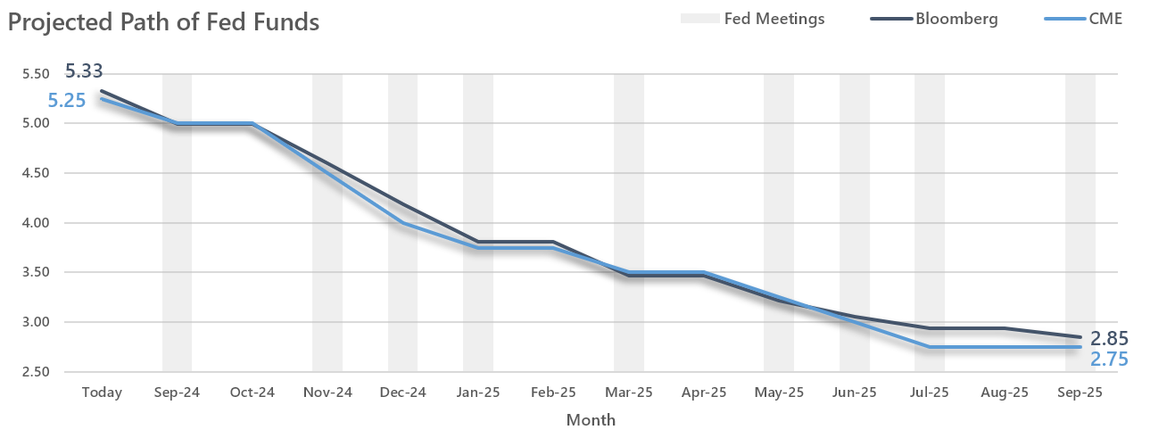
Potential path of interest rates
Both models show a similar rate path over the next 12 months

Slide 14
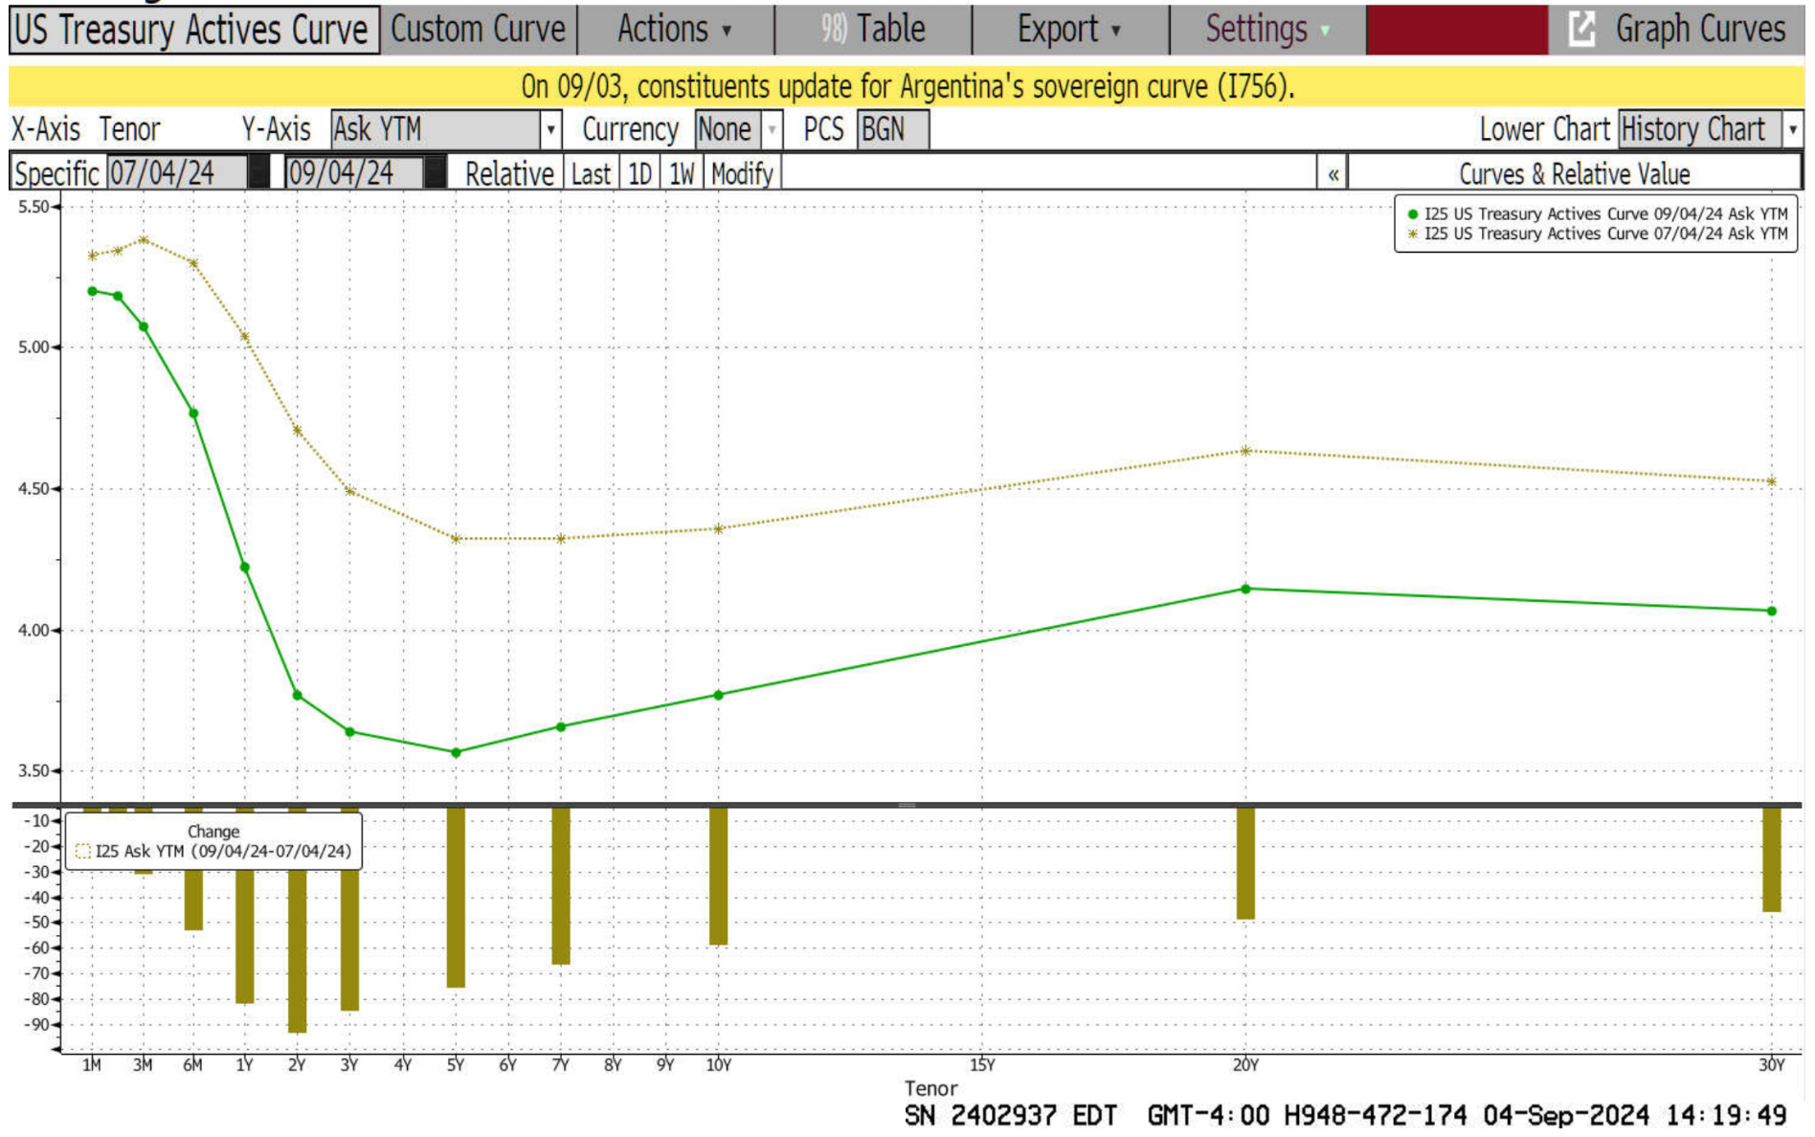
What this means for markets
This economic data and expectations from the market have led to a further steepening of the yield curve

Slide 15
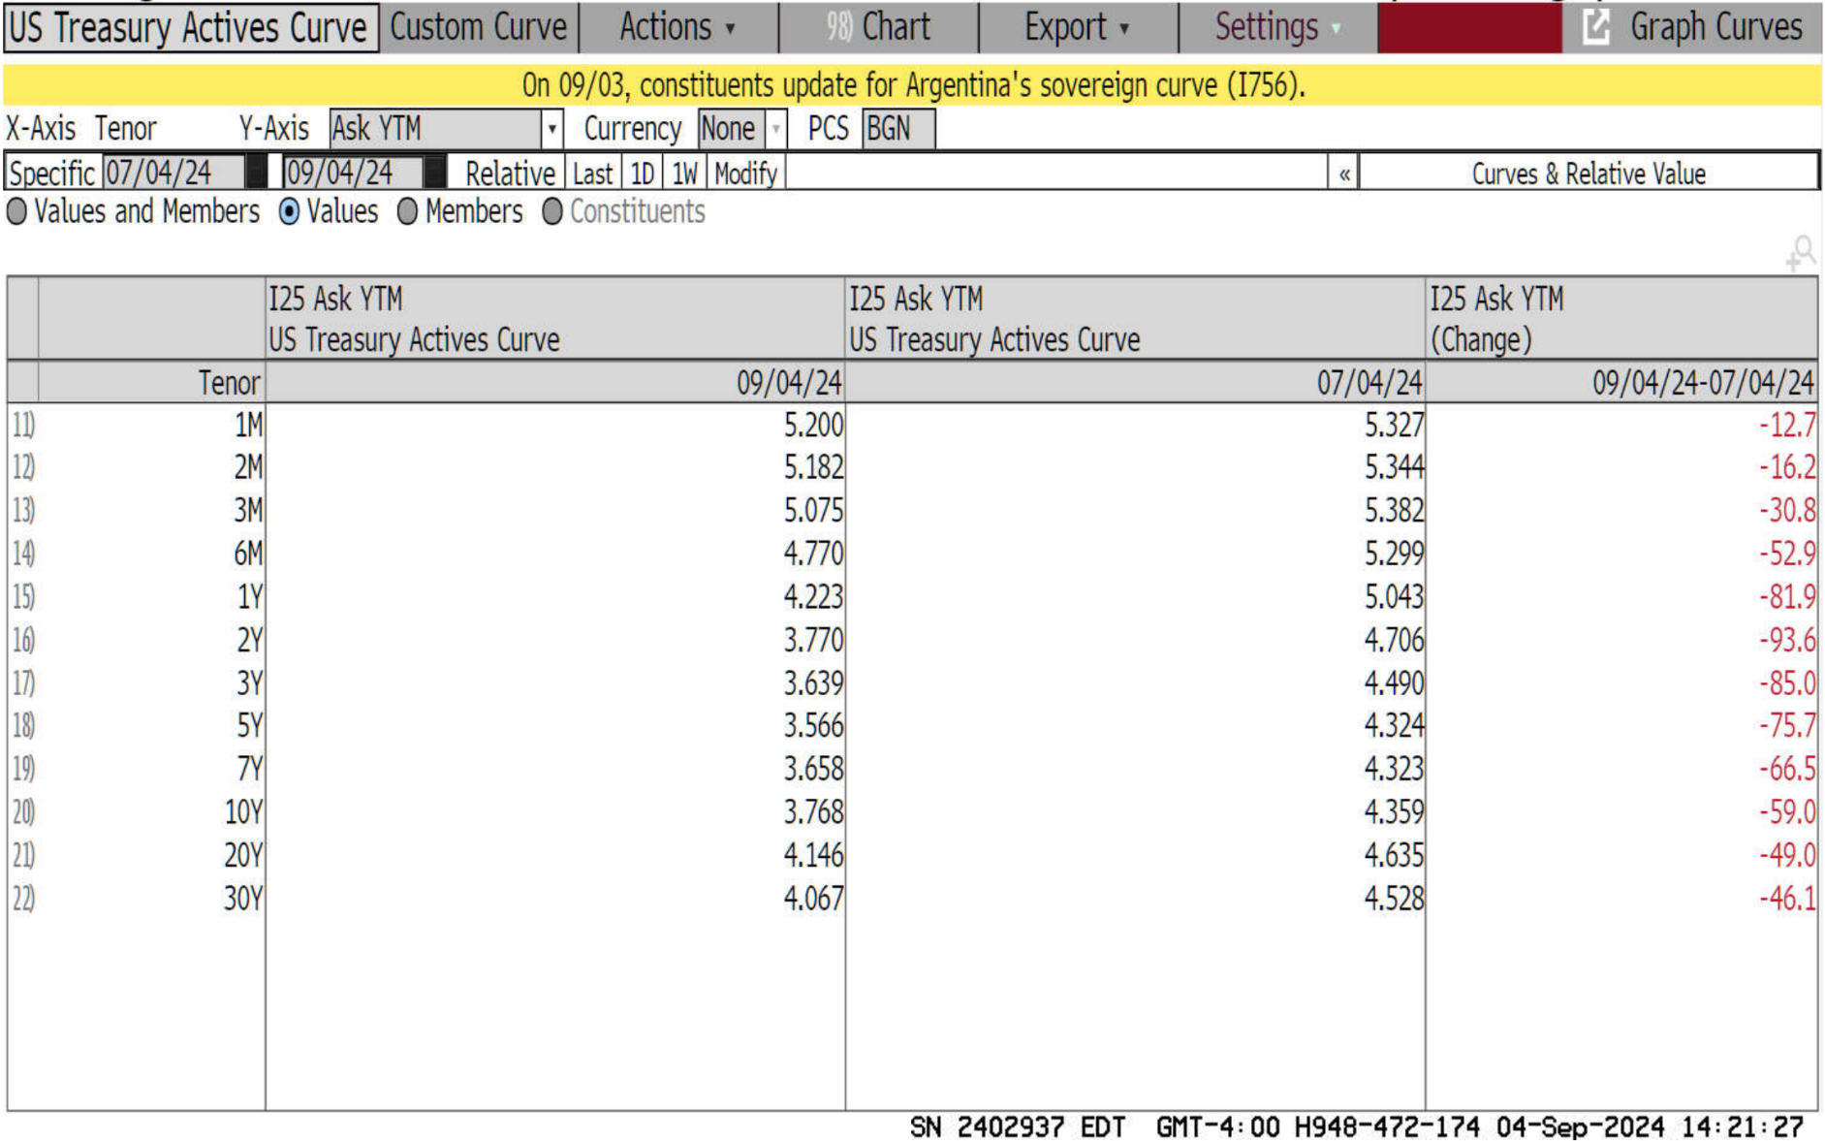
What this means for markets
The market has already seen treasuries (and other investment yields) moving much lower in anticipation of lower rates.

Slide 16
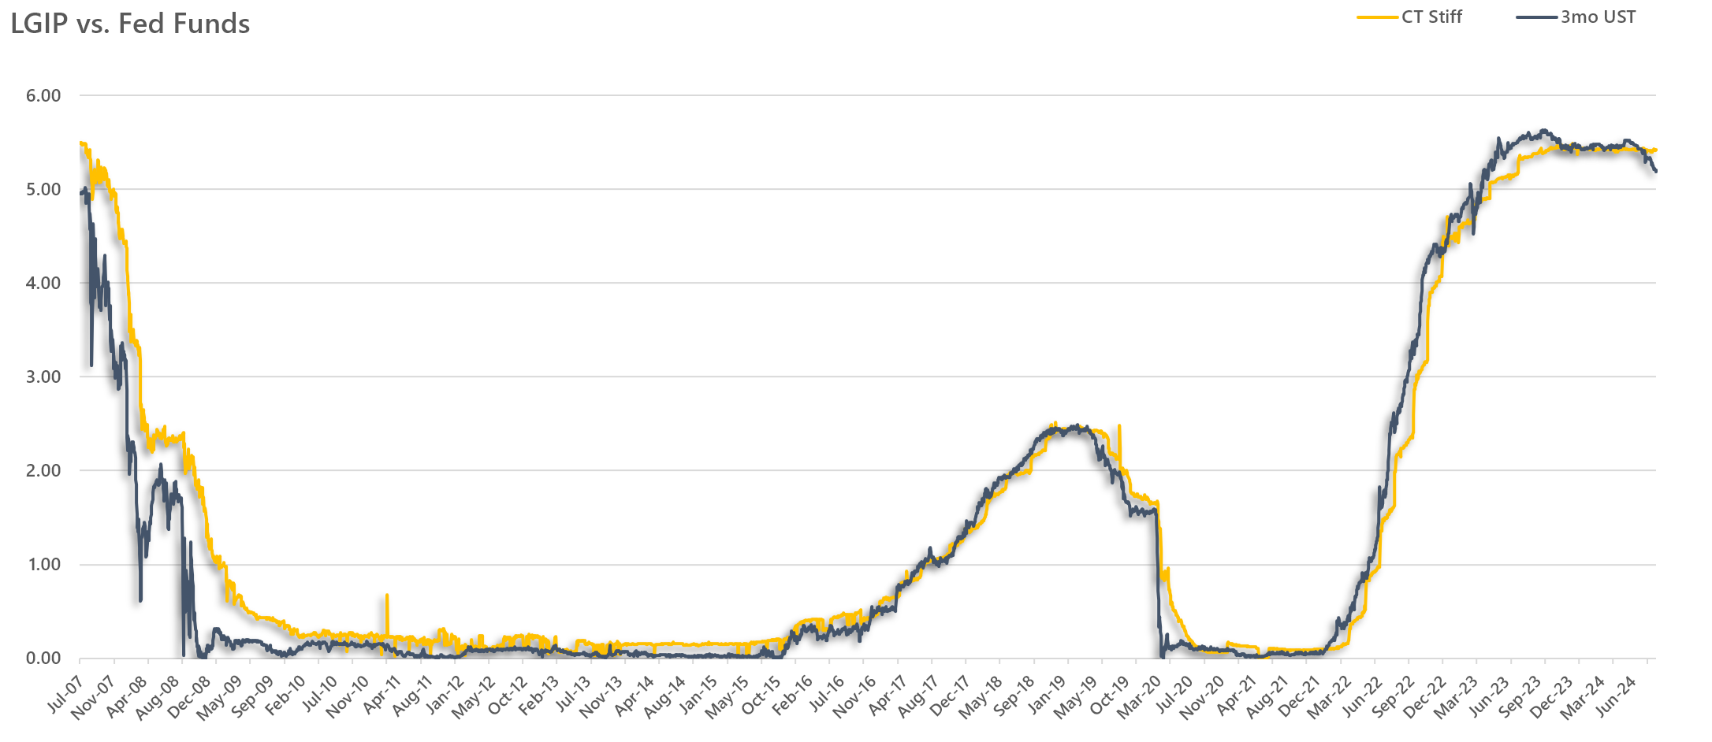
LGIP’s and Fed Funds
96% β
Due to their short-term nature most LGIP’s move extremely close to fed funds with a 96% beta

Slide 17
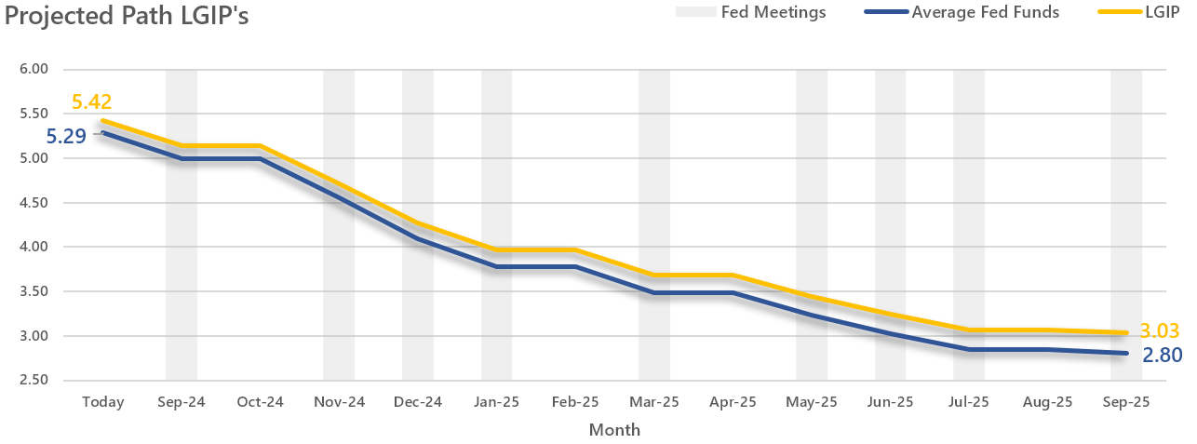
Potential Path of LGIPs
If we use the average fed funds rate path shown by the Bloomberg and CME models and the 96% beta, we can anticipate LGIP’s to see a 239bps drop in the next 12 months

Slide 18
Impact on Income
The average rate of an LGIP in the last 12mo was 5.42%
That average rate in the last 24 months has been 4.93%
From a budget standpoint:
$10mm @ 5.42% = $542k
$10mm @ 3.03% = $303k
$10mm @ 4.93% = $493k
$239k-$190k loss in revenue
Income being generated from LGIP’s could drop by -40% in the next 12 months

Slide 19
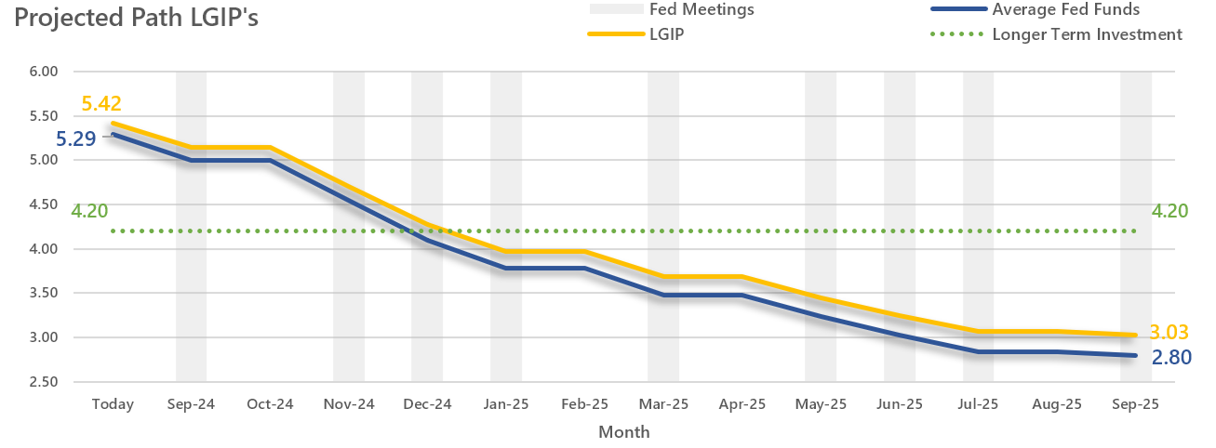
How can we protect our income?
Pick up 117bps tomorrow
Give up 122 bps today
By locking out some yield a little further on the curve we may be able to preserve some of this income before it drops

Slide 20
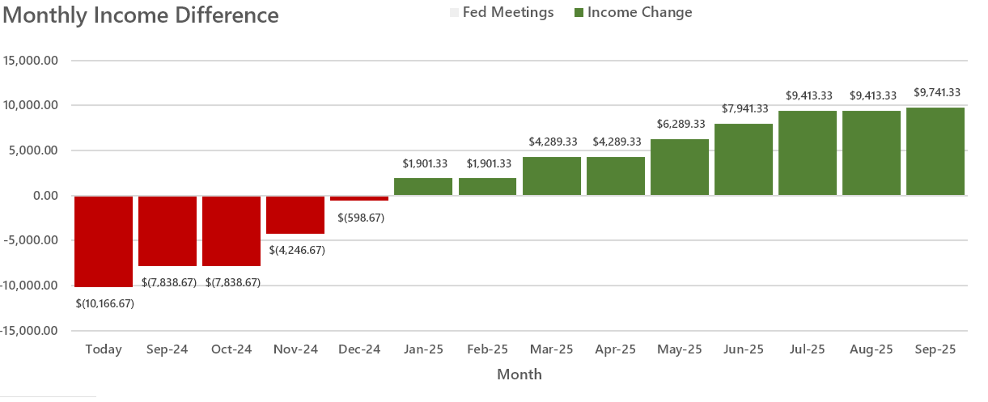
How can we protect our income?
If the fed cuts along the expected path, the locked-in investment outperforms for longer
While the lower rate on a longer-term investment may not look good today, its about protecting earnings in the future.

Slide 21
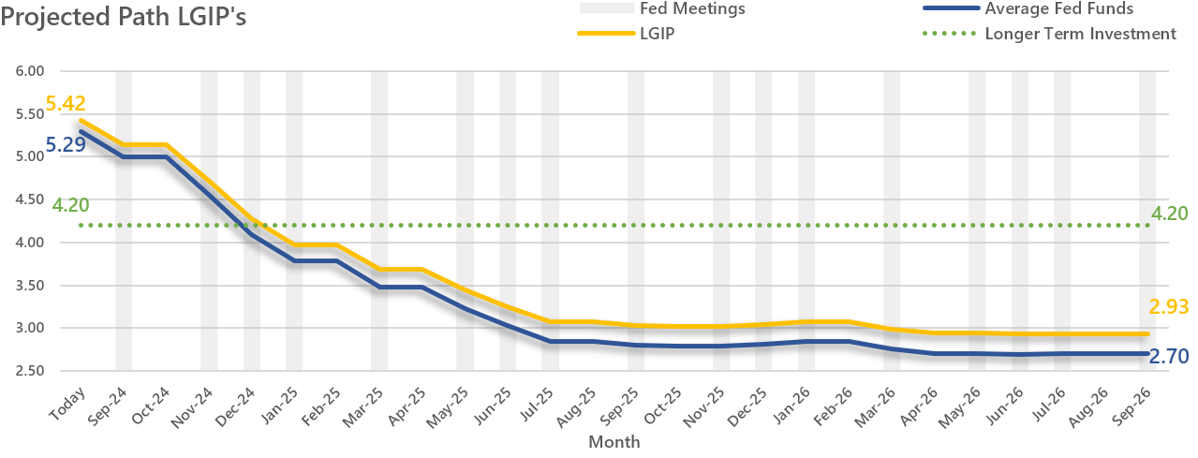
How can we protect our income?
The further out a lower rate environment is projected, the more the benefits of locking in some yield become apparent

Slide 22
Investment Objectives
Liquidity
Yield
Safety
Mitigate Interest Rate Risk and Credit Risk
Meet Cashflow Requirements
Earn a reasonable rate of return
Core principals of building an investment portfolio

Slide 23
Thinking about budget protection
Short-Term Cash Needs
Intermediate Cash Needs
Longer Term Cash Needs
Deposits in Local Banks
LGIP’s
1-3 Year Investments
3-5 Year Investments
Liquidity Portfolio
Core Portfolio
With the change of direction in interest rates, we should refocus our core portfolio for income protection

Slide 24
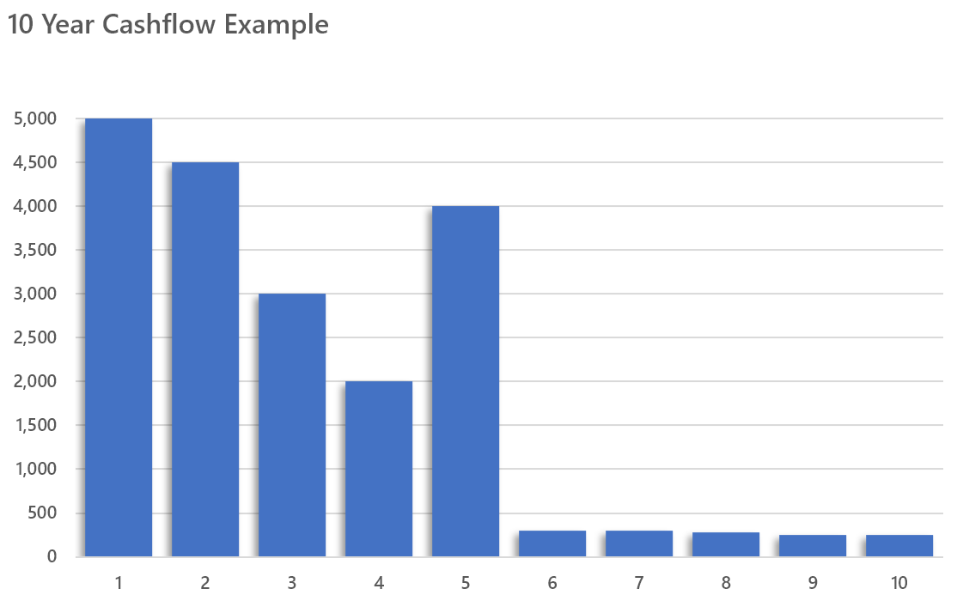
Importance of Cashflow
Liquidity
Defensive Cash Flow
Income Protection
MBS/CMO Cash Flow
In order to build a portfolio that fits our needs and objectives we need a strategy!

Slide 25
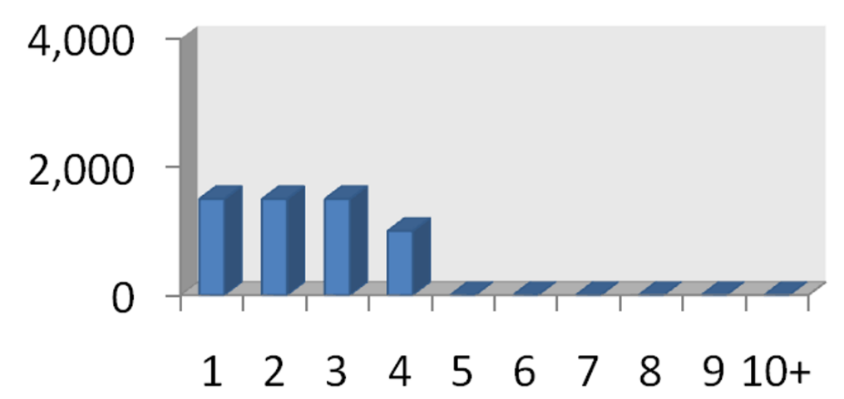
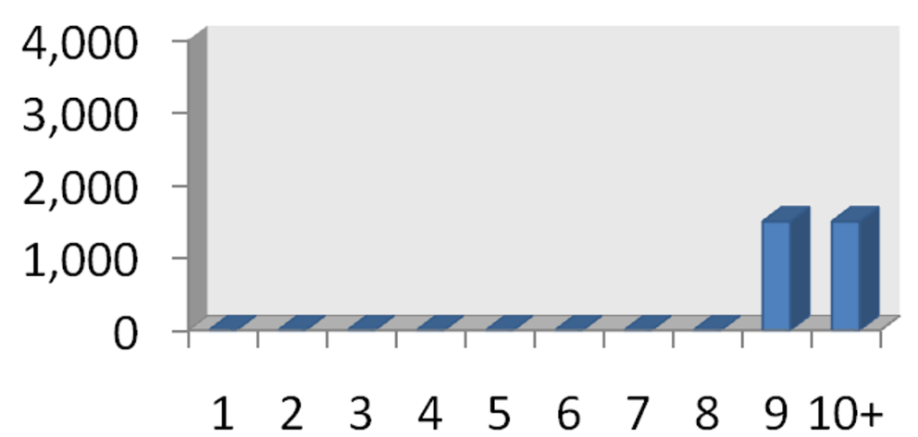
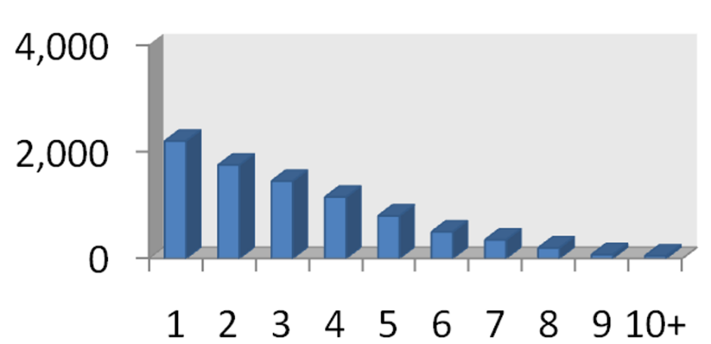
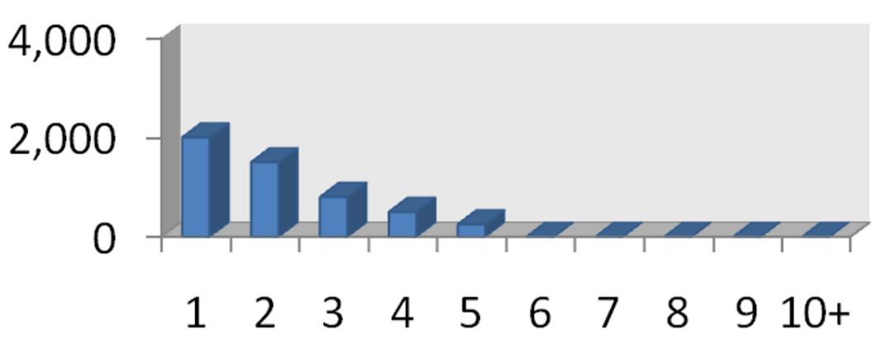
Investment Sectors
Agency/Certificates
CMBS/Muni
MBS
CMO
Each investment sector has different yield/cash flow characteristics

Slide 26
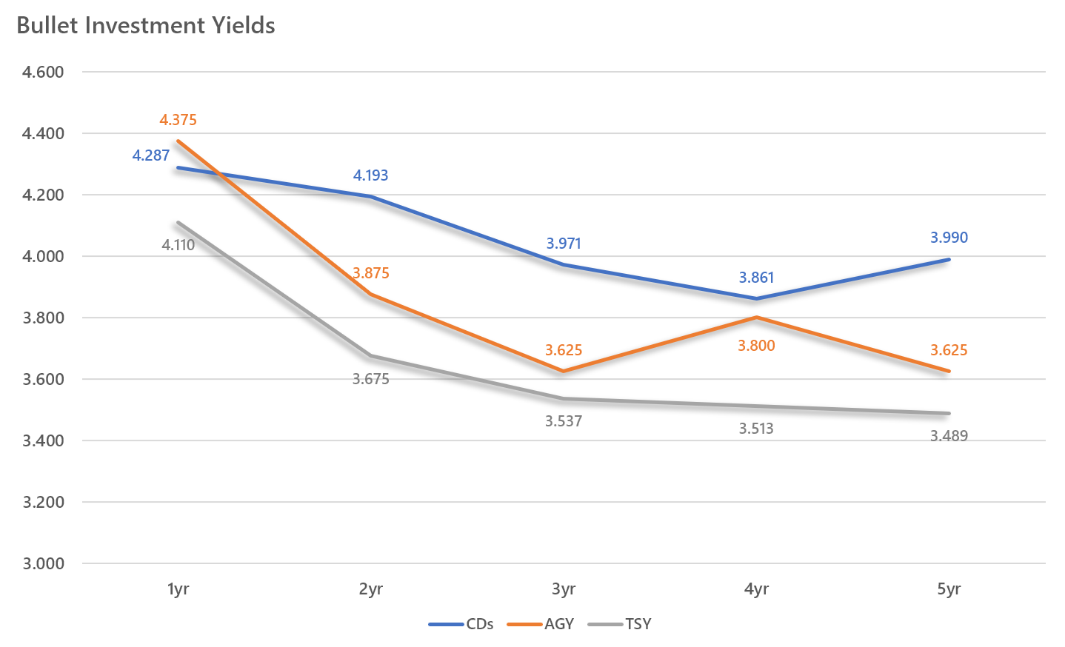
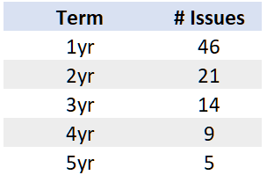
Bullet Protection
CD Issuance by Term
The added challenge for certificates is the lack of issuance in the longer terms
For bullets, the longer the term the more reinvestment rate protection we have, but different bullets can offer substantially different yields

Slide 27
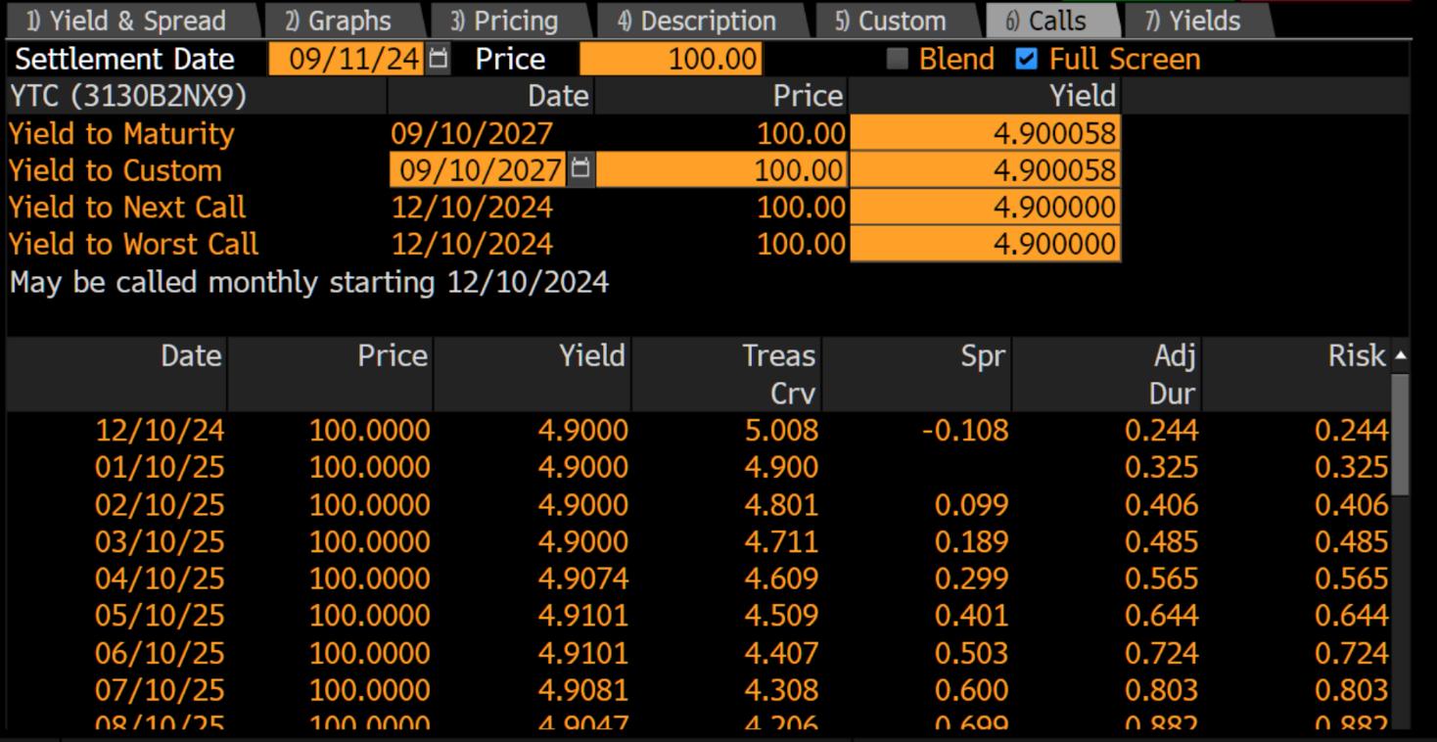
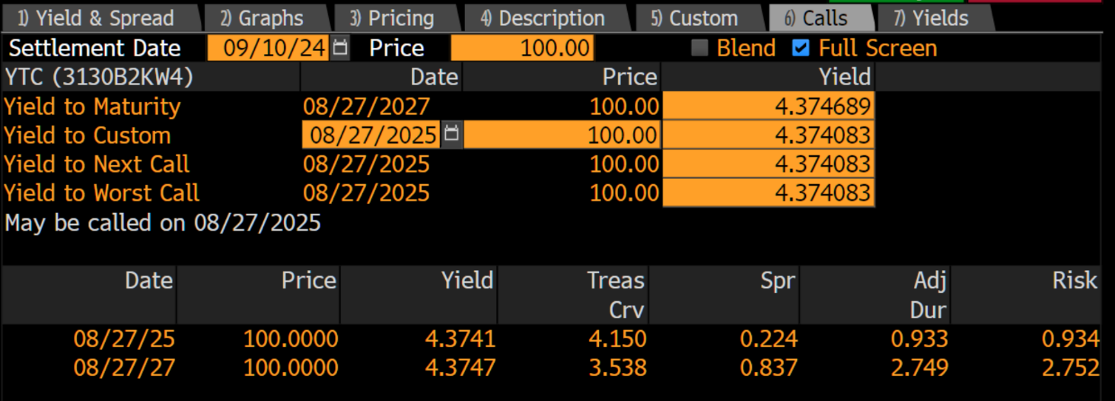
Callable Bond Protection
3yr NC 3mo
4.90% starting yield
Can be called quarterly starting in 3mo (12/10/2007)
The top bond looks better from a yield perspective, but if the Fed cuts rates its at risk of being called away.
The reinvestment risk would be having to take on a potentially lower yield.
A structure with more protection against getting called often comes with a lower potential rate.
3yr NC 1yr
4.37% starting yield
Can be called only once, 1 year from now (08/27/2025)

Slide 28
Amortizing Protection
Premium 15yr MBS
Seasoned Discount 15yr MBS
Adding yield is “easy” right now. The tricky part is adding yield that will still be on your books in 2025 & beyond.

Slide 29
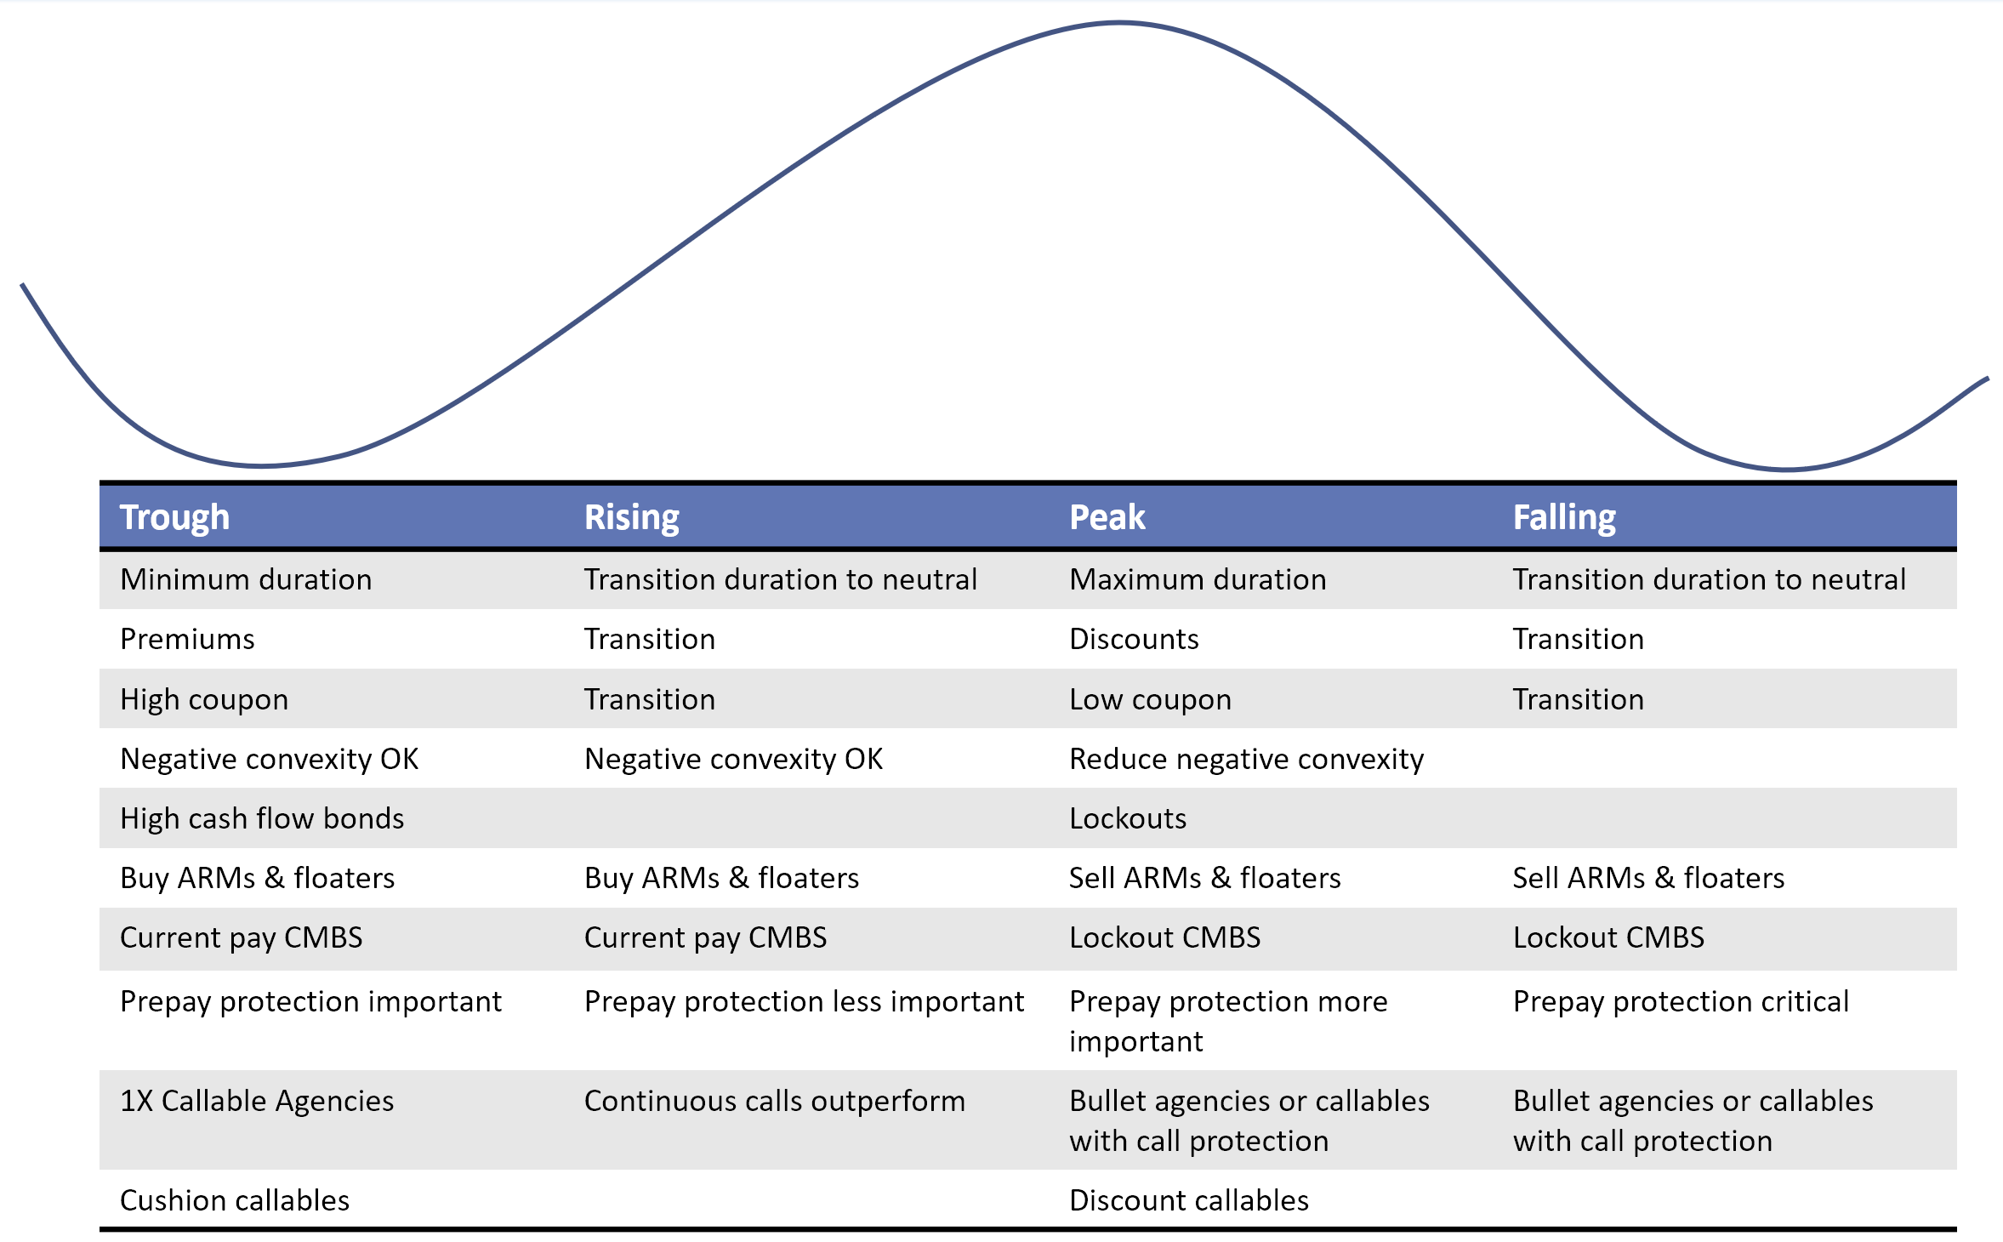
What investments should we focus on

Slide 30
Agencies, CD and Treasuries
Agencies, CDs and Treasuries
With bullet spreads through their longer-term averages and the continued yield curve inversion, we recommend laddering heavily discounted 3- to 5-year maturity callables as excellent late-cycle bullet alternatives. Avoid purchasing bullets with little to no spread vs like-maturity USTs.
When available, look to add heavily discounted 3- to 5-year step-ups with back-end bullet options (one-time and canary calls) which will provide either a yield kick if called or lock-in late cycle yields and roll down the curve with significant spread over like-maturity bullets.
Look for opportunities to sell short maturities and deploy the proceeds on the intermediate and longer end of the curve.
New CD issuers (rare names) are coming to market as additional funding resources are still being explored.
Prefer CD bullets over callables due to late cycle but picking up a few longer callable CDs could add some pick-up in income.
Focus CD purchases in 2-5 year bullets, and some 3-5 year callables that offer the best call protection.
*Investment strategies subject to state statutes, policy and portfolio objectives

Slide 31
Municipals
Municipals
Focus taxable municipal purchases on the long end with higher coupons to reduce price volatility.
Use taxable municipals as agency alternatives with AA/AAA credits to support them
The municipality should make an extensive effort to analyze and monitor the credit metrics of municipal holdings. The municipality will buy insured bonds with A or better underlying ratings or AA rated without insurance.
*Investment strategies subject to state statutes, policy and portfolio objectives

Slide 32
Mortgage Backed Securities (MBS)
MBS
The fluctuations in interest rates over the past two quarters emphasize our primary focus on investing in MBS pools with stable and consistent cashflow characteristics.
Our core MBS holdings will remain in shorter weighted average maturity pools offering higher scheduled principal payments and reduced refinancing risk, while new purchases will be guided by relative value and outlook on rates.
As such, we will prioritize purchasing seasoned discount MBS pools with features that provide prepayment protection. These features include lower loan balances, retail origination, bank servicers, states with high refinancing costs (NY, TX, FL), higher percentages of cash-out refinances, lower weighted avg. coupons (WAC), lower FICO scores, and higher spreads at origination (SATO)
We will aim to add pools with more positive convexity. Specifically, lower-coupon, deep-discount pools that will not accelerate paydowns significantly if rates fall. Recently the best value has been found in moderate-to-very seasoned 30yr MBS pools with 2.5-4.5 coupons.
We will also consider pools with re-performing, modified, and other credit-constrained borrower loans, as they will be less rate-sensitive and thus less able to refinance if rates fall and also offer some extension protection through buyouts due to re-delinquencies.
We will continue to be very selective with new production current coupon MBS, as these loans may exhibit very high-rate sensitivity, leading to unwanted cash flow volatility and negative convexity.
*Investment strategies subject to state statutes, policy and portfolio objectives

Slide 33
Collateralized Mortgage Obligations (CMO)
CMO
Preferred CMO structures will be shore/intermediate average life (2-5yrs) that exhibit stable cash flow characteristics.
Primary focus will be on lower coupon (2-5%) discount tranches off seasoned collateral and/or collateral stories that exhibit both extension and contraction protection as mentioned in MBS strategy.
When available look to add seasoned deeply-discounted CMO’s that exhibit more positive convexity and total return potential.
Special focus will be on adding CMO’s backed by 30yr GNMA collateral with structures similar to those mentioned above.
Additionally, we will prioritize collateral such as re-performing loans, specific Housing Finance Authority programs, or lower loan balances with hurdles or higher refinancing costs, as they offer contraction protection.
Another focus will be adding seasoned deep-discount senior trances of Freddie Mac Seasoned Loans Transaction Trusts (SLST) will have short stated maturities (10yrs from issuance) and currently offer attractive projected yields and some total return price appreciation potential with prepayment protection from the underlying re-performing loans.
*Investment strategies subject to state statutes, policy and portfolio objectives

Slide 34
Commercial Mortgage Securities (CMBS)
CMBS
Agency CMBS less than 5yr average life offer portfolio stability and offering competitive yield while the direction of rates and shape of the yield curve come into clearer focus.
Freddie K’s. Fannie ACE’s and full yield maintenance pools offer generous relative value vs. other fixed income alternatives.
Short and immediate sequential GNMA Project loan purchases that are evaluated at low CPJ projections offer ample yield while providing significant protection from prepayments.
Investors seeking adjustable-rate bonds will find better value in Agency CMBS vs. SBA 7a adjustable rate pools.
*Investment strategies subject to state statutes, policy and portfolio objectives

Slide 35
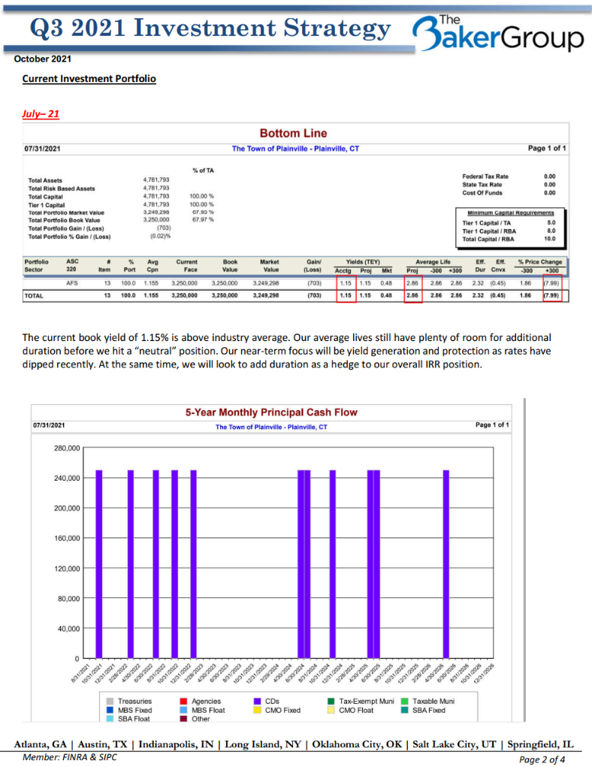
Written Investment Strategy
Economic Update
Portfolio Update
Portfolio Strategy
Having a written investment strategy can minimize the time and effort that goes into managing an investment portfolio

Slide 36
Key Take-Aways
The economic environment is shifting back to falling rates
The Fed looks ready to act on worsening economic conditions and is poised to start cutting rates
Markets are projecting multiple rates cuts necessary in order cushion the economy
The cost of staying short-term will come in the way of tighter income
With the Fed cutting rates, short-term LGIP’s will see diminishing returns putting a squeeze on revenues
Do we understand what the rate cuts might mean to our portfolios and our budgets?
Make sure your portfolio is “recession/crisis ready”
During your next portfolio review, ask the question – Are we recession ready and how can we be better prepared?
Make sure you are adding the “right” types of investments for your portfolio. Don’t just gravitate towards the highest yield
Are we utilizing ALL the potential options available to us
Short-term investment yield’s have made it easy to ignore all other options
Do we know/understand all the potential investment options available to us?
There may be options available that can help lock-in some yield to protect our budgets as rates drop
Have a plan
The best thing we can do is to review our portfolio and options regularly
Understand what options are available to us, and the pros/cons of each

Slide 37
We are here to help!
77th Annual Fall Conference
2024
Greg Tomaszewicz - gregt@gobaker.com
AP, Senior Financial Strategist
405-415-7342

Slide 38
Disclaimer
INTENDED FOR USE BY INSTITUTIONAL INVESTORS ONLY. Any data provided herein is for informational purposes only and is intended solely for the private use of the reader. Although information contained herein is believed to be from reliable sources, The Baker Group LP does not guarantee its completeness or accuracy.
Opinions constitute our judgment and are subject to change without notice. The instruments and strategies discussed here may fluctuate in price or value and may not be suitable for all investors; any doubt should be discussed with a Baker representative. Past performance is not indicative of future results. Changes in rates may have an adverse effect on the value of investments. This material is not intended as an offer or solicitation for the purchase or sale of any financial instruments.

